Slide 1
NodeJS

Slide 2
NodeJS
Node.js is a very powerful JavaScript-based framework/platform built on Google Chrome's JavaScript V8 Engine
Node.js uses an event-driven, non-blocking I/O model that makes it lightweight and efficient
All NodeJS applications have “package.json” file

Slide 3
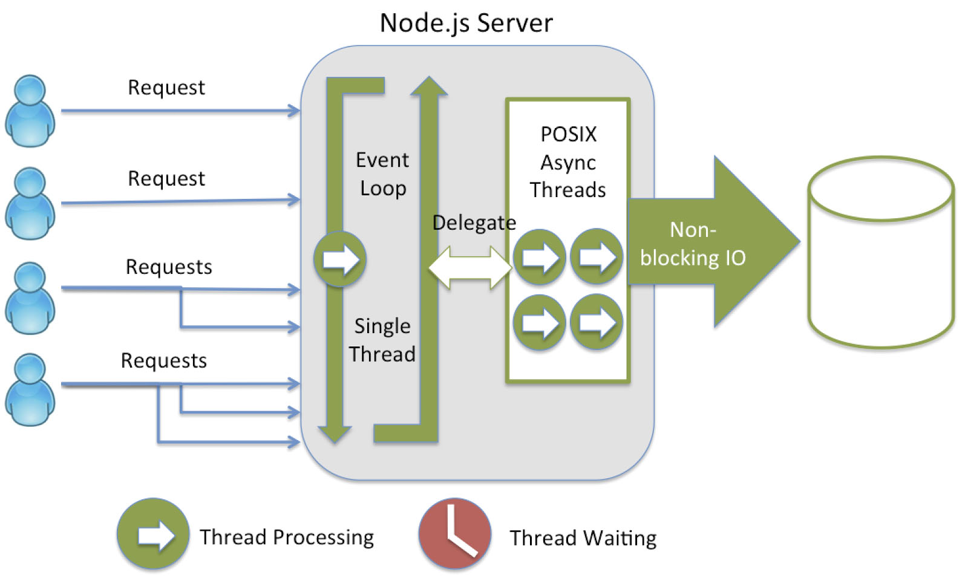
How NodeJS works?

Slide 4
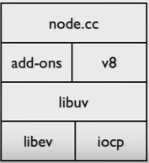
NodeJS Libs

Slide 5
NodeJS Uses
Used to develop I/O intensive web applications such as video streaming sites, single-page applications etc.

Slide 6
NodeJS Features
Asynchronous and Event Driven
Very Fast
Single Threaded but highly scalable
No buffering

Slide 7
Where to use NodeJS?
I/O bound applications
Data streaming applications
Data Intensive Real Time Applications (DIRT)
JSON API based applications
Single Page applications

Slide 8
Where not to use NodeJS?
CPU intensive applications

Slide 9
NodeJS Advantages
No need of context switching as NodeJS runs on single thread
Scalable due to non-blocking I/O
Example: In mobile apps, NodeJS is best at talking to other services. LinkedIn mobile apps use NodeJS

Slide 10
NodeJS Disadvantages
Bad concurrency primitives
Single Threaded
Reliance on stringly-typed programming
Hard to make things fault tolerant (though alleviated some what by the introduction of domain)

Slide 11
NodeJS – Practical Issues
Node will pause execution to run the garbage collector eventually/periodically. Your server will pause for a hiccup when this happens
Stack traces are often lost due to the event queue, so your logging and debugging methodology needs to change significantly
Forgetting to use return when you invoke the callback in a guard clause and don't want a function to continue to execute past that point

Slide 12

NodeJS REPL
REPL – Real Eval Print Loop
Represents a computer environment like a window console or Unix/Linux shell where a command is entered and system responds with an output in interactive mode
node – to start the REPL

Slide 13
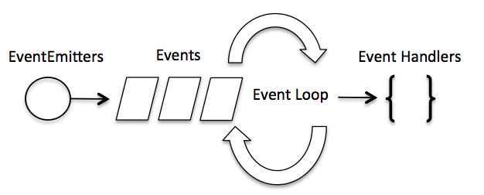
Event Loop
NodeJS is a single threaded application but it support concurrency via concept of event and callbacks
As every API of NodeJS are asynchronous and being a single thread, it uses async function calls to maintain the concurrency
Node uses observer pattern
Node thread keeps an event loop and whenever any task get completed, it fires the corresponding event which signals the event listener function to get executed

Slide 14
EventEmitter
EventEmitter Class lies in events module
Many objects in Node emit events. Example:-
net.Server - when peer connects to it
fs.readStream - when the file is opened
Some methods:-
addListener(event, listener)
on(event, listener)
once(event, listener)
removeListener(event, listener)
removeAllListeners([event])
setMaxListener(n)
listeners(event)
emit(event, [arg1], [arg2], […])
Samples:-
var events = require('events');
var eventEmitter = new events.EventEmitter();
var listner1 = function listner1() { console.log('listner1 executed.'); } var listner2 = function listner2() { console.log('listner2 executed.'); }
function eventEmitter.addListener('connection', listner1);
function eventEmitter.on('connection', listner2);
eventEmitter.emit('connection');

Slide 15
File System Vs Stream API
File System
Wrappers around standard POSIX (Portable Operating System Interface) functions
Both asynchronous and synchronous versions are available
Stream
Abstract interface implemented by various objects in NodeJS
All streams are instances of “EventEmitter”
Base stream classes provides are Readable, Writable, Duplex and Transform
Pipe feature is available in Stream

Slide 16
Sync
Library that makes simple to run asynchronous functions in synchronous manner, using node-fibers
Uses JavaScript native design – Function.prototype.sync
Doesn’t block the whole process. It blocks only current thread
Use:-
Retrieve the child table record using parent table keys sequentially
Link:-
https://www.npmjs.com/package/sync

Slide 17
Global Objects
NodeJS global objects are global in nature and they are available in all modules
__filename, __dirname, setTimeout(cb, ms), clearTimeout(t), setInterval(cb, ms)
It doesn’t need “require()”
NodeJS console is a global object and is used to print different levels of messages to “stdout” and “stderr”
NodeJS process is another global object, an instance of EventEmitter and emits the following events
exit, beforeExit, uncaughtException, Signal Events
process global objects can be used to get/read environment information / variable through standard input and output
Buffers – Global class to handle octet streams
Timers – All timer functions are globals
clearImmediate(immediateObject), setInterval, setTimeout
JavaScript - Globally available object is “window”. In NodeJS, it is “global”. Any variable that we create in a node js file is scoped only to that module
Link:-
http://www.tutorialspoint.com/nodejs/nodejs_process.htm

Slide 18
Utility Modules
OS Module – Basic OS related utility functions
Path Module – Handling and transforming file paths
Net Module – Provides both server and client as streams
DNS Module – Provides functions to do DNS lookup
Domain Module – Way to handle multiple different I/O operations as a single group
Link:-
http://www.tutorialspoint.com/nodejs/nodejs_utitlity_module.htm

Slide 19
Express Framework
Express is a minimal and flexible Node.js web application framework that provides a robust set of features to develop web and mobile applications
Some features:-
Respond to HTTP requests
Defines routing table to perform different action based on HTTP Method and URL
Allows to dynamically render HTML pages based on passing arguments to templates
Important modules in Express:-
body-parser - Handling JSON, Raw, Text and URL encoded form data
cookie-parser - Parse cookie header and populate req.cookies
multer - To handle multipart/form-data
RESTful API calls:-
Express framework is used for REST API
Link:-
http://www.tutorialspoint.com/nodejs/nodejs_express_framework.htm

Slide 20
Package and Module
A Package is any of:
a) a folder containing a program described by a package.json file
b) a gzipped tarball containing (a)
c) a url that resolves to (b)
d) a <name>@<version> that is published on the registry with (c)
e) a <name>@<tag> that points to (d)
f) a <name> that has a latest tag satisfying (e)
g) a git url that, when cloned, results in (a)
Module:
A module is anything that can be loaded with require() in a Node.js program
Link:-
https://docs.npmjs.com/how-npm-works/packages

Slide 21
npm-shrinkwrap
npm shrinkwrap
This command locks down the versions of a package's dependencies so that you can control exactly which versions of each dependency will be used when your package is installed
Link:-
https://docs.npmjs.com/cli/shrinkwrap
Use this command if the packages are not checked-in into the repository

Slide 22
npm commands
Use npm-check-updates or npm outdated to suggest the latest versions
$ npm install -g npm-check-updates
$ npm-check-updates
Update package.json with new versions if you agree
npm-check-updates –u
Then do a clean install (w/o the rm I got some dependency warnings)
$ rm -rf node_modules
$ npm install
$npm ls → List of local packages
$npm ls –gl → List of global packages
$npm test → To execute the tests

Slide 23
Node - Debugging
Node.js includes a full-featured out-of-process debugging utility accessible via a simple TCP-based protocol and built-in debugging client
To use it, start Node.js with the debug argument followed by the path to the script to debug; a prompt will be displayed indicating successful launch of the debugger

Slide 24
Node – Best Practices
When specifying modules dependencies: use 1.0.x syntax. Please don’t use the syntax “>= 0.2.0” syntax. This means that you can take the path version of the particular release, however the major and minor version should remain same because the future version may not be compatible with the earlier versions
When specifying node versions in modules: use >= 0.4.0 or 0.4.x | 0.5.x syntax
When specifying node versions in apps: use 0.4.x or 0.4.0 syntax
Module authors encounter a much wider surface area of use cases, and as such should be more liberal in the versions of node.js they accept. On the other hand, application developers typically have no upstream dependencies and should be more explicit about what version of node.js they are expecting on the target system
Take advantage of devDependencies

Slide 25
Node – Run in Production
Create web user for your system
# useradd -mrU web
Create the required directories
Set the owner and group as ‘web’ for those directories
Get the source from repository
Run the application $node app.js
Deploy the application in all load balancing servers and start the server

Slide 26
Node – Ansible
Ansible is an application deployment, configuration management and orchestration tool
Ansible can be used to automate the deployment process in multiple clusters
Configurations are expressible in what Ansible calls “Playbooks”, which are human and machine-parseable YAML data format, making it easy to audit with other programs, and easy for non-developers to read and understand
ansible-playbook -i [inventory file] app.yml → command to run the playbook

Slide 27
Node – Browserify
Browserify is an open-source JavaScript tool that allows developers to write Node.js-style modules that compile for use in the browser
With Browserify, you can write code that uses require() in the same way that you would use it in Node
browserify js/main.js -o js/findem.js –d → Command to create browserify JS file
It imports each module only once though it is mentioned redundantly in various JS files
npm is able to run the command line scripts to simplify the browserify file creation process whenever it is being changed. The below script should be present in “package.json”
"scripts": { "build-js": "browserify js/main.js > js/findem.js" }
npm run build-js → To execute the script separately rather than executing all the scripts present in package.json
Browserify goes well with Grunt build too

Slide 28
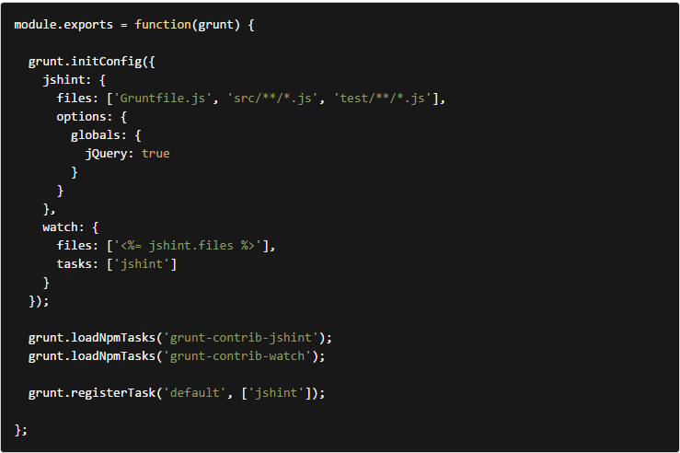
Grunt
Grunt: JavaScript Task Runner
Grunt has lots of plugins
Automation: Automates the repetitive tasks such as minification, compilation, unit testing, linting, etc.
Sample Gruntfile

Slide 29
Gulp
Automation: Gulp is a toolkit that helps you automate painful or time-consuming tasks in your development workflow
Platform-agnostic: Integrations are built into all major IDEs and people are using gulp with PHP, .NET, Node.js, Java, and other platforms
Some Gulp plugins:
Saas compile (gulp-ruby-sass)
JSHint (gulp-jshint)
Concatenation (gulp-concat)
Uglify (gulp-uglify)
Notify of changes (gulp-notify)
Create tasks for scripts, styles, images etc
Advantages of Gulp: It uses node.js streams API, making it faster to build as it doesn’t need to write temporary files/folders to disk. So it is very much faster than Grunt

Slide 30
JavaScript Static Code Checker
Lint is the process of checking the source code for Programmatic as well as Stylistic errors
Some of the JavaScript static code analysis tools are as follows:
ESLint - The pluggable linting utility for JavaScript and JSX
Google’s Closure Compiler - JavaScript optimizer that rewrites code to be faster and smaller, and checks use of native JavaScript functions
JSCS - JavaScript Code Style Checker
JSHint - A community driven fork of JSLint
JSLint - JavaScript syntax checker and validator
Plato - A source code visualization, static analysis, and complexity tool

Slide 31
References
https://docs.npmjs.com/cli/
https://nodejs.org/api/documentation.html
http://www.tutorialspoint.com/nodejs/
https://en.wikipedia.org/wiki/POSIX
https://www.quora.com/What-are-the-disadvantages-of-using-Node-js
http://www.ebaytechblog.com/2014/10/02/dont-build-pages-build-modules/
http://blog.carbonfive.com/2014/06/02/node-js-in-production/
http://www.ebaytechblog.com/2013/05/17/how-we-built-ebays-first-node-js-application/
https://github.com/robrighter/node-boilerplate
http://blog.nodejitsu.com/package-dependencies-done-right/#best-practices
https://github.com/nodeapps
https://github.com/ethoinformatics/sample-ui-browserify
https://github.com/gulpjs/gulp
http://gruntjs.com/plugins

