Slide 1
Frameworks

Slide 2
Dependency Injection (DI)
Spring and Google Guice are two powerful dependency injection frameworks

Slide 3
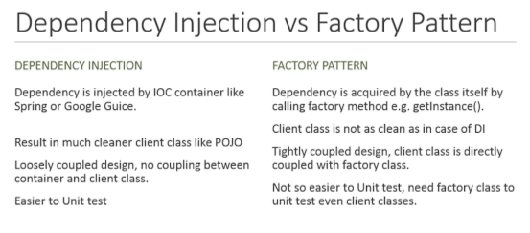
DI Vs Factory Pattern

Slide 4
Play Vs Lift – Web App Framework
Feature | Play | Lift
Programming Language | Java (any JVM scripting language Scala) | Scala
Template Language | Groovy, Japid, Velocity etc. | HTML5
Scripting Language Support | CoffeeScript, Ruby | JavaScript
Cloud Platform Support | Heroku, Amazon EC2, CloudBee, OpenShift etc. | Heroku, Amazon EC2
WebSocket Support | Yes | No

Slide 5
References
http://www.theserverside.com/feature/Spring-vs-Guice-The-Clash-of-the-IOC-Containers
https://dzone.com/articles/thibaultdelor
https://www.quora.com/How-does-dependency-injection-work-in-Spring
http://arquillian.org/
http://javarevisited.blogspot.co.uk/2015/06/difference-between-dependency-injection.html
http://vschart.com/compare/play-framework/vs/lift-web-framework

