Slide 1
Web service

Slide 2
REST
REST – Representational State Transfer
REST is a software architectural style of WWW
The term representational state transfer was introduced and defined in 2000 by Roy Fielding
The name "Representational State Transfer" is intended to evoke an image of how a well-designed Web application behaves:
a network of web pages (a virtual state-machine), where the user progresses through the application by selecting links (state transitions)
resulting in the next page (representing the next state of the application) being transferred to the user and rendered for their use
Unlike SOAP-based web services, there is no "official" standard for RESTful web APIs. This is because REST is an architectural style, while SOAP is a protocol

Slide 3
HTTP Request Methods
GET – Requests using GET should only retrieve data and should have no other effect
HEAD - The HEAD method asks for a response identical to that of a GET request, but without the response body. This is useful for retrieving meta-information written in response headers, without having to transport the entire content
POST - The POST method requests that the server accept the entity enclosed in the request as a new subordinate of the web resource identified by the URI
PUT - The PUT method requests that the enclosed entity be stored under the supplied URI
DELETE - The DELETE method deletes the specified resource
TRACE - The TRACE method echoes the received request so that a client can see what (if any) changes or additions have been made by intermediate servers
OPTIONS - The OPTIONS method returns the HTTP methods that the server supports for the specified URL. This can be used to check the functionality of a web server by requesting '*' instead of a specific resource
CONNECT - The CONNECT method converts the request connection to a transparent TCP/IP tunnel, usually to facilitate SSL-encrypted communication (HTTPS) through an unencrypted HTTP proxy
PATCH - The PATCH method applies partial modifications to a resource

Slide 4
HTTP Request Methods
HTTP Verb | CRUD | Entire Collection | Specific Item
POST | Create | 201 – Created | 404 – Not Found 409 – Conflict
GET | Read | 200 – OK | 200 – OK 404 – Not Found
PUT | Update/Replace | 404 – Not Found | 200 – OK 204 – No Content
PATCH | Update/Modify | 404 – Not Found | 200 – OK 204 – No Content
DELETE | Delete | 404 – Not Found | 200 – OK 404 – No Content

Slide 5
Safe Methods
Safe methods (or nullipotent) – meaning that calling it produces no side-effects
GET Method is Safe method

Slide 6
Safe Methods And Idempotent
Safe methods (or nullipotent) – meaning that calling it produces no side-effects
GET Method is Safe method
HTTP Method | Idempotent | Safe
OPTIONS | Yes | Yes
GET | Yes | Yes
HEAD | Yes | Yes
PUT | Yes | No
POST | No | No
DELETE | Yes | No
PATCH | No | No

Slide 7
PUT Vs POST
PUT is idempotent and POST is not idempotent
PUT and POST are both unsafe methods
Use PUT when you can update a resource completely through a specific resource
If you do not know the actual resource location, for instance, when you add a new article, but do not have any idea where to store it, you can POST it to an URL, and let the server decide the actual URL

Slide 8
Richardson Maturity Model
The Richardson Maturity Model is a way to grade your API according to the constraints of REST. The better your API adheres to these constraints, the higher its score is. The Richardson Maturity Model knows 4 levels (0-3), where level 3 designates a truly RESTful API
Level 0: Swamp of POX - Level 0 uses its implementing protocol (normally HTTP, but it doesn't have to be) like a transport protocol. That is, it tunnels requests and responses through its protocol without using the protocol to indicate application state. It will use only one entry point (URI) and one kind of method (in HTTP, this normally is the POST method). Examples of these are SOAP and XML-RPC
Level 1: Resources - When your API can distinguish between different resources, it might be level 1. This level uses multiple URIs, where every URI is the entry point to a specific resource
Level 2: HTTP verbs - This level suggests that in order to be truly RESTful, your API MUST use HTTP verbs
Level 3: Hypermedia controls - Level 3, the highest level, uses HATEOAS to deal with discovering the possibilities of your API towards the clients

Slide 9
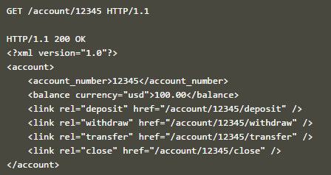
HATEOAS
HATEOAS - Hypertext As The Engine Of Application State
It means that hypertext should be used to find your way through the API

Slide 10
RestFul
Is my API RESTful when I use (only) JSON?
No. One of the key constraints on REST is that a RESTful API must use hypermedia formats (the HATEOAS constraint). Unfortunately, JSON is not a hypermedia format. There is no predefined way to deal with link discovery in JSON
Although JSON doesn't have inherent hypermedia support, some standardisation is on its way to change that. JSON-LD, which is already an official W3C standard, and HAL, which is a personal project, formalize the expression of links in JSON so that clients can instantly follow and discover these links without having to rely on out-of-band additional knowledge.

Slide 11
Versioning the API
The "URL" way:
A commonly used way to version your API is to add a version number in the URL. For instance: /api/v1/article/1234
The hypermedia way
GET /api/article/1234 HTTP/1.1
Accept: application/vnd.api.article+xml; version=1.0

Slide 12
Code-On Demand (COD)
Code-on-Demand (COD) is the only optional constraint in REST. It allows clients to improve its flexibility because in fact it is the server who decides how certain things will be done. For instance, with Code-On-Demand, a client can download a JavaScript, java applet or even a flash application in order to encrypt communication so servers are not aware of any encryption routines / keys used in this process
However, using COD reduces visibility, which is why this constraint is optional. Also, not every API needs this kind of flexibility

Slide 13
HTTP Response Codes
4xx codes are used to tell the client that a fault has taken place on THEIR side
5xx codes tell the client something happened on the server and their request by itself was perfectly valid. The client can continue and try again with the request without modification

Slide 14
RestFul Security
Basic authentication with TLS (formerly known as SSL) – Just sending a username and password that is Base64 encoded. Basic authentication should never be used without TLS (formerly known as SSL) encryption because the username and password combination can be easily decoded otherwise
Oauth 1.0a – This is the most secured of the three common protocols. Oauth1 is a widely-used, tested, secure, signature-based protocol. The protocol uses a cryptographic signature, (usually HMAC-SHA1) value that combines the token secret, nonce, and other request based information. The great advantage of OAuth 1 is you never directly pass the token secret across the wire, which completely eliminates the possibility of anyone seeing a password in transit. This is the only of the three protocols that can be safely used without SSL. However, this level of security comes with a price: generating and validating signatures can be a complex process. You have to use specific hashing algorithms with a strict set of steps
Oauth2 – completely different from Oauth1.0a. It reduces complexity by removing the signature. All the encryption is now handled by TLS, which is required. Disadvantage is that there is not as many Oauth2 libraries as there are Oauth1a libraries.
Custom security protocol – should be avoided as much as possible

Slide 15
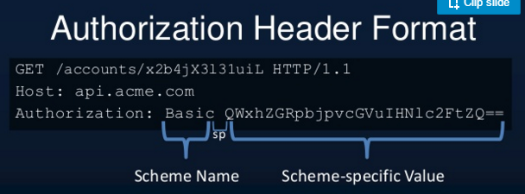
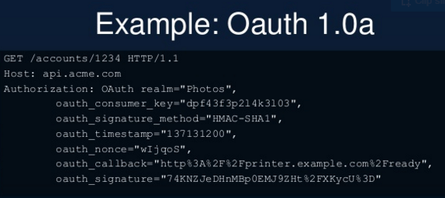
RestFul Security Samples - 1
Basic authentication with TLS
Oauth 1.0a

Slide 16
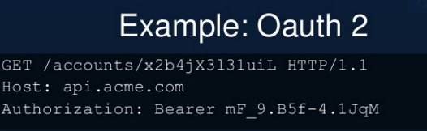
RestFul Security Samples - 2
Oauth 2.0
Status code 401 – Unauthorized really means unauthenticated. You need valid credentials for me to respond to this request
Status code 403 – Forbidden really means Unauthorized. I understood your credentials, but so sorry, you are not allowed!
Oauth is an authorization protocol, not an authentication or SSO protocol
JWT = JSON Web Token – very new spec, but clean and simple

Slide 17
Oauth1.0a Vs Oauth2
Oauth 1.0a | Oauth2
Signature is required | Signature is not required
Complex | Simple compared to Oauth1.0a
Many libraries are available | Not many libraries are available
TLS (i.e. SSL) is not mandatory | TLS is mandatory

Slide 18
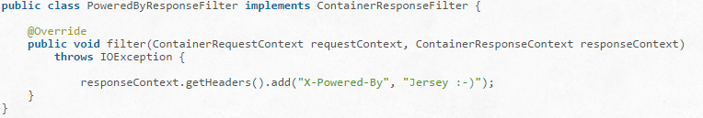
Filters and Interceptors – P1
Filters and interceptors can be used on both sides, on the client and the server side
Filters can modify inbound and outbound requests and responses including modification of headers, entity and other request/response parameters
Interceptors are used primarily for modification of entity input and output streams. You can use interceptors for example to zip and unzip output and input entity streams
Filters can be used when you want to modify any request or response parameters like headers. For example you would like to add a response header "X-Powered-By" to each generated response
Pre-matching (before resource is identified) and post-matching filters (after resource is identified)
Annotations - @PreMatching

Slide 19
Filters and Interceptors – P2
Client Filters – Similar to container filter. no request will actually be sent to the server at all
Interceptors - Interceptors share a common API for the server and the client side. It is used to manipulate entities, via manipulating entity input/output streams. If you for example need to encode entity body of a client request then you could implement an interceptor to do the work for you
Two types of Interceptors:
ReaderInterceptors - Manipulate request entity stream on the server side
WriteInterceptors - Response entity

Slide 20
RestFul API – Best Practices
Validation - Validate all inputs on the server. Protect your server against SQL or NoSQL injection attacks
Session based authentication - Use session based authentication to authenticate a user whenever a request is made to a Web Service method
No sensitive data in URL - Never use username, password or session token in URL , these values should be passed to Web Service via POST method
Restriction on Method execution - Allow restricted use of methods like GET, POST, DELETE. GET method should not be able to delete data
Validate Malformed XML/JSON - Check for well formed input passed to a web service method
Throw generic Error Messages - A web service method should use HTTP error messages like 403 to show access forbidden etc.
Cookies – Set the ‘secure’ and ‘httpOnly’ flags for secure cookies

Slide 21
References
https://en.wikipedia.org/wiki/Representational_state_transfer
http://restcookbook.com/HTTP%20Methods/put-vs-post/
https://stormpath.com/blog/secure-your-rest-api-right-way/
http://www.tutorialspoint.com/restful/restful_security.htm
https://jersey.java.net/documentation/latest/filters-and-interceptors.html

