Slide 1
Design Patterns

Slide 2
SOLID Principles
Single Responsibility Principle - a class should have only a single responsibility (i.e. changes to only one part of the software's specification should be able to affect the specification of the class).
Open/Close Principle - "software entities … should be open for extension, but closed for modification.“
Liskov substitution Principle - "objects in a program should be replaceable with instances of their subtypes without altering the correctness of that program." See also design by contract.
Interface segregation principle - "many client-specific interfaces are better than one general-purpose interface.“
Dependency inversion principle - one should "depend upon abstractions, [not] concretions."

Slide 3
Design Patterns - Creational
Creational Patterns:
Abstract Factory
Builder
Factory Method
Prototype
Singleton
Structural Patterns:
Adaptor
Bridge
Factory Method
Prototype
Singleton

Slide 4
Design Patterns - Structural
Structural Patterns:
Adaptor
Bridge
Composite
Decorator
Façade
Flyweight
Proxy

Slide 5
Design Patterns - Behavioral
Behavioral Patterns:
Chain of Responsibility
Command
Interpreter
Mediator
Memento
Observer
State
Strategy
Template Method
Visitor

Slide 6
Design Patterns – J2EE Patterns
J2EE Patterns:
MVC
Business Delegate
Composite Entity
Data Access Object
Front Controller
Intercepting Filter
Service Locator
Transfer Object

Slide 7
Design Patterns – Misc.
Misc. Patterns:
typesafe enum
RESTful WS

Slide 8
Decorator Pattern – Structural
Add/attach new responsibilities to objects dynamically using composition
Example:- FloorBouquet decoration
When you inherit functionality through subclassing, the functionality is statically set at compile time and it doesn’t always lead to the most flexible nor maintainable designs. If you need to add new features, code modifications are required, which is a violation of the Open Closed Principle.

Slide 9
Composite Pattern - Structural
Hierarchical tree structure
Example: Windows file system, Products and Product Catalog
A node can have one or more leaves or other nodes. This is called recursive composition and can be best illustrated through a file system directory structure.

Slide 10
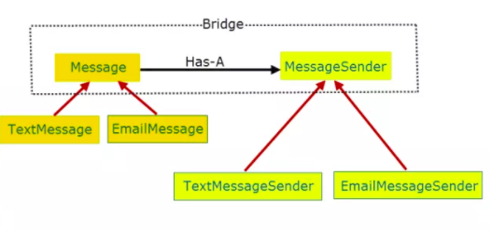
Bridge Pattern - Structural
When we use inheritance, we are permanently binding the implementation to the abstraction. As a result, any change made to one affects the other. A more flexible way is to separate the abstraction and the implementation, and this is where the bridge pattern comes in
Example:- Message sender implementation i.e. EmailMessageSender, TextMessageSender

Slide 11
Adapter Pattern - Structural
Convert the interface of a class into another interface clients expect. Adapter lets classes work together that couldn’t otherwise because of incompatible interfaces
Example:- TextFormattable, NewLineFormatter
New requirement:- CsvFormattable, CsvFormatter
Solution:- CsvAdapterImpl that will act as an adapter to make both the incompatible interfaces (TextFormattable and CsvFormattable) work together
There are two variants of adapters: Object adapter that relies on composition and class adapter that relies on inheritance.

Slide 12
Composition over inheritance
This principle states that classes should achieve polymorphic behaviour and code reuse by their composition rather than inheritance from a base or parent class
Benefits – Higher flexibility, provides more stable business domain, accommodates future requirements changes that would otherwise require complex restructuring
It is more natural to build business-domain classes out of various components than trying to find commonality between them and creating a family tree
Drawbacks – Methods implementations need to be duplicated in the derived type (i.e. less code reuse). This drawback can be avoided by using traits, mixins or protocol extensions

Slide 13
References
http://www.javacamp.org/designPattern/
http://www.tutorialspoint.com/design_pattern/
https://springframework.guru/gang-of-four-design-patterns/composite-pattern/
https://en.wikipedia.org/wiki/Composition_over_inheritance

