Slide 1
Microservices using AWS (disclaimer : This is just a personal notes. Some of the contents are copied from AWS whitepapers and website)

Slide 2
Characteristics of Microservices
Decentralized
Polyglot – Each Microservices can be developed in different programming languages based on the requirement and needs
Independent
Do one thing well
Black Box
You build it, you run it

Slide 3
Monolithic Vs MicroServices
Monolithic | MicroServices
Simplicity | Partial Deployment
Consistency | Availability
Inter Module refactoring | Preserve Modularity
 | Multiple platforms

Slide 4
Must Have In MicroServices Env
Basic monitoring
Rapid Provisioning
Rapid Application Deployment
DevOps Culture

Slide 5
Cassandra – Netflix uses it
NoSQL at scale
Open Source
Multi-Regional
Multi-directional
Available
Partition Tolerance
Tuneable Consistency

Slide 6
Cache – Read Data
Cache is an important concept to protect the resources being used for similar request and improve performance of the application

Slide 7
MicroServices failure
Find whether the problem is in the critical service or non-critical service
Try to avoid the cascading affect of the failure
Use Circuit Breakers pattern to avoid cascading effect
Hystrix – Software provides Circuit Breaker implementation
Spring cloud adapts Hystrix in Spring Cloud library
@EnableCircuitBreaker
@HystrixCommand(fallbackMethod = "reliable“) – where reliable is the method which returns static string when the calling service is not available

Slide 8
Spring Cloud Features
Distributed / Versioned configuration
Service registration and discovery
Routing
Service-to-service calls
Load balancing
Circuit breakers
Global locks
Distributed messaging

Slide 9
Decomposition
Decompose by business capability
Follow design principles – Single Responsibility Principle (SRP), Common Closure Principle (CCP)
CCP – Classes that change for the same reason should be in the same package
Decompose by subdomain
Subdomains can be classified as follows:-
Core - key differentiator for the business and the most valuable part of the application
Supporting - related to what the business does but not a differentiator. These can be implemented in-house or outsourced
Generic - not specific to the business and are ideally implemented using off the shelf software

Slide 10
API Gateway
Why API gateway?
Single entry point for all clients
Authenticate the client and generates the access token (JSON web token) which will be used by service
The number of service instances and their locations (host + port) changes dynamically
Partitioning into services can change over time and should be hidden from clients
Services might use a diverse set of protocols, some of which might not be web friendly
Different clients need different data
Network performance is different for different types of clients (i.e. Mobile, Web etc.)
API gateway benefits?
Solves the problem of determining the location of service instance
Provides the optimal API for each client
Reduces the number of requests/roundtrips. For example, the API gateway enables clients to retrieve data from multiple services with a single round-trip. Fewer requests also means less overhead and improves the user experience. An API gateway is essential for mobile applications.

Slide 11
API Gateway
Simplifies the client by moving logic for calling multiple services from the client to API gateway
API Gateway Drawbacks:-
Increased complexity - the API gateway is yet another moving part that must be developed, deployed and managed
Increased response time due to the additional network hop through the API gateway - however, for most applications the cost of an extra roundtrip is insignificant
API Gateway Implementations:-
Netflix API gateway
AWS API gateway
API Gateway Patterns:-
Either use client side or server side service discovery
Authenticates the user and pass an Access Token
Uses Circuit Breaker
Often implements the API Composition Pattern

Slide 12
API Gateway – VETRO Pattern
VETRO – Validation, Enrich, Transform, Route and Operate
Enrich:-
Smart endpoints and dumb pipes is one of the popular design pattern which makes a strong case to keep Gateways as dumb as possible. Service composition or aggregation is a slippery slope as it opens up for developers to add complex logic (could be business logic) in Gateways.
Netflix like companies took U-turn on “smart endpoints and dump pipes” pattern and doing service aggregation in Gateway for improving scalability, performance to cater to a large variety of devices.
Enriching the messages between front and backend systems often involves validating security and adding relevant user context and tailoring messages for receiving party, but developers must use caution and not add any business logic in Gateway.
Route and Operate:-
Often, service traffic is routed through many intermediaries like reverse proxies, web servers, load balancers, etc… It gets very annoying to isolate the one who ate your headers. So, use caution when using transport headers for routing the consumers.

Slide 13
Observability
Centralized logging - Use a centralized logging service that aggregates logs from each service instance. The users can search and analyze the logs. They can configure alerts that are triggered when certain messages appear in the logs.
AWS Cloud Watch
Metrics - Instrument a service to gather statistics about individual operations. Aggregate metrics in centralized metrics service, which provides reporting and alerting. There are two models for aggregating metrics:
push - the service pushes metrics to the metrics service
pull - the metrics services pulls metrics from the service
AWS Cloud Watch, Prometheus
Audit Logging – Log it in database
Distributed Tracing (Monitoring):
Assigns each external request a unique external request id
Passes the external request id to all services that are involved in handling the request
Include the external request id in all log messages
Record information about the requests and operations performed

Slide 14
Observability
Tools – Microservice chassis framework, Spring Cloud Sleuth
It also tells Spring Cloud Sleuth to deliver traces to Zipkin via RabbitMQ
Exception Tracking - Report all exceptions to a centralized exception tracking service that aggregates and tracks exceptions and notifies developers
Health Check - A service has an health check API endpoint (e.g. HTTP /health) that returns the health of the service. The API endpoint handler performs various checks, such as
the status of the connections to the infrastructure services used by the service instance
the status of the host, e.g. disk space
application specific logic
A health check client - a monitoring service, service registry or load balancer - periodically invokes the endpoint to check the health of the service instance

Slide 15
Data Management
Database per service
Shared database
Saga
API Composition
CQRS – Command, Query, Responsibility and Segregation
Event sourcing
Transaction log tailing
Database triggers
Application events

Slide 16
Netflix Zuul
Netflix Zuul is a proxy solution to forward requests to Microservices
Features:-
Authentication and Security
Insights and monitoring
Dynamic Routing
Stress Testing
Load Shedding
Static response handling
Multi-region resiliency

Slide 17
Microservices
Microservices using AWS can be developed in many ways:-
Microservices without the serverless architecture
Microservices using Amazon Elastic Container service

Slide 18
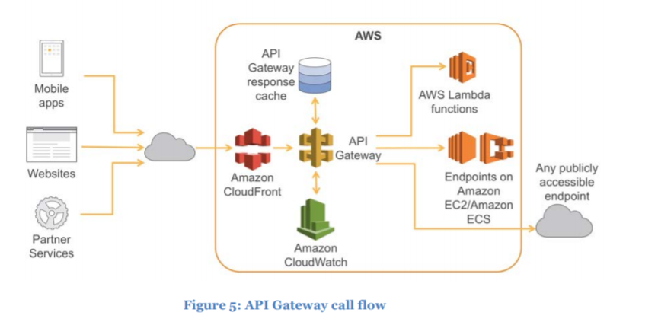
Microservices using API gateway

Slide 19
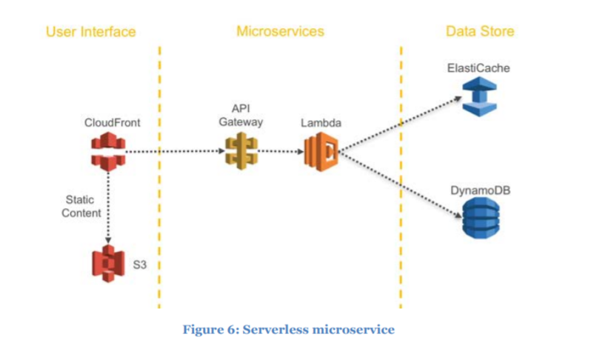
Microservices using serverless

Slide 20
Microservices using serverless
The AWS Serverless Application Model (AWS SAM) is a convenient way to define serverless applications. AWS SAM is natively supported by CloudFormation and defines a simplified syntax for expressing serverless resources. To deploy your application, simply specify the resources you need as part of your application, along with their associated permissions policies in a CloudFormation template, package your deployment artifacts, and deploy the template.

Slide 21
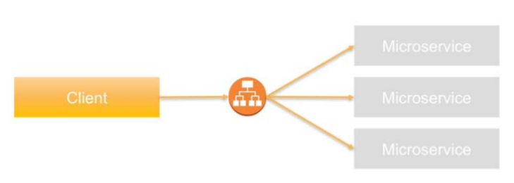
Service Discovery
One of the primary challenges with Microservices architectures is allowing services to discover and interact with each other.
Client-Side Service Discovery:-
Hard code the IP address of the target as part of the configuration of the communication source
It isn’t recommended for Microservices architectures due to the dynamic nature of target properties. Every time the target system changes its properties—regardless of whether it’s the IP address or port information—the source system has to update the configuration
Application load balancer based service discovery:-

Slide 22
Service Discovery
Application load balancer based service discovery:-
Advantages:-
Provides health checks and automatic registration/de-registration of back end services in failure cases
Offers path and host based routing approaches
You can configure a custom domain name for each Microservice and associate the domain name with the Application Load Balancer’s DNS name using a CNAME entry. The DNS names of the service endpoints are then published across other applications that need access
DNS based service discovery - Amazon Route 53 could be another source for holding service discovery information
Service discovery using Amazon ECS event system
Service discovery using configuration management - OpsWorks is a configuration management service that uses Chef, an automation platform that treats server configurations as code. OpsWorks uses Chef to automate how servers are configured, deployed, and managed across your EC2 instances or on-premises compute environments

Slide 23
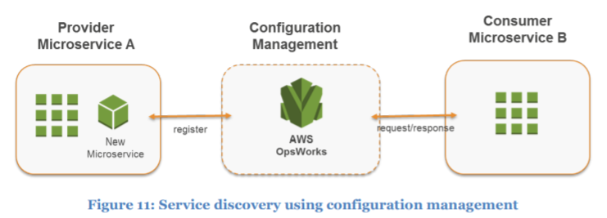
Service Discovery

Slide 24
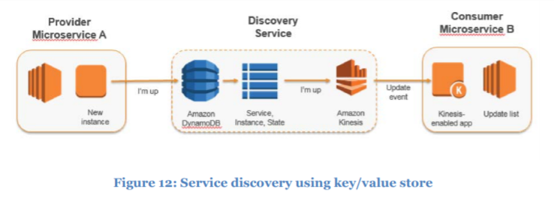
Service Discovery
Service discovery using key value store - You can also use a key-value store for discovery of Microservices. Although it takes longer to build this approach compared to other approaches, it provides more flexibility and extensibility and doesn’t encounter DNS caching issues.

Slide 25
Service Discovery – Third Party Services
HashiCorp Consul
Netflix Eureka

Slide 26
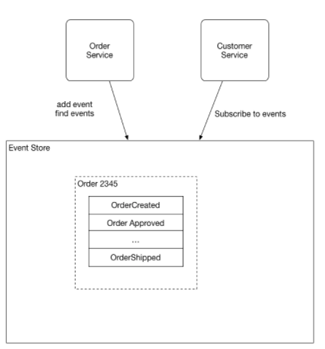
Distributed Data Management
Event source pattern
Event sourcing persists the state of a business entity such an Order or a Customer as a sequence of state-changing events. Whenever the state of a business entity changes, a new event is appended to the list of events. Since saving an event is a single operation, it is inherently atomic. The application reconstructs an entity’s current state by replaying the events.

Slide 27
Distributed Data Management
Instead of simply storing the current state of each order as a row in an ORDERS table, the application persists each Order as a sequence of events. The CustomerService can subscribe to the order events and update its own state
In the context of Microservices architectures, event sourcing enables decoupling different parts of an application by using a publish/subscribe pattern, and it feeds the same event data into different data models for separate Microservices. Event sourcing is frequently used in conjunction with the CQRS pattern (Command, Query, Responsibility, Segregation) to decouple read from write workloads and optimize both for performance, scalability, and security

Slide 28
Asynchronous Message
Asynchronous messaging makes a much better default for communication between Microservices
Along with going Asynchronous, you should always apply backpressure. Backpressure is all about flow control, ensuring that a fast producer should not be able to overwhelm a slower consumer by being allowed to send it more data than it can handle

Slide 29
Circuit Breaker Pattern
It's common for software systems to make remote calls to software running in different processes, probably on different machines across a network. One of the big differences between in-memory calls and remote calls is that remote calls can fail, or hang without a response until some timeout limit is reached. What's worse if you have many callers on a unresponsive supplier, then you can run out of critical resources leading to cascading failures across multiple systems.
Circuit breaker is a FSM (Finite State Machine), which means that it has a finite set of states: Closed, Open and Half-Open
Closed – Permit all traffic and monitor thresholds. Trip circuit if performance degrades or failure detected
Open – Prevents all requests to service, wait x seconds to attempt reset
Half-open – Prevents single request, measure thresholds, close circuit if within bounds otherwise trip circuit
Circuit breakers exist in most microservices frameworks and platforms; for example, in Akka, Lagom, and Hystrix

Slide 30
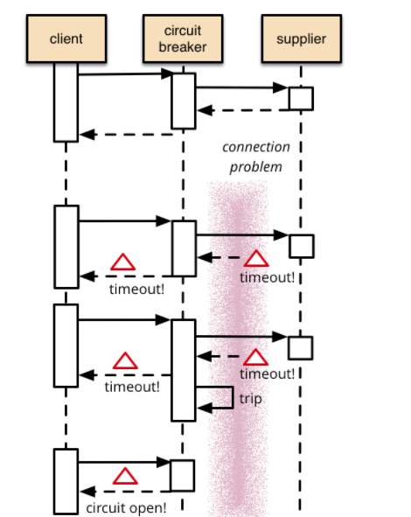
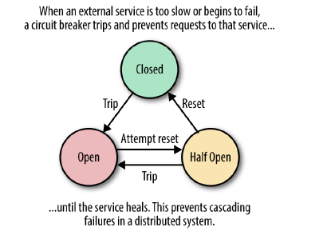
Circuit Breaker

Slide 31
References
https://d1.awsstatic.com/whitepapers/microservices-on-aws.pdf
http://microservices.io/patterns/data/event-sourcing.html
https://martinfowler.com/bliki/CircuitBreaker.html
https://spring.io/guides/gs/circuit-breaker/
https://github.com/Netflix/zuul/wiki
https://dzone.com/articles/vetro-for-rest-apis

