Slide 1
SCALA

Slide 2
Scala – Scalable Language
Java 8 is not going to kill Scala nor the other way around, instead, Scala will move from general-purpose language to a special-purpose language, focusing more on the scalability, cluster computing and reactive computing use cases, again this is for now!

Slide 3
Scala – Advantages
Suitable for Web 2.0 movement
Verbosity - Less boiler-plate code and less code required to accomplish similar things in Java
Immutability - The ability to safely access collections and data concurrently without the inherent issues that usually associated with mutable data structures parallel programming
Scalability - the functional paradigm and immutability -among other things- by design, makes Scala a winner on the scalability side
High maintainability and productivity
High scalability
High testability
Provides features of concurrent programming

Slide 4
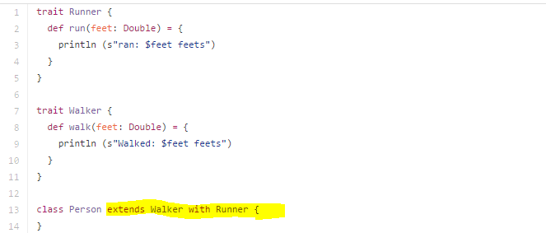
Scala – Advantages over Java 8 – P1
Immutability – 100% Thread-Safety, Cleaner code, No side effects, Execution speed up
Actors implementation
Thread based actors
Event based actors
Traits - A trait encapsulates method and field definitions, which can then be reused by mixing them into classes. A class can mix in any number of traits. If it might be reused in multiple, unrelated classes, make it a trait. Only traits can be mixed into different parts of the class hierarchy
Mixin class compositions in Scala

Slide 5
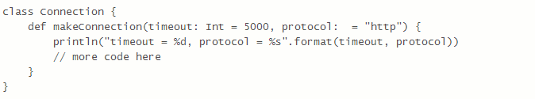
Scala – Advantages over Java 8 – P2
Mixin class compositions can be used to define Singleton objects
Scala just allows traits mixins and we cannot mixin classes
Scala allows higher order functions. These are functions that take other functions as parameters, or whose result is a function
Scala provides the ability to give parameters default values that can be used to allow a caller to omit those parameters
Everything is object in Scala. There is no primitive data types

Slide 6
Scala – Advantages over Java 8 – P3
There is no static modifiers in Scala. Everything is considered as object. Equivalent to static modifier is Singleton objects in Scala
There is no default access modifier in Scala. Anything declared without private or protected is considered as public
An Extractor in Scala is an object that has a method called unapply as one of its members
Scala doesn’t have checked exceptions
Try{…} catch {…} – Catch block uses matching to identify and handle the exception i.e. it doesn’t require particular exception object to be caught
Scala has finally block as well

Slide 7
Higher Order Programming
Higher-order programming is a style of computer programming that uses software components, like functions, modules or objects, as values
For example, in higher-order programming, one can pass functions as arguments to other functions and functions can be the return value of other functions

Slide 8
Scala – Actors
Scala's primary concurrency construct is actors
Actors are basically concurrent processes that communicate by exchanging messages
The Scala Actors library provides both asynchronous and synchronous message sends (the latter are implemented by exchanging several asynchronous messages). Moreover, actors may communicate using futures where requests are handled asynchronously, but return a representation (the future) that allows to await the reply

Slide 9
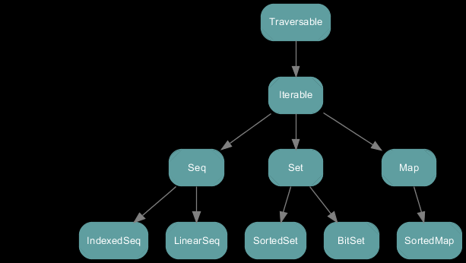
Scala – Collections API

Slide 10
Scala – Case Class
Immutable by default
Decomposable through pattern matching
Compared by structural equality instead of by reference
Succinct to instantiate and operate on

Slide 11
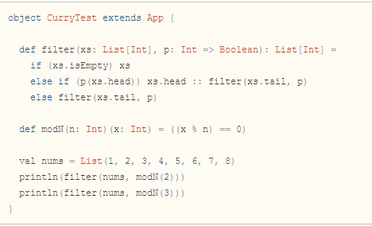
Scala – Currying
Currying is the technique of transforming a function that takes multiple arguments into a function that takes a single argument
Methods may define multiple parameter lists. When a method is called with a fewer number of parameter lists, then this will yield a function taking the missing parameter lists as its arguments
Output:-
List(2,4,6,8)
List(3,6)

Slide 12
Scala – Distributed Computing Frameworks
Play web framework - Play framework supports both Java and Scala and that could prove to be a valuable advantage
Apache Spark

Slide 13
Hadoop
Apache Hadoop is a framework for distributed processing
Integrates MapReduce (parallel processing), YARN (job scheduling) and HDFS (distributed file system)

Slide 14

Hadoop - Architecture

Slide 15
Hadoop – Suitable For
Big Data simply consists of a huge amount of very structured data (i.e. customer names and addresses) you may have no need for the advanced streaming analytics and machine learning functionality provided by Spark

Slide 16
Hadoop Vs Apache Spark
Hadoop | Spark
Great solution for one-pass computations | Suitable for multi-pass computations and algorithms
Requires integration of tools such as Mahout for Machine Learning and Storm for streaming data processing | Spark ecosystem has in house tools such as Spark core, MLlib, Stream, SQL and GraphX
Each step in the data processing workflow has one Map phase and one Reduce phase and you'll need to convert any use case into MapReduce pattern to leverage this solution Series of MapReduce jobs and execute them in sequence | Intermediate storage not required. It can use complex, multi-step data pipelines using directed acyclic graph (DAG) pattern
Provides basic functionality | Not a replace for Hadoop. It is just an comprehensive solution

Slide 17
Apache Spark
Apache Spark
Fast and general engine for large scale data processing
Runs program up to 100x faster than Hadoop MapReduce in memory or 10x faster on disk
Ease of use – Write applications quickly in Java, Scala, Python, R
Generality – Combine SQL, streaming, and complex analytics
Spark powers a stack of libraries including SQL and DataFrames, MLlib for machine learning, GraphX, and Spark Streaming
Spark runs on Hadoop, Mesos, standalone, or in the cloud. It can access diverse data sources including HDFS, Cassandra, HBase, and S3
Spark provides programmers with an application programming interface centered on a data structure called the resilient distributed dataset (RDD), a read-only multiset of data items distributed over a cluster of machines, that is maintained in a fault-tolerant way
The availability of RDDs facilitates the implementation of both iterative algorithms, that visit their dataset multiple times in a loop, and interactive/exploratory data analysis, i.e., the repeated database-style querying of data
Spark also supports a pseudo-distributed local mode, usually used only for development or testing purposes, where distributed storage is not required and the local file system can be used instead; in such a scenario, Spark is run on a single machine with one executor per CPU core
RDD is immutable and their operations are lazy

Slide 18
Apache Spark – Advantages
In-memory data storage and near real-time processing. So, it performs several times faster than other big data technologies
Spark also supports lazy evaluation of big data queries, which helps with optimization of the steps in data processing workflows
API improves developer productivity
It’s designed to be an execution engine that works both in-memory and on-disk
Spark will attempt to store as much as data in memory and then will spill to disk
Offers interactive shell for Scala and Python. This is not available in Java yet

Slide 19
Apache Spark – Disadvantages
It doesn’t have its own distributed storage system. It uses HDFS (Hadoop Distributed File System). Distributed storage is fundamental to many of today’s Big Data projects
Security and support infrastructure is not as advanced

Slide 20
Apache Spark - Ecosystem
Apache Spark Components
Spark Core
Spark SQL
Spark Streaming
Spark MLlib
GraphX

Slide 21
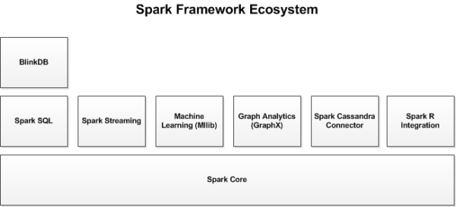
Apache Spark - Ecosystem

Slide 22
Apache Spark - Core
Spark Core is the foundation of the overall project
It provides distributed task dispatching, scheduling, and basic I/O functionalities, exposed through an application programming interface (for Java, Python, Scala, and R) centered on the RDD abstraction
This interface mirrors a functional/higher-order model of programming: a "driver" program invokes parallel operations such as map, filter or reduce on an RDD by passing a function to Spark, which then schedules the function's execution in parallel on the cluster. These operations, and additional ones such as joins, take RDDs as input and produce new RDDs
Fault-tolerance is achieved by keeping track of the "lineage" of each RDD, the sequence of operations produced it, so that it can be reconstructed in the case of data loss
Spark provides two types of shared variables to make it efficient to run the Spark programs in a cluster. These are Broadcast Variables and Accumulators
broadcast variables reference read-only data that needs to be available on all nodes
accumulators can be used to program reductions in an imperative style. They can be used to implement counters (as in MapReduce) or sums

Slide 23
Apache Spark - Core
RDD supports two types of operations:
Transformation
Action
Transformation: Transformations don't return a single value, they return a new RDD. Nothing gets evaluated when you call a Transformation function, it just takes an RDD and return a new RDD
Some of the Transformation functions are map, filter, flatMap, groupByKey, reduceByKey, aggregateByKey, pipe, and coalesce
Action: Action operation evaluates and returns a new value. When an Action function is called on a RDD object, all the data processing queries are computed at that time and the result value is returned
Some of the Action operations are reduce, collect, count, first, take, countByKey, and foreach

Slide 24
Apache Spark - SQL
Spark SQL is a component on top of Spark Core that introduces a new data abstraction called DataFrames which provides support for structured and semi-structured data
Spark SQL provides a domain-specific language to manipulate DataFrames in Scala, Java, or Python
It also provides SQL language support, with command-line interfaces and ODBC/JDBC server

Slide 25
Apache Spark - Streaming
Spark Streaming leverages Spark Core's fast scheduling capability to perform streaming analytics
It ingests data in mini-batches and performs RDD transformations on those mini-batches of data
This design enables the same set of application code written for batch analytics to be used in streaming analytics, on a single engine

Slide 26
Apache Spark - MLlib
MLlib – Machine Language Library
Spark MLlib is a distributed machine learning framework on top of Spark Core that, due in large part of the distributed memory-based Spark architecture, is as much as nine times as fast as the disk-based implementation used by Apache Mahout and scales better than Vowpal Wabbit

Slide 27
Apache Spark - GraphX
GraphX is a distributed graph processing framework on top of Spark
It provides an API for expressing graph computation that can model the Pregel abstraction
It also provides an optimized runtime for this abstraction

Slide 28
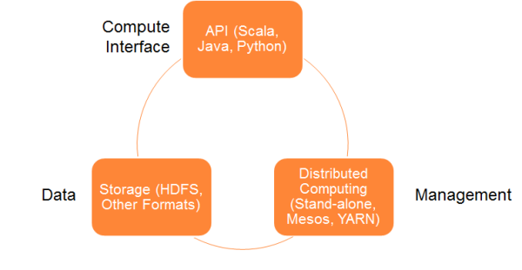
Apache Spark - Architecture
Data Storage - Spark uses HDFS file system for data storage purposes. It works with any Hadoop compatible data source including HDFS, HBase, Cassandra, etc.
API - The API provides the application developers to create Spark based applications using a standard API interface. Spark provides API for Scala, Java, and Python programming languages
Management Framework - Spark can be deployed as a Stand-alone server or it can be on a distributed computing framework like Mesos or YARN

Slide 29
Apache Spark - Interact
Once Spark is up and running, you can connect to it using the Spark shell for interactive data analysis. Spark Shell is available in both Scala and Python languages. Java doesn’t support an interactive shell yet, so this feature is currently not available in Java
You use the commands spark-shell.cmd and pyspark.cmd to run Spark Shell using Scala and Python respectively
http://localhost:4040

Slide 30
References – P1
https://www.linkedin.com/pulse/scala-question-2016-mark-makary?trk=pulse_spock-articles
http://spark.apache.org/
https://en.wikipedia.org/wiki/Apache_Spark
https://github.com/apache/spark
http://www.infoq.com/articles/apache-spark-introduction
http://bigdatauniversity.com/
http://www.forbes.com/sites/bernardmarr/2015/06/22/spark-or-hadoop-which-is-the-best-big-data-framework/#19a11e0f532c
http://bigdata.andreamostosi.name/
http://bigdata.andreamostosi.name/
https://github.com/alexandru/scala-best-practices/blob/master/sections/2-language-rules.md
http://www.alternatestack.com/development/mixin-class-compositions-in-scala/
https://intellipaat.com/interview-question/apache-spark-interview-questions/?utm_source=spark%20interview%20linkedin_SM&utm_medium=posting&utm_campaign=spark%20interview%20linkedin_SM%2Fposting

Slide 31
References – P2
https://databricks.com/blog/2014/10/10/spark-petabyte-sort.html

