Slide 1
Java8 Stream

Slide 2

Internal Iteration
Using the Collection interface requires iteration to be done by the user (for example, using for-each); this is called external iteration. The Streams library by contrast uses internal iteration—it does the iteration for you and takes care of storing the resulting stream value somewhere; you merely provide a function saying what’s to be done.

Slide 3
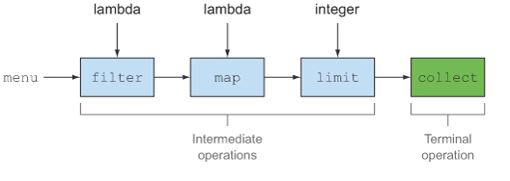
Stream Operations
The Stream interface in java.util.stream.Stream defines many operations. They can be classified into two categories.
You can see two groups of operations:
filter, map, and limit can be connected together to form a pipeline
collect causes the pipeline to be executed and closes it

Slide 4
Pure Functions
Properties of pure functions:-
The function should be idempotent
No matter how many times you call it, a pure function will yield the same result for the same given input
A pure function has no side-effects: no matter what you do with it, the pure function will not change any other element in your program
Two rules:-
The function does not change anything
The function does not depend on anything that may possibly change

Slide 5
Why function purity matters?
Lazy evaluation means that a function may be evaluated now, or later, or the evaluation may be skipped entirely. Anything goes as long as the desired result is obtained. But if the function has a side-effect then lazy evaluation won't work. The next example shows what happens when the function pipeline includes an impure function.
List<Integer> numbers = Arrays.asList(1, 2, 3);
int[] factor = new int[] { 2 };
Stream<Integer> stream = numbers.stream()
.map(e -> e * factor[0]);
factor[0] = 0;
stream.forEach(System.out::println);
Java assumes that lambda expressions and closures provided to operations are pure. If your code doesn't meet this expectation then you will suffer the consequences
Avoid shared mutability
Lazy evaluation and easy parallel execution are two significant benefits of using a functional pipeline. Both features hinge on functional purity, meaning that lambdas and closures must not have any side-effects in your program

Slide 6
References
Java 8 in Action
https://www.ibm.com/developerworks/library/j-java8idioms11/index.html

