Slide 1
REACTOR

Slide 2
Reactor Dispatchers
Reactor has four dispatchers to pick from: synchronous, ring buffer, thread pool, and event loop.
Synchronous is typically used inside a consumer, especially if you use Stream s and Promise s.
Ring buffer is used for large volumes of non-blocking events and is based on the LMAX disruptor.
Thread pool is ideal for longer running tasks that might be IO bound, and when it doesn’t matter what thread they are run on.
Event loop is used when you need all events on the exact same thread.

Slide 3
Reactor Systems
Reactive Systems – is a message driven based upon asynchronous message passing.

Slide 4
Reactor Programming
Reactive Programming – is a great technique for making individual components performant and efficient through asynchronous and non-blocking execution, most often together with a mechanism for backpressure
Dealing with possibly infinite streams is very challenging, as we need to face a problem of a backpressure. It’s not difficult to get into a situation in which an Observable is emitting items more rapidly than a subscriber can consume them. We will look at the different solutions to the problem of growing buffer of unconsumed items.

Slide 5
Cold Vs Hot observable
Cold Observable | Hot Observable
Cold Observable is providing items in a lazy way (i.e. only when the subscriber is ready to consume) | Hot Observable emits items at its own pace, and it is up to its observers to keep up When the Observer is not able to consume items as quickly as they are produced by an Observable they need to be buffered or handled in some other way, as they will fill up the memory, finally causing OutOfMemoryException.
Cold Observables do not need to have any form of a backpressure because they work in a pull fashion | Temporary Fix – Increase the buffer size

Slide 6
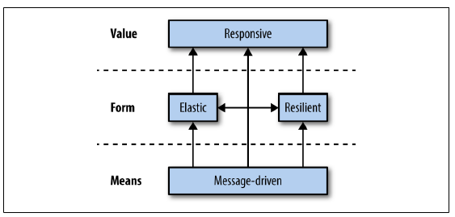
Four traits of reactive systems

Slide 7
References
https://spring.io/guides/gs/messaging-reactor/
http://www.baeldung.com/rxjava-backpressure

