Slide 1
SprinG Vs GUICe

Slide 2
Dependency Injection (DI)
Spring and Google Guice are two powerful dependency injection frameworks

Slide 3
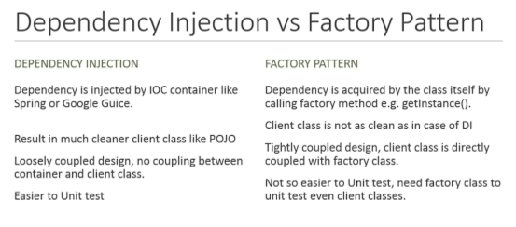
DI Vs Factory Pattern

Slide 4
References
http://www.theserverside.com/feature/Spring-vs-Guice-The-Clash-of-the-IOC-Containers
https://dzone.com/articles/thibaultdelor
https://www.quora.com/How-does-dependency-injection-work-in-Spring
http://arquillian.org/
http://javarevisited.blogspot.co.uk/2015/06/difference-between-dependency-injection.html

