Slide 1
kotlin

Slide 2
Kotlin
Statically typed language
Functional style programming
Suitable language for Android development
Removes the NULL issue on Java which is the main problem for many Android application crashes
100% interoperable with Java
It hasn’t re-implemented the Java collection framework to achieve interoperability
Write less code and be happy

Slide 3
Kotlin on Android
Kotlin provides integration with Android studio, Google’s primary IDE for Android

Slide 4
Some Java Issues address in Kotlin
Null references are controlled by type system
No raw types
Arrays in Kotlin are invarient - This means that Kotlin does not let us assign an Array<String> to an Array<Any>, which prevents a possible runtime failure
Kotlin also has specialized classes to represent arrays of primitive types without boxing overhead: ByteArray, ShortArray, IntArray and so on
Kotlin has proper function types, as opposed to Java’s SAM (Single abstract method) conversions
Use-site variants without wildcards
Kotlin does not have checked exceptions

Slide 5
Inline Function
Inline function improves performance
Disadvantages - Inlining may cause the generated code to grow; however, if we do it in a reasonable way (i.e. avoiding inlining large functions), it will pay off in performance

Slide 6
Coroutines
Basically, coroutines are computations that can be suspended without blocking a thread. Blocking threads is often expensive, especially under high load, because only a relatively small number of threads is practical to keep around, so blocking one of them leads to some important work being delayed.
No context switch or any other involvement of the OS is required

Slide 7
String templates
Strings may contain template expressions, i.e. pieces of code that are evaluated and whose results are concatenated into the string. A template expression starts with a dollar sign ($) and consists of either a simple name:
val i = 10
println("i = $i") // prints "i = 10"

Slide 8
Sealed classes
Sealed classes are used for representing restricted class hierarchies, when a value can have one of the types from a limited set, but cannot have any other type
A sealed class is abstract by itself, it cannot be instantiated directly and can have abstract members.
Sealed classes are not allowed to have non-private constructors (their constructors are private by default).

Slide 9
Visibility Modifiers
private, protected, internal and public
The default visibility, used if there is no explicit modifier, is public
If you do not specify any visibility modifier, public is used by default, which means that your declarations will be visible everywhere
If you mark it internal, it is visible everywhere in the same module

Slide 10
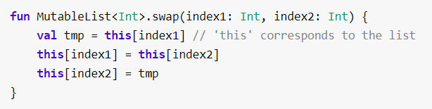
Extensions
Kotlin, similar to C# and Gosu, provides the ability to extend a class with new functionality without having to inherit from the class or use any type of design pattern such as Decorator. This is done via special declarations called extensions. Kotlin supports extension functions and extension properties.
To declare an extension function, we need to prefix its name with a receiver type, i.e. the type being extended. The following adds a swap function to MutableList<Int>:

Slide 11

Data classes
We frequently create classes whose main purpose is to hold data. In such a class some standard functionality and utility functions are often mechanically derivable from the data. In Kotlin, this is called a data class and is marked as data:
The compiler automatically derives the following members from all properties declared in the primary constructor:
equals()/hashCode() pair;
toString() of the form "User(name=John, age=42)";
componentN() functions corresponding to the properties in their order of declaration;
copy() function

Slide 12
Interfaces
Interfaces in Kotlin are very similar to Java 8. They can contain declarations of abstract methods, as well as method implementations. What makes them different from abstract classes is that interfaces cannot store state. They can have properties but these need to be abstract or to provide accessor implementations.

Slide 13
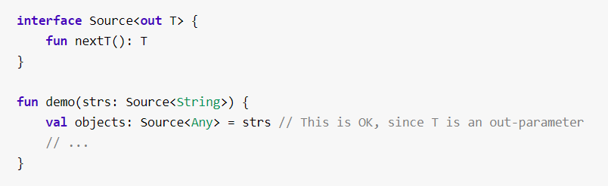
Variance
One of the most tricky parts of Java's type system is wildcard types (see Java Generics FAQ). And Kotlin doesn't have any. Instead, it has two other things: declaration-site variance and type projections.
First, let's think about why Java needs those mysterious wildcards. The problem is explained in Effective Java, Item 28: Use bounded wildcards to increase API flexibility. First, generic types in Java are invariant, meaning that List<String> is not a subtype of List<Object>. Why so? If List was not invariant, it would have been no better than Java's arrays, since the following code would have compiled and caused an exception at runtime:
In Java we have List<? super String> a supertype of List<Object>. This is called contravariance
Declaration-site variance: - out modifier

Slide 14
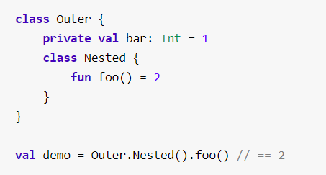
Nested Classes
Classes can be nested in other classes:-

Slide 15
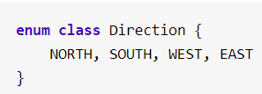
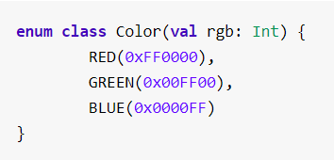
Enum Classes
The most basic usage of enum classes is implementing type-safe enums:
Since each enum is an instance of the enum class, they can be initialized as:

Slide 16
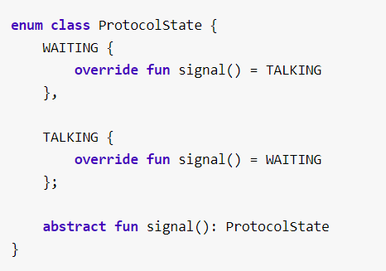
Anonymous Classes -
Note that if the enum class defines any members, you need to separate the enum constant definitions from the member definitions with a semicolon, just like in Java.

Slide 17
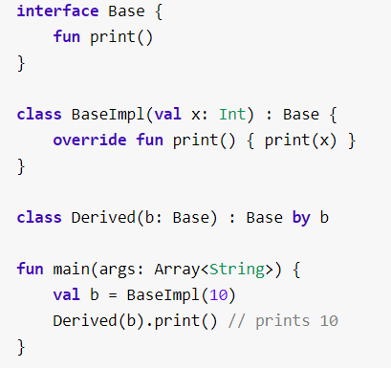
Delegation (Alternative to inheritance)
The Delegation pattern has proven to be a good alternative to implementation inheritance, and Kotlin supports it natively requiring zero boilerplate code. A class Derived can inherit from an interface Base and delegate all of its public methods to a specified object:

Slide 18
Delegation (Alternative to inheritance)
The by-clause in the supertype list for Derived indicates that b will be stored internally in objects of Derived and the compiler will generate all the methods of Base that forward to b.

Slide 19
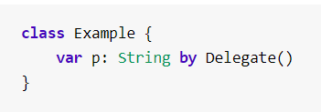
Delegated Properties
There are certain common kinds of properties, that, though we can implement them manually every time we need them, would be very nice to implement once and for all, and put into a library. Examples include:
lazy properties: the value gets computed only upon first access;
observable properties: listeners get notified about changes to this property;
storing properties in a map, instead of a separate field for each property.
To cover these (and other) cases, Kotlin supports delegated properties:

Slide 20
Standard Library
The Kotlin Standard Library provides living essentials for everyday work with Kotlin. These include:
Higher-order functions implementing idiomatic patterns (let, apply, use, synchronized, etc).
Extension functions providing querying operations for collections (eager) and sequences (lazy).
Various utilities for working with strings and char sequences.
Extensions for JDK classes making it convenient to work with files, IO, and threading.

Slide 21
References
https://kotlinlang.org/docs/reference/inline-functions.html
https://kotlinlang.org/docs/reference/nested-classes.html

