Slide 1
MicroServices

Slide 2
MicroServices
MicroServices is a software architecture style in which complex applications are composed of small, independent processes communicating with each other using language-agnostic APIs

Slide 3
MicroServices Approach
Don’t start with MicroServices approach
Almost all the cases where the development approach started with MicroServices system from scratch, it has ended up in serious trouble

Slide 4
Disadvantages of Monolithic
Difficult to maintain the application
More difficult and sometimes impossible to scale, especially in PaaS (cloud) environments
If one part of the application fails, everything fails

Slide 5
Advantages of MicroServices
Applications are more flexible
Every Microservice can be developed independently of other MicroServices:
Simplifies lifecycle and change management,
Makes it easier to use different technologies or upgrade to newer versions
Each services can scale out separately as needed
Makes it easier to adopt new technologies for parts of an application
Makes it much more efficient to scale applications in PaaS and Docker-like environments
IDE is faster making developers more productive
The web container starts faster, which makes developers more productive, and speeds up deployments
Dynamic scaling based on current load with services such as Heroku and AWS ELB

Slide 6
Disadvantages of MicroServices
Testing is more difficult
Requires inter-service communication mechanism
Implementing use cases that span multiple services without using distributed transactions is difficult
Deployment complexity. In production, there is also the operational complexity of deploying and managing a system comprised of many different service types

Slide 7
J2EE 6 Specification
Web Services – JAX-RS, Enterprise web services, JAX-WS, JAXB, Web Services Metadata, Java API for XML based RPC, Java API for XML messaging, JAXR
Web Technologies – Servlet 3.0, JSF 2.0, JSP 2.2, JSTL 1.2, Debugging support for other languages
Enterprise Application Technologies – Web Beans 1.0, Dependency Injection for Java 1.0, Bean Validation 1.0, EJB 3.1, J2EE Connector Architecture 1.6, Java Persistence 2.0, Common Annotation of Java Platform 1.1, Java Message Service API 1.1, JTA 1.1 and Java Mail 1.4
Management and Security Technologies – Java Authentication Service Provider Interface for Containers, Java Authorization Contract for container 1.3, J2EE application deployment 1.2, J2EE management 1.1
J2EE Related Specs in Java SE – JAXP 1.3, Java Database Connectivity 4.0, JMX 2.0, JAF 1.1 and Streaming API for XML (StAX) 1.0

Slide 8
Advantages and Disadvantages of EJB
Advantages:
The major operations of managing transactions, state, multithreading, connection pooling etc. will be managed by the EJB container. The security is also provided by the EJB container
The isolation of labor in developing, deploying, administering, providers made it faster to develop an EJB application
The EJB architecture is compatible with other APIs like Servlets and JSPs
Disadvantages:
EJB is a heavy container
Complicated and large specification
Requires only Java client. For other language client, you need to go for web service
Lots of resources are used and have also lot of artifacts

Slide 9
Disadvantages of J2EE
Sometimes application servers required for a full J2EE application can be overkill
Ruby, PHP, Python and others languages require less time and effort to get a website running
A large number of applications don't need technologies like messaging buses, distributed transaction support, timer services, etc.

Slide 10
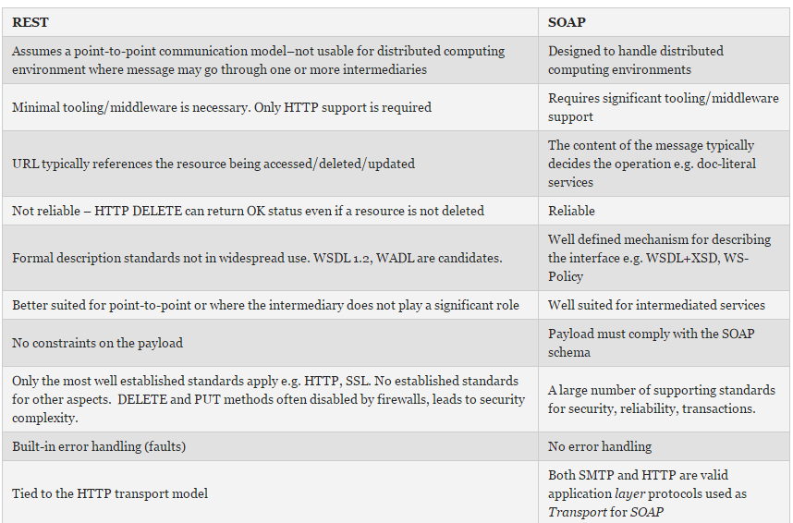
REST Vs SOAP

Slide 11
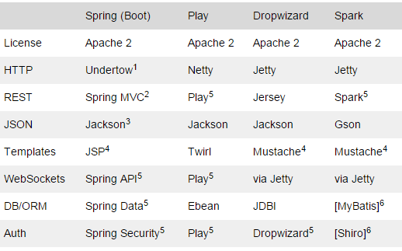
Frameworks

Slide 12
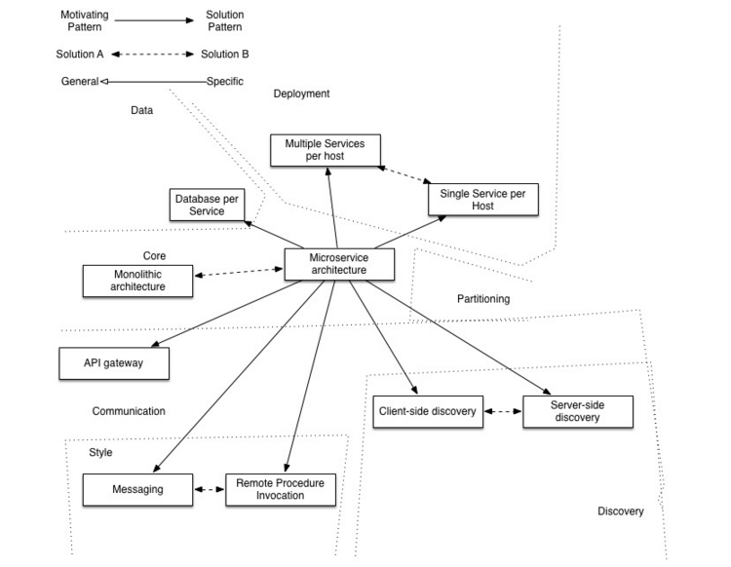
MicroServices Pattern

Slide 13
MicroServices Pattern – Cntd…
The API Gateway pattern defines how clients access the services in a MicroServices architecture
The Client-side Discovery and Server-side Discovery patterns are used to route requests for a client to an available service instance in a MicroServices architecture
The Messaging and Remote Procedure Invocation patterns are two different ways that services can communicate
The Single Service per Host and Multiple Services per Host patterns are two different deployment strategies
The Database per Service pattern describes how each service has its own database
The Microservice chassis pattern says build MicroServices using a framework that handles cross-cutting concerns

Slide 14
MicroServices Technologies
Spring Boot: Sprint boot is evolutionary offering of already stable spring framework. Over the time, Spring framework has become collection of various products. They used their concept of spring io platform and provided another way to package application, which provides fat jar
Dropwizard: Dropwizard pulls together stable, mature libraries from the Java ecosystem into a simple, light-weight package that lets you focus on getting things done. Dropwizard has out-of-the-box support for sophisticated configuration, application metrics, logging, operational tools, and much more, allowing you and your team to ship a production-quality web service in the shortest time possible.
MicroServices Chassis Frameworks:-
Java – Spring Boot, Spring Cloud, Dropwizard, Spark (Java 8), Lagom, RestExpress
Go – Gizmo, Micro, and Go Kit

Slide 15
MicroServices Framework Evaluation
REST Support
Dependency Injection (DI) Support
Persistence Support
Transaction Support
Configuration Management
Dependency Management
Metrics
Good Community Support

Slide 16
Top 4 challenges when implementing MicroServices
Corporate culture
Microservices management
Diagnostics and Monitoring
Time and resources

Slide 17
References
http://martinfowler.com/tags/microservices.html
http://ee.kumuluz.com/tutorial/2015/06/04/microservices-with-java-ee-and-kumuluzee.html
https://www.heroku.com/platform
https://www.docker.com/what-docker
https://en.wikipedia.org/wiki/Microservices
http://microservices.io/
https://opensource.com/life/15/10/4-java-web-frameworks
http://www.oracle.com/technetwork/java/javaee/tech/javaee6technologies-1955512.html
https://dzone.com/articles/j2ee-compare-restful-vs-soap
http://www.infoq.com/news/2016/03/lagom-microservices-framework
https://www.lightbend.com/community/core-projects/akka
http://www.infoq.com/news/2016/03/lagom-microservices-framework
http://www.schibsted.pl/2015/07/spring-boot-and-dropwizard-in-microservices-development/

