Slide 1
Angular

Slide 2
Angular
AngularJS | Angular
Dependency injection tokens are always strings | Tokens can have different types. They are often classes. They may also be strings.
There is exactly one injector. Even in multi-module applications, everything is poured into one big namespace. | There is a tree hierarchy of injectors, with a root injector and an additional injector for each component.

Slide 3
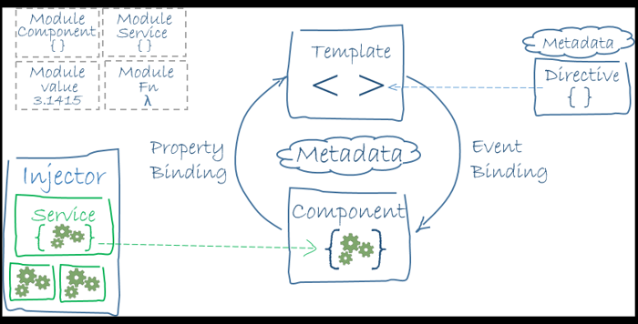
Angular Architecture

Slide 4
NgModule class
Angular apps are modular and Angular has its own modularity system called NgModules
Every Angular app has at least one NgModule class, the root module, conventionally named AppModule

Slide 5
RxJS
RxJS is a library for composing asynchronous and callback-based code in a functional, reactive style. Many Angular APIs, including HttpClient, produce and consume RxJS Observables.

Slide 6
Passing values between components
Service should be used to pass values from one component to another which is not in the same hierarchy
Receiving component:-
ngOnInit() {
this.myService.currentMessage.subscribe(message => this.message = message);
}
Sending component:-
sendMessage(message: type_of_the_message) {
this.messageSource.next(message);
}

Slide 7
References
https://angular.io/guide/upgrade
https://stackoverflow.com/questions/48763221/angular-pass-parameter-to-another-component

