Slide 1
Spring-MVC

Slide 2
Spring Benefits
Lightweight – Size and transparency
Inversion of Control (IOC) – Loose coupling is achieved in spring using the technique IOC
Aspect oriented (AOP)
Container – Spring contains and manages the life cycle and configuration of application objects
MVC Framework
Transaction Management
Exception Handling

Slide 3
Spring – Inversion of Control (IoC)
IoC says that you do not create your objects but describe how they should be created. You don't directly connect your components and services together in code but describe which services are needed by which components in a configuration file. A container (the IOC container) is then responsible for hooking it all up
Types – Constructor based and Setter based
Advantages:
Minimized the amount of code
Loose coupling is promoted
Container supports eager and lazy loading of services

Slide 4
Spring MVC over Struts MVC
Spring MVC is versatile and flexible based on interfaces
Spring provides both interceptors and controllers, thus helps to factor out common behavior to the handling of many requests
Spring can be configured with different view technologies like Freemarker, JSP, Tiles, Velocity, XLST etc.
In Spring MVC Controllers can be configured using DI (IOC) that makes its testing and integration easy

Slide 5
Spring MVC Advantages
Clear separation of roles - controller, validator, command object, form object, model object, DispatcherServlet, handler mapping, view resolver, etc.
Powerful and straightforward configuration of both framework and application classes as JavaBeans
Reusable business code
Customizable binding and validation
Customizable handler mapping and view resolution
Customizable locale and theme resolution
A JSP form tag library, introduced in Spring 2.0, that makes writing forms in JSP pages much easier. Etc.

Slide 6
Spring MVC – Request Flows
DispatcherServlet – Get all the requests
HandlerMapping – DispatcherServlet consults HandlerMapping to call the appropriate Controller
Controller - takes the request and calls the appropriate service methods and set model data and then returns view name to the DispatcherServlet
ViewResolver - The DispatcherServlet will take help from ViewResolver to pickup the defined view for the request
Once view is finalized, The DispatcherServlet passes the model data to the view which is finally rendered on the browser

Slide 7
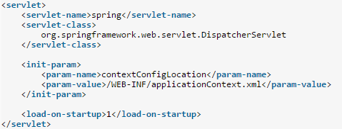
Spring MVC – Config Files
By default, DispatcherServlet loads its configuration file using <servlet_name>-servlet.xml. E.g. with above web.xml file, DispatcherServlet will try to find spring-servlet.xml file in classpath
ContextLoaderListener reads the spring configuration file (with value given against “contextConfigLocation” in web.xml), parse it and loads the beans defined in that config file. e.g.
Now add DispatcherServlet entry in web.xml file so that all incoming requests come though DispatcherServlet only
Spring configuration files – Multiple files are possible

Slide 8
Spring MVC – JSON
Add Jackson dependency
Now you are ready to return JSON response from your MVC controller. All you have to do is return JAXB annotated object from method and use @ResponseBody annotation on this return type
@RestController = @Controller + @ResponseBody

Slide 9
Spring MVC – Difference
<context:annotation-config> = Scanning and activating annotations in “already registered beans”
<context:component-scan> = Bean Registration + Scanning and activating annotations

Slide 10
Spring MVC – Annotation
@Component annotation marks a java class as a bean so the component-scanning mechanism of spring can pick it up and pull it into the application context
@Repository annotation is a specialization of the @Component annotation with similar use and functionality. In addition to importing the DAOs into the DI container, it also makes the unchecked exceptions (thrown from DAO methods) eligible for translation into Spring DataAccessException
@Service annotation is also a specialization of the component annotation. It doesn’t currently provide any additional behavior over the @Component annotation, but it’s a good idea to use @Service over @Component in service-layer classes because it specifies intent better
@Controller annotation marks a class as a Spring Web MVC controller. It too is a @Component specialization, so beans marked with it are automatically imported into the DI container. When you add the @Controller annotation to a class, you can use another annotation i.e. @RequestMapping; to map URLs to instance methods of a class

Slide 11

Spring MVC – ViewResolver
ViewResolver is an interface to be implemented by objects that can resolve views by name. There are plenty of ways using which you can resolve view names. These ways are supported by various in-built implementations of this interface. Most commonly used implementation is InternalResourceViewResolver class. It defines prefix and suffix properties to resolve the view component.

Slide 12
Spring MVC – MultipartResolver
Spring comes with MultipartResolver to handle file upload in web application. There are two concrete implementations included in Spring
CommonsMultipartResolver for Jakarta Commons FileUpload
StandardServletMultipartResolver for Servlet 3.0 Part API
If a DispatcherServlet detects a multipart request, it will resolve it via the configured MultipartResolver and pass on a wrapped HttpServletRequest. Controllers can then cast their given request to the MultipartHttpServletRequest interface, which permits access to any MultipartFiles

Slide 13
Spring MVC – Validation
Spring supports validations primarily into two ways.
Using JSR-303 Annotations and any reference implementation e.g. Hibernate Validator
Using custom implementation of org.springframework.validation.Validator interface
To activate this custom validator as a spring managed bean, you need to do one of following things:
Add @Component annotation to EmployeeValidator class and activate annotation scanning on the package containing such declarations.
<context:component-scan base-package="com.demo" />
Alternatively, you can register the validator class bean directly in context file.
<bean id="employeeValidator" class="com.demo.validator.EmployeeValidator" />

Slide 14
Spring MVC – Interceptor
Like servlet filters that they can pre-handle and post-handle every web request they serve — before and after it’s handled by that servlet.
In the similar way, you can use HandlerInterceptor interface in your spring MVC application to pre-handle and post-handle web requests that are handled by Spring MVC controllers. These handlers are mostly used to manipulate the model attributes returned/submitted they are passed to the views/controllers
A handler interceptor can be registered for particular URL mappings
Each handler interceptor must implement the HandlerInterceptor interface
Three callback methods:-
preHandle()
postHandle()
afterCompletion()
Problem with HandlerInterceptor interface is that your new class will have to implement all three methods irrespective of whether it is needed or not. To avoid overriding, you can use HandlerInterceptorAdapter class. This class implements HandlerInterceptor and provide default blank implementations

Slide 15
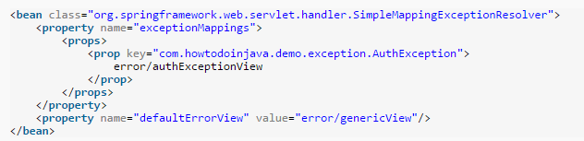
Spring MVC – Exception Handling
One or more exception resolver beans can registered in the web application context to resolve uncaught exceptions
These beans have to implement the HandlerExceptionResolver interface for DispatcherServlet to auto-detect them
SimpleMappingExceptionResolver
If this exception occurs, go to this error view

Slide 16
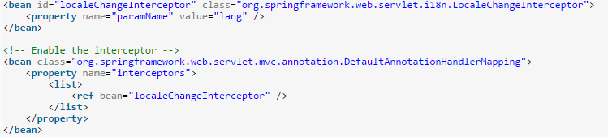
Spring MVC – Localization
Spring framework is shipped with LocaleResolver to support the internationalization and thus localization as well. To make Spring MVC application supports the internationalization, you will need to register two beans
SessionLocaleResolver - It resolves locales by inspecting a predefined attribute in a user’s session. If the session attribute doesn’t exist, this locale resolver determines the default locale from the accept-language HTTP header
LocaleChangeInterceptor - This interceptor detects if a special parameter is present in the current HTTP request. The parameter name can be customized with the paramName property of this interceptor. If such a parameter is present in the current request, this interceptor changes the user’s locale according to the parameter value

Slide 17
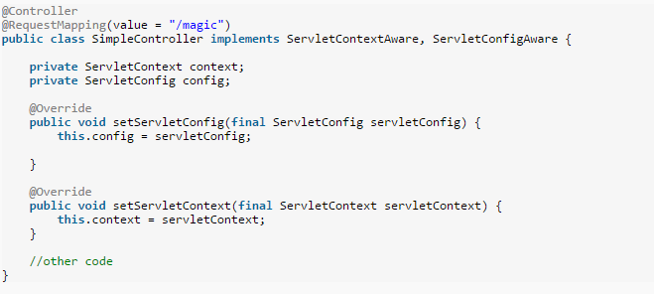
Spring MVC – Get ServletContext and ServletConfig object
Simply implement ServletContextAware and ServletConfigAware interfaces and override below methods

Slide 18
References
http://www.tutorialspoint.com/spring/spring_interview_questions.htm
http://howtodoinjava.com/spring/spring-mvc/spring-mvc-interview-questions-with-answers/

