Slide 1
AWS Solution Architect

Slide 2
AWS Account
Default maximum number of users in an AWS account is 5000

Slide 3
Availability Zone
Availability Zone names are unique per account and do not represent a specific set of physical resources

Slide 4
VPC
Security Groups in VPC allow you to specify rules for both outgoing and incoming traffic
The maximum number of VPCs allowed per region is 5. The limit for Internet gateways per region is directly correlated to this one. Increasing this limit will increase the limit on Internet gateways per region by the same amount.
Amazon creates the requested VPC and the following linked services:
a DHCP options set (this set enables DNS for instances that need to communicate over the VPC's Internet gateway)
a Route Table (it contains a set of rules, called routes, that are used to determine where network traffic is directed)
a Network ACL (it is a list of rules to determine whether traffic is allowed in or out of any subnet associated with the network ACL)
A route table contains a set of rules, called routes, that are used to determine where network traffic is directed. Each route in a table specifies a destination CIDR and a target. If a subnet have a route with the destination (0.0.0.0/0) and target the Internet Gateway, the subnet is known as a public subnet. If a subnet doesn't have a route to the Internet (0.0.0.0/0) through a gateway, the subnet is known as a private subnet.
If you don't explicitly associate a subnet with a network ACL, the subnet is automatically associated with the default network ACL that allows all inbound and outbound traffic.
It's important to disable the Source destination Check on NAT Instance
In VPC, an instance retains the private IP

Slide 5
VPC
Site to site VPN connection requires public IP address to your Amazon VPC gateway
Launch a NAT instance in a public subnet and route internet bound traffic to the NAT instance from Private subnet
To use the AWS VPN CloudHub, you must create a virtual private gateway with multiple customer gateways. You can use the same Border Gateway Protocol (BGP) Autonomous System Number (ASN) for each, or if you prefer, you can use a unique ASN for each
BGP acts as a proxy between virtual private gateway and customer gateway. When you use BGP, the routing can be dynamic routing
The Dynamic Host Configuration Protocol (DHCP) provides a standard for passing configuration information to hosts on a TCP/IP network. In AWS, after you create a set of DHCP options, you can't modify them. If you want your VPC to use a different set of DHCP options, you must create a new set and associate them with your VPC. You can also set up your VPC to use no DHCP options at all.
Amazon VPC supports the creation of an Internet gateway. This gateway enables Amazon EC2 instances in the VPC to directly access the Internet.
You can establish multiple VPN connections to a single virtual private gateway from multiple customer gateways
You can create several sets of DHCP options in AWS. If you want your VPC to use a different set of DHCP options, you must create a new set and associate them with your VPC. You can also set up your VPC to use no DHCP options at all.

Slide 6
VPC
The default limit for NAT gateways per Availability Zone is 5. A NAT gateway in the pending, active, or deleting state counts against your limit.
When the user launches an instance which is not a part of the non-default subnet, it will only have a private IP assigned to it. The instances part of a subnet can communicate with each other but cannot communicate over the internet or to the AWS services, such as RDS / S3
When a NAT instance is available, this route will mostly be present to allow internet access. Destination: 0.0.0.0/0 & Target: i-123456 (To route all internet traffic to the NAT Instance)
A user can create a subnet with VPC and launch instances inside that subnet. When the user is launching an instance he needs to select an option which attaches a public IP to the instance. If the user has not selected the option to attach the public IP then it will only have a private IP when launched. The user cannot connect to the instance from the internet. If the user wants an elastic IP to connect to the instance from the internet he should create an internet gateway and assign an elastic IP to instance.
The default number of subnets per VPC is 200

Slide 7
VPC to Data Centre
Some AWS customers establish a single shared connection for multiple VPCs to minimize the number of remote connections they need to configure. Configurations like these can be beneficial because they save time and effort, and simplify network management
Approaches
Shared services VPC
Transit VPC
Shared service and transit VPC

Slide 8
VPC – With Single Public Subnet (Scenario 1)
The configuration for this scenario includes a virtual private cloud (VPC) with a single public subnet, and an Internet gateway to enable communication over the Internet. We recommend this configuration if you need to run a single-tier, public-facing web application, such as a blog or a simple website.

Slide 9
VPC - Public and Private VPC from Wizard (Scenario 2)
A user can create a subnet with VPC and launch instances inside that subnet. If the user has created a public private subnet, the instances in the public subnet can receive inbound traffic directly from the internet, whereas the instances in the private subnet cannot. If these subnets are created with Wizard, AWS will create a NAT instance with an elastic IP. Wizard will also create two subnets with route tables. It will also create an internet gateway and attach it to the VPC.
The configuration for this scenario includes a virtual private cloud (VPC) with a public subnet and a private subnet. We recommend this scenario if you want to run a public-facing web application, while maintaining back-end servers that aren't publicly accessible. A common example is a multi-tier website, with the web servers in a public subnet and the database servers in a private subnet. You can set up security and routing so that the web servers can communicate with the database servers.
The instances in the public subnet can send outbound traffic directly to the Internet, whereas the instances in the private subnet can't. Instead, the instances in the private subnet can access the Internet by using a network address translation (NAT) gateway that resides in the public subnet. The database servers can connect to the Internet for software updates using the NAT gateway, but the Internet cannot establish connections to the database servers.

Slide 10
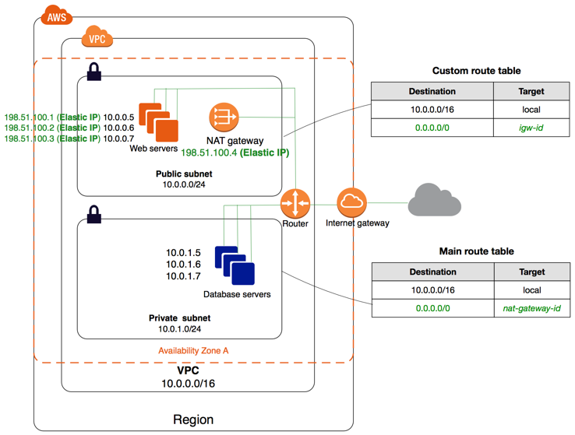
VPC - Public and Private VPC from Wizard (Scenario 2)
Notes:
Connect to internet using Internet Gateway or NAT gateway.

Slide 11
VPC - VPC with Public and Private Subnets and AWS Managed VPN Access (Scenario 3)
The configuration for this scenario includes a virtual private cloud (VPC) with a public subnet and a private subnet, and a virtual private gateway to enable communication with your own network over an IPsec VPN tunnel. We recommend this scenario if you want to extend your network into the cloud and also directly access the Internet from your VPC. This scenario enables you to run a multi-tiered application with a scalable web front end in a public subnet, and to house your data in a private subnet that is connected to your network by an IPsec VPN connection.
Currently, we do not support IPv6 communication over a VPN connection; however, instances in the VPC can communicate with each other via IPv6, and instances in the public subnet can communicate over the Internet via IPv6.

Slide 12
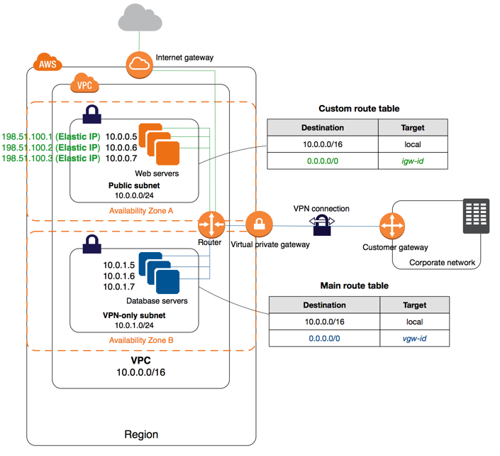
VPC - VPC with Public and Private Subnets and AWS Managed VPN Access (Scenario 3)..
Notes:
No NAT gateway here. The private subnet is connected to VPG.

Slide 13
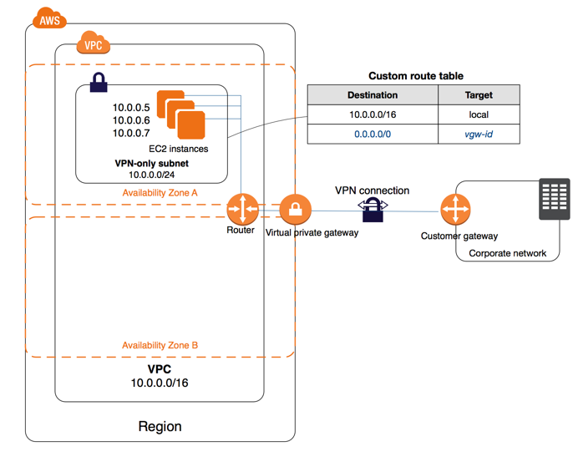
VPC - VPC with a Private Subnet Only and AWS Managed VPN Access (Scenario 4)
The configuration for this scenario includes a virtual private cloud (VPC) with a single private subnet, and a virtual private gateway to enable communication with your own network over an IPsec VPN tunnel. There is no Internet gateway to enable communication over the Internet. We recommend this scenario if you want to extend your network into the cloud using Amazon's infrastructure without exposing your network to the Internet.

Slide 14
VPC – NAT Instance (EC2)
You can also use the VPC wizard to configure a VPC with a NAT instance; however, we recommend that you use a NAT gateway.

Slide 15
NAT Gateway
NAT Gateway – present in Public subnet
It uses Elastic IP address
Private subnet uses NAT gateway to connect to internet
You are charged for creating and using a NAT gateway in your account. NAT gateway hourly usage and data processing rates apply. Amazon EC2 charges for data transfer also apply
NAT gateways are not supported for IPv6 traffic—use an egress-only internet gateway instead.
Each NAT gateway is created in a specific Availability Zone and implemented with redundancy in that zone. You have a limit on the number of NAT gateways you can create in an Availability Zone
If you have resources in multiple Availability Zones and they share one NAT gateway, in the event that the NAT gateway’s Availability Zone is down, resources in the other Availability Zones lose internet access. To create an Availability Zone-independent architecture, create a NAT gateway in each Availability Zone and configure your routing to ensure that resources use the NAT gateway in the same Availability Zone.
If you no longer need a NAT gateway, you can delete it. Deleting a NAT gateway disassociates its Elastic IP address, but does not release the address from your account.
A NAT gateway supports the following protocols: TCP, UDP, and ICMP
You cannot associate a security group with a NAT gateway.
You can use a network ACL to control the traffic to and from the subnet in which the NAT gateway is located. The network ACL applies to the NAT gateway's traffic.

Slide 16
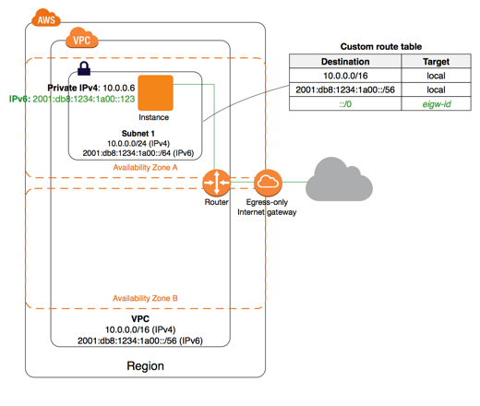
VPC - VPC with egress only Internet Gateway (Scenario 5)
If you want your instance to be able to access the Internet, but you want to prevent resources on the Internet from initiating communication with your instance, you can use an egress-only Internet gateway.
Supports IPv6 address

Slide 17
VPC – Create wizard
The wizard does not create a NAT instance by default. The user can create it manually and attach it with a VPN only subnet.
Note that there is a difference between NAT instance vs NAT gateway

Slide 18
VPC Peering
A VPC peering connection allows the user to route traffic between the peer VPCs using private IP addresses as if they are a part of the same network
You cannot have more than one VPC peering connection between the same two VPCs at the same time
VPC peering only routes traffic between source and destination VPCs. VPC peering does not support edge to edge routing

Slide 19
VPC Custom Route Table
When you create a subnet, we automatically associate it with the main route table for the VPC. By default, the main route table doesn't contain a route to an Internet gateway. The following procedure creates a custom route table with a route that sends traffic destined outside the VPC to the Internet gateway, and then associates it with your subnet.
On the Routes tab, choose Edit, Add another route, and add the following routes as necessary. Choose Save when you're done.
For IPv4 traffic specify 0.0.0.0/0 in the Destination box, and select the Internet gateway ID in the Target list.
For IPv6 traffic, specify ::/0 in the Destination box, and select the Internet gateway ID in the Target list.

Slide 20
VPC CIDR Block
CIDR block of the VPC can be same as the CIDR block of the subset for a single subnet in the VPC or a subset (to enable multiple subsets)
Rule: The CIDR blocks of the subset must not overlap
CIDR block – 20.0.0.0/24 supports 256 IP addresses. The user can break this CIDR into two subnets, each supporting 128 IP addresses

Slide 21
Default VPC
When we create a default VPC, we do the following to set it up for you:
Create a VPC with a size /16 IPv4 CIDR block (172.31.0.0/16). This provides up to 65,536 private IPv4 addresses.
Create a size /20 default subnet in each Availability Zone. This provides up to 4,096 addresses per subnet, a few of which are reserved for our use.
Create an internet gateway and connect it to your default VPC.
Create a main route table for your default VPC with a rule that sends all IPv4 traffic destined for the internet to the internet gateway.
Create a default security group and associate it with your default VPC.
Create a default network access control list (ACL) and associate it with your default VPC.
Associate the default DHCP options set for your AWS account with your default VPC.

Slide 22
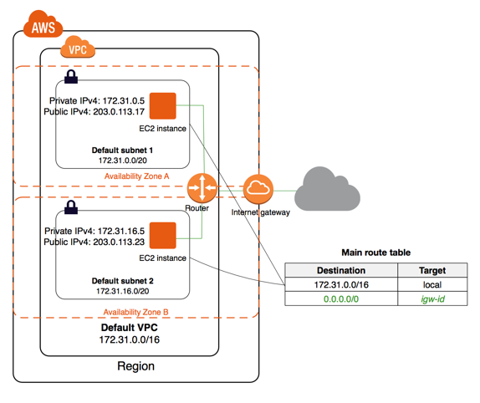
Default VPC Continued…
Notes:
Note : Route table entries, VPC connected to Internet Gateway

Slide 23
Default Subnet
By default, a default subnet is a public subnet, because the main route table sends the subnet's traffic that is destined for the internet to the internet gateway. You can make a default subnet into a private subnet by removing the route from the destination 0.0.0.0/0 to the internet gateway. However, if you do this, any EC2 instance running in that subnet can't access the internet.

Slide 24
DHCP Option sets
The Dynamic Host Configuration Protocol (DHCP) provides a standard for passing configuration information to hosts on a TCP/IP network.
DHCP options sets are associated with your AWS account so that you can use them across all of your virtual private clouds (VPC).
The Amazon EC2 instances you launch into a nondefault VPC are private by default; they're not assigned a public IPv4 address unless you specifically assign one during launch, or you modify the subnet's public IPv4 address attribute. By default, all instances in a nondefault VPC receive an unresolvable host name that AWS assigns. You can assign your own domain name to your instances, and use up to four of your own DNS servers. To do that, you must specify a special set of DHCP options to use with the VPC.

Slide 25
Customer Gateway
Customer gateway configuration – Totally 4 parts
3 mandatory parts – IKE, IPSec, and Tunnel
1 optional part - BGP

Slide 26
Domain Servers - DNS
You can assign your own domain name to your instances and use up to four of your own DNS servers. To do that, you must specify a special set of DHCP options to use with the VPC
By design, AWS DNS does not respond to requests originating from outside the VPC

Slide 27
AMI
Your organization might have multiple AWS accounts. Amazon EC2 enables you to specify additional AWS accounts that can use your Amazon Machine Images (AMIs) and Amazon EBS snapshots. Each AMI has a LaunchPermission attribute that controls which AWS accounts can access the AMI
CreateVolumePermission – To create the volume while launching the instance from AMI
AWS does not copy launch permissions, user-defined tags, or Amazon S3 bucket permissions from the source AMI to the new AMI

Slide 28
VPN
VPN connection-hours are billed for any time your VPN connections are in the "available" state. The "available" state is an attribute of the VPN connection, not the tunnels themselves, and therefore the status of the tunnels has no impact on the VPN connection billing.

Slide 29
VPN Connections
You can connect your VPC to remote networks by using a VPN connection.
Connectivity Options:-
AWS managed VPN - You can create an IPsec VPN connection between your VPC and your remote network. On the AWS side of the VPN connection, a virtual private gateway provides two VPN endpoints (tunnels) for automatic failover. You configure your customer gateway on the remote side of the VPN connection.
AWS VPN CloudHub - If you have more than one remote network (for example, multiple branch offices), you can create multiple AWS managed VPN connections via your virtual private gateway to enable communication between these networks.
Third party software VPN appliance - You can create a VPN connection to your remote network by using an Amazon EC2 instance in your VPC that's running a third party software VPN appliance. AWS does not provide or maintain third party software VPN appliances; however, you can choose from a range of products provided by partners and open source communities.

Slide 30
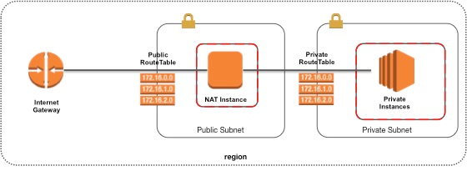
VPC

Slide 31
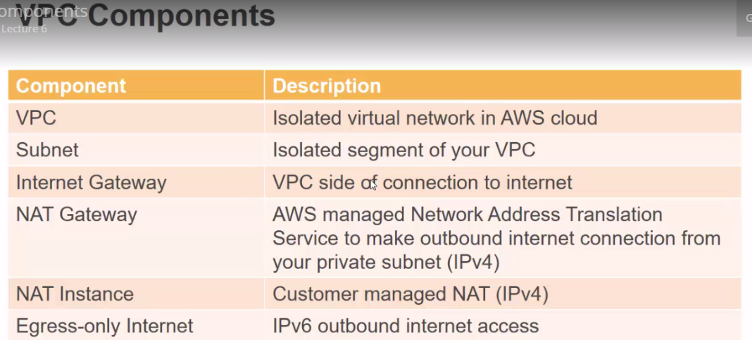
VPC Components

Slide 32
Placement Group
A placement group is a logical grouping of instances within a single Availability Zone. Placement groups are recommended for applications that benefit from low network latency, high network throughput, or both. To provide the lowest latency, and the highest packet-per-second network performance for your placement group, choose an instance type that supports enhanced networking.

Slide 33
CloudWatch
You can create a CloudWatch alarm that watches a single metric. The alarm performs one or more actions based on the value of the metric relative to a threshold over a number of time periods. The action can be an Amazon EC2 action, an Auto Scaling action, or a notification sent to an Amazon SNS topic.
An alarm has three possible states:
OK—The metric is within the defined threshold
ALARM—The metric is outside of the defined threshold
INSUFFICIENT_DATA—The alarm has just started, the metric is not available, or not enough data is available for the metric to determine the alarm state

Slide 34
CloudWatch
Two types of namespaces
Custom Namespace
AWS Namespace
Types of monitoring
Basic Monitoring every 5 Minutes
Detailed Monitoring every 1 minute
CloudWatch logs can monitor:-
Application generated log files
OS generated log files
Any other messages of interest
When you recover an EC2 instance using CloudWatch Alarm, what happens to the instance? Instance is moved to a different physical host. Instance has same metadata including public IP address
Alarm is associated with one metric
9 dimensions and 1 metric

Slide 35
CloudWatch
Memory usage metric – requires custom CloudWatch metrics
You can't use IAM to control access to CloudWatch data for specific resources. The same applies for AWS Direct Connect

Slide 36
CloudWatch Metrics
Using the Cloudwatch Monitoring scripts for Linux, you can measure memory and disk usage of your Linux EC2 instances
DisableAlarmActions API - Disables the actions for the specified alarms. When an alarm's actions are disabled, the alarm actions do not execute when the alarm state changes.
When a user is setting up an alarm on the EC2 instance metric, the time period should be equal to or more than the metric frequency. For basic monitoring, the metric is monitored at every 5 minutes (300 seconds)
AWS CloudWatch supports the custom metrics. The user can always capture the custom data and upload the data to CloudWatch using CLI or APIs. The user can publish data to CloudWatch as single data points or as an aggregated set of data points called a statistic set using the command “put-metric-data”. It is recommended that when the user is having multiple data points per minute, he should aggregate the data so that it will minimize the number of calls to put-metric-data. In this case it will be single call to CloudWatch instead of 1000 calls if the data is aggregated.
A dimension is a key-value pair used to uniquely identify a metric. CloudWatch treats each unique combination of dimensions as a separate metric. Thus, if the user is making 4 calls with the same metric name but a separate dimension, it will create 4 separate metrics.
CloudWatch won't take any future actions, which includes the reboot instance, until the current ALARM state is dealt with.

Slide 37
SQS
Standard Queue | FIFO Queue
Unlimited transactions per second | 300 transactions per second
At-Least once delivery | Exactly once delivery
Best Effort Ordering - Occasionally, messages are delivered in an order different from which they were sent. | Limited Throughput
High Throughput: Standard queues have nearly-unlimited transactions per second (TPS). | First-ln-First-out Delivery: The order in which messages are sent and received is strictly preserved.

Slide 38
SQS
Maximum visibility timeout – 12 hours. The visibility timeout controls how long a message is invisible in the queue while it is being worked on by a processing instance. This interval should not be confused with how long the message can remain in the queue.
Default visibility timeout – 30 seconds
The SQS message retention period is configurable and can be set anywhere from 1 minute to 2 weeks. The default is 4 days and once the message retention limit is reached your messages will be automatically deleted.
Queue Name : http://sqs.us-east-2.amazonaws.com/123456789012/MyQueue
123456789012 is the account id
A single Amazon SQS message queue can contain an unlimited number of messages. However, there is a 120,000 limit for the number of inflight messages for a standard queue and 20,000 for a FIFO queue.
DeleteMessageQueue – is NOT a valid command
The SQS message retention period is configurable and can be set anywhere from 1 minute to 2 weeks.
Maximum data size – 256 KB
Amazon SQS supports SOAP and QUERY APIs only
Security - Access Key ID and request signature, or through the use of an X.509 certificate.

Slide 39
Auto Scaling
Availability Zone Rebalancing process (AZRebalance) - Auto Scaling performs various processes, such as Launch, Terminate, and Availability Zone Rebalance (AZRebalance). The AZRebalance process type seeks to maintain a balanced number of instances across Availability Zones within a region. If the user suspends the Terminate process, the AZRebalance process can cause the Auto Scaling group to grow up to ten percent larger than the maximum size. This is because Auto Scaling allows groups to temporarily grow larger than the maximum size during rebalancing activities. If Auto Scaling cannot terminate instances, the Auto Scaling group could remain up to ten percent larger than the maximum size until the user resumes the Terminate process type.
Auto scaling can be terminated temporarily
When rebalancing, Auto Scaling launches new instances before terminating the old ones, so that rebalancing does not compromise the performance or availability of your application. Because Auto Scaling attempts to launch new instances before terminating the old ones, being at or near the specified maximum capacity could impede or completely halt rebalancing activities. To avoid this problem, the system can temporarily exceed the specified maximum capacity of a group by a 10 percent margin (or by a 1-instance margin, whichever is greater) during a rebalancing activity.
Auto Scaling can automatically maintain capacity
You can create an Auto Scaling group directly from an EC2 instance. When you use this feature, Auto Scaling automatically creates a launch configuration for you as well.

Slide 40
Auto Scaling
Groups:- Your EC2 instances are organized into groups so that they can be treated as a logical unit for the purposes of scaling and management. When you create a group, you can specify its minimum, maximum, and, desired number of EC2 instances.
Launch configurations:- Your group uses a launch configuration as a template for its EC2 instances. When you create a launch configuration, you can specify information such as the AMI ID, instance type, key pair, security groups, and block device mapping for your instances.
When auto scaling, each instance is guaranteed to be just like the last one. It's repeatable, scalable, and reliable.
When you create your Auto Scaling group, you must associate it with a Launch Configuration. You can attach only one Launch Configuration to an Auto Scaling group at a time and it cannot be modified.
The AWS account comes with the default limits on the resources for AutoScaling and other Amazon Web Services. Unless otherwise noted, each limit is per region. There is a default limit of 20 AutoScaling groups and 100 launch configurations per region.
AutoScaling rounds off the values returned by the PercentChangeInCapacity to the lower number if the value is positive. If the current count is 68 and the policy gets executed, the total number of instances to be added will be calculated as 6.8 (10% of 68). AWS will round it off to 6 and launch 6 more instances.
as-describe-launch-configs --show-long – Command describes all the launch config parameters created by the AWS account in the specified region.

Slide 41
Auto Scaling
When a user is creating a new launch configuration from the existing instance, AS will take all the parameters except the instance ID and config name from the existing instance. The launch config though, will not take the new block device mapping into consideration and instead use the one which was the default one with AMI. In this case there was no additional block device with EBS. Thus, the future EBS will have 0 additional EBS volumes
Even though the user has configured the termination policy, before AutoScaling selects an instance to terminate, it first identifies the Availability Zone that has more instances than the other Availability Zones used by the group. Within the selected Availability Zone, it identifies the instance that matches the specified termination policy.
If you want to change the launch configuration of your Auto Scaling group, you have to first create a new launch configuration and then update your Auto Scaling group by attaching the new launch configuration.
If the user has configured two separate single availability zone Auto Scaling groups and wants to merge them then he should update one of the groups and delete the other one.
as-cmd - when executed will list all the commands and their description in the console

Slide 42
Auto Scaling – Administrative Suspension
Auto Scaling enables you to suspend and then resume one or more of the Auto Scaling processes in your Auto Scaling group. This can be useful when you want to investigate a configuration problem or other issue with your web application and then make changes to your application, without triggering the Auto Scaling process.
Auto Scaling might suspend processes for Auto Scaling groups that repeatedly fail to launch instances. This is known as an administrative suspension, and most commonly applies to Auto Scaling groups that have been trying to launch instances for over 24 hours but have not succeeded in launching any instances. You can resume processes suspended for administrative reasons.

Slide 43
Auto Scaling – Termination Policy
Default termination policy:-
Auto Scaling determines whether there are instances in multiple Availability Zones. If so, it selects the Availability Zone with the most instances and at least one instance that is not protected from scale in.
Auto Scaling determines which unprotected instances in the selected Availability Zone use the oldest launch configuration.
If there are multiple instances that use the oldest launch configuration, Auto Scaling determines which unprotected instances are closest to the next billing hour.
If there is more than one unprotected instance closest to the next billing hour, Auto Scaling selects one of these instances at random.

Slide 44
Elastic IP Address
The number of Elastic IP addresses you can have in EC2 per region is 5
The advantage of associating the Elastic IP address with the network interface instead of directly with the instance is that you can move all the attributes of the network interface from one instance to another in a single step

Slide 45
CloudTrail
CloudTrail integration with CloudWatch Logs delivers API activity captured by CloudTrail to a CloudWatch Logs log stream in the CloudWatch Logs log group you specify

Slide 46
Amazon RDS
Before launching actual RDS instances, you need to configure a DB Subnet Group
A DB Subnet Group is a collection of subnets (typically private) that you create in a VPC and designate for your DB instances. Each DB subnet group should have subnets in at least two Availability Zones in a given region. Note that SQL Server Mirroring with a SQL Server DB instance requires at least 3 subnets in distinct Availability Zones.
When Amazon RDS creates a DB instance in a VPC, it assigns a network interface to your DB instance by using an IP address selected from your DB Subnet Group. If the primary DB instance of a Multi-AZ deployment fails, Amazon RDS can promote the corresponding standby and subsequently create a new standby using an IP address from an assigned subnet in one of the other Availability Zones.
The rules of a Security Group control the inbound traffic that's allowed to reach the instances that are associated with the security group and the outbound traffic that's allowed to leave them. By default, security groups allow all outbound traffic and deny all inbound traffic.
No charge for replicating the data from primary instance to secondary instance
IO operation briefly suspended while the backup process initializes, and you may experience a brief period of elevated latency
You do not need to specify a destination port number when you create DB security group rules; the port number defined for the DB instance is used as the destination port number for all rules defined for the DB security group
You can create MySQL, MariaDB, PostgreSQL, and Oracle RDS DB instances with up to 6TB of storage and SQL Server RDS DB instances with up to 4TB of storage when using the Provisioned IOPS and General Purpose (SSD) storage types.
Notes:
Step 1: DB Subnet Group creation
Step 2: Once RDS is available i.e. created, Add an inbound rule to the VPC Security Group

Slide 47
Amazon RDS
RDS automatically provisions and maintains a synchronous standby replica in a different AZ
Synchronous replication only acknowledges a transaction after it has been durably stored in both the primary location and its replicas. It is ideal for protecting the integrity of data from the event of a failure of the primary node. Synchronous replication can also scale read capacity for queries that require the most up-to-date data (strong consistency)
SQL Server – performs synchronous logical replication rather than synchronous physical replication
Redshift block size – 1024 KB / 1MB
While deploying the RDS, you can select the AZ into which you deploy it
Aurora stores 6 copies of data by default
RDS backup retention period is 35 days
Microsoft SQL express edition – maximum storage size is 300 GB
In case of outage, the RDS automatically switches to a standby replica in another AZ if you have enabled Multiple AZ
Notes:
Step 1: DB Subnet Group creation
Step 2: Once RDS is available i.e. created, Add an inbound rule to the VPC Security Group

Slide 48
RDS – Internet Accessible
If the RDS instance is required to be accessible from the internet:
The organization must setup that the RDS instance is enabled with the VPC attributes, DNS hostnames and DNS resolution.
The organization must enable the parameter in the console which makes the RDS instance publicly accessible.
The organization must allow access from the internet in the RDS VPC security group.

Slide 49
Subnet
Subnets are segments of a VPC's IP address range that allow you to group your resources based on security and operational needs
By default, new subnets in a custom VPC can communicate with each other across AZ
Every subnet in your VPC must be associated with exactly one Route Table. However, multiple subnets can be associated with the same Route Table.
Instances that you launch into a default subnet receive both a public IP address and a private IP address
Instances that you launch into a nondefault subnet in a default VPC don't receive a public IP address or a DNS hostname. You can change your subnet's default public IP addressing behavior.

Slide 50
Storage
Note: Ephemeral storage is also known as instance storage. It is temporary storage that is added to your instance, unlike EBS which is an attached volume that is permanent in nature.
General purpose and Provisioned IOPS - Both are SSD based and suitable for random I/O workloads
Snowball offers convenient way to transfer large amount of data by physically shipping the data using secure snowball appliance
Unencrypted to Encrypted:-
Create a snapshot
Copy the snapshot while applying encryption parameters
Restore the encrypted snapshot to a new volume
Two types of block devices:-
Instance store volumes (virtual devices whose underlying hardware is physically attached to the host computer for the instance)
EBS volumes (remote storage devices)
RAID - Redundant Array of Inexpensive Disks
RAID 5 and RAID 6 are not recommended for Amazon EBS because the parity write operations of these RAID modes consume some of the IOPS available to your volumes.

Slide 51
Storage
When modifying EBS snapshot permissions with AWS Console, one of the options is to make the snapshot public or not. However, snapshots with AWS Marketplace product codes can't be made public.

Slide 52
Storage Gateway
It is an on-premise virtual appliance that can be used to cache S3 locally at a customer site
Gateway-Stored volumes store your primary data locally, while asynchronously backing up that data to AWS. Used for low latency applications.
Gateway-Cached volumes retain a copy of frequently accessed data subsets locally. Cached volumes offer a substantial cost savings on primary storage and minimize the need to scale your storage on-premises.

Slide 53
CloudFront - CDN
Two different kinds of distributions:-
Web Distributions for HTTP/HTTPS-delivered contents
RTMP Distributions for delivering streaming media content to end users in real time
Each distribution has a unique cloudfront.net domain name (e.g. cdn123.cloudfront.net) that can be used to reference objects through the global network of edge locations.
To use Amazon CloudFront:-
Store the original versions of your files on one or more origin servers. An origin server is the location of the definitive version of an object. Origin servers could be an Amazon S3 bucket, an Amazon EC2 instance, an Elastic Load Balancer or another remote server.
Create a distribution to register the origin servers with Amazon CloudFront.
Use your distribution’s domain name in your web pages, media player, or application. When end users request an object using this domain name, they are automatically routed to the nearest edge location for high-performance delivery of your content.
CloudFront can handle data transfer rate 1,000 MBPS and 1000 requests per second

Slide 54
CloudFront - Distribution
Web:-
Create a web distribution if you want to:
Speed up distribution of static and dynamic content, for example, .html, .css, .php, and graphics files.
Distribute media files using HTTP or HTTPS.
Add, update, or delete objects, and submit data from web forms.
Use live streaming to stream an event in real time.
You store your files in an origin - either an Amazon S3 bucket or a web server. After you create the distribution, you can add more origins to the distribution.
RTMP:-
Create an RTMP distribution to speed up distribution of your streaming media files using Adobe Flash Media Server's RTMP protocol. An RTMP distribution allows an end user to begin playing a media file before the file has finished downloading from a CloudFront edge location. Note the following:
To create an RTMP distribution, you must store the media files in an Amazon S3 bucket
To use CloudFront live streaming, create a web distribution.

Slide 55
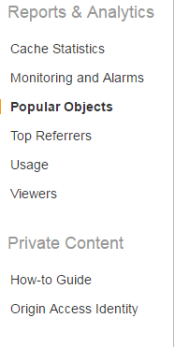
CloudFront - Setup
CloudFront immediately assigns an ID and a Domain Name to the distribution and starts updating the edge locations to serve your content
If you don't need the distribution anymore, you can disable and then delete it. A disabled distribution is no longer functional and Amazon stops billing for it

Slide 56
CloudFront - Cost
CloudFront pricing is based on data transfer to the Internet or origin site, as well as HTTP requests
CloudFront currently has edge locations in North America, South America, Asia, Australia and Europe. Total 5 edge locations
Amazon charges the same for distributing dynamic content as it does for distributing static content
OAI - Original Archive Identity

Slide 57
CloudFormation
CloudFormation automatically handles dependencies between the resources in the stack. The EC2 instance can't be created without a security group, so CloudFormation waits for the security group to finish before moving on.
CloudFormation is easy to integrate into other workflows because all it does is orchestrate other AWS products and make it easy to repeat patterns.
Name for the security group itself because CloudFormation generates one automatically
Outputs: Tab has the EC2 or resource URL
List-stacks command is used to list any of the stacks you have created or have deleted up to 90 days ago

Slide 58
ELB
ELB Protocols supported – HTTP, HTTPS, TCP, SSL. SSH protocol is not supported.
Elastic Load Balancers can be enabled within a single Availability Zone or across multiple zones for greater consistent application performance
By default, your Classic Load Balancer distributes incoming requests evenly across its enabled Availability Zones. For example, if you have ten instances in Availability Zone us-west-2a and two instances in us-west-2b, the requests are distributed evenly between the two Availability Zones. As a result, the two instances in us-west-2b serve the same amount of traffic as the ten instances in us-west-2a. To ensure that your load balancer distributes incoming requests evenly across all instances in its enabled Availability Zones, enable cross-zone load balancing.
Cross-zone load balancing reduces the need to maintain equivalent numbers of instances in each enabled Availability Zone, and improves your application's ability to handle the loss of one or more instances.
Only Classic load balancer supports TCP protocol
When a user is configuring ELB and registering the EC2 instances with it, ELB will create a source security group. If the user wants to allow traffic only from ELB, he should remove all the rules set for the other requests and open the port only for the ELB source security group.
The user can specify a maximum time of 3600 seconds (1 hour) for the load balancer to keep the connections alive before reporting the instance as deregistered.

Slide 59
ELB
Elastic Load Balancing uses a Secure Socket Layer (SSL) negotiation configuration which is known as a Security Policy. It is used to negotiate the SSL connections between a client and the load balancer. When client is requesting ELB DNS over SSL and if the load balancer is configured to support the Server Order Preference, then the load balancer gets to select the first cipher in its list that matches any one of the ciphers in the client's list. Server Order Preference ensures that the load balancer determines which cipher is used for the SSL connection.
Elastic Load Balancing uses a Secure Socket Layer (SSL) negotiation configuration which is known as a Security Policy. It is used to negotiate the SSL connections between a client and the load balancer. Elastic Load Balancing supports the following versions of the SSL protocol:
TLS 1.2
TLS 1.1
TLS 1.0
SSL 3.0
ELB helps to deliver stateful services
Controller service is responsible for monitoring the Load Balancers
The SSL and TLS protocols use an X.509 certificate (SSL/TLS server certificate) to authenticate both the client and the back-end application
ELB can’t have multiple SSL certificates on load balancer

Slide 60
ELB -Failover
You have the option of either using an Elastic Load Balancer or multiple Elastic IP addresses and configuring DNS failover with health checks using route 53. You cannot configure a Route53 A record that points to an ELB and you can’t use a NAT as a makeshift Load Balancer.

Slide 61
EC2
By default, Amazon EBS root device volumes are automatically deleted when the instance terminates
Your existing software license is tied to physical cores and sockets. Since AWS provides virtual instances, what option does AWS have for existing software licenses at hardware level? Answer: Use dedicated hosts to obtain a single tenant hardware and use your license
Multiple EBS volumes can be attached to an instance. However, a volume can be associated with only one instance
Elastic File Store supports one to thousands of Amazon EC2 instances connecting to a file system concurrently
EBS offers seamless encryption of data volumes and snapshots
EBS stores redundant copies across single AZ zone in a region
EC2 dedicated hosting – Modes : Dedicated and Host
http://169.254.169.254 – IP address to retrieve instance metadata or user data
Possible to transfer a reserved instance from one AZ to another. There are 20 Reserved Instances per Availability Zone in each month.
Partial upfront, All upfront and No upfront – payment options are associated with Reserved Instances
Shuffle Sharding

Slide 62
EC2
Certain AWS resource types like Amazon EC2 instances, Amazon RDS DB instances, Amazon Elastic Block Store (Amazon EBS) volumes, etc., can be launched from a golden image: a snapshot of a particular state of that resource. When compared to the bootstrapping approach, a golden image results in faster start times and removes dependencies to configuration services or third-party repositories.
Amazon ENI, or an elastic network interface, is a virtual network interface that can be easily created, attached, and detached from any of your EC2 Instances within your VPC.
T2 instances provide a baseline level of CPU performance with the ability to burst above the baseline. T2 instances are for workloads that don’t use the full CPU often or consistently, but occasionally need to burst. T2 instances’ baseline performance and ability to burst are governed by CPU Credits. Each T2 instance receives CPU Credits continuously, the rate of which depends on the instance size.
i2.8xlarge EC2 instance type is a member of the storage optimized instance family.
Micro instances have low network performance and storage capacity and are no longer offered as a current generation instance type.
XEN is the underlying Hypervisor for EC2
Reservation IDs apply to all instances, and are different from Reserved Instances. Every instance launched by EC2 has a reservation ID.

Slide 63
EC2
For stream-based services, AWS Lambda calculates the request rate as follow:
request rate = number of concurrent executions / function duration
If the organization keeps copying data to S3 it will take a much longer time to recovery and may not fit the warm standby solution
Proactive Cyclic Scaling allows you to scale during the desired time window.
The Public IP address is not managed on the instance: It is, instead, an alias applied as a network address translation of the Private IP address
Command ec2-create-vpc – Create VPC with specified CIDR block

Slide 64
EC2 – Dedicated Instance
Dedicated instances are Amazon EC2 instances that run in a virtual private cloud (VPC) on hardware that's dedicated to a single customer. The dedicated instances cannot have RDS installed. You can have some reserved instances in dedicated instances.

Slide 65
EC2 – Tenancy
Value | Description
default | An instance launched into the VPC runs on shared hardware by default, unless you explicitly specify a different tenancy during instance launch.
dedicated | An instance launched into the VPC is a Dedicated instance by default, unless you explicitly specify a tenancy of host during instance launch. You cannot specify a tenancy of default during instance launch.

Slide 66
EC2 – Tenancy
Three tenancies – default, host and dedicated
Instances launched in dedicated tenancy cannot be changed to default. However, it can be changed to host.

Slide 67
EC2 – Public IP address
The Public IP address is not managed on the instance: It is, instead, an alias applied as a network address translation of the Private IP address
A public IP address is assigned to your instance from Amazon's pool of public IPv4 addresses, and is not associated with your AWS account. When a public IP address is disassociated from your instance, it is released back into the public IPv4 address pool, and you cannot reuse it

Slide 68
EC2 Instance – Meta Data
Instance metadata is data about your instance that you can use to configure or manage the running instance.
EC2 instances can also include dynamic data, such as an instance identity document that is generated when the instance is launched.
Instance metadata categories:-
iam/info
iam/security-credentials/role-name
instance-action
Commands:-
curl http://169.254.169.254/latest/meta-data/
GET http://169.254.169.254/latest/meta-data/
curl http://169.254.169.254/latest/meta-data/local-hostname
curl http://169.254.169.254/latest/meta-data/public-hostname

Slide 69
EC2 Instance – User Data
When you launch an instance in Amazon EC2, you have the option of passing user data to the instance that can be used to perform common automated configuration tasks and even run scripts after the instance starts. You can pass two types of user data to Amazon EC2: shell scripts and cloud-init directives. You can also pass this data into the launch wizard as plain text, as a file (this is useful for launching instances using the command line tools), or as base64-encoded text (for API calls).

Slide 70
Lambda
For an event source to invoke your Lambda function, you must grant permissions using the permissions policy attached to the Lambda function. The event source mapping is maintained within the event source service.
AWS Lambda polls the stream and invokes the Lambda function when records are detected on the stream
Published version of Lambda function – Both code and configuration information are immutable

Slide 71
EC2 Tags
Tags enable you to categorize your AWS resources in different ways, for example, by purpose, owner, or environment. This is useful when you have many resources of the same type — you can quickly identify a specific resource based on the tags you've assigned to it.
You can assign tags only to resources that already exist. You can't terminate, stop, or delete a resource based solely on its tags; you must specify the resource identifier. For example, to delete snapshots that you tagged with a tag key called DeleteMe, you must use the DeleteSnapshots action with the resource identifiers of the snapshots, such as snap-1234567890abcdef0. To identify resources by their tags, you can use the DescribeTags action to list all of your tags and their associated resources.

Slide 72
EC2 Instance Store
The data in an instance store persists only during the lifetime of its associated instance. If an instance reboots (intentionally or unintentionally), data in the instance store persists. However, data on instance store volumes is lost under the following circumstances.
Failure of an underlying drive
The instance stop
Terminating an instance

Slide 73
Route 53
You can set up a variety of failover configurations using Amazon Route 53 alias: weighted, latency, geolocation routing, and failover resource record sets.
Active-active failover: Use this failover configuration when you want all of your resources to be available the majority of the time. When a resource becomes unavailable, Amazon Route 53 can detect that it's unhealthy and stop including it when responding to queries. Active-passive failover: Use this failover configuration when you want a primary group of resources to be available the majority of the time and you want a secondary group of resources to be on standby in case all of the primary resources become unavailable. When responding to queries, Amazon Route 53 includes only the healthy primary resources. If all of the primary resources are unhealthy, Amazon Route 53 begins to include only the healthy secondary resources in response to DNS queries.
Active-active-passive and other mixed configurations: You can combine alias and non-alias resource record sets to produce a variety of Amazon Route 53 behaviors.
In Route 53, if you have multiple resources that perform the same function, you can configure DNS failover so that Amazon Route 53 will route your traffic from an unhealthy resource to a healthy resource.
Limit – 50 domain names, but it can be increased by contacting AWS support
A/AAAA address record or host record is used to point your domain address to physical IP address
CNAME to point the subdomain to ELB using Route 53

Slide 74
Route 53
CNAME record is a type of resource record in the Domain Name System (DNS) used to specify that a domain name is an alias for another domain, the canonical domain. All information, including subdomains, IP addresses, etc., are defined by the canonical domain.
In Amazon Route 53, you cannot create a hosted zone for a top-level domain (TLD).
The resource record sets contained in a hosted zone must share the same suffix. For example, the example.com hosted zone can contain resource record sets for www.example.com and www.aws.example.com subdomains, but it cannot contain resource record sets for a www.example.ca subdomain.
Route53 has a security feature that prevents internal DNS from being read by external sources. The work around is to create a EC2 hosted DNS instance that does zone transfers from the internal DNS, and allows itself to be queried by external servers.

Slide 75
Route 53 – Policy Types
Simple routing policy
Weighted routing policy
Failover
Geolocation
Geoproximity
Latency
Multi-value answer

Slide 76
IAM
AWS Identity and Access Management (IAM) is a web service that helps you securely control access to AWS resources for your users. You can specify permission to a single user or you can use groups to specify permissions for a collection of users, which can make those permissions easier to manage for those users. Furthermore you can use a Role for grant authorization to AWS resources without any credentials (password or access keys) directly associated with it
You can create customer managed policies to define sets of permissions to attach to principal entities (users, groups, and roles) in your AWS account.
Instead of creating and distributing your AWS credentials, you can delegate permission to making API requests using IAM roles.
ARN is transformed to the user's unique principal ID when the policy is saved. This helps mitigate the risk of someone escalating their privileges by removing and recreating the user.
You can’t create hierarchies of IAM group
User and policy documents are applied globally
Root account has admin access
Power user access to all AWS services except the management of groups and users within IAM
Create a role in the Development account and specify the Production account as trusted entity. Developers can use the role in the AWS Management console to access the resources in the Production account

Slide 77
IAM
An organization has multiple AWS accounts to isolate a development environment from a testing or production environment. IAM role with cross account access will provide a solution
AWS: secure transport – IAM policy condition key to check whether the request was sent using SSL
IAM is available through AWS management console, CLI, IAM QUERY API

Slide 78
Bastion Host
Including bastion hosts in your VPC environment enables you to securely connect to your Linux instances without exposing your environment to the Internet. After you set up your bastion hosts, you can access the other instances in your VPC through Secure Shell (SSH) connections on Linux. Bastion hosts are also configured with security groups to provide fine-grained ingress control.
Bastion servers – can act as a proxy as well
Ssh:agent – using this agent will help to avoid storing the private key in Bastian host. This is another layer of security.

Slide 79
Network ACL
Stateless
The rules are executed in order
ACLs process strictly by rule number and processes the rules until a matching one is found
By default, it allows all inbound and outbound traffic

Slide 80
Security Groups
Stateful
Confined to a region
Doesn’t have deny rules
Security Group consolidates all rules and evaluates all of them before deciding if traffic is allowed
Security groups act as a firewall for associated instances, controlling both inbound and outbound traffic at the instance level. You must add rules to a security group that enable you to connect to your instance from your IP address using RDP. It is good security practice to restrict RDP (Remote Desktop Protocol) connections to an authorized list of IP addresses rather than anyone.
In AWS EC2, while configuring a security group, the user needs to specify the IP address in CIDR notation. The CIDR IP range 10.20.30.40/32 says it is for a single IP 10.20.30.40. If the user specifies the IP as 10.20.30.40 only, the security group will not accept and ask for it in a CIDR format.
You can't enable an instance to communicate with an instance outside its region using security group rules.
You can create up to 50 rules per security group in Amazon EC2-VPC

Slide 81
Security Groups Commands
When setting up security groups for incoming traffic in your VPC network, to add one or more ingress(incoming traffic) rules to a security group
authorize-security-group-ingress (AWS CLI)
ec2-authorize (Amazon EC2 CLI)
Grant-EC2SecurityGroupIngress (AWS Tools for Windows PowerShell)

Slide 82
S3
For objects larger than 100 megabytes, you should consider using the Multipart Upload capability.
Probability of loss = 100 – durability
S3 offers encryption services for data at flight and at rest
Amazon S3 offers three pricing options. Storage (per GB per month), data transfer in or out (per GB per month), and requests (per x thousand requests per month).
Maximum file size = 5 TB, Minimum object size = 0 bytes
Maximum number of buckets per account is 100
S3 –IA – immediate access to file with less cost, files not reproducible easily
AWS Identity and Access Management (IAM) policies, Access Control Lists (ACLs), bucket policies, and query string authentication.
Amazon S3 provides authentication mechanisms to ensure that stored data is secured against unauthorized access.
S3 bucket URL format. Note the hyphen between s3 and region
http://s3-aws-region.amazonaws.com/mynewbucket
http://mynewbucket.s3.aws-region.amazonaws.com

Slide 83
S3 - Tags
You cannot tag individual folders within an S3 bucket. If you create an individual user for each staff member, there will be no way to keep their active directory credentials synched when they change their password. You should either create a federation proxy or identity provider and then use AWS security token service to create temporary tokens. You will then need to create the appropriate IAM role for which the users will assume when writing to the S3 bucket.
Object tagging enables you to categorize storage. Each tag is a key-value pair.
You can add tags to new objects when you upload them or you can add them to existing objects. Note the following:
You can associate up to 10 tags with an object. Tags associated with an object must have unique tag keys.
A tag key can be up to 128 Unicode characters in length and tag values can be up to 256 Unicode characters in length.
Key and values are case sensitive.
Temporary security credential is valid for 1 hour by default

Slide 84
S3 – Multipart Upload
Improved throughput
Quick recovery from network failures
Ability to begin the upload before you know the final object size
Ability to pause and resume object uploads
Maximum part size 5 GB

Slide 85
S3 – Character Set
SOAP Request – UTF-8
REST API – US-ASCII

Slide 86
S3 – Metadata
Delete marker metadata cannot be updated
HTTP Header can have 4KB of data
User defined metadata prefixed with “x-amz-meta-”
Maximum number of object life cycle rules is 1000

Slide 87
S3 – Dev Pays
SOAP API request doesn’t support Dev Pays
Requester is charged for reading the content

Slide 88
S3 – CORS
Configures in “Permission Screen” on management console
AllowedOrigin Element - In the AllowedOrigin element you specify the origins that you want to allow cross-domain requests
AllowedMethod Element - In the CORS configuration, you can specify the following values for the AllowedMethod element
GET
PUT
POST
DELETE
HEAD
The AllowedHeader element specifies which headers are allowed in a pre-flight request through the Access-Control-Request-Headers header.
Each ExposeHeader element identifies a header in the response that you want customers to be able to access from their applications
The MaxAgeSeconds element specifies the time in seconds that your browser can cache the response for a pre-flight request as identified by the resource, the HTTP method, and the origin
When Amazon S3 receives a pre-flight request from a browser, it evaluates the CORS configuration for the bucket and uses the first CORSRule rule that matches the incoming browser request to enable a cross-origin request.

Slide 89
S3 – Archive Retrieval Options
You can specify one of the following when restoring an archived object:
Expedited - Expedited retrievals allow you to quickly access your data when occasional urgent requests for a subset of archives are required. For all but the largest archived objects (250 MB+), data accessed using Expedited retrievals are typically made available within 1–5 minutes. There are two types of Expedited retrievals: On-Demand and Provisioned. On-Demand requests are similar to EC2 On-Demand instances and are available most of the time. Provisioned requests are guaranteed to be available when you need them. For more information, see Provisioned Capacity.
Standard - Standard retrievals allow you to access any of your archived objects within several hours. Standard retrievals typically complete within 3–5 hours. This is the default option for retrieval requests that do not specify the retrieval option.
Bulk - Bulk retrievals are Amazon Glacier’s lowest-cost retrieval option, enabling you to retrieve large amounts, even petabytes, of data inexpensively in a day. Bulk retrievals typically complete within 5–12 hours.

Slide 90
S3 – Life Cycle Policies
Need to enable bucket versioning to manage S3 lifecycle policies

Slide 91
Glacier
Every Glacier storage object has a 8 KB metadata stored in S3 and 32 KB metadata stored in Glacier. So, it is not efficient to store small objects in Glacier
There is NO data transfer in charges for using Glacier

Slide 92
SES
ISP or SES blocks the malicious content
Best practice is to use both SPF (Sender Policy Framework) and DKIM (Domain Keys Identified Mail) are recommended
DomainKeys Identified Mail (DKIM) is a standard that allows senders to sign their email messages and ISPs, and use those signatures to verify that those messages are legitimate and have not been modified by a third party in transit.
Every Amazon SES sender has a unique set of sending limits, which are calculated by Amazon SES on an ongoing basis:
Sending quota — the maximum number of emails you can send in a 24-hour period.
Maximum send rate — the maximum number of emails you can send per second.
New Amazon SES users start in the Amazon SES sandbox, which is a test environment that has a sending quota of 1,000 emails per 24-hour period, at a maximum rate of 1 email per second..
Sending limits are based on recipients rather than on messages. You can check your sending limits at any time by using the Amazon SES console.

Slide 93
Lambda
Multiple versions of Lambda – Create Alias entry and point to desired version. Event source needs to use Alias ARN to access the function

Slide 94
Redshift
Redshift is optimized for batched write operations and reading high volumes of data to minimize I/O and maximize data throughput

Slide 95
SWF
Domain – A collection of related workflows
Longest duration of an SWF workflow execution – 12 months

Slide 96
AMI
AMI – Private or Public
Copying an AMI:-
Launch permissions
S3 permissions
User defined tags
When the user has launched an EC2 instance from an instance store backed AMI and the admin team wants to create an AMI from it, the user needs to setup the AWS AMI or the API tools first. Once the tool is setup the user will need the following credentials:
AWS account ID;
AWS access and secret access key;
X.509 certificate with private key.

Slide 97
OpsWork
AWS OpsWorks is a configuration management service that provides managed instances of Chef and Puppet. Chef and Puppet are automation platforms that allow you to use code to automate the configurations of your servers.
Opswork service can implement Chef Recipes
Cloudwatch – Detailed mode is enabled by default

Slide 98
EMR
Use split size in the MapReduce job configuration, then adjust the number of simultaneous mapper tasks so that more tasks can be processed at once
Cluster states:-
STARTING – The cluster provisions, starts, and configures EC2 instances.
BOOTSTRAPPING – Bootstrap actions are being executed on the cluster.
RUNNING – A step for the cluster is currently being run.
WAITING – The cluster is currently active, but has no steps to run.
TERMINATING - The cluster is in the process of shutting down.
TERMINATED - The cluster was shut down without error.
TERMINATED_WITH_ERRORS - The cluster was shut down with errors.

Slide 99
STS – Secure Token Service
The AWS Security Token Service (STS) is a web service that enables you to request temporary, limited-privilege credentials for AWS Identity and Access Management (IAM) users or for users that you authenticate (federated users).
AssumeRole, AssumeRoleWithSAML, AssumeRoleWithWebIdentity – API actions or call in AWS STS return temporary security credentials with a default expiration time of one hour

Slide 100
VPN CloudHub
If you have multiple VPN connections, you can provide secure communication between sites using the AWS VPN CloudHub. The VPN CloudHub operates on a simple hub-and-spoke model that you can use with or without a VPC. This design is suitable for customers with multiple branch offices and existing Internet connections who would like to implement a convenient, potentially low-cost hub-and-spoke model for primary or backup connectivity between these remote offices.
Sites that use AWS Direct Connect connections to the virtual private gateway can also be part of the AWS VPN CloudHub.

Slide 101
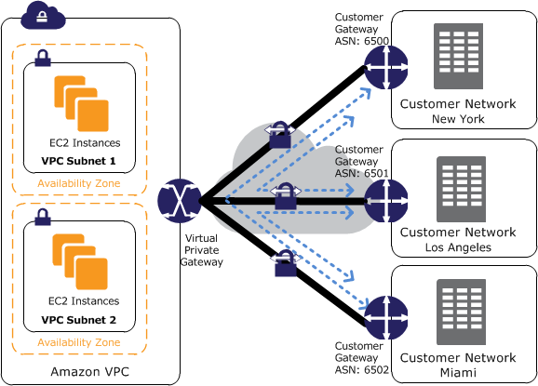
VPN CloudHub Continued

Slide 102
VPN Direct Connect (Without Internet)
AWS Direct Connect is a network service that provides an alternative to using the Internet to utilize AWS cloud services
Using AWS Direct Connect, data that would have previously been transported over the Internet can now be delivered through a private network connection between AWS and your data center or corporate network
All AWS services, including Amazon Elastic Compute Cloud (EC2), Amazon Virtual Private Cloud (VPC), Amazon Simple Storage Service (S3), and Amazon DynamoDB can be used with AWS Direct Connect
Each AWS Direct Connect connection can be configured with one or more virtual interfaces. Virtual interfaces may be configured to access AWS services such as Amazon EC2 and Amazon S3 using public IP space, or resources in a VPC using private IP space.
AWS Direct Connect has two separate charges: port-hours and Data Transfer. Pricing is per port-hour consumed for each port type. Partial port-hours consumed are billed as full hours.
1Gbps and 10Gbps ports are available.Speeds of 50Mbps, 100Mbps, 200Mbps, 300Mbps, 400Mbps, and 500Mbps can be ordered from any APN partners supporting AWS Direct Connect.
An AWS Direct Connect location provides access to Amazon Web Services in the region it is associated with, as well as access to other regions in the country (i.e. all US regions).
Connections to AWS Direct Connect require single mode fiber, 1000BASE-LX (1310nm) for 1 gigabit Ethernet, or 10GBASE-LR (1310nm) for 10 gigabit Ethernet.

Slide 103
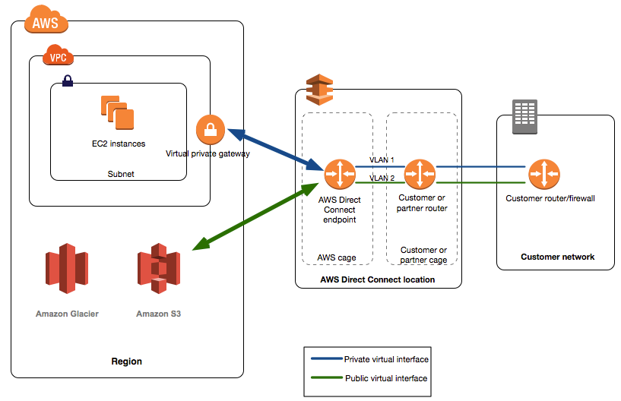
VPN Direct Connect (Without Internet)

Slide 104
VPN Direct Connect (Without Internet)
Each virtual interface must be tagged with a customer-provided tag that complies with the Ethernet 802.1Q standard. This tag is required for any traffic traversing the AWS Direct Connect connection.
To connect to public AWS products such as Amazon EC2 and Amazon S3 through the AWS Direct Connect, you need to provide the following:
A public Autonomous System Number (ASN) that you own (preferred) or a private ASN.
Public IP addresses (/30) (that is, one for each end of the BGP session) for each BGP session.
The public routes that you will advertise over BGP.
If you use aws:SourceIp, and the request comes from an Amazon EC2 instance, the instance's public IP address is used to determine if access is allowed.
Data transfer IN is $0.00 per GB in all locations but Data transfer OUT has different rate according to the location.
Permissions granted using IAM cover all the Amazon Web Services resources you use with AWS Direct Connect, so you cannot use IAM to control access to AWS Direct Connect data for specific resources.
It is possible to configure multiple virtual interfaces on a single AWS Direct Connect connection, and you'll need one private virtual interface for each VPC to connect to. Each virtual interface needs a VLAN ID, interface IP address, ASN, and BGP key.
To use your AWS Direct Connect connection with another AWS account, you can create a hosted virtual interface for that account.
AWS recommends enabling Bidirectional Forwarding Detection (BFD) when configuring your connections to ensure fast detection and failover.

Slide 105
VPN Direct Connect (Without Internet)
If the cross connect is not completed within 90 days, the authority granted by the LOA-CFA expires.
All AWS services can be used with AWS Direct Connect

Slide 106
Kinesis
Amazon Kinesis Streams – can be used for multi-stage processing using specialized algorithms

Slide 107
SAML 2.0
SAML 2.0 can be used to give your federated users SSO access to AWS management console
After the client browser posts the SAML assertion, AWS sends the sign-in URL as a redirect, and the client browser is redirected to the Console
The portal first verifies the user's identity in your organization, then generates a SAML authentication response

Slide 108
Security
A SYN flood is a form of denial-of-service attack in which an attacker sends a succession of SYN requests to a target's system in an attempt to consume enough server resources to make the system unresponsive to legitimate traffic.

Slide 109
CloudHSM – Hardware Security
The AWS CloudHSM service helps you meet corporate, contractual and regulatory compliance requirements for data security by using dedicated Hardware Security Module (HSM) appliances within the AWS cloud.
The AWS CloudHSM service defines a resource known as a high-availability (HA) partition group, which is a virtual partition that represents a group of partitions, typically distributed between several physical HSMs for high-availability

Slide 110
Import/Export
AWS Import/Export supports:
Import to Amazon S3 Export from Amazon S3 Import to Amazon EBS Import to Amazon Glacier AWS Import/Export does not currently support export from Amazon EBS or Amazon Glacier.

Slide 111
Key pairs
Key pairs consist of a public and private key, where you use the private key to create a digital signature, and then AWS uses the corresponding public key to validate the signature. Key pairs are used only for Amazon EC2 and Amazon CloudFront.
EC2 Key Pairs, Security Groups, and ELBs are region-specific.

Slide 112
ENI (Elastic Network Interface)
Scenarios for Network Interfaces:-
Attaching multiple network interfaces (ENIs) to an EC2 instance is useful to:
Create a management network.
Use network and security appliances in your VPC.
Create dual-homed instances with workloads/roles on distinct subnets
Create a low-budget, high-availability solution.
Amazon ENI, or an elastic network interface, is a virtual network interface that can be easily created, attached, and detached from any of your EC2 Instances within your VPC. Each ENI has a set of attributes that are preserved after it has been detached from an instance and attached to a new one
You can attach 2 ENI to an instance. The second ENI attached via CLI may not terminate when the instance is terminated from console
When 2 ENIs attached to an EC2 instance, AWS doesn’t allocate public IP address
Dual-homed or dual-homing can refer to either an Ethernet device that has more than one network interface, for redundancy purposes, or in firewall technology, dual-homed is one of the firewall architectures for implementing preventive security.

Slide 113
ENI (Elastic Network Interface)
According to "Best Practices for Configuring Elastic Network Interfaces," you can attach an elastic network interface to an instance under the following conditions:
when it's running (hot attach)
when it's stopped (warm attach)
when the instance is being launched (cold attach).
Multiple ENIs can be attached to a EC2 instance
The organization should use ENIs with separate subnets so one instance can have two subnets, and the respective security groups for controlled access. One instance can be private and other instance can be public
Attaching another network interface to an instance is not a method to increase or double the network bandwidth to or from the dual-homed instance
The maximum number of ENIs that can be attached to a single EC2 instance depends on the instance type. In any case, the maximum number of ENIs that can be attached to the largest instances is 8
There are certain network and security appliances, such as load balancers, network address translation (NAT) servers, and proxy servers, which prefer to be configured with multiple elastic network interfaces.

Slide 114
ENI (Elastic Network Interface)
ENI terminates by default – When it is attached to an instance via Management console
ENI doesn’t terminates – When it is attached to an instance via CLI command

Slide 115
Customer Gateway
The address of the external interface for your customer gateway must be a static address. You can create additional VPN connections to other VPCs using the same customer gateway device. You can reuse the same customer gateway IP address for each of those VPN connections
To establish redundant VPN connections and customer gateways on your network, you would need to set up a second VPN connection. However, you must ensure that the customer gateway IP address for the second VPN connection is publicly accessible.
To secure every communication between your customer gateway and the virtual private gateway of your VPC, Internet Key Exchange (IKE) protocol uses Diffie-Helman to establish ephemeral keys that add a layer of security to the communications.
The AWS endpoint is not the initiator; your customer gateway must initiate the tunnels. Your gateway must support the ability to bind the IPsec tunnel to a logical interface. The logical interface contains an IP address used to establish BGP peering to the virtual private gateway. This logical interface should perform no additional encapsulation (for example, GRE, IP in IP). Your interface should be set to a 1399 byte Maximum Transmission Unit (MTU).

Slide 116
EBS (Elastic Block Storage)
In AWS CloudFormation, if you want to map an Amazon Elastic Block Store to an Amazon EC2 instance, you reference the logical IDs to associate the block stores with the instance.
io1 – Provisioned IOPS SSD – type suitable for database type activities
20 : 1 – Maximum IOPS to memory size ratio
EBS Volume – Geographic scope is Availability Zone
EBS Snapshot - Geographic scope is Region
4 GB to 16 TB – SDD memory size
SDD – Suitable for random access – 256 KB blocks
HDD – Suitable for sequential access
In Amazon Web Services, when a user asks AWS to delete data in the cloud, AWS does not decommission the underlying physical media. The storage blocks are marked as unallocated only
New EBS volumes now receive their maximum performance the moment that they are available and do not require initialization (formerly known as pre-warming). However, storage blocks on volumes that were restored from snapshots must be initialized (pulled down from Amazon S3 and written to the volume) before you can access the block. This preliminary action takes time and can cause a significant increase in the latency of an I/O operation the first time each block is accessed..
Command to pre warm EBS - dd if=/dev/xvdf of=/dev/null bs=1M
The default limit for the maximum number of volumes that can be created is 5000 per AWS account.
Launching an instance that is EBS-optimized provides the user with a dedicated connection between the EC2 instance and the EBS volume.

Slide 117
EBS (Elastic Block Storage)
The user can join multiple provisioned IOPS volumes together in a RAID 1 configuration to achieve better fault tolerance.
When I/O performance is more important than fault tolerance, the RAID 0 configuration must be used; for example, as in a heavily used database
For a better and consistent snapshot of the root EBS volume, AWS recommends stopping the instance.
The substitutions option can only be used when manifestVersion is set to 2.0 and is not available for Amazon EBS or Amazon Glacier import jobs.
The number of snapshots that Amazon EBS can manage is 10,000.
Snapshots with AWS Marketplace product codes can't be made public.
Amazon EBS encryption uses AWS Key Management Service (AWS KMS) master keys when creating encrypted volumes and any snapshots created from your encrypted volumes.
Volume status checks are automated tests that run every 5 minutes and return a pass or fail status. If all checks pass, the status of the volume is ok. If a check fails, the status of the volume is impaired.
A Provisioned IOPS volume must be at least 10 GB in size
Amazon RDS provides three storage types: magnetic, General Purpose (SSD), and Provisioned IOPS (input/output operations per second). Magnetic (Standard) storage is ideal for applications with light or burst I/O requirements.

Slide 118
EBS (Elastic Block Storage)
General Purpose SSD volumes provide the ability to burst to 10,000 IOPS per volume, independent of volume size, to meet the performance needs of most applications.
To attach an Amazon EBS volume to an instance using the command line, you can use one of the following commands:
attach-volume (AWS CLI)
ec2-attach-volume (Amazon EC2 CLI)
Add-EC2Volume (AWS Tools for Windows PowerShell)
Amazon EBS currently supports up to 20,000 IOPS per volume on Provisioned IOPS volumes.
EBS backed EC2 instance – stopped and started – Runs on new host computer
EBS backed EC2 instance – Rebooted – Doesn’t run on new host computer

Slide 119
EIP (Elastic IP)
You first allocate an EIP for use in a VPC and then associate it with an instance in your VPC (it can be assigned to only one instance at a time).
An EIP is a property of network interfaces. You can associate an EIP with an instance by updating the network interface attached to the instance.
If you associate an EIP with the eth0 network interface of your instance, its current public IP address (if it had one) is released to the EC2-VPC public IP address pool. If you disassociate the EIP, the eth0 network interface is automatically assigned a new public IP address within a few minutes. This doesn't apply if you've attached a second network interface to your instance.
There are differences between an EIP that you use in a VPC and one that you use in EC2-Classic.
You can move an EIP from one instance to another. The instance can be in the same VPC or another VPC but not in EC2-Classic.
Your EIPs remain associated with your AWS account until you explicitly release them.
To ensure efficient use of EIPs, AWS impose a small hourly charge when they aren't associated with a running instance or when they are associated with a stopped instance or an unattached network interface. While your instance is running, you aren't charged for one EIP associated with the instance, but you are charged for any additional EIPs associated with the instance.
You're limited to 5 Elastic IP addresses; to help conserve them, you can use a NAT instance.

Slide 120
ec2-net-utils
Amazon Linux AMIs may contain additional scripts installed by AWS, known as ec2-net-utils. These scripts optionally automate the configuration of your network interfaces. These scripts are available for Amazon Linux only.
For AWS Linux, the ec2-net-utils package can take care of this step. It configures additional network interfaces that the user can attach while the instance is running, refreshes secondary IP addresses during DHCP lease renewal, and updates the related routing rules.
Components of ec2-net-utils:-
udev rules - Identifies network interfaces when they are attached, detached, or reattached to a running instance, and ensures that the hotplug script runs
hotplug script - Generates an interface configuration file suitable for use with DHCP. Also generates a route configuration file
DHCP script - Whenever the network interface receives a new DHCP lease, this script queries the instance metadata for Elastic IP addresses. For each Elastic IP address, it adds a rule to the routing policy database to ensure that outbound traffic from that address uses the correct network interface. It also adds each private IP address to the network interface as a secondary address.
The hotplug script that is part of ec2-net-utils used with ENIs generates an interface configuration file suitable for use with DHCP (/etc/sysconfig/network-scripts/ifcfg-ethN). It also generates a route configuration file (/etc/sysconfig/network-scripts/route-ethN).

Slide 121
ec2-net-utils
ec2ifup ethN - Extends the functionality of the standard ifup. After this script rewrites the configuration files ifcfg-ethN and route-ethN, it runs ifup.
ec2ifdown ethN - Extends the functionality of the standard ifdown. After this script removes any rules for the network interface from the routing policy database, it runs ifdown.
ec2ifscan - Checks for network interfaces that have not been configured and configures them.

Slide 122
AWS WAF (Web App Firewall)
AWS WAF – Web ACLs
AWS WAF is a web application firewall that helps protect your web applications from common web exploits that could affect application availability, compromise security, or consume excessive resources. AWS WAF gives you control over which traffic to allow or block to your web applications by defining customizable web security rules
You can use AWS WAF to create custom rules that block common attack patterns, such as SQL injection or cross-site scripting, and rules that are designed for your specific application. New rules can be deployed within minutes, letting you respond quickly to changing traffic patterns.
Size constraint conditions
IP match conditions
String match conditions
AWS WAF normally present in front of web servers or load balancers

Slide 123
Trusted Adviser
An online resource to help you reduce cost, increase performance, and improve security by optimizing your AWS environment, Trusted Advisor provides real time guidance to help you provision your resources following AWS best practices.
Whether there is MFA configure on the root account
Advice on security groups and what ports have unrestricted access

Slide 124
ECS Agent Software
The ECS agent runs on most common flavors of Linux.
Debian
Ubuntu
CentOS
Amazon Linux
RedHat
Ways to provide security privileges to Docker containers
Role granted to an ECS task
Role granted to an ECS container instances

Slide 125
Certificate Preparation
Session videos from AWS re:Invent
AWS documentation web site
A Cloud Guru Blog
Amazon kindle versions of the AWS documentation
AWS Blog by Jeff Barr
A Cloud Guru forum

Slide 126
DynamoDB Headers
Content-type
X-amz-date
X-amz-target
Host

Slide 127
DynamoDB
By using proxy, it is not possible for a developer to achieve item level access control
By using FGAC, it is possible for a developer to achieve item level access control
By using Per-Client Embedded Token, it is possible for a developer to achieve item level access control

Slide 128
LDAP
Use SAML to enable SSO between AWS and LDAP

Slide 129
Shared Responsibility Model
The security of the cloud is managed by Amazon AWS provider
The security in the cloud is responsibility of the customer
Physical networking comes as part of the responsibility of AWS

Slide 130
References
AWS online documentation
http://docs.aws.amazon.com/AmazonVPC/latest/UserGuide/default-vpc.html
http://docs.aws.amazon.com/AmazonVPC/latest/UserGuide/VPC_Scenario2.html

