Slide 1
MicroServices

Slide 2
MicroServices
MicroServices is a software architecture style in which complex applications are composed of small, independent processes communicating with each other using language-agnostic APIs

Slide 3
MicroServices Approach
Don’t start with MicroServices approach
Almost all the cases where the development approach started with MicroServices system from scratch, it has ended up in serious trouble

Slide 4
Disadvantages of Monolithic
Difficult to maintain the application
More difficult and sometimes impossible to scale, especially in PaaS (cloud) environments

Slide 5
Advantages of MicroServices
Applications are more flexible
Every Microservice can be developed independently of other MicroServices, which simplifies lifecycle and change management, makes it easier to use different technologies or upgrade to newer versions
Makes it easier to adopt new technologies for parts of an application
Makes it much more efficient to scale applications in PaaS and Docker-like environments
IDE is faster making developers more productive
The web container starts faster, which makes developers more productive, and speeds up deployments

Slide 6
Disadvantages of MicroServices
Testing is more difficult
Requires inter-service communication mechanism
Implementing use cases that span multiple services without using distributed transactions is difficult
Deployment complexity. In production, there is also the operational complexity of deploying and managing a system comprised of many different service types

Slide 7
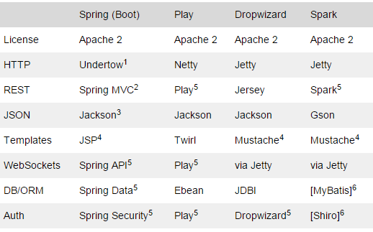
Frameworks

Slide 8
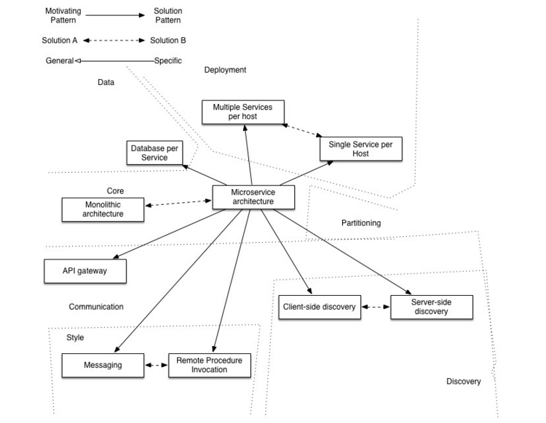
MicroServices Pattern

Slide 9
MicroServices Pattern – Cntd…
The API Gateway pattern defines how clients access the services in a MicroServices architecture
The Client-side Discovery and Server-side Discovery patterns are used to route requests for a client to an available service instance in a MicroServices architecture
The Messaging and Remote Procedure Invocation patterns are two different ways that services can communicate
The Single Service per Host and Multiple Services per Host patterns are two different deployment strategies
The Database per Service pattern describes how each service has its own database
The Microservice chassis pattern says build MicroServices using a framework that handles cross-cutting concerns

Slide 10
MicroServices Technologies
Spring Boot: Sprint boot is evolutionary offering of already stable spring framework. Over the time, Spring framework has become collection of various products. They used their concept of spring io platform and provided another way to package application, which provides fat jar
Dropwizard

Slide 11
References
http://martinfowler.com/tags/microservices.html
http://ee.kumuluz.com/tutorial/2015/06/04/microservices-with-java-ee-and-kumuluzee.html
https://www.heroku.com/platform
https://www.docker.com/what-docker
https://en.wikipedia.org/wiki/Microservices
http://microservices.io/
https://opensource.com/life/15/10/4-java-web-frameworks

