Slide 1
AngularJS

Slide 2
AngularJS
AngularJS is a powerful JavaScript framework
Used in a Single Page Application (SPA) projects
AngularJS is a structural framework for dynamic web apps
Angular's data binding and dependency injection eliminate much of the code you currently have to write
Used to create RIA (Rich Internet Application)
Used to create client side application (using JavaScript) in a clean MVC way
AngularJS is cross-browser compliant. It automatically handles JavaScript code suitable for each browser

Slide 3
Core Features
Data-Binding – Automatic synchronization of data between model and view components
Scope – Object that refer to the model. They act as a glue between controller and view
Controller – JS function that are bound to a particular scope
Services – Singleton objects e.g. $http
Filters – Selects a subset of items from an array and returns a new array
Directives – Markers on DOM elements. Some built-in directives ngBind, ngModel
Templates – Rendered view with information from controller and model
Routing – Concept of switching views
Model View Whatever – MVC design pattern for dividing an application into different parts
Deep Linking – allows you to encode the state of application in the URL so that it can be bookmarked
Dependency Injection – It has built-in dependency injection that helps the developer by making the easier to develop, understand and test

Slide 4
Concepts
Data-Binding
Scope
Dependency Injection
Filters
Services
Factory
Expressions
Providers
Validators
Directives
Controllers
Modules
Expressions

Slide 5
AngularJS Components
ng-app: This directive defines and links an AngularJS application to HTML
ng-model: This directive binds the values of AngularJS application data to HTML input controls
ng-bind: This directive binds the AngularJS application data to HTML tags

Slide 6
Advantages of AngularJS
Provides capability to create Single Page Application (SPA)
Two way data binding
Code is unit testable
Uses dependency injection and makes use of separation of concerns
Provides reusable components
Applications can run on all major browsers and smart phones including Android and iOS based phones/tablets
ng-include can be used to embed html within another html. This feature is not available in HTML

Slide 7
Disadvantages of AngularJS
Not Secure: Server side authentication is must to keep an application secure
Not degradable: If your application user disables JavaScript then user will just see the basic page and nothing more

Slide 8
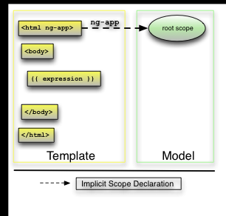
Bootstrapping AngularJS apps
Bootstrapping AngularJS apps automatically using the ngApp directive is very easy and suitable for most cases. In advanced cases, such as when using script loaders, you can use the imperative / manual way to bootstrap the app
There are 3 important things that happen during the app bootstrap:
The injector that will be used for dependency injection is created
The injector will then create the root scope that will become the context for the model of our application
Angular will then "compile" the DOM starting at the ngApp root element, processing any directives and bindings found along the way
Once an application is bootstrapped, it will then wait for incoming browser events that might change the model. Once such an event occurs, Angular detects if it caused any model changes and if changes are found, Angular will reflect them in the view by updating all of the affected bindings

Slide 9
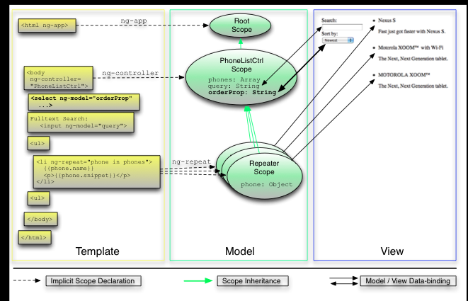
Two way data binding
Data changes in model reflects in view automatically and vice versa. No need of DOM manipulations

Slide 10
AngularJS Directive
AngularJS directives are used to extend HTML. These are special attributes starting with ng- prefix
Some directives:
ng-app – Starts an AngularJS application
ng-init – Initializes application data
ng-model – defines the model that is variable to be used in AngularJS
ng-repeat – Repeats the html elements for each item in a collection

Slide 11
AngularJS – ngBind
The ngBind attribute tells Angular to replace the text content of the specified HTML element with the value of a given expression, and to update the text content when the value of that expression changes
Typically, you don't use ngBind directly, but instead you use the double curly mark up like {{ expression }} which is similar but less verbose
It is preferable to use ngBind instead of {{ expression }} if a template is momentarily displayed by the browser in its raw state (i.e. un-compiled state) before Angular compiles it. Since ngBind is an element attribute, it makes the bindings invisible to the user while the page is loading
An alternative solution to this problem would be using the ngCloak directive

Slide 12
AngularJS – ngCloak
The ngCloak directive is used to prevent the Angular html template from being briefly displayed by the browser in its raw (un-compiled) form while your application is loading
Use this directive to avoid the undesirable flicker effect caused by the html template display
The directive can be applied to the <body> element, but the preferred usage is to apply multiple ngCloak directives to small portions of the page to permit progressive rendering of the browser view

Slide 13
AngularJS – ngCsp
Angular has some features that can break certain CSP (Content Security Policy) rules
If you intend to implement these rules then you must tell Angular not to use these features
This is necessary when developing things like Google Chrome Extensions or Universal Windows Apps
The following rules affect Angular
unsafe-eval
unsafe-inline

Slide 14
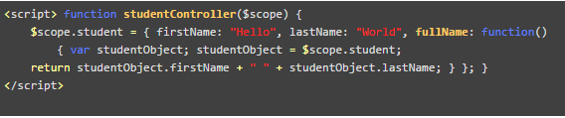
AngularJS Expression & Controller
AngularJS expressions are used to bind application data to html. Expressions are written in double braces like {{ expression}}
AngularJS controller controls the flow of data in the application. It is defined using ng-controller directive
Controller is a JavaScript object containing attributes / properties and functions
Controller accepts $scope as a parameter which refers to the application/module that controller is to control
Sample controller:
$scope – refers to application which is to use the studentController object
$scope.student is property of studentController object
firstName and lastName are two properties of $scope.student object
fullName is the function of $scope.student object whose task is to return the combined name

Slide 15
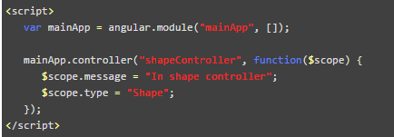
AngularJS Scope
Scope is a special JavaScript object which plays the role of joining controller with the views.
Scope contains the model data. In controllers, model data is accessed via $scope object
Sample controller:
$scope is passed as first argument to controller during its constructor definition
$scope.message and $scope.type are the models which are to be used in the HTML page
We've set values to models which will be reflected in the application module whose controller is shapeController
We can define functions as well in $scope
Scope Inheritance: Scope are controllers specific. If we defines nested controllers then child controller will inherit the scope of its parent controller

Slide 16
AngularJS Scope Contd…
$scope functions $watch(), $digest() and $apply() are some of the central functions
AngularJS creates a "watch" internally. A watch means that AngularJS watches changes in the variable on the $scope object. Watches are created using the $scope.$watch() function
$digest – Angular calls the digest function that iterates through all watchers for any changes. If a watched variable has changed, a corresponding listener function is called
$apply is used to execute some code, and then call $scope.$digest() after that

Slide 17
AngularJS Services
AngularJS supports the concepts of "Separation of Concerns" using services architecture
Services are JavaScript functions and are responsible to do a specific tasks only. Controllers, filters can call them as on requirement basis. Services are normally injected using dependency injection mechanism of AngularJS
Sample built-in services include $http, $route, $window, $location etc.
There are two ways to create service:-
factory - module.factory( 'factoryName', function ); - When you’re using a Factory you create an object, add properties to it, then return that same object. When you pass this service into your controller, those properties on the object will now be available in that controller through your factory
service - module.service( 'serviceName', function ); - When you’re using Service, it’s instantiated with the ‘new’ keyword. Because of that, you’ll add properties to ‘this’ and the service will return ‘this’. When you pass the service into your controller, those properties on ‘this’ will now be available on that controller through your service.
http://tylermcginnis.com/angularjs-factory-vs-service-vs-provider/
AngularJS services are singleton
Providers are the only service you can pass into your .config() function

Slide 18
AngularJS JSONP
JSONP – JSON with Padding
AngularJS's $http service is also capable of sending JSONP requests. The normal AJAX calls can only send requests to URLs within the same domain as the HTML page sending the requests was loaded from. You can get around this with JSONP requests
A JSONP request is not sent via the XHR object like AJAX calls normally are. Instead, a <script> element is created and inserted into the HTML page
<script src="http://wiki.com/theService.json?callback=theServiceResponse&p1=v1&p2=v2"></script>
Note the callback function is padded in the request URL. In AngularJS, the function name is supplied behind the scene by AngularJS
$http.jsonp( url, config );
JSONP Security: The remote service could send back any JavaScript which would then get executed inside your HTML page. An evil remote service could send back JavaScript which attempts to steal information from your application and sent it to a third party service. Only make JSONP calls to services you trust

Slide 19
AngularJS Filter
AngularJS filters are used to change modify the data and can be clubbed in expression or directives using pipe character
uppercase - converts a text to upper case text
lowercase - converts a text to lower case text
currency - formats text in a currency format
filter - filter the array to a subset of it based on provided criteria
orderby - orders the array based on provided criteria

Slide 20


AngularJS Table & Include
ng-repeat directive can be used to draw table easily
HTML does not support embedding html pages within html page. To achieve this functionality following ways are used:
Using AJAX
Using Server Side Includes
ng-include can be used to embed HTML pages within a HTML page

Slide 21
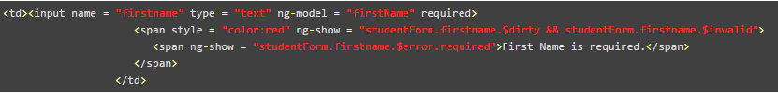
AngularJS Forms
AngularJS enriches form filling and validation
Events: AngularJS provides multiple events which can be associated with the HTML controls. Some of the events are as follows:
ng-click
ng-dbl-click
ng-mousedown
ng-mouseup
ng-change
Validate Data: Following can be used to track error
$dirty - states that value has been changed
$invalid - states that value entered is invalid
$error - states the exact error

Slide 22
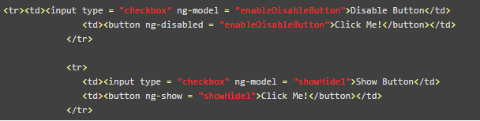
AngularJS HTML DOM
The following directive can be used to bind application data to attributes of HTML DOM Elements
ng-disabled – disables a given control
ng-show – shows a given control
ng-hide – hides a given control
ng-click – represents a AngularJS click event

Slide 23
AngularJS Custom Directive
Custom directives are used in AngularJS to extend the functionality of HTML. Custom directives are defined using "directive" function
During bootstrap (one time activity),
compile() method finds the matching elements
link() method will process the element based on the scope of the directive
AngularJS provides support to create custom directives for following type of elements
Element directives – Activates when a matching element is encountered
Attribute - Activates when a matching attribute is encountered
CSS – Activates when a matching CSS is encountered
Comment – Activates when a matching comment is encountered
Define custom html tags
<student name = “Hello"></student><br/>
<student name = “World"></student>
Define the custom directive to handle above custom html tags
mainApp.directive('student', function() {

Slide 24
AngularJS Views
AngularJS supports Single Page Application via multiple views on a single page. To do this AngularJS has provided ng-view and ng-template directives and $routeProvider services
ng-view – simply creates a place holder where a corresponding view can be placed based on the configuration
ng-template – directive is used to create an html view using script tag. It contains "id" attribute which is used by $routeProvider to map a view with a controller
$routeProvider is the key service which set the configuration of URLs, map them with the corresponding html page or ng-template, and attach a controller with the same

Slide 25
Routing and Multiple Views
ngRoute module: is disturbed separately from the core Angular framework
Provides routing and deep linking services and directives for angular apps
Application routes in Angular are declared via the $routeProvider, which is the provider of the $route service. This service makes it easy to wire together controllers, view templates, and the current URL location in the browser. Using this feature, we can implement deep linking, which lets us utilize the browser's history (back and forward navigation) and bookmarks

Slide 26
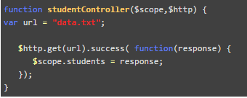
AngularJS – HTTP Service
AngularJS provides $http control which works as a service to read data from the server. The server makes a database call to get the desired records

Slide 27
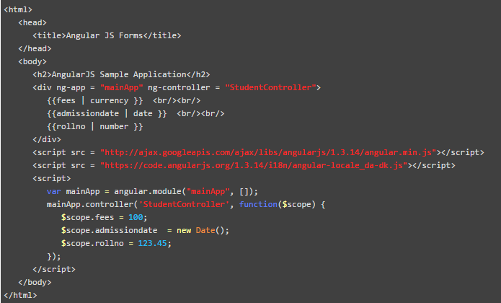
AngularJS – Internationalization
AngularJS supports inbuilt internationalization for three types of filters:
currency, date and numbers

Slide 28
AngularJS Testability
AngularJS has an integrated dependency injection framework, provides mocks for many heavy dependencies (server-side communication)
ngMock: module provides support to inject and mock Angular services into unit tests. In addition, ngMock also extends various core ng services such that they can be inspected and controlled in a synchronous manner within test code
angular.mock: Namespace from 'angular-mocks.js' which contains testing related code
Jasmine: Jasmine is a behavior-driven development framework for testing JavaScript code. It does not depend on any other JavaScript frameworks. It does not require a DOM
describe – Global Jasmine function with two parameters: a string and a function
Matchers – Each matcher implements a boolean comparison between actual and expected value
expect(a).toBe(b); expect(a).not.toBe(null);
Jasmine unit test are run with Karma Test Runner
Jasmine end to end tests are run with Protracter End-to-End test runner
Web driver is required to execute the Protracter script : npm run update-webdriver
Run the Protracter test : npm run protractor

Slide 29
AngularJS Continuous Integration
Travis CI: Travis CI is a continuous integration service, which can monitor GitHub for new commits to your repository and execute scripts such as building the app or running tests
CloudBees: CloudBees have provided a CI/deployment setup

Slide 30
JQuery
AngularJS can use jQuery if it's present in your app when the application is being bootstrapped. If jQuery is not present in your script path, Angular falls back to its own implementation of the subset of jQuery that we call jQLite
jqLite is a tiny, API-compatible subset of jQuery that allows Angular to manipulate the DOM in a cross-browser compatible way. jqLite implements only the most commonly needed functionality with the goal of having a very small footprint
To use jQuery, simply ensure it is loaded before the angular.js file. You can also use the ngJq directive to specify that jqlite should be used over jQuery, or to use a specific version of jQuery if multiple versions exist on the page
If jQuery is available, angular.element is an alias for the jQuery function. If jQuery is not available, angular.element delegates to Angular's built-in subset of jQuery, called "jQuery lite" or jqLite.

Slide 31
CSS in Angular
By default in Angular, when you attach CSS directly to a component, we scope that css exclusively to that component.
Two ways:-
Global CSS
Component-scoped CSS
Three ways of component encapsulation:-
Emulated mode
Native mode – uses Shadow DOM
None

Slide 32
Best Practices
Namespace distributed code – OpenSource code should be name spaced
Only use .$broadcast(), .$emit(), and .$on() for atomic events
Always let users use expressions “{{}}” whenever possible
Extend directives by using Directive Controllers
Add teardown code to controllers and directives - Controllers and directives emit an event right before they are destroyed. You can perform the garbage collection there.
Leverage modules properly – Group your code into related bundles. This way if you remove a module, your app still works
Add NPM and Bower support

Slide 33
Angular – Performance Improvement
Minimize the number of registered watchers
Tools such as Batarang, chrome Angular watchers are useful tools
Maximum the performance of registered watchers
Use ng-if rather than ng-show
As AngularJS doesn’t have native support for unregistering watchers, you can use solutions like bindonce
<div bindonce bo-text=” ’TRANSLATION.KEY’ | translate ”></div>
Pagination i.e. use paginate:page in <ng-repeat> directory
Infinite scrolling
Cache calculated properties
Scalyr Directives
Angular Fastscroll (in div tags)
Tools:
Chrome DevTools
Batarang Plugin
angular-instruments

Slide 34
Angular – Top 3 Performance Tips
Make events fast
Minimize change detections:-
By default, components in an Angular application undergo change detection with nearly every user interaction. But, Angular allows you take control of this process. You can indicate to Angular if a component subtree is up to date and exclude it from change detection.
The first way to exclude a component subtree from change detection is by setting the `changeDetection` property to `ChangeDetectionStrategy.OnPush` in the @Component decorator.
Minimize DOM manipulations:-
By default, when iterating over a list of objects, Angular will use object identity to determine if items are added, removed, or rearranged. This works well for most situations. However, with the introduction of immutable practices, changes to the list’s content generates new objects. In turn, ngFor will generate a new collection of DOM elements to be rendered. If the list is long or complex enough, this will increase the time it takes the browser to render updates. To mitigate this issue, it is possible to use trackBy to indicate how a change to an entry is determined.

Slide 35
References
https://docs.angularjs.org/tutorial/
https://github.com/angular/angular-seed
https://docs.angularjs.org/tutorial/step_00
https://www.madewithangular.com/#/
https://github.com/angular/angular.js/wiki/Best-Practices
https://github.com/angular/angular-seed
http://www.slideshare.net/damienklinnert/angular-performance-tuning-for-large
https://blog.angular.io/3-tips-for-angular-runtime-performance-from-the-real-world-d467fbc8f66e

