Slide 1
Core java

Slide 2
Java – Class Loader
The Java Classloader is a part of the Java Runtime Environment that dynamically loads Java classes into the Java Virtual Machine. Usually classes are only loaded on demand. The Java run time system does not need to know about files and file systems because of classloaders. Delegation is an important concept to understand when learning about classloaders
When the JVM is started, three class loaders are used:
Bootstrap class loader - <JAVA_HOME>/jre/lib
Extensions class loader - <JAVA_HOME>/jre/lib/ext
System class loader – CLASSPATH environment variable

Slide 3
Java – User Defined Class Loader
It is possible to create your own class loader without understanding the finer details of the Java Virtual Machine. Every Java class loader has a parent class loader, defined when a new class loader is instantiated or set to the virtual machine's system default class loader
To load or unload classes at runtime
This is an important feature for:
Implementing scripting languages, such as Jython
Allowing multiple namespaces to communicate. This is one of the foundations of CORBA / RMI protocols for example
To modify the loaded bytecode (load time weaving of aspects when using AOP)
To change the way bytecode is loaded (i.e. use encrypted Java class bytecode)

Slide 4
JAR Hell
Accidental presence of two different versions of a library installed on a system
Multiple libraries or applications require different versions of library foo
A Java program is not required to use only a single "flat" classloader, but instead may be composed of several (potentially very many) nested, cooperating classloaders. Classes loaded by different classloaders may interact in complex ways not fully comprehended by a developer, leading to errors or bugs that are difficult to analyze, explain, and resolve
Solutions:-
The OSGi Alliance (Open Services Gateway initiative) specified (starting as JSR 8 in 1998) a modularity framework that aims to solve JAR hell for current and future VMs in ME, SE, and EE that is widely adopted
Java Module System – expected in Java 9

Slide 5
JVM Architecture
Hotspot Architecture:
High performance and massive scalability
HotSpot JVM JIT compilers generate dynamic optimizations
It make optimization decisions while the Java application is running and generate high-performing native machine instructions targeted for the underlying system architecture
The main components of the JVM include the classloader, the runtime data areas, and the execution engine
There are three components of the JVM that are focused on when tuning performance
Heap – Objects are stored
Garbage Collector
JIT Compiler
Performance Basics:
Responsiveness - How quickly an application or system responds with a requested piece of data
Throughput - Number of transactions completed in a given time

Slide 6
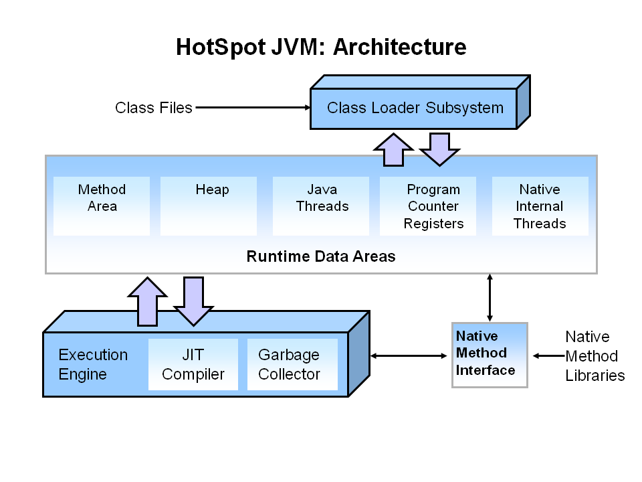
JVM Architecture

Slide 7
Java – Garbage Collection
Automatic garbage collection is the process of looking at heap memory, identifying which objects are in use and which are not, and deleting the unused objects
An in use object, or a referenced object, means that some part of your program still maintains a pointer to that object
An unused object, or unreferenced object, is no longer referenced by any part of your program. So the memory used by an unreferenced object can be reclaimed
Step 1: Marking - This is where the garbage collector identifies which pieces of memory are in use and which are not
Step 2: Normal Deletion - Normal deletion removes unreferenced objects leaving referenced objects and pointers to free space
Step 2a: Deletion with Compaction - To further improve performance, in addition to deleting unreferenced objects, you can also compact the remaining referenced objects. By moving referenced object together, this makes new memory allocation much easier and faster

Slide 8
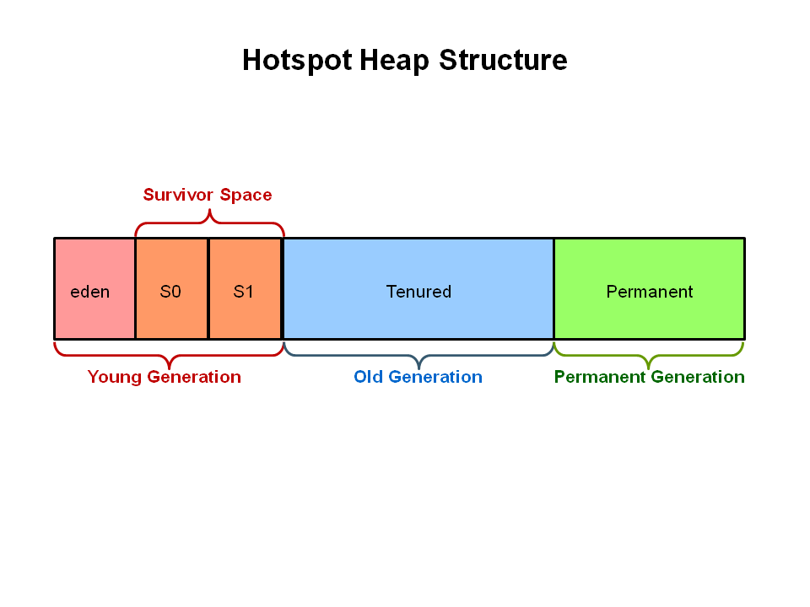
JVM Generations
The heap is broken up into smaller parts or generations. The heap parts are: Young Generation, Old or Tenured Generation, and Permanent Generation

Slide 9
JVM Generations
The Young Generation is where all new objects are allocated and aged. When the young generation fills up, this causes a minor garbage collection. Some surviving objects are aged and eventually move to the old generation
Stop the World Event - All minor garbage collections are "Stop the World" events. This means that all application threads are stopped until the operation completes. Minor garbage collections are always Stop the World events
The Old Generation is used to store long surviving objects. Typically, a threshold is set for young generation object and when that age is met, the object gets moved to the old generation. Eventually the old generation needs to be collected. This event is called a major garbage collection
Major garbage collection are also Stop the World events. Often a major collection is much slower because it involves all live objects. So for Responsive applications, major garbage collections should be minimized
The Permanent generation contains metadata required by the JVM to describe the classes and methods used in the application

Slide 10
Island of Isolation
class A { B myB; }
class B { A myA; }
A a = new A();
B b = new B();
a.b = b; b.a = a;
a = null;
b = null; ---End
At the end, the reference to the outside world is null, so both object ‘a’ and ‘b’ are eligible for garbage collection

Slide 11
Generational GC Process
First, any new objects are allocated to the eden space
When the eden space fills up, a minor garbage collection is triggered
Referenced objects are moved to the first survivor space. Unreferenced objects are deleted when the eden space is cleared
Object Aging: At the next minor GC, the same thing happens for the eden space. Unreferenced objects are deleted and referenced objects are moved to a survivor space. However, in this case, they are moved to the second survivor space (S1). In addition, objects from the last minor GC on the first survivor space (S0) have their age incremented and get moved to S1. Once all surviving objects have been moved to S1, both S0 and eden are cleared. Notice we now have differently aged object in the survivor space
Additional Aging: At the next minor GC, the same process repeats. However this time the survivor spaces switch. Referenced objects are moved to S0. Surviving objects are aged. Eden and S1 are cleared
Promotion: This slide demonstrates promotion. After a minor GC, when aged objects reach a certain age threshold (8 in this example) they are promoted from young generation to old generation

Slide 12
Generational GC Process
Promotion Continues: As minor GCs continue to occur objects will continue to be promoted to the old generation space
So that pretty much covers the entire process with the young generation. Eventually, a major GC will be performed on the old generation which cleans up and compacts that space

Slide 13
Garbage Collector Tools
Visual GC plugin for Visual VM
JConsole

Slide 14
Java Garbage Collector Switches
Java Garbage Collector switches
Switch | Description
-Xms | Sets the initial heap size for when the JVM starts.
-Xmx | Sets the maximum heap size.
-Xmn | Sets the size of the Young Generation.
-XX:PermSize | Sets the starting size of the Permanent Generation.
-XX:MaxPermSize | Sets the maximum size of the Permanent Generation

Slide 15
Java Garbage Collectors – Serial GC
The Serial GC
The serial collector is the default for client style machines in Java SE 5 and 6. With the serial collector, both minor and major garbage collections are done serially (using a single virtual CPU). In addition, it uses a mark-compact collection method. This method moves older memory to the beginning of the heap so that new memory allocations are made into a single continuous chunk of memory at the end of the heap. This compacting of memory makes it faster to allocate new chunks of memory to the heap.
To enable the Serial Collector use: -XX:+UseSerialGC
Uses:
Choice for most applications that do not have low pause time requirements and run on client-style machines
Popularly used in applications where high number of JVMs are run on the same machine
Suitable for small applications with less number of threads

Slide 16
Java Garbage Collectors – Parallel GC
The Parallel GC
The parallel garbage collector uses multiple threads to perform the young genertion garbage collection. By default on a host with N CPUs, the parallel garbage collector uses N garbage collector threads in the collection. The number of garbage collector threads can be controlled with command-line options: -XX:ParallelGCThreads=<desired number>
To enable the Parallel Collector use: -XX:+UseParallelGC
-XX:+UseParallelOldGC
Uses:
Also called a throughput collector
Since it can use multiple CPUs to speed up application throughput. This collector should be used when a lot of work need to be done and long pauses are acceptable

Slide 17
Java Garbage Collectors – CMS
CMS – Concurrent Mark and Sweep Collector
The Concurrent Mark Sweep (CMS) collector (also referred to as the concurrent low pause collector) collects the tenured generation. It attempts to minimize the pauses due to garbage collection by doing most of the garbage collection work concurrently with the application threads. Normally the concurrent low pause collector does not copy or compact the live objects. A garbage collection is done without moving the live objects. If fragmentation becomes a problem, allocate a larger heap
Note: CMS collector on young generation uses the same algorithm as that of the parallel collector
-XX:+UseConcMarkSweepGC
-XX:ParallelCMSThreads=<n> - to set number of threads
Uses:
The CMS collector should be used for applications that require low pause times and can share resources with the garbage collector

Slide 18
Java Garbage Collectors – G1
G1 Garbage Collector
The Garbage First or G1 garbage collector is available in Java 7 and is designed to be the long term replacement for the CMS collector. The G1 collector is a parallel, concurrent, and incrementally compacting low-pause garbage collector that has quite a different layout from the other garbage collectors described previously
-XX:+UseG1GC
The Garbage-First (G1) collector is a server-style garbage collector, targeted for multi-processor machines with large memories. It meets garbage collection (GC) pause time goals with a high probability, while achieving high throughput
The G1 collector is designed for applications that:
Can operate concurrently with applications threads like the CMS collector
Compact free space without lengthy GC induced pause times
Need more predictable GC pause durations
Do not want to sacrifice a lot of throughput performance
Do not require a much larger Java heap

Slide 19
GC – Finalize Method
Finalize method in Java also called finalizer is a method defined in java.lang.Object and called by Garbage collector before collecting any object which is eligible for GC. Finalize() method provides last chance to object to do clean up and free any remaining resource
Object eligibility for GC:
An object becomes eligible for garbage collection when there is no live reference for that object or it can not be reached by any live thread. Cyclic reference doesn’t count as live reference and if two objects are pointing to each other and there is no live reference for any of them, than both are eligible for GC. Also Garbage collection thread is a daemon thread which will run by JVM based upon GC algorithm and when runs it collects all objects which are eligible for GC

Slide 20
TreeSet
A NavigableSet implementation based on a TreeMap. The elements are ordered using their natural ordering, or by a Comparator provided at set creation time, depending on which constructor is used
Not synchronized i.e. not thread safe
If multiple threads access a tree set concurrently, and at least one of the threads modifies the set, it must be synchronized externally. This is typically accomplished by synchronizing on some object that naturally encapsulates the set. If no such object exists, the set should be "wrapped" using the Collections.synchronizedSortedSet method. This is best done at creation time, to prevent accidental unsynchronized access to the set:
SortedSet s = Collections.synchronizedSortedSet(new TreeSet(...));
The iterators returned by this class's iterator method are fail-fast: if the set is modified at any time after the iterator is created, in any way except through the iterator's own remove method, the iterator will throw a ConcurrentModificationException. Thus, in the face of concurrent modification, the iterator fails quickly and cleanly, rather than risking arbitrary, non-deterministic behavior at an undetermined time in the future

Slide 21
HashSet Vs TreeSet
Parameter | HashSet | TreeSet
Performance | Better compared to TreeSet | Slower
Null Object | Allows null objects | Doesn’t allow null object because compareTo method throws NPE
Backed by | HashMap | TreeMap
Compare Method | Uses equal() method | Uses compareTo() method
Ordering | Doesn’t guarantee ordering | Guarantee’s ordering

Slide 22
Method Hiding
Instance Methods - An instance method in a subclass with the same signature (name, plus the number and the type of its parameters) and return type as an instance method in the superclass overrides the superclass's method
Static Methods - If a subclass defines a static method with the same signature as a static method in the superclass, then the method in the subclass hides the one in the superclass
The distinction between hiding a static method and overriding an instance method has important implications:
The version of the overridden instance method that gets invoked is the one in the subclass
The version of the hidden static method that gets invoked depends on whether it is invoked from the superclass or the subclass
Scenario | Superclass Instance Method | Superclass Static Method
Subclass Instance Method | Overrides | Generates a compile-time error
Subclass Static Method | Generates a compile-time error | Hides

Slide 23
Checked Vs Unchecked Exceptions
Checked | Unchecked
Compile time exceptions | Run time exceptions i.e. not verified during compile time
Handle the exception or use throws keyword | All Unchecked exceptions are direct sub classes of RuntimeException class
IOException SQLException DataAccessException ClassNotFoundException InvocationTargetException MalformedURLException | NullPointerException ArrayIndexOutOfBound IllegalArgumentException IllegalStateException

Slide 24
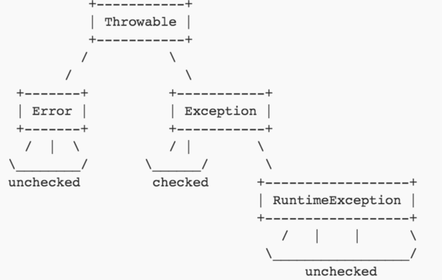
Checked Vs Unchecked Exceptions

Slide 25
Restrictions on Generics
To use Java generics effectively, you must consider the following restrictions:
Cannot Instantiate Generic Types with Primitive Types
Cannot Create Instances of Type Parameters
Cannot Declare Static Fields Whose Types are Type Parameters
Cannot Use Casts or instanceof With Parameterized Types
Cannot Create Arrays of Parameterized Types
Cannot Create, Catch, or Throw Objects of Parameterized Types
Cannot Overload a Method Where the Formal Parameter Types of Each Overload Erase to the Same Raw Type

Slide 26
HashTable Vs HashMap
HashTable | HashMap
Synchronized | Not synchronized
Does not allow null | Allows null
ConcurrentHashMap – similar to HashTable | LinkedHashMap – predictable iteration order

Slide 27
Count Number of same letters in String
Imperative approach (linear) – Sequentially going through all the characters and count the matching one
Recursive approach
Regular expression
Java 8 – Stream API - someString.chars().filter(ch -> ch == 'e').count()
External libraries – StringUtils class in apache commons library
Spring also has StringUtils class

Slide 28
Blocking Queue
How to tell the consumer that the producer is not sending any values?
Answer : Poison message to tell the worker to stop

Slide 29
Reflection Vs Introspection
Java – Static typing system
The ability to inspect the code in the system and see object types is not reflection, but rather Type Introspection. Reflection is then the ability to make modifications at runtime by making use of introspection. The distinction is necessary here as some languages support introspection, but do not support reflection. One such example is C++
Using reflection to invoke the method
Method method = foo.getClass().getMethod("doSomething", null);
method.invoke(foo, null);

Slide 30
Finally block execution
Finally block will not be executed during the below scenarios:-
When System.exit() is invoked
JVM crash
Infinite loop in try block
OS forcibly terminates the JVM using kill command
Host system dies

Slide 31
Memory Leaks
Can be created when the database or byte stream connections are not closed properly

Slide 32
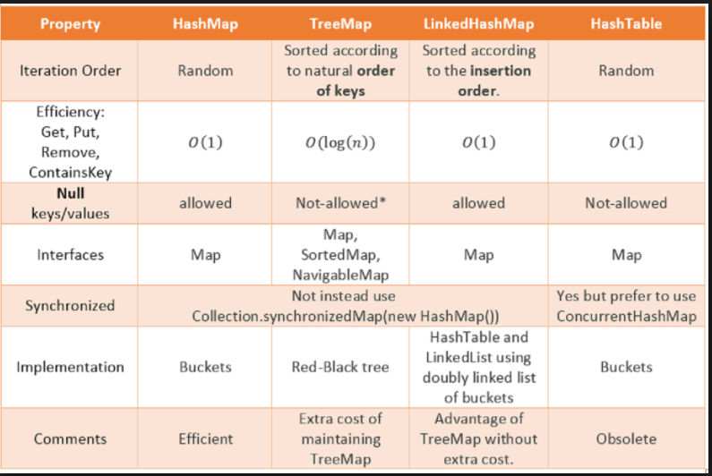
HashMap Vs TreeMap

Slide 33
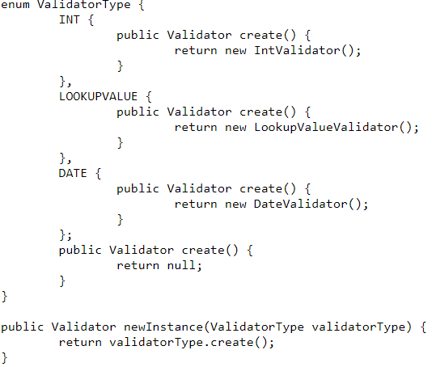
Ways to avoid IF-ELSE or SWITCH case
Reflection – caller has to remember the fully qualified name
Map
Enum

Slide 34
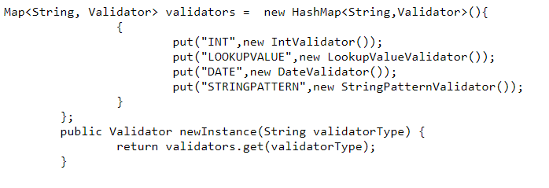
Ways to avoid IF-ELSE or SWITCH case
Map

Slide 35
Code Review – Main
Does code meet functional requirement
Any side effect of this change
Concurrency – Is thread safe?
Readability and Maintenance
Consistency
Performance
Exception Handling
Simplicity
Reuse of existing code
Unit test

Slide 36
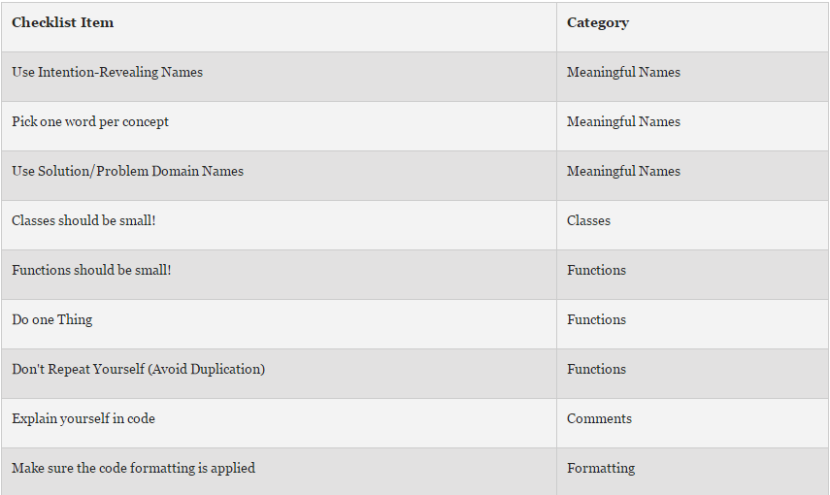
Code Review – Clean Code

Slide 37
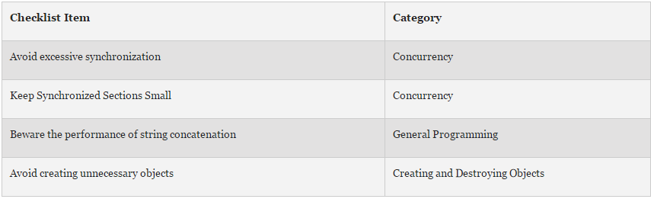
Code Review – Performance

Slide 38
Code Review – General
Category | Checklist Item
Use checked exceptions for recoverable conditions and runtime exceptions for programming errors | Exceptions
Favour the use of standard exceptions | Exceptions
Don't ignore exceptions | Exceptions
Check parameters for validity | Methods
Return empty arrays or collections, not nulls | Methods
Minimize the accessibility of classes and members | Classes and Interfaces
In public classes, use accessor methods, not public fields | Classes and Interfaces
Minimize the scope of local variables | General Programming
Refer to objects by their interfaces | General Programming
Adhere to generally accepted naming conventions | General Programming
Avoid finalizers | Creating and Destroying Objects
Always override hashCode when you override equals | General Programming
Always override toString | General Programming
Use enums instead of int constants | Enums and Annotations
Use marker interfaces to define types | Enums and Annotations
Synchronize access to shared mutable data | Concurrency
Prefer executors to tasks and threads | Concurrency
Document thread safety | Concurrency
Valid JUnit / JBehave test cases exist | Testing

Slide 39
References
https://en.wikipedia.org/wiki/Java_Classloader
https://en.wikipedia.org/wiki/OSGi
http://www.oracle.com/webfolder/technetwork/tutorials/obe/java/gc01/index.html
http://www.oracle.com/webfolder/technetwork/tutorials/obe/java/G1GettingStarted/index.html
http://javarevisited.blogspot.co.uk/2012/10/10-garbage-collection-interview-question-answer.html
https://docs.oracle.com/javase/tutorial/java/IandI/override.html
http://javarevisited.blogspot.co.uk/2011/09/code-review-checklist-best-practice.html
https://dzone.com/articles/java-code-review-checklist
http://crunchify.com/better-understanding-on-checked-vs-unchecked-exceptions-how-to-handle-exception-better-way-in-java/
http://misko.hevery.com/code-reviewers-guide/
http://www.baeldung.com/java-count-chars
https://www.javacodegeeks.com/2014/10/factory-without-if-else.html

