Slide 1
RestFUL

Slide 2
HTTP 2
To improve performance, you can even send multiple requests over a single connection, that way you avoid the complete TCP and SSL handshake overhead on later requests

Slide 3
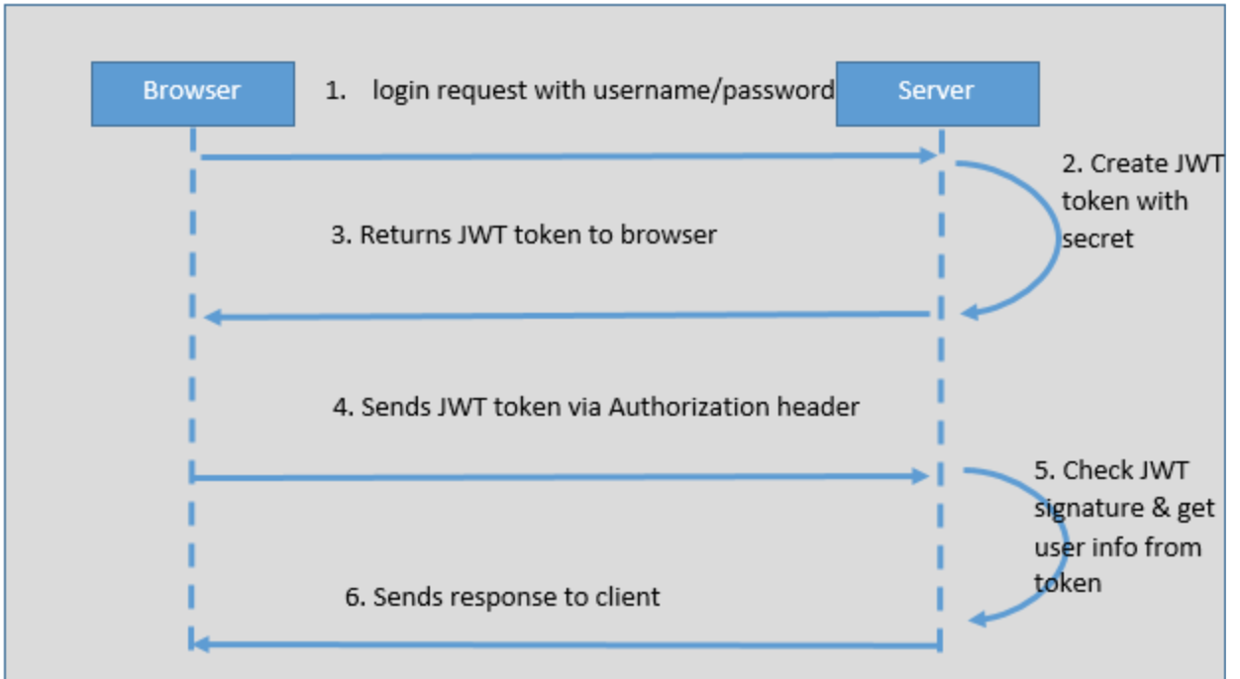
JWT

Slide 4
JWT
JWT consists of three parts separated by dots:-
Header
Payload
Signature
xxxx.yyyy.zzzz
Payload – contains the claims. Claims are statements about an entity and additional metadata. There are 3 types of claims: reserved, public and private
Signature – To create the signature part you have to take the encoded header, the encoded payload, a secret, the algorithm specified in the header, and sign that.
You can use HMAC SHA256 algorithm

Slide 5
JWT Benefits
CORS
No need for CSRF protection
Reduced load on authorization server
No need for distributed session store

Slide 6
JWT Tradeoffs
More vulnerable to XSS attacks
Access token can grow in size in case of increased number of claims
True statelessness and revocation are mutually exclusive
File download API can be tricky to implement

Slide 7
OAuth2 Providers
Google, Github, Facebook and Okta

Slide 8
References
https://restfulapi.net/security-essentials/
https://www.owasp.org/index.php/REST_Security_Cheat_Sheet
https://github.com/murraco/spring-boot-jwt

