Slide 1
Microservices using AWS (disclaimer : This is just a personal notes. Some of the contents are copied from AWS whitepapers and website)

Slide 2
Characteristics of Microservices
Decentralized
Polyglot – Each Microservices can be developed in different programming languages based on the requirement and needs
Independent
Do one thing well
Black Box
You build it, you run it

Slide 3
Microservices
Microservices using AWS can be developed in many ways:-
Microservices without the serverless architecture
Microservices using Amazon Elastic Container service

Slide 4
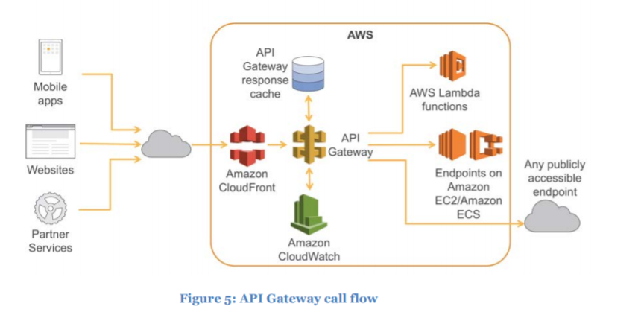
Microservices using API gateway

Slide 5
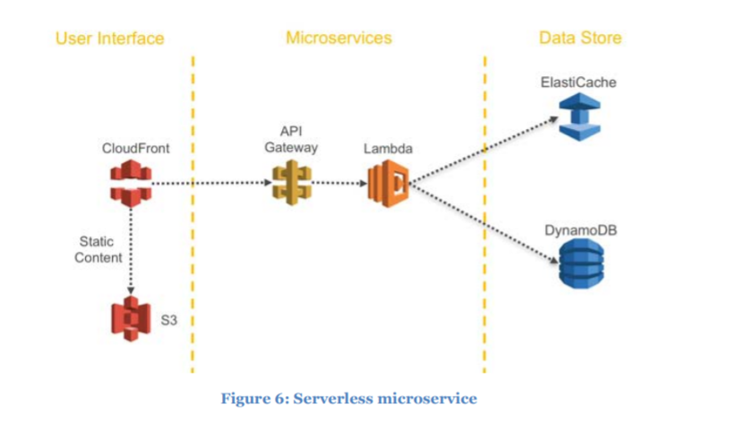
Microservices using serverless

Slide 6
Microservices using serverless
The AWS Serverless Application Model (AWS SAM) is a convenient way to define serverless applications. AWS SAM is natively supported by CloudFormation and defines a simplified syntax for expressing serverless resources. To deploy your application, simply specify the resources you need as part of your application, along with their associated permissions policies in a CloudFormation template, package your deployment artifacts, and deploy the template.

Slide 7
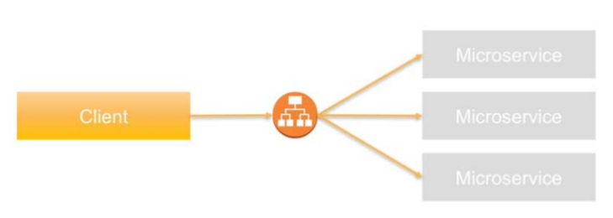
Service Discovery
One of the primary challenges with Microservices architectures is allowing services to discover and interact with each other.
Client-Side Service Discovery:-
Hard code the IP address of the target as part of the configuration of the communication source
It isn’t recommended for Microservices architectures due to the dynamic nature of target properties. Every time the target system changes its properties—regardless of whether it’s the IP address or port information—the source system has to update the configuration
Application load balancer based service discovery:-

Slide 8
Service Discovery
Application load balancer based service discovery:-
Advantages:-
Provides health checks and automatic registration/de-registration of back end services in failure cases
Offers path and host based routing approaches
You can configure a custom domain name for each Microservice and associate the domain name with the Application Load Balancer’s DNS name using a CNAME entry. The DNS names of the service endpoints are then published across other applications that need access
DNS based service discovery - Amazon Route 53 could be another source for holding service discovery information
Service discovery using Amazon ECS event system
Service discovery using configuration management - OpsWorks is a configuration management service that uses Chef, an automation platform that treats server configurations as code. OpsWorks uses Chef to automate how servers are configured, deployed, and managed across your EC2 instances or on-premises compute environments

Slide 9
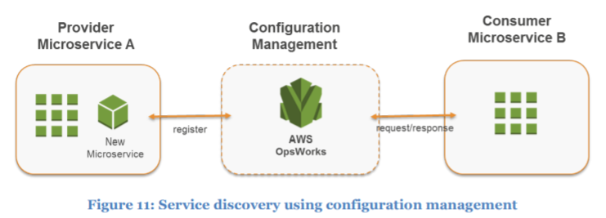
Service Discovery

Slide 10
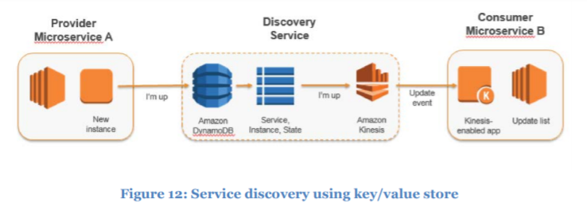
Service Discovery
Service discovery using key value store - You can also use a key-value store for discovery of Microservices. Although it takes longer to build this approach compared to other approaches, it provides more flexibility and extensibility and doesn’t encounter DNS caching issues.

Slide 11
Service Discovery – Third Party Services
HashiCorp Consul
Netflix Eureka

Slide 12
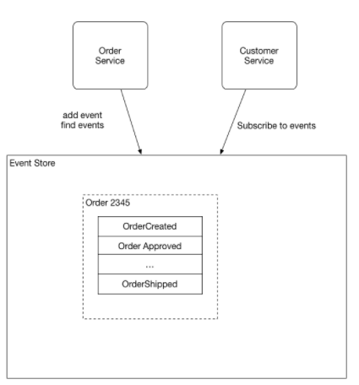
Distributed Data Management
Event source pattern
Event sourcing persists the state of a business entity such an Order or a Customer as a sequence of state-changing events. Whenever the state of a business entity changes, a new event is appended to the list of events. Since saving an event is a single operation, it is inherently atomic. The application reconstructs an entity’s current state by replaying the events.

Slide 13
Distributed Data Management
Instead of simply storing the current state of each order as a row in an ORDERS table, the application persists each Order as a sequence of events. The CustomerService can subscribe to the order events and update its own state
In the context of Microservices architectures, event sourcing enables decoupling different parts of an application by using a publish/subscribe pattern, and it feeds the same event data into different data models for separate Microservices. Event sourcing is frequently used in conjunction with the CQRS pattern (Command, Query, Responsibility, Segregation) to decouple read from write workloads and optimize both for performance, scalability, and security

Slide 14
References
https://d1.awsstatic.com/whitepapers/microservices-on-aws.pdf
http://microservices.io/patterns/data/event-sourcing.html

