Slide 1
JUnit

Slide 2
@Before Vs @BeforeClass
@Before | @BeforeClass
Executed before each test | Runs once before the entire test fixture
Creating the object for each test | When multiple tests need to share the same computationally expensive setup code. Establishing a database connection falls into this category

Slide 3
Parameterized class
Used to run the same test multiple times
Use the @RunWith(Parameterized.class)
@Parameterized.Parameters – annotate the method to pass the input and expected result

Slide 4
@BeforeClass and Parameterized Test
@BeforeClass doesn’t work well with @Parameterized class
Example scenario – When you read the property file on @BeforeClass and get the value, it would come as null in the test cases
Workaround –
Comment out the BeforeClass and call the BeforeClass method directly from Parameterized method
@Parameterized.Parameters
public static Collection setCollections() {
setup();
}
public static void setup() {
Properties props = new Properties();
}

Slide 5
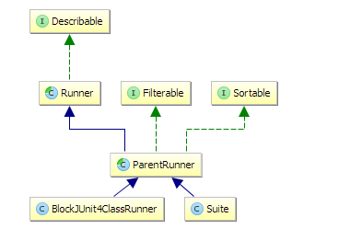
Junit Runners
Class hierarchy of standard Junit Runners

Slide 6
BlockJUnit4ClassRunner
BlockJUnit4ClassRunner is the default Runner that is used if no other Runner is provided. So this is the Runner that is typically used if you run a single test class
This class can be used to create custom Junit runner
JUnit Runners are highly customizable and give you the option to change to complete test execution process

Slide 7
RunnerScheduler Interface
Represents a strategy for scheduling when individual test methods should be run (in serial or parallel) WARNING: still experimental, may go away.
Two methods :-
finished()
schedule (Runnable childStatement)

Slide 8
Rules
Rules allow very flexible addition or redefinition of the behaviour of each test method in a test class. Testers can reuse or extend one of the provided Rules below, or write their own
ExpectedException – Used to test the exceptions
TemporaryFolder - allows creation of files and folders that are deleted when the test method finishes
ExternalResource - is a base class for Rules (like TemporaryFolder) that set up an external resource before a test (a file, socket, server, database connection, etc.), and guarantee to tear it down afterward
ErrorCollector - The ErrorCollector Rule allows execution of a test to continue after the first problem is found
Verifier is a base class for Rules like ErrorCollector, which can turn otherwise passing test methods into failing tests if a verification check is failed.
TestName Rule makes the current test name available inside test methods

Slide 9
References
http://feraldeveloper.blogspot.co.uk/2013/12/beforeclass-and-parametrized-junit-tests.html
http://www.mscharhag.com/java/understanding-junits-runner-architecture
https://github.com/junit-team/junit4/wiki/Rules

