Slide 1
JUnit

Slide 2
@Before Vs @BeforeClass
@Before | @BeforeClass
Executed before each test | Runs once before the entire test fixture
Creating the object for each test | When multiple tests need to share the same computationally expensive setup code. Establishing a database connection falls into this category

Slide 3
Parameterized class
Used to run the same test multiple times
Use the @RunWith(Parameterized.class)
@Parameterized.Parameters – annotate the method to pass the input and expected result

Slide 4
@BeforeClass and Parameterized Test
@BeforeClass doesn’t work well with @Parameterized class
Example scenario – When you read the property file on @BeforeClass and get the value, it would come as null in the test cases
Workaround –
Comment out the BeforeClass and call the BeforeClass method directly from Parameterized method
@Parameterized.Parameters
public static Collection setCollections() {
setup();
}
public static void setup() {
Properties props = new Properties();
}

Slide 5
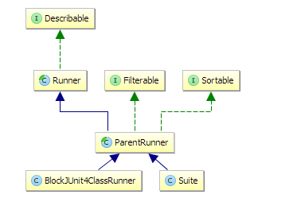
Junit Runners
Class hierarchy of standard Junit Runners

Slide 6
BlockJUnit4ClassRunner
BlockJUnit4ClassRunner is the default Runner that is used if no other Runner is provided. So this is the Runner that is typically used if you run a single test class
This class can be used to create custom Junit runner
JUnit Runners are highly customizable and give you the option to change to complete test execution process

Slide 7
RunnerScheduler Interface
Represents a strategy for scheduling when individual test methods should be run (in serial or parallel) WARNING: still experimental, may go away.
Two methods :-
finished()
schedule (Runnable childStatement)

Slide 8
References
http://feraldeveloper.blogspot.co.uk/2013/12/beforeclass-and-parametrized-junit-tests.html
http://www.mscharhag.com/java/understanding-junits-runner-architecture

