Slide 1
AngularJS

Slide 2
AngularJS
AngularJS is a powerful JavaScript framework
Used in a Single Page Application (SPA) projects
AngularJS is a structural framework for dynamic web apps
Angular's data binding and dependency injection eliminate much of the code you currently have to write
Used to create RIA (Rich Internet Application)
Used to create client side application (using JavaScript) in a clean MVC way
AngularJS is cross-browser compliant. It automatically handles JavaScript code suitable for each browser

Slide 3
Core Features
Data-Binding – Automatic synchronization of data between model and view components
Scope – Object that refer to the model. They act as a glue between controller and view
Controller – JS function that are bound to a particular scope
Services – Singleton objects e.g. $http
Filters – Selects a subset of items from an array and returns a new array
Directives – Markers on DOM elements. Some built-in directives ngBind, ngModel
Templates – Rendered view with information from controller and model
Routing – Concept of switching views
Model View Whatever – MVC design pattern for dividing an application into different parts
Deep Linking – allows you to encode the state of application in the URL so that it can be bookmarked
Dependency Injection – It has built-in dependency injection that helps the developer by making the easier to develop, understand and test

Slide 4
Concepts
Data-Binding
Scope
Dependency Injection
Filters
Services
Factory
Expressions
Providers
Validators
Directives
Controllers
Modules
Expressions

Slide 5
AngularJS Components
ng-app: This directive defines and links an AngularJS application to HTML
ng-model: This directive binds the values of AngularJS application data to HTML input controls
ng-bind: This directive binds the AngularJS application data to HTML tags

Slide 6
Advantages of AngularJS
Provides capability to create Single Page Application (SPA)
Two way data binding
Code is unit testable
Uses dependency injection and makes use of separation of concerns
Provides reusable components
Applications can run on all major browsers and smart phones including Android and iOS based phones/tablets

Slide 7
Disadvantages of AngularJS
Not Secure: Server side authentication is must to keep an application secure
Not degradable: If your application user disables JavaScript then user will just see the basic page and nothing more

Slide 8
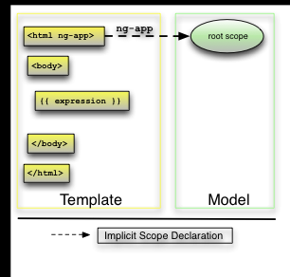
Bootstrapping AngularJS apps
Bootstrapping AngularJS apps automatically using the ngApp directive is very easy and suitable for most cases. In advanced cases, such as when using script loaders, you can use the imperative / manual way to bootstrap the app
There are 3 important things that happen during the app bootstrap:
The injector that will be used for dependency injection is created
The injector will then create the root scope that will become the context for the model of our application
Angular will then "compile" the DOM starting at the ngApp root element, processing any directives and bindings found along the way
Once an application is bootstrapped, it will then wait for incoming browser events that might change the model. Once such an event occurs, Angular detects if it caused any model changes and if changes are found, Angular will reflect them in the view by updating all of the affected bindings

Slide 9
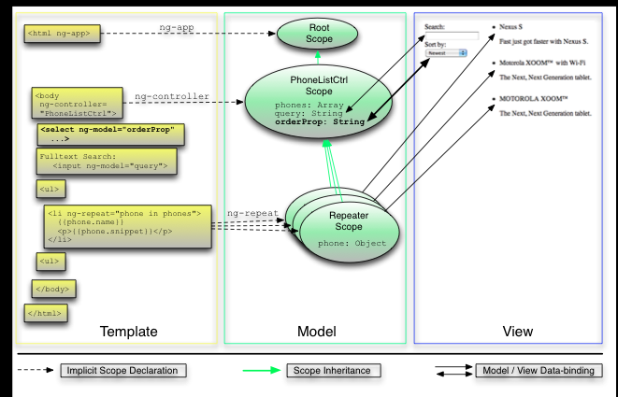
Two way data binding
Data changes in model reflects in view automatically and vice versa. No need of DOM manipulations

Slide 10
Routing and Multiple Views
ngRoute module: is disturbed separately from the core Angular framework
Provides routing and deep linking services and directives for angular apps
Application routes in Angular are declared via the $routeProvider, which is the provider of the $route service. This service makes it easy to wire together controllers, view templates, and the current URL location in the browser. Using this feature, we can implement deep linking, which lets us utilize the browser's history (back and forward navigation) and bookmarks

Slide 11
AngularJS Testability
AngularJS has an integrated dependency injection framework, provides mocks for many heavy dependencies (server-side communication)
ngMock: module provides support to inject and mock Angular services into unit tests. In addition, ngMock also extends various core ng services such that they can be inspected and controlled in a synchronous manner within test code
angular.mock: Namespace from 'angular-mocks.js' which contains testing related code
Jasmine: Jasmine is a behavior-driven development framework for testing JavaScript code. It does not depend on any other JavaScript frameworks. It does not require a DOM
describe – Global Jasmine function with two parameters: a string and a function
Matchers – Each matcher implements a boolean comparison between actual and expected value
expect(a).toBe(b); expect(a).not.toBe(null);
Jasmine unit test are run with Karma Test Runner
Jasmine end to end tests are run with Protracter End-to-End test runner
Web driver is required to execute the Protracter script : npm run update-webdriver
Run the Protracter test : npm run protractor

Slide 12
AngularJS Testability
AngularJS has an integrated dependency injection framework, provides mocks for many heavy dependencies (server-side communication)
ngMock: module provides support to inject and mock Angular services into unit tests. In addition, ngMock also extends various core ng services such that they can be inspected and controlled in a synchronous manner within test code
angular.mock: Namespace from 'angular-mocks.js' which contains testing related code
Jasmine: Jasmine is a behavior-driven development framework for testing JavaScript code. It does not depend on any other JavaScript frameworks. It does not require a DOM
describe – Global Jasmine function with two parameters: a string and a function
Matchers – Each matcher implements a boolean comparison between actual and expected value
expect(a).toBe(b); expect(a).not.toBe(null);
Jasmine unit test are run with Karma Test Runner
Jasmine end to end tests are run with Protracter End-to-End test runner
Web driver is required to execute the Protracter script : npm run update-webdriver
Run the Protracter test : npm run protractor

Slide 13
JQuery
AngularJS can use jQuery if it's present in your app when the application is being bootstrapped. If jQuery is not present in your script path, Angular falls back to its own implementation of the subset of jQuery that we call jQLite
jqLite is a tiny, API-compatible subset of jQuery that allows Angular to manipulate the DOM in a cross-browser compatible way. jqLite implements only the most commonly needed functionality with the goal of having a very small footprint
To use jQuery, simply ensure it is loaded before the angular.js file. You can also use the ngJq directive to specify that jqlite should be used over jQuery, or to use a specific version of jQuery if multiple versions exist on the page
If jQuery is available, angular.element is an alias for the jQuery function. If jQuery is not available, angular.element delegates to Angular's built-in subset of jQuery, called "jQuery lite" or jqLite.

Slide 14
Best Practices
Namespace distributed code – OpenSource code should be name spaced
Only use .$broadcast(), .$emit(), and .$on() for atomic events
Always let users use expressions “{{}}” whenever possible
Extend directives by using Directive Controllers
Add teardown code to controllers and directives - Controllers and directives emit an event right before they are destroyed. You can perform the garbage collection there.
Leverage modules properly – Group your code into related bundles. This way if you remove a module, your app still works
Add NPM and Bower support

Slide 15
References
https://docs.angularjs.org/tutorial/
https://github.com/angular/angular-seed
https://docs.angularjs.org/tutorial/step_00
https://www.madewithangular.com/#/
https://github.com/angular/angular.js/wiki/Best-Practices
https://github.com/angular/angular-seed

