Slide 1


The 4th International Conference on Intelligent Computing
and Next Generation Networks (ICNGN 2025)
Alzheimer’s Disease Detection Using Deep Learning Models
JEFF H
II Year B.Tech CSE
School of Computer Science and Engineering
Vellore Institute of Technology, Chennai, India

Slide 2
INTRODUCTION
Alzheimer’s disease (AD) is the most common cause of dementia affecting millions worldwide and leading to progressive cognitive decline and loss of independence.
Early detection is crucial but traditional tests often lack sensitivity especially in differentiating AD from mild cognitive impairment (MCI).
Neuroimaging (MRI) provides insights but is complex and time consuming for manual interpretation.
Deep learning, particularly Convolutional Neural Networks (CNNs) offer an automated and efficient solution for detecting AD from MRI scans.
Vellore Institute of Technology, Chennai
1

Slide 3
PROBLEM STATEMENT
Current diagnostic methods rely on cognitive assessments and expert interpretation of neuroimaging.
These approaches are time intensive and may fail to identify early stage AD where timely intervention is most effective.
Automated deep learning models have shown significant potential in analyzing neuroimaging data.
Therefore, developing a reliable, accurate and efficient automated system is essential for supporting clinicians in early AD diagnosis
Vellore Institute of Technology, Chennai
1

Slide 4
RESEARCH OBJECTIVE
Develop a deep learning system for automated Alzheimer’s detection using neuroimaging to aid clinical decisions.
Evaluate ResNet50, MobileNetV2 and InceptionV3 for Alzheimer’s classification based on accuracy, sensitivity, specificity and efficiency.
Integrate Augmented Attention to enhance feature extraction and assess performance improvement in classification performance.
Vellore Institute of Technology, Chennai
4
1

Slide 5
PROPOSED SYSTEM
Early detection of Alzheimer’s disease is crucial for timely intervention but diagnosing it remains challenging due to subtle symptoms and complex neuroimaging patterns.
We analyze a deep learning based system using MRI images for early detection and classification.
MobileNetV2
ResNet50
InceptionV3
Incorporated Augmented Attention
Vellore Institute of Technology, Chennai
1

Slide 6
DATASET
Preprocessing steps:
Noise reduction.
Image resizing for model compatibility
Image augmentation (e.g., rotation, flipping, brightness adjustments) to increase data diversity.
Dataset: ADNI - 4 Classes
Class | Count
Non Demented | 9600
Mild Demented | 8960
Very Mild Demented | 8960
Moderate Demented | 6464
Vellore Institute of Technology, Chennai
9
1

Slide 7
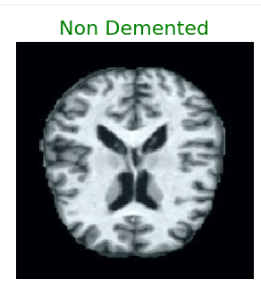
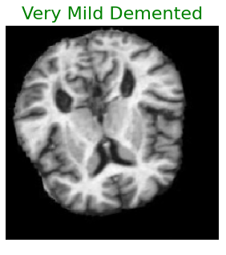
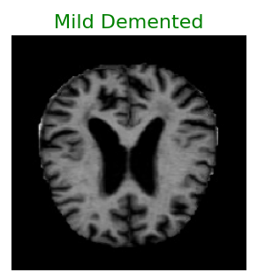
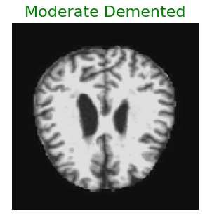
Sample Images

Slide 8
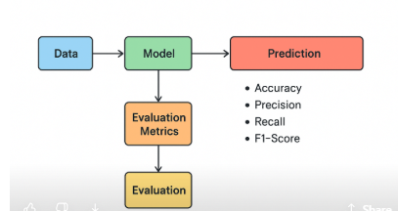
PROPOSED FLOW DIAGRAM
Vellore Institute of Technology, Chennai
1

Slide 9
MobileNetV2
MobileNetV2 uses depthwise separable convolutions to perform efficient and lightweight feature extraction greatly reducing computation while maintaining strong accuracy.
Its architecture captures essential local patterns in MRI scans making it effective within the ensemble for Alzheimer’s classification.
Base Model: MobileNetV2 pre-trained on ImageNet dataset
Input shape : (224, 224, 3)
Output Layer: Dense (4 units, Softmax) for classification.
Optimizer: Adam (Learning rate: 0.0001).
Loss Function: Categorical Crossentropy.
Vellore Institute of Technology, Chennai
14
1

Slide 10
ResNet50
Utilizes skip connections enabling effective training of deep networks without the vanishing gradient problem.
Base Model: ResNet50 pre-trained on ImageNet,
input shape (224, 224, 3).
Custom Layers:
GlobalAveragePooling2D to reduce spatial dimensions.
Dense (512 units, ReLU) with L2 regularization (0.01).
BatchNormalization for stable training.
Dropout (30%) for regularization.
Output Layer: Dense (4 units, Softmax) for classification.
Optimizer: Adam (Learning rate: 0.0001).
Loss Function: Categorical Crossentropy.
Vellore Institute of Technology, Chennai
18
1

Slide 11
InceptionV3
InceptionV3 extracts multi-scale features by processing the MRI image through parallel convolution paths (1×1, 3×3, 5×5), allowing it to detect both fine and large-scale structural patterns.
Its multi-branch architecture helps capture diverse Alzheimer’s biomarkers such as hippocampal shrinkage, cortex thinning, and ventricle enlargement.
Base Model: InceptionV3 pre-trained on ImageNet
Input shape (224, 224, 3)
Output Layer: Dense (4 units, Softmax) for classification.
Optimizer: Adam (Learning rate: 0.0001).
Loss Function: Categorical Crossentropy.
Vellore Institute of Technology, Chennai
22
1

Slide 12
AUGMENTED ATTENTION
Input: Pre-processed MRI scans (224x224x3).
Base Extractor: MobileNetV2 /ResNet50/ InceptionV3 / Augmented Attention
Augmented Attention Mechanism:
Apply both channel and spatial attention.
Focus on important regions and features based on learned attention scores.
Flatten: Convert the output of the attention mechanism into a 1D vector.
Fully Connected Layers:
Dense layers for further feature processing.
Dropout layers for regularization.
Output: Softmax classification into AD, MCI, and Healthy.
Vellore Institute of Technology, Chennai
16
1

Slide 13
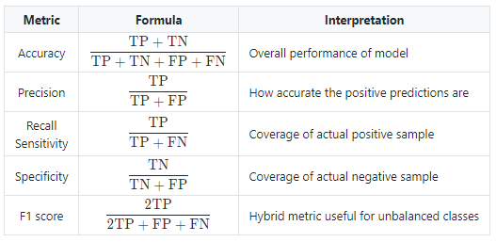
EVALUATION METRICS

Slide 14
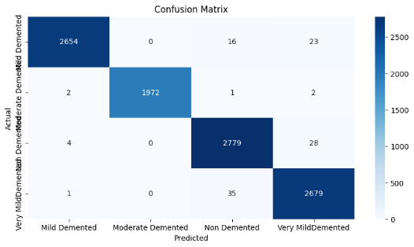
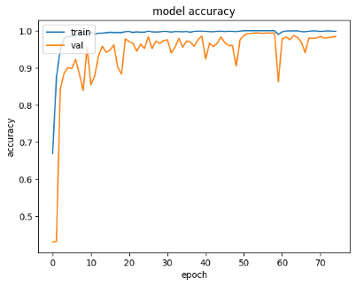
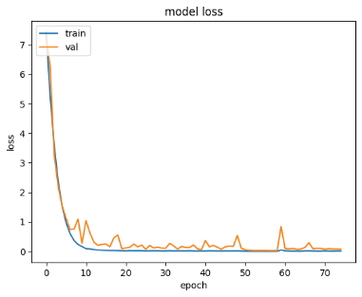
Results and Discussion - MobileNetV2
Confusion Matrix
Accuracy Curve
Loss Curve
Model | Class | Precision | Recall | F1-Score | Support | Accuracy
MobileNetV2 | Mild Demented | 1 | 0.99 | 0.99 | 2693 | 98.9%
 | Moderate Demented | 1.00 | 1 | 1 | 1977
 | Non-Demented | 0.98 | 0.99 | 0.98 | 2811
 | Very Mild Demented | 0.98 | 0.99 | 0.98 | 2715
Vellore Institute of Technology, Chennai
15
1

Slide 15
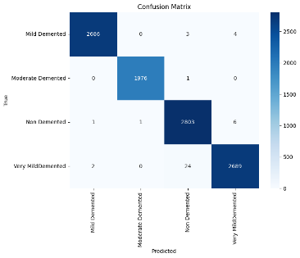
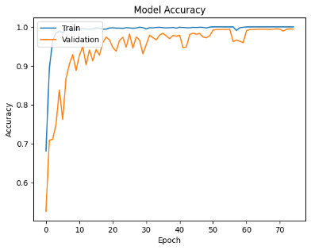
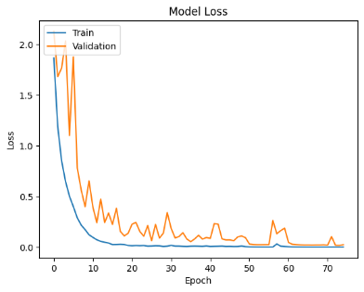
MobileNetV2 + ATTENTION
Confusion Matrix
Accuracy Curve
Loss Curve
Model | Class | Precision | Recall | F1-Score | Support | Accuracy
MobileNetV2 | Mild Demented | 1.00 | 1.00 | 1.00 | 2693 | 99.6%
 | Moderate Demented | 1.00 | 1.00 | 1.00 | 1977
 | Non-Demented | 0.99 | 1.00 | 0.99 | 2811
 | Very Mild Demented | 1.00 | 0.99 | 0.99 | 2715
Vellore Institute of Technology, Chennai
17
1

Slide 16
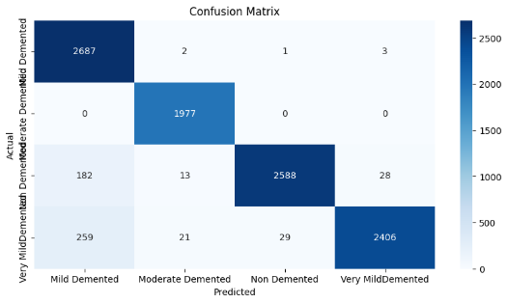
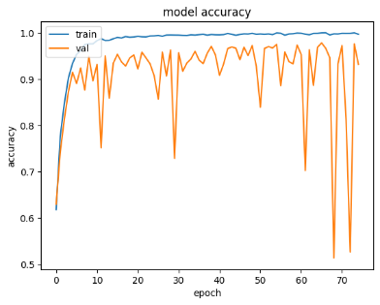
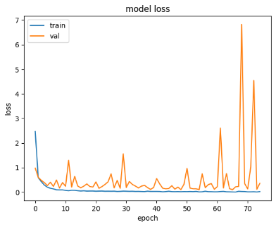
Results and Discussion : ResNet50
Confusion Matrix
Accuracy Curve
Loss Curve
Model | Class | Precision | Recall | F1-Score | Support | Accuracy
ResNet50 | Mild Demented | 0.86 | 1.00 | 0.92 | 2693 | 94.7%
 | Moderate Demented | 0.98 | 1.00 | 0.99 | 1977
 | Non-Demented | 0.99 | 0.92 | 0.95 | 2811
 | Very Mild Demented | 0.99 | 0.89 | 0.93 | 2715
Vellore Institute of Technology, Chennai
19
1

Slide 17

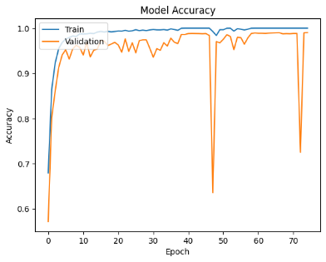
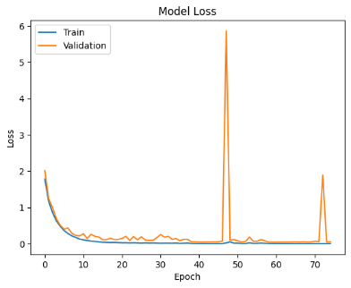
RESULTS: ResNet50 + ATTENTION
Confusion Matrix
Accuracy Curve
Loss Curve
Model | Class | Precision | Recall | F1-Score | Support | Accuracy
ResNet50 | Mild Demented | 1.00 | 1.00 | 1.00 | 2693 | 99.3%
 | Moderate Demented | 1.00 | 1.00 | 1.00 | 1977
 | Non-Demented | 0.99 | 0.99 | 0.99 | 2811
 | Very Mild Demented | 0.99 | 0.99 | 0.99 | 2715
Vellore Institute of Technology, Chennai
21
1

Slide 18

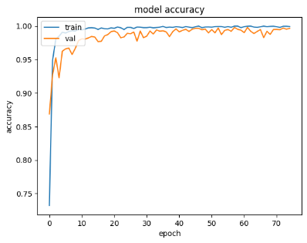
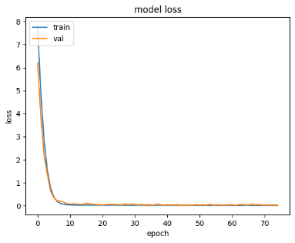
Results and Discussion : InceptionV3
Confusion Matrix
Accuracy Curve
Loss Curve
Model | Class | Precision | Recall | F1-Score | Support | Accuracy
InceptionV3 | Mild Demented | 1.00 | 1.00 | 1.00 | 2693 | 99.8%
 | Moderate Demented | 1.00 | 1.00 | 1.00 | 1977
 | Non-Demented | 1.00 | 1.00 | 1.00 | 2811
 | Very Mild Demented | 1.00 | 1.00 | 1.00 | 2715
Vellore Institute of Technology, Chennai
23
1

Slide 19

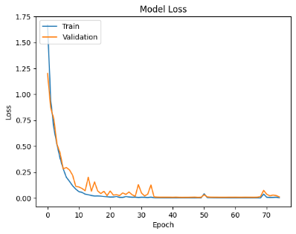

RESULTS: InceptionV3 + ATTENTION
Confusion Matrix
Accuracy Curve
Loss Curve
Model | Class | Precision | Recall | F1-Score | Support | Accuracy
InceptionV3 | Mild Demented | 1.00 | 1.00 | 1.00 | 2693 | 99.8%
 | Moderate Demented | 1.00 | 1.00 | 1.00 | 1977
 | Non-Demented | 1.00 | 1.00 | 1.00 | 2811
 | Very Mild Demented | 1.00 | 1.00 | 1.00 | 2715
Evaluation Metrics
Vellore Institute of Technology, Chennai
25
1

Slide 20
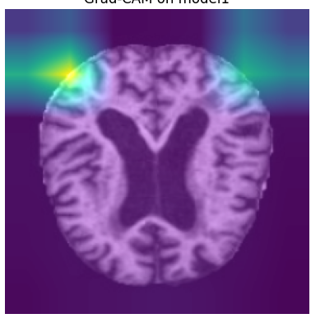
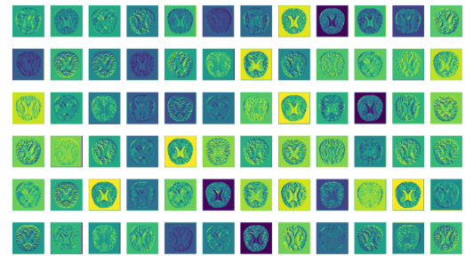
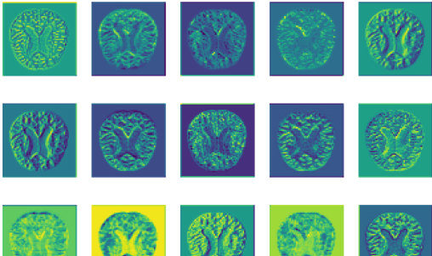
Visualization

Slide 21
CONCLUSION AND FUTURE WORK
Base models MobileNetV2, ResNet50, InceptionV3 achieved an accuracy of 98.9%, 94.7% and 99.8% accuracy respectively.
After incorporating Attention Augmentionwith MobileNetV2, ResNet50, InceptionV3 accuracies improved to 99.6%, 99.3% and 99.8% respectively.
Key Contributions:
Enhanced feature recognition in MRI scans
Improved model performance with attention mechanisms
Clinically useful for early diagnosis, especially in resource-limited settings
Future Scope:
Integration of multimodal data (genetics, biomarkers, cognitive scores)
Explainable AI (XAI) for clinical transparency
Expansion to continuous monitoring via wearable devices
Vellore Institute of Technology, Chennai
27
1

Slide 22
REFERENCES
Ji, H., Liu, Z., Yan, W. Q., & Klette, R. (2019, June). Early diagnosis of Alzheimer's disease using deep learning. In Proceedings of the 2nd international conference on control and computer vision (pp. 87-91).
Ibrahim, R., Ghnemat, R., & Abu Al-Haija, Q. (2023). Improving Alzheimer’s disease and brain tumor detection using deep learning with particle swarm optimization. AI, 4(3), 551-573.
Hazarika, R. A., Maji, A. K., Kandar, D., Jasinska, E., Krejci, P., Leonowicz, Z., & Jasinski, M. (2023). An approach for classification of Alzheimer’s disease using deep neural network and brain magnetic resonance imaging (MRI). Electronics, 12(3), 676.
Sharma, S., Guleria, K., Tiwari, S., & Kumar, S. (2022). A deep learning based convolutional neural network model with VGG16 feature extractor for the detection of Alzheimer Disease using MRI scans. Measurement: Sensors, 24, 100506.
Seliya, Naeem, Taghi M. Khoshgoftaar, and Jason Van Hulse. "A study on the relationships of classifier performance metrics." 2009 21st IEEE international conference on tools with artificial intelligence. IEEE, 2009
Helaly, H. A., Badawy, M., & Haikal, A. Y. (2022). Deep learning approach for early detection of Alzheimer’s disease. Cognitive computation, 14(5), 1711-1727.
Vellore Institute of Technology, Chennai
1

Slide 23
REFERENCES
Murugan, S., Venkatesan, C., Sumithra, M. G., Gao, X. Z., Elakkiya, B., Akila, M., & Manoharan, S. (2021). DEMNET: A deep learning model for early diagnosis of Alzheimer diseases and dementia from MR images. Ieee Access, 9, 90319-90329.
Venugopalan, J., Tong, L., Hassanzadeh, H. R., & Wang, M. D. (2021). Multimodal deep learning models for early detection of Alzheimer’s disease stage. Scientific reports, 11(1), 3254.
Ullah, H. T., Onik, Z., Islam, R., & Nandi, D. (2018, April). Alzheimer's disease and dementia detection from 3D brain MRI data using deep convolutional neural networks. In 2018 3rd international conference for convergence in technology (I2CT) (pp. 1-3). IEEE.
Nawaz, A., Anwar, S. M., Liaqat, R., Iqbal, J., Bagci, U., & Majid, M. (2020, November). Deep convolutional neural network based classification of Alzheimer's disease using MRI data. In 2020 IEEE 23rd International Multitopic Conference (INMIC) (pp. 1-6). IEEE.
Marwa, E. G., Moustafa, H. E. D., Khalifa, F., Khater, H., & AbdElhalim, E. (2023). An MRI-based deep learning approach for accurate detection of Alzheimer’s disease. Alexandria Engineering Journal, 63, 211-221.
Farooq, A., Anwar, S., Awais, M., & Rehman, S. (2017, October). A deep CNN based multi-class classification of Alzheimer's disease using MRI. In 2017 IEEE International Conference on Imaging systems and techniques (IST) (pp. 1-6). IEEE.
Vellore Institute of Technology, Chennai
1

Slide 24
REFERENCES
Rao, B. S., & Aparna, M. (2023). A review on Alzheimer’s disease through analysis of MRI images using deep learning techniques. IEEE Access, 11, 71542-71554.
Gupta, M., Kumar, R., & Abraham, A. (2024). Adversarial Network-Based Classification for Alzheimer’s Disease Using Multimodal Brain Images: A Critical Analysis. IEEE Access.
Ftoutou, A., Majdoub, N., & Ladhari, T. (2023, October). Alzheimer's Disease Classification Using Deep Learning. In 2023 IEEE International Conference on Artificial Intelligence & Green Energy (ICAIGE) (pp. 1-6). IEEE.
Vellore Institute of Technology, Chennai
1

Slide 25
Thank You
Vellore Institute of Technology, Chennai
33

