Slide 1
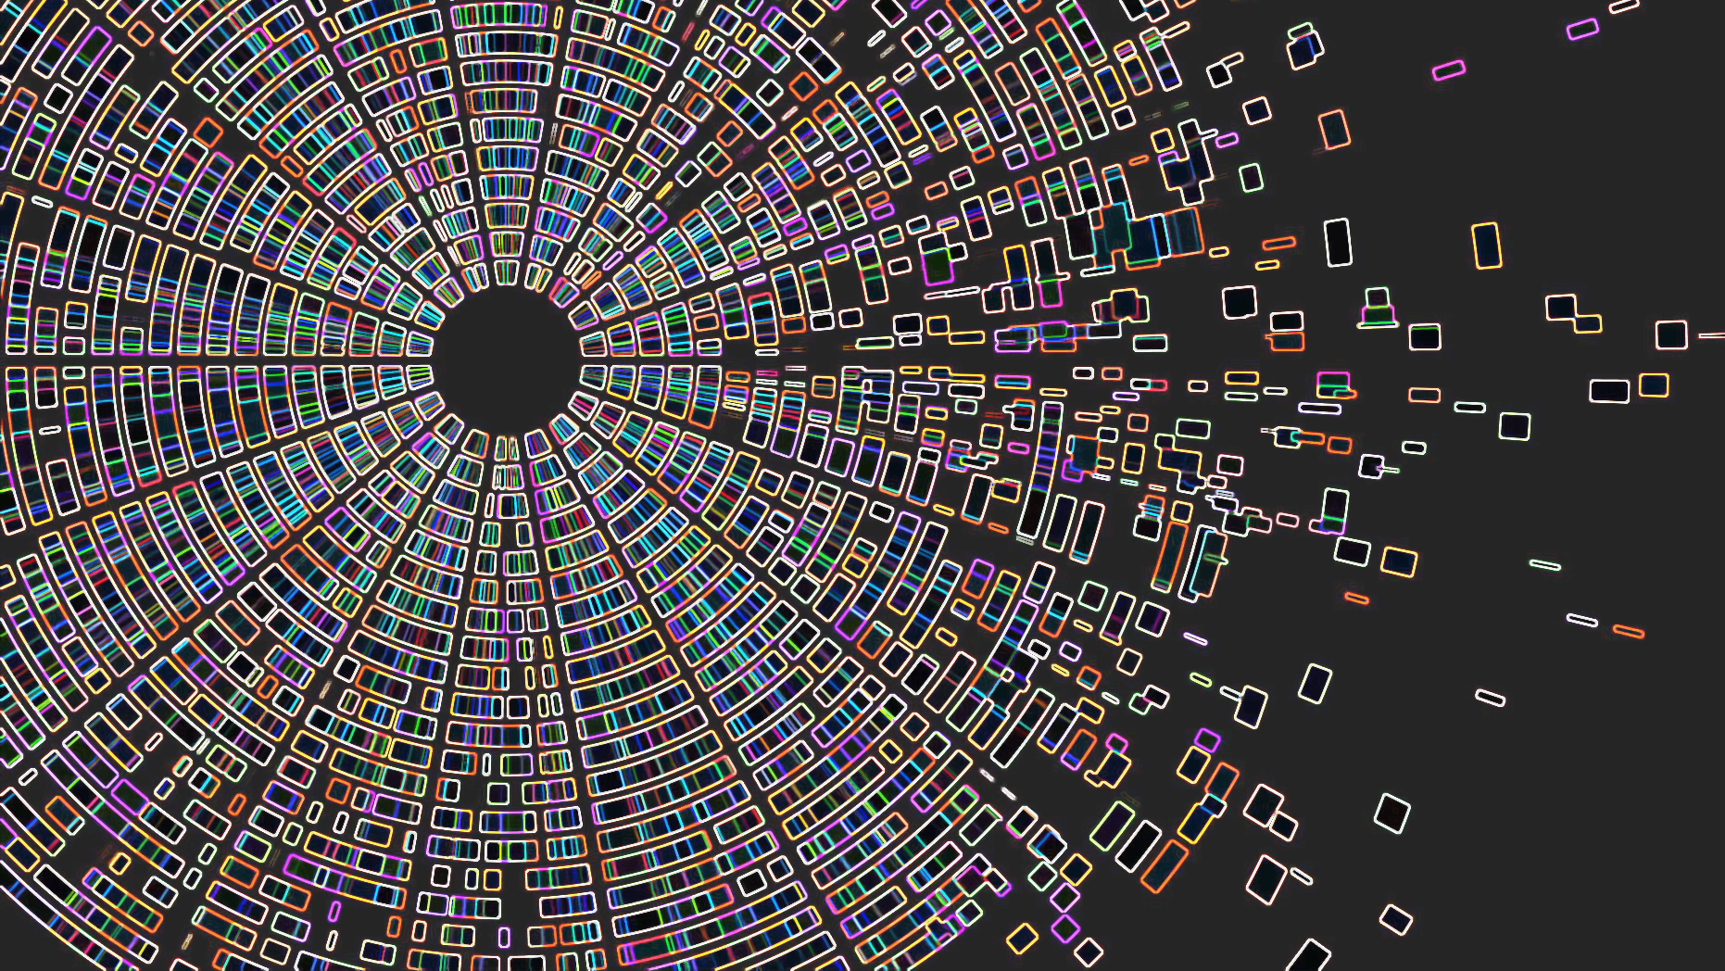
ITAI 1378 Midterm Blueprint Proposal
Tattoo & Street Art Visual Classifier
A transfer-learning computer vision system categorizing body ink, outdoor murals, and background clutter.
Author
Jonathan S. Aldana
Project Tier
Tier 1: Core (single-Task CNN)
Institution
Houston City College

Slide 2
The Problem: Identifying Distinguishing Physical Markers
The Real-World Challenge
In missing persons registries, disaster victim identification (DVI), and medical biometric records, being able to distinguish physical features such as tattoos, scars, and skin patterns is crucial for human identification.
When searching through digital evidence, personal photos, or intake databases, automated image search tools constantly confuse outdoor murals, street graffiti, clothing prints, or plain skin with actual permanent body ink.
Who Cares & Why Does It Matter?
Who: Humanitarian recovery organizations, forensic pathologists, and digital registries.
Why: Reviewing thousands of uncategorized personal photos manually to verify if an image depicts a real tattoo on a victim or missing person causes critical delays during recovery and identification efforts.
What Will Solve It?
An automated 3-class vision classifier (tats, street_art, none) that filters out urban murals, graffiti, and background noise, isolating physical body markings for rapid review.

Slide 3
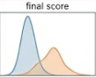


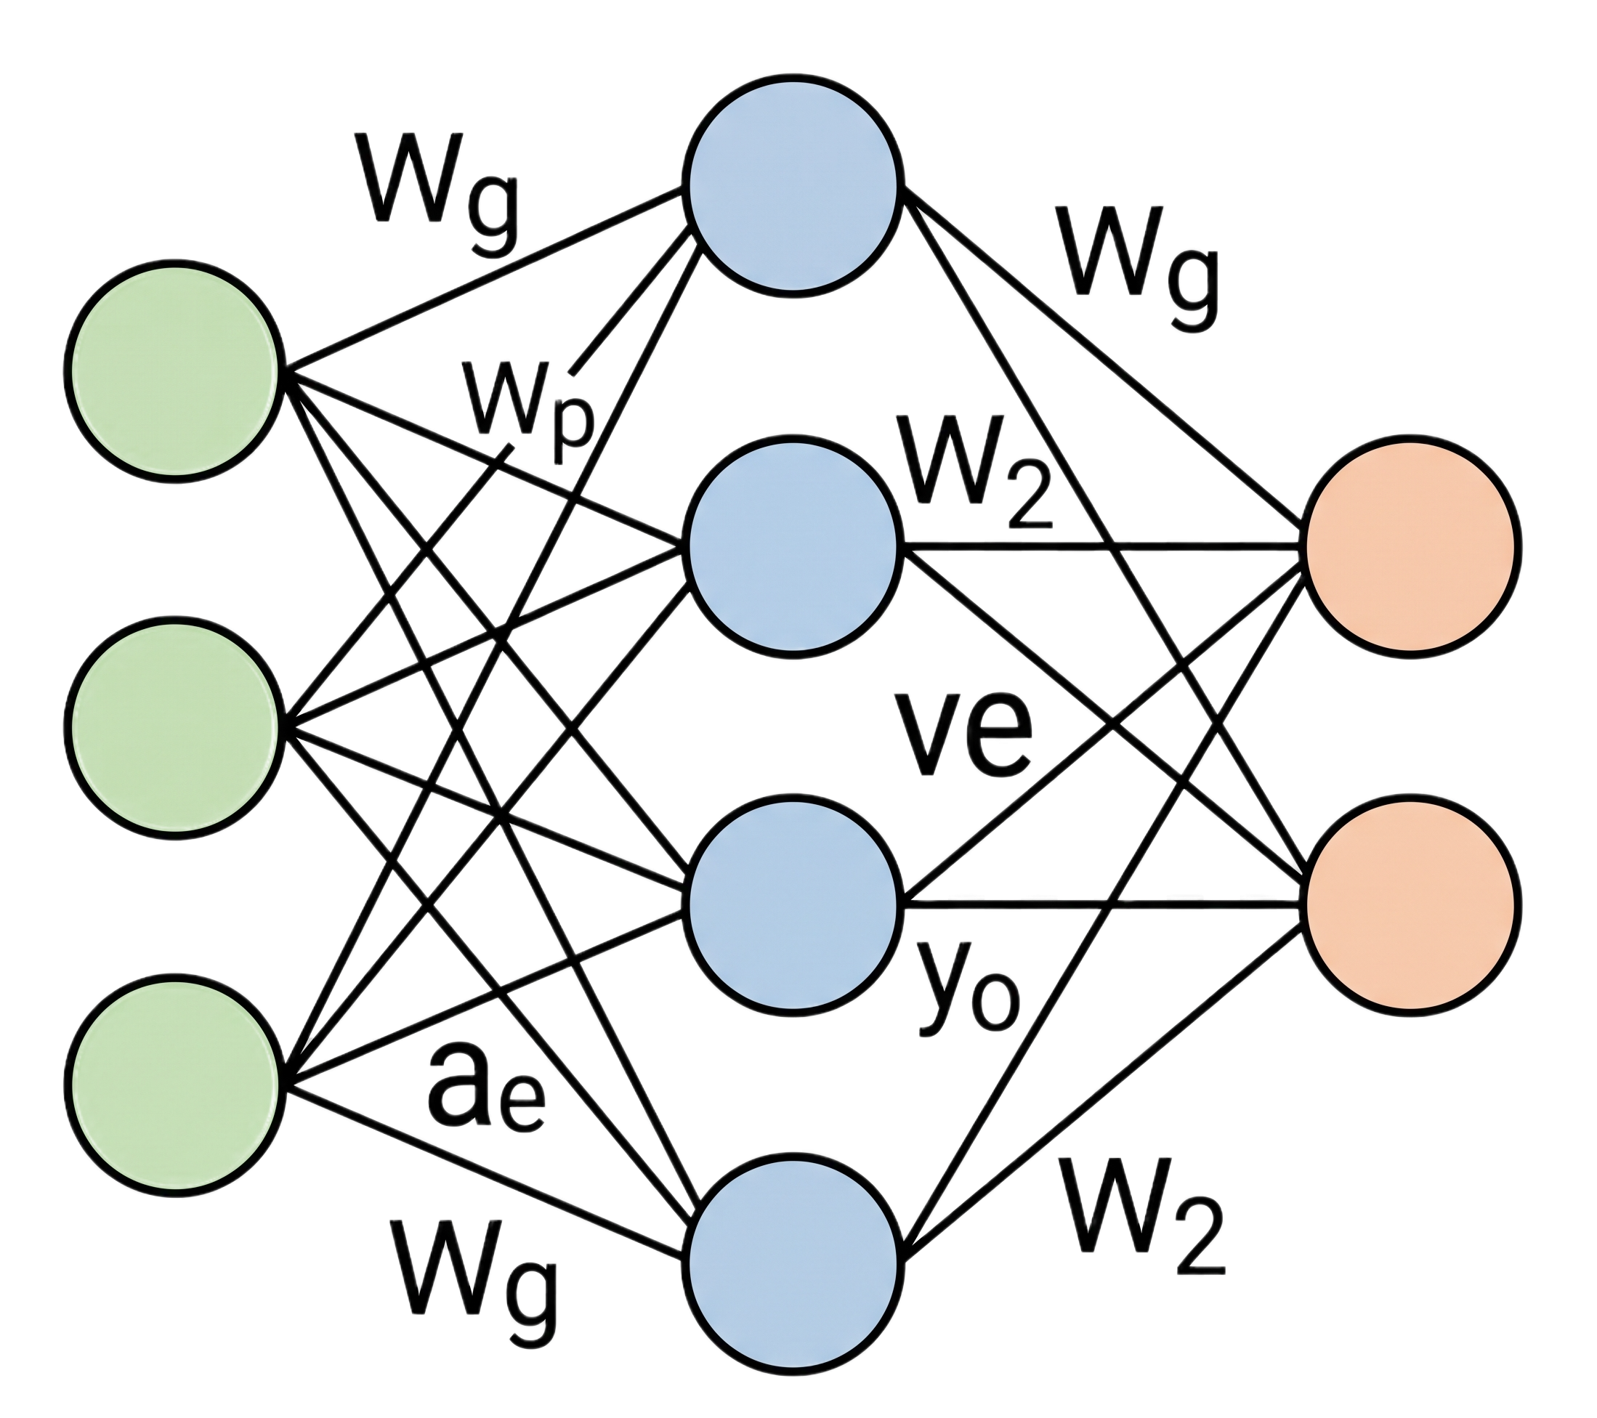
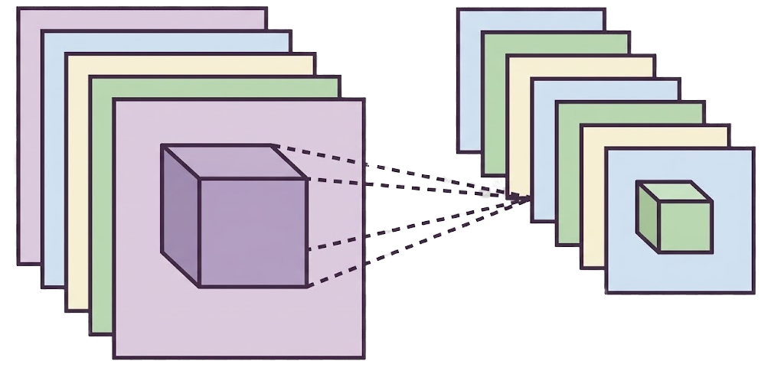

The Solution: 3-stage triage pipeline
Input & Processing
- Input Image / Crop
- Resize to 224x224
- Normalize Tensors
Feature Extraction
- Pretrained Resnet/MobileNetV2
- Frozen Feature Weights
- Extract Texture & Edge Features
Classification Head
- Custom Linear Layer (2048 -> 3)
- Trainable Classification Head
- Softmax Activation
Decision Output
- Final Class Probabilities
- Output Label: tats | street_art | none
- Decision Confidence Score
tensor
An end-to-end deep learning pipeline ingests raw field images, extracts texture and edge representations using a pretrained ResNet50 backbone, and classifies the input into tattoos, street murals, or background clutter to rapidly triage physical identification markers.

Slide 4

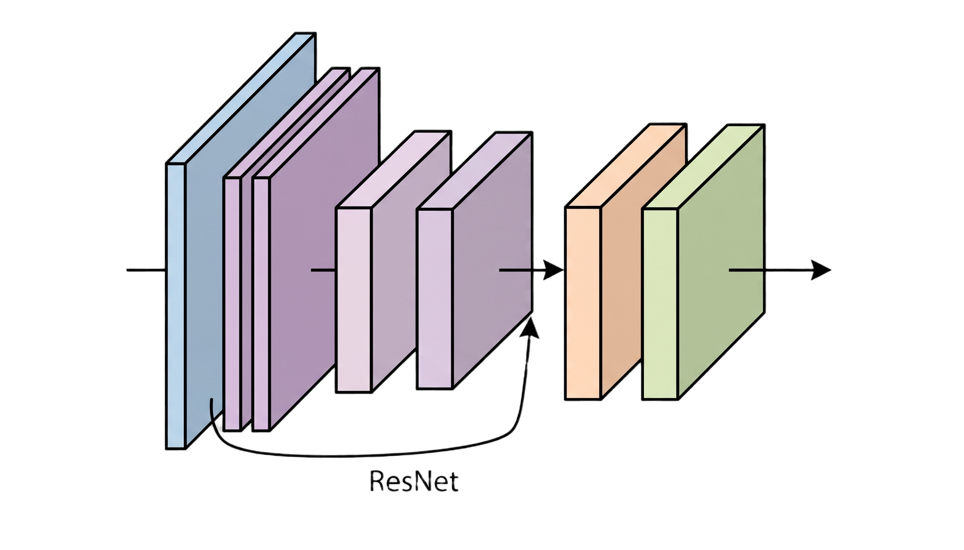



Technical Approach & Justification
CV Technique
Model Architecture
Framework & Tools
- PyTorch & Torchvision for neural network modeling and transforms
- Data Loaders: Standard ImageFolder directory structure
- Hardware: Google Colab with free-tier T4 GPU acceleration
- Multi-Class Image Classification
- 3 target classes: tats, street_art, none
- Focus: Automated visual triage isolating human skin ink from outdoor street artwork
- ResNet50 Backbone (ImageNet Pretrained)
- Transfer Learning: Frozen feature extraction layers to preserve generalized weights
- Custom Head: Linear classification layer ($2048→3$) + Softmax
Why This Approach: Transfer learning via ResNet50 is optimal for a 2,600-image dataset. Pretrained convolutional layers extract rich edge and texture features out of the box, preventing severe overfitting while allowing the model to train efficiently within Colab's GPU session limits.

Slide 5
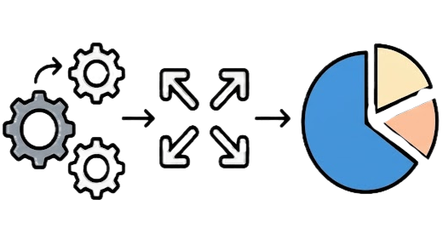
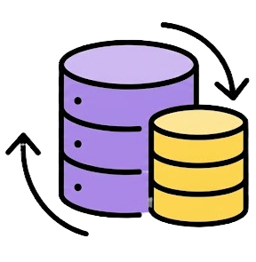
Data Plan & Architecture
Dataset Composition & Class Distribution
Data Pipeline & Split Strategy
- Train Split (80%): 2,128 (931 none, 641 tats, 556 street_art)
- Validation Split (10%): 265 (116 none, 80 tats, 69 street_art)
- Test Split (10%): 268 (117 none, 81 tats, 70 street_art)
- Resolution & Tensors: Resized to 224x224 RGB, ImageNet Normalization
- Augmentations: Random Horizontal flip, slight rotation, color jitter
- Total Volume: 2,661 Images across 3 classes
- tats: 802 images (skin ink, line work, pigmentation)
- street_art: 695 images (murals, spray paint on urban surfaces)
- none: 1,164 images (billboards, traffic signs, clear and damaged skin, noise)
- Sources: Curated from Roboflow Universe and Images taken by Me.
Data Labeling Challenge & Mitigation: Fine tattoo linework can visually mimic intricate urban murals on building surfaces (Graffiti). Mitigated by heavily weighting the none class (1,164 images, including bare/damaged skin, street signs, billboards, and blank walls) to force the model to learn localized dermis context rather than just raw edges or pigment.

Slide 6

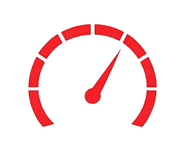
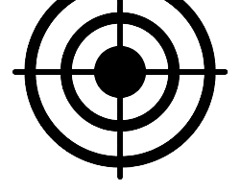
Evaluation Criteria & Success Metrics
Primary Performance
Secondary Evaluation
Baseline & Resource Constraints
- Balance Metric: Macro F1-Score ≥ 0.78 to account for class imbalance (1,164 none vs. 695 street_art).
- Priority Recall: Tattoo Recall target ≥ 85%% to ensure actionable identification markers are rarely missed in intake workflows.
- Diagnostic Audit: Per-class Precision/Recall Analysis and a 3x3 Confusion Matrix to pinpoint whether false positives stem from skin textures or wall patterns.
- Chance Baseline: 33.3% (random assignment across 3 classes).
- Zero-Rule Majority Baseline: 43.7% (predicting none on all inputs: 1,164/2,661).
- Inference Budget: < 200 ms per image on standard CPU instances; < 25ms on CUDA-enabled runtimes.
- Storage Footprint: Quantized model weights kept at < 100MB for lightweight containerization.
- Target Metric: 80% Overall Multi-Class Top-1 Accuracy
- Operational Goal: Establish reliable automated routing across body ink, street murals, and negative background clutter.
- Optimization Loss: Cross-Entropy Loss with Softmax activation on final logits.
- Minimum Threshold: Model must sustain > 75% accuracy across all three individual classes to prevent one class from dragging down the aggregate score.
Model Selection Protocol: Checkpoints will be ranked by the lowest Validation Loss rather than accuracy alone. Training terminates early if validation loss does not improve after 5 epochs to prevent memorization of repetitive skin tones or background noise. Final verification occurs solely on the untouched 268-image test set.

Slide 7
Project Milestone Plan & Timeline
Phase | Project Goal | Milestone | 16 Week Term
🧭 Blueprint | Project Proposal & architecture plan approved | Midterm Pitch Submitted | Week 10
🥊 First Working Demo | Pretrained ResNet50 pipeline runs end-to-end on sample batches | Pipeline verifies inference end-to-end | Week 11
🛠️ Make it Yours | Ingest the full 2,661 dataset; fine-tune the head on tats, street_art, none | Model actively trains on custom classes | Weeks 12-13
📈 Improve & Measure | Measure against targets (≥ 80% Acc, ≥ 0.78 F1); tune augmentations. | Test metrics & confusion matrix logged | Week 14
📦 Package & Present | Finalize PyTorch weights (100MB), README, demo video & deck | Final deliverables submitted | Week 15
Why Does the Demo Precede Full Data Work? In industry workflows, proving the ResNet50 inference pipeline runs end-to-end on a small sample de-risks deployment early. This confirms code and GPU environments work before investing compute time in training across all 2,661 images.

Slide 8


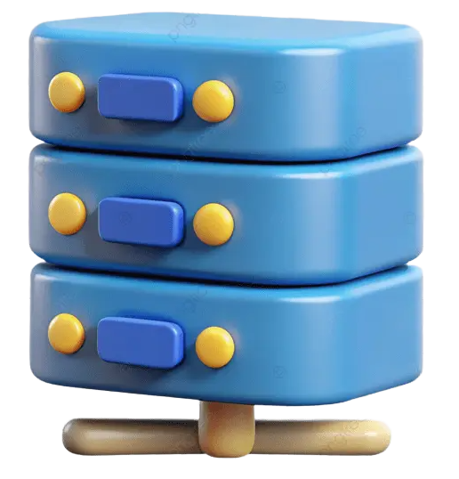
Risks & Computational Resources
Domain Overfitting
Class Imbalance Risk
Compute & Estimated Cost
- Risk: High visual similarity between intricate tattoo linework and fine mural line art leads to misclassifications.
- Impact: False positives where human skin with tattoos is flagged as street graffiti or vice versa.
- Plan B: Unfreeze deeper ResNet50 residual layers to learn fine-grained substrate textures and apply heavy color jitter + affine augmentation.
- Risk: Skewed training set (1,164 none vs. 695 street_art) can cause the model to default toward predicting the majority class.
- Impact: High overall accuracy but poor recall on street murals and tattoos.
- Plan B: Implement class-weighted cross-entropy loss to penalize minority-class errors, or apply oversampling via augmentations on street_art.
- Primary Platform: Google Colab with free-tier NVIDIA T4 GPU (16GB VRAM).
- Backup Compute: Kaggle Notebooks (free P100/T4 GPUs, 30hrs/week).
- Local Fallback: CPU workstation for evaluation and batch testing
- Estimated Cost: $0.00 (fully leveraging accessible, free-tier cloud GPU resources).
Risk Protocol: Model checkpoints are monitored against per-class F1-scores during training. If any single class drops below 70% recall, Plan B interventions (class weighting and deep layer unfreezing) are triggered before the final test evaluation.

