Slide 1

SNAKE MANIA
Submitted in the partial fulfillment for the award of the degree of
BACHELOR OF ENGINEERING
IN
Computer Science with Specialization in AI and ML
Submitted by:
Kunal
20BCS6278
Under the Supervision of:
Mr.Gurpreet Singh Panesar

Slide 2



Team Members
KUNAL GAURAV
20BCS6748
HIMANNSHU GIDWANI
20BCS6637
KUNAL
20BCS6278

Slide 3
01
03
INTRODUCTION TO PROJECT
OBJECTIVES OF THE WORK
02
04
PROBLEM FORMULATION
METHODOLOGY USED
Contents

Slide 4
05
07
RESULTS AND OUTPUTS
FUTURE SCOPE
06
08
CONCLUSION
REFERENCES
Contents

Slide 5
INTRODUCTION TO PROJECT
The Snake-Mania is a game written in C++ based on the classic Nokia Snake game which has been around since the earliest days of home computing and has re-emerged in recent years on mobile phones.
It isn't the world's greatest game, but it does give you an idea of what you can achieve with a language like C++, and perhaps the basis by which to extend the principles and create more interesting games of your own.

Slide 6
PROBLEM FORMULATION
To create an arcade snake game called “Snake Mania” using C++ which will run on the console window .
Helps us to implement C++ programming in games
Powerful tool to help children develop certain life skills
Improve language and math skills
Improve hand-eye co-ordination and help

Slide 7
OBJECTIVES
Snake-Mania is a simple console application with very simple graphics. In this project, you can play the popular “Snake Game” just like you played it elsewhere.
Foods are provided at the several co-ordinates of the screen for the snake to eat. Every time the snake eats the food, its length will by increased by one element along with the score.
The control of this games are as follows :-
W – UP
S – DOWN
A – LEFT
D – RIGHT

Slide 8
METHODOLOGIES USED
We’ve divided the project in four parts :
GUI.h – For the background of our game which include play area borders and scoreboard portion .
gotoxy.h – For moving the cursor to specific co-ordinates of the console screen .
color.h – For coloring the background console , snake and scoreboard .
Main.cpp – For the main logic of program and loops .

Slide 9
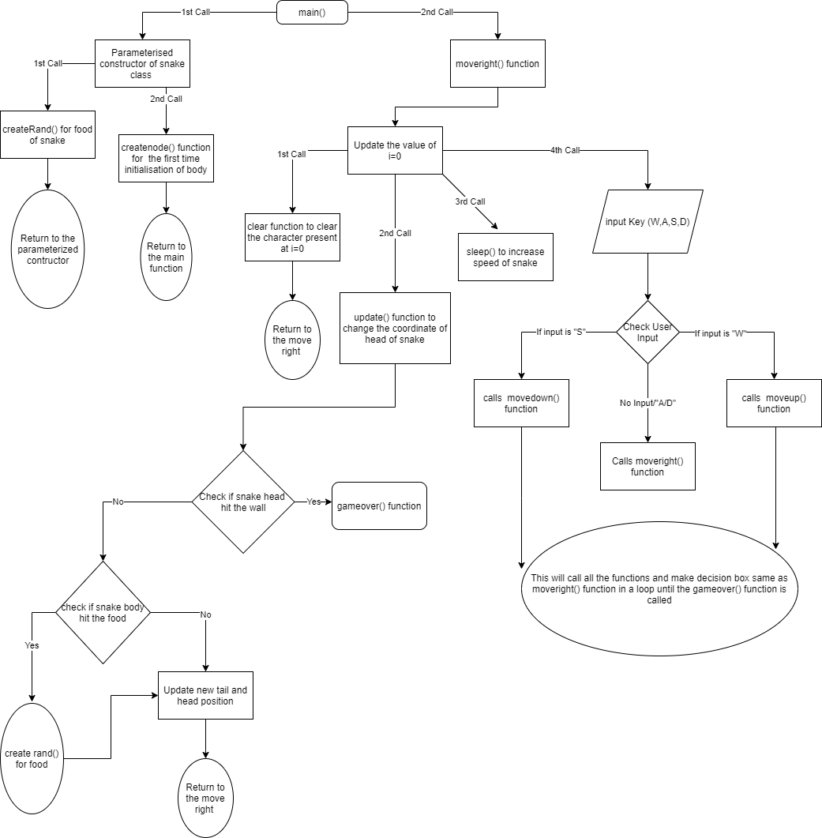
Flow Diagram

Slide 10
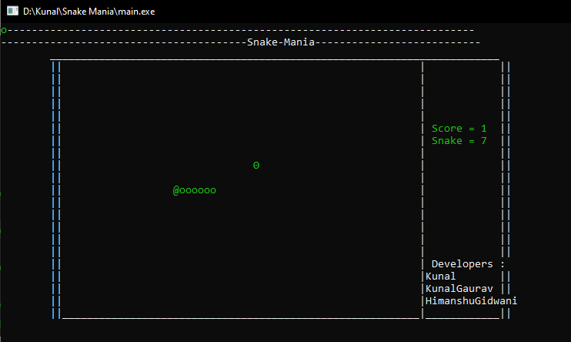
Outputs
PLAY SCREEN

Slide 11
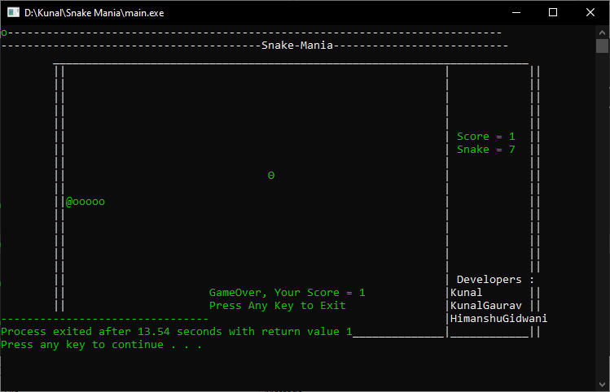
GAME OVER MENU

Slide 12
CONCLUSION
Snake-Mania based on Classic Nokia Snake game can run on any low end PC having a C++ compiler
No Internet Connections Required
By creating this game we got to know how C++ language can be used to create big games like PUBG PC , CS:GO

Slide 13

FUTURE SCOPE
Our project will be able to implement in future after making some changes and modifications as we make our project at a very low level. So the modifications that can be done in our project are:
It can be made with good graphics using QT libraries.
We can add more options like Top scores and Player Profile.
We can add multiplayer option
We can make a Play/Pause Menu

Slide 14
References
https://www.geeksforgeeks.org/c-classes-and-objects/
https://data-flair.training/blogs/header-files-in-c-cpp/
https://slidesgo.com/
https://www.codespeedy.com/play-music-in-cpp/
https://devdocs.io/cpp/

Slide 15
Thank You!!

