Slide 1
Optimising a large image operation
|I1 - I2| / (I1 + I2 + eps) on two 1.1-billion-pixel images
Timing study: numpy vs numexpr, dtypes, memory and CPU cores

Slide 2
The problem
Compute, pixel by pixel: |I1 - I2| / (I1 + I2 + eps)
Two images of 1.1 billion pixels each (32,000 x 34,375).
  Stored as uint8 (0..255) - the normal image format, 1 byte/pixel.
The arithmetic must be done in a wider type:
  on uint8, subtraction wraps and addition overflows.
Goal: get the answer as fast as possible, using as little RAM as possible.

Slide 3
What we varied (the experiments)
1. Input storage: uint8 vs float32.
2. Compute/result type: float16 / float32 / float64.
3. How the code is written: naive one-liner vs in-place (out=).
4. Library: numpy vs numexpr (JIT + multithreaded).
5. Number of CPU cores: 1, 2, 4, 8, 10.
6. Forcing the result type: numexpr float64 vs forced float32.
Everything measured with time.perf_counter, arrays allocated first,
  and a checksum taken afterwards to prove the result is real and correct.

Slide 4
Results at 1.1e9 pixels (uint8 inputs)
Method | Type | Cores | Time | Gpixel/s | Result RAM
numpy naive | float32 | 1 | 10.74 s | 0.10 | 4.40 GB
numpy in-place (out=) | float32 | 1 | ~1.8 s | ~0.62 | 4.40 GB
numpy naive | float16 | 1 | 16.93 s | 0.06 | 2.20 GB
numpy in-place | float16 | 1 | 15.27 s | 0.07 | 2.20 GB
numexpr (safe) | float64 | 10 | 0.514 s | 2.14 | 8.80 GB
numexpr forced out=float32 | float32 | 10 | 0.486 s | 2.26 | 4.40 GB

Slide 5
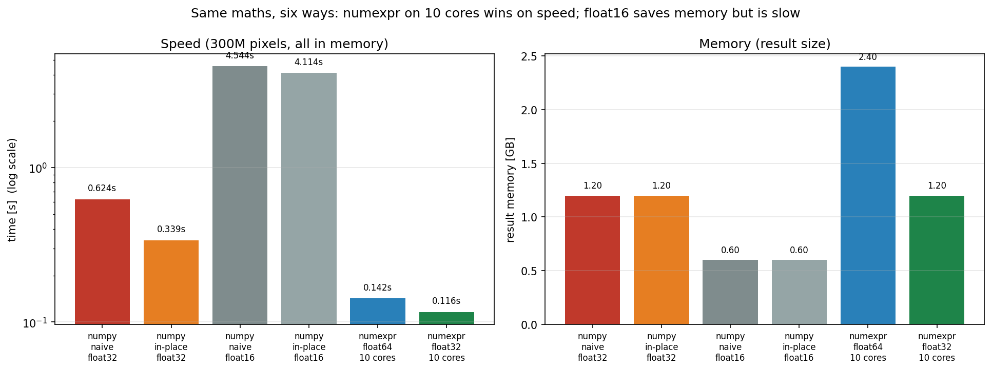
In-memory comparison (300M pixels)
Stable, fair comparison (nothing swaps).
in-place ~2x faster than naive.
float16 ~12x slower than float32.
numexpr on 10 cores ~3-6x faster than numpy.
float32 result halves memory.

Slide 6
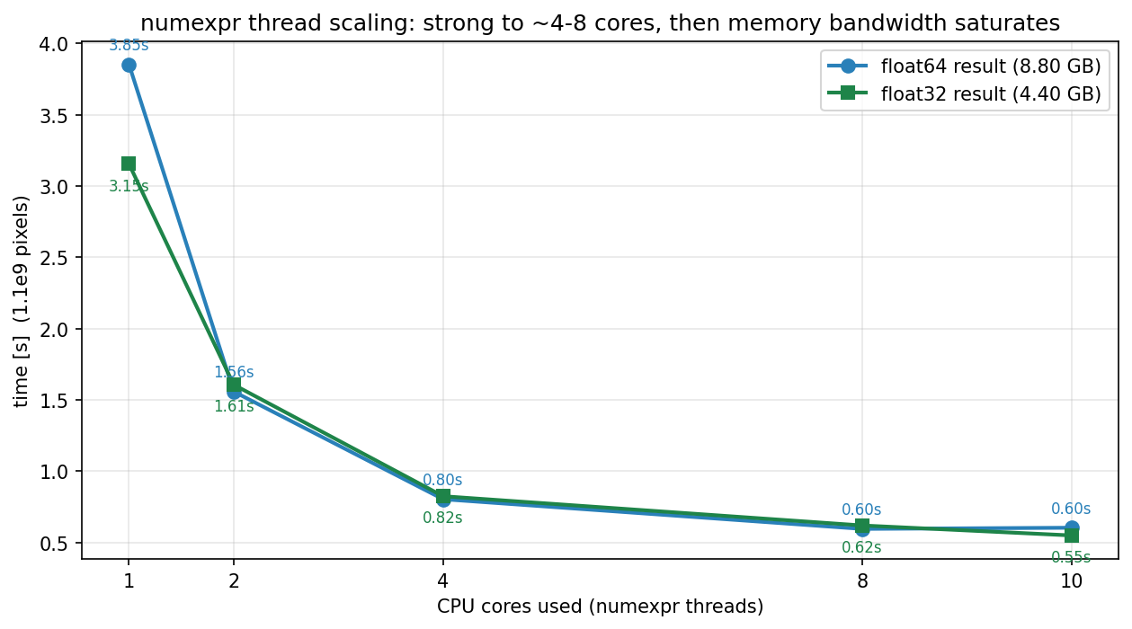
Thread scaling: numexpr (1.1e9 pixels)
1 thread = numpy speed.
Big gains up to ~4-8 cores.
Then the memory bus saturates.
float32 is as fast or faster, at half the RAM.

Slide 7
Headline: force numexpr to 32-bit
numexpr version | Result type | Time (1.1e9) | Result RAM
default, casting='safe' | float64 | 0.514 s | 8.80 GB
forced out=float32 | float32 | 0.486 s | 4.40 GB

Slide 8
Why forcing 32-bit is a free win
Same speed: 0.486 s vs 0.514 s.
Half the RAM: 4.40 GB vs 8.80 GB.
Identical answer (same checksum).
How: pass a pre-allocated float32 buffer as out=,
  with casting='same_kind' (numexpr refuses the downcast under 'safe').

Slide 9
Lessons for code optimisation
1. Keep inputs small: uint8, not float32 (4x less data).
2. Compute in float32 - never in uint8 (wraps/overflows).
3. Reuse memory: in-place / out= avoids full-size temporaries (~2x).
4. Parallelise: numexpr uses all cores (the single biggest speed win).
5. Force the 32-bit result - same speed, half the memory.
6. Keep data in RAM - swapping to disk cost ~10x.
7. If it cannot fit: process in chunks (row blocks) to avoid swap.

Slide 10
The winning configuration
uint8 inputs + numexpr + all cores + forced float32 result.
Result: ~0.49 s and 4.40 GB for 1.1 billion pixels.
  vs the naive float32 numpy one-liner: 10.74 s and swapping.
Run it:
  normdiff_numexpr.py --pixels 1.1e9 --mode numpy numexpr --out-dtype float32
Report timings with context: input dtype, compute dtype, cores, in-RAM or swap.

