Slide 1
SAR Range-Doppler Explorer
Range, azimuth and Doppler in a Synthetic Aperture Radar image
Task 1 - interactive simulation (range_doppler_interactive.py)

Slide 2
What is SAR?
SAR = Synthetic Aperture Radar: a radar on a moving platform images the ground.
  A small antenna is moved along a path; the many echoes are combined to act like one very long antenna - a 'synthetic aperture'.
The radar sends short frequency-swept pulses (chirps) and listens for echoes.
Echo delay gives distance (range); the changing echo frequency (Doppler) from motion gives the along-track position (azimuth).
Result: a two-dimensional image that works day or night and through clouds.

Slide 3
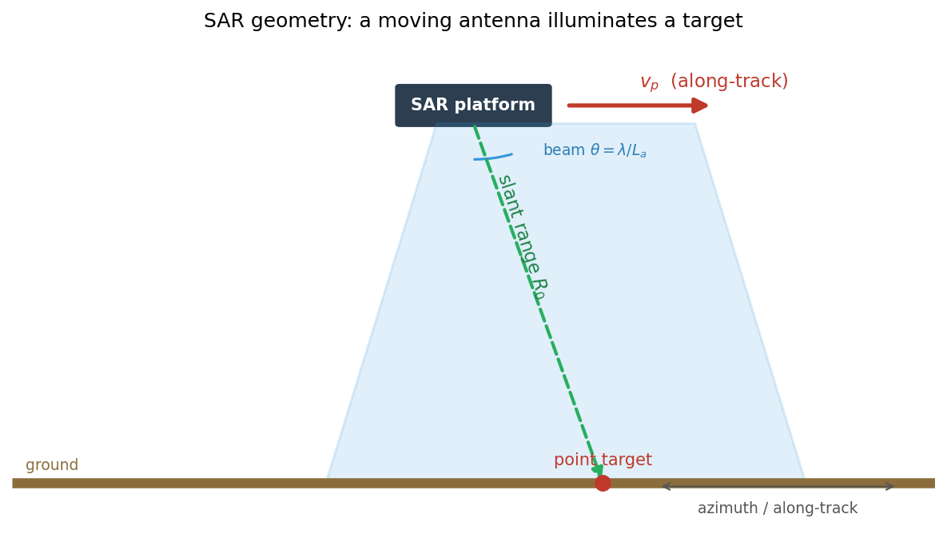
Two dimensions of a SAR image
Range (cross-track):
  measured from echo delay, R = c*tau/2
  clarity set by bandwidth B
Azimuth (along-track):
  measured from Doppler history
  clarity set by antenna length La

Slide 4
What the interactive explorer does
Simulates a single point target and processes it with the Range-Doppler Algorithm.
Left panel: the Range-Doppler map (range vs Doppler frequency).
Right panel: the fully compressed SAR image (range vs azimuth).
Five sliders + one checkbox update both panels live (~12 frames/second).
Live read-out: dR, rho_az, f_dc, Bd, Na.
Press 'r' or click Reset to return to defaults.

Slide 5
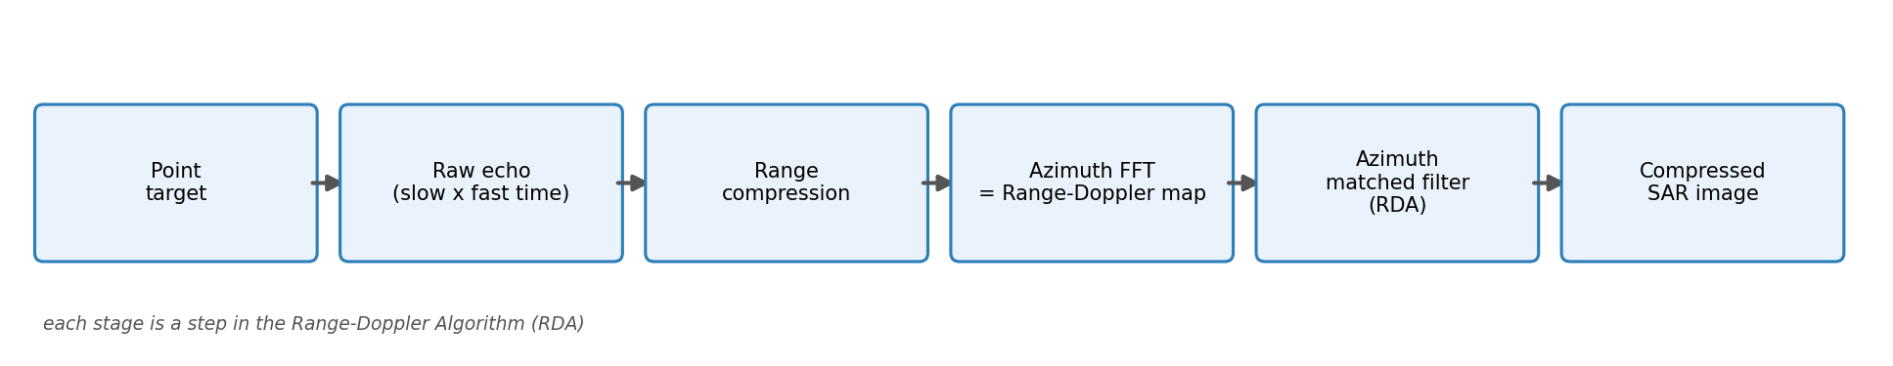
The processing chain (methodology)
1. Build the raw echo in slow-time x fast-time.
2. Range compression (matched filter).
3. FFT along azimuth -> Range-Doppler map.
4. Azimuth matched filter (in Doppler domain).
5. Display in dB.

Slide 6
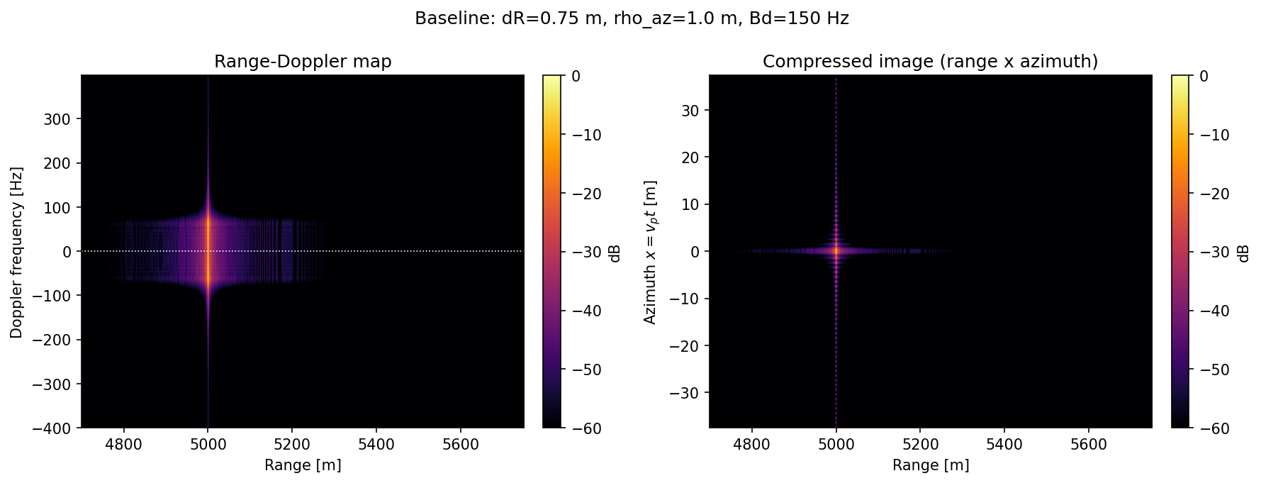
Baseline result
A point target focuses to a bright spot.
Range-Doppler map: energy in a narrow Doppler band at R0.
Compressed image: one sharp point at (R0, x0).

Slide 7
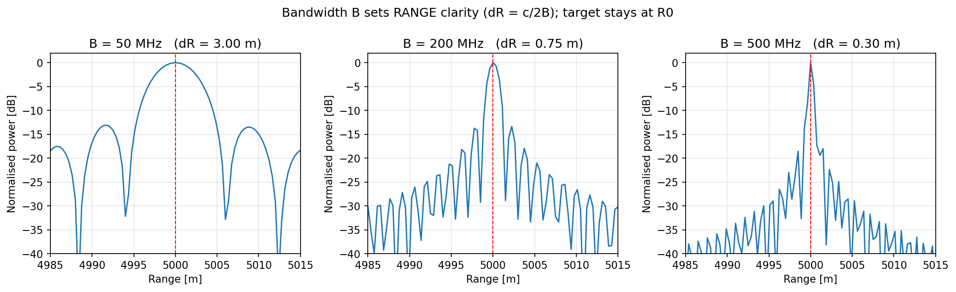
Variable 1 - Bandwidth B
Range resolution dR = c / (2B).
Wider B -> narrower mainlobe -> sharper in range.
Target POSITION does not move: peak stays at R0.
Clarity only, not position.

Slide 8
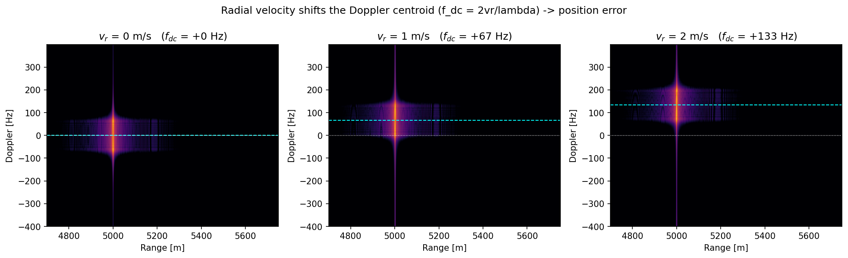
Variable 2 - Radial velocity vr
Doppler centroid f_dc = 2 vr / lambda.
Shifts the target along the Doppler axis.
Also causes range walk (vr * Ta).
Uncompensated -> azimuth position error and smearing.

Slide 9
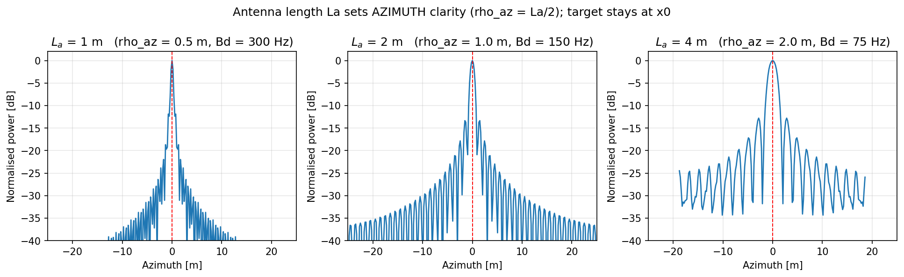
Variable 3 - Antenna length La
Azimuth resolution rho_az = La / 2.
Doppler bandwidth Bd = 2 vp / La.
Shorter antenna -> wider beam -> finer azimuth resolution.
Target POSITION does not move: peak stays at x0.

Slide 10
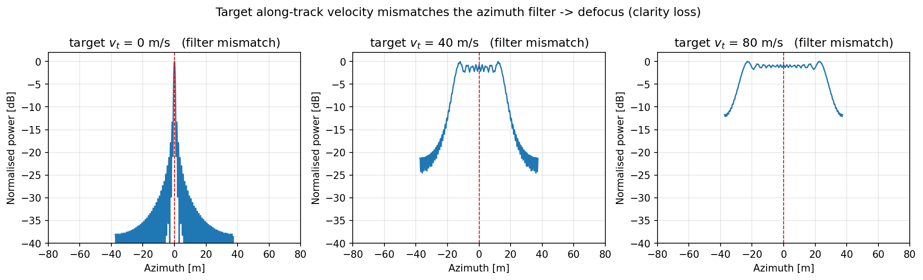
Variable 4 - Target along-track velocity vt
A moving target's Doppler rate differs from the stationary filter.
Phase mismatch -> azimuth defocus (smeared, lower peak).
Clarity loss; position roughly unchanged.

Slide 11
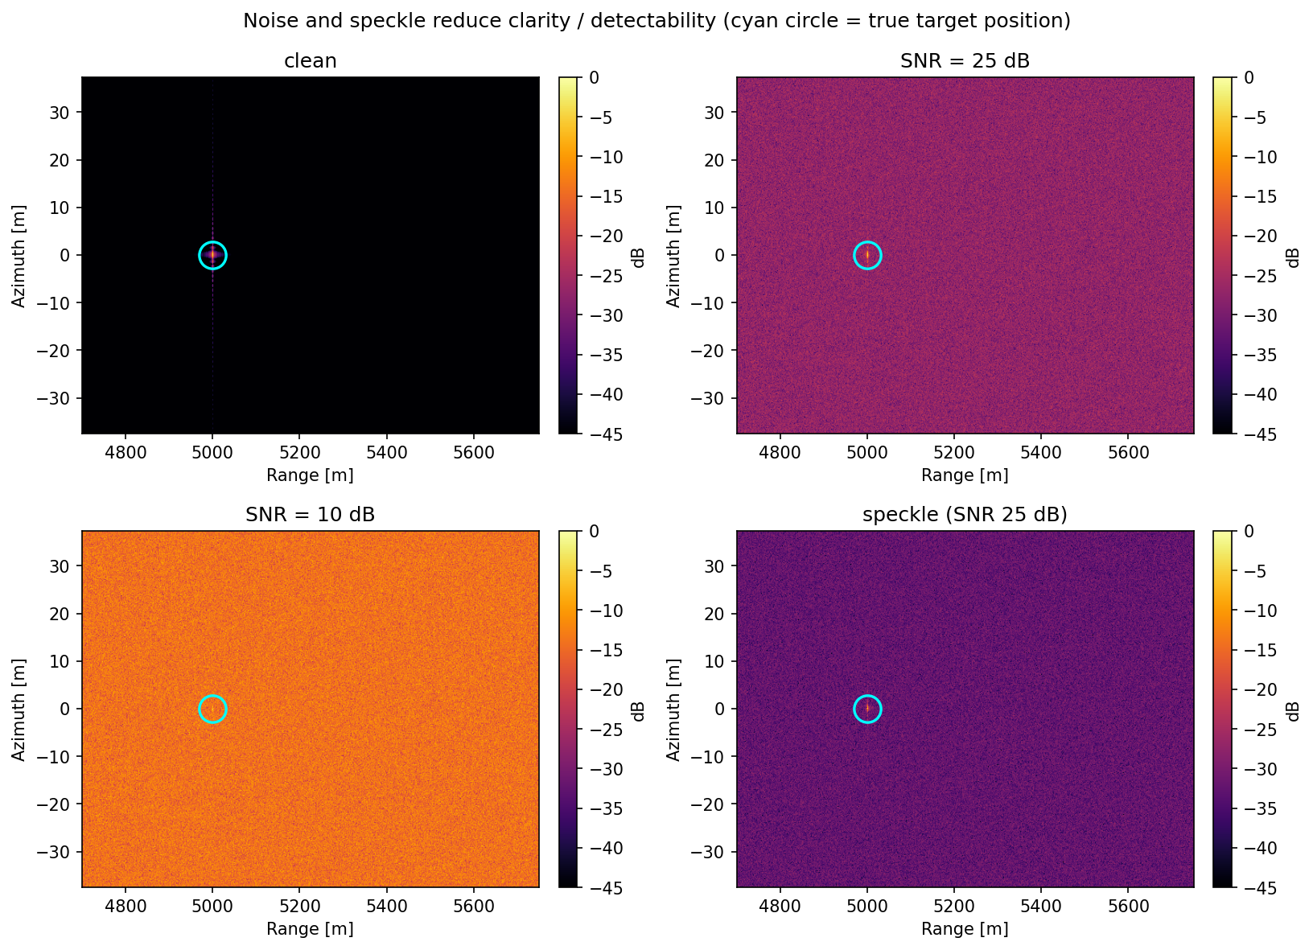
Variable 5 - SNR and speckle
Low SNR -> noise floor rises, target buried.
Speckle = multiplicative Rayleigh noise (grainy texture).
Both reduce detectability / clarity.
Position unaffected.

Slide 12
Results at a glance: what affects clarity vs position
Variable | Affects clarity | Affects position | Key formula
Bandwidth B | Range clarity | No | dR = c / 2B
Radial velocity vr | Defocus if large | Doppler / azimuth | f_dc = 2vr/lambda
Antenna length La | Azimuth clarity | No | rho_az = La/2
Along-track velocity vt | Azimuth defocus | ~No | Doppler-rate mismatch
SNR / speckle | Detectability | No | noise floor / Rayleigh

Slide 13
Cheat sheet: the equations
Range resolution: dR = c / (2B)
Azimuth resolution: rho_az = La / 2
Doppler bandwidth: Bd = 2 vp / La
Doppler rate: fR = 2 vp^2 / (lambda R0)
Doppler centroid (moving): f_dc = 2 vr / lambda
Synthetic aperture time: Ta = R0 * theta / vp, theta = lambda / La
Range to target: R = c * tau / 2

Slide 14
Glossary of SAR terms
Range - distance to target, from echo delay.
Azimuth / cross-range - along-track position, from Doppler.
Slant range R0 - straight-line distance from radar to target.
Chirp - a pulse whose frequency sweeps over time.
Pulse / range compression - matched filtering that sharpens echoes in range.
Doppler history - the changing echo frequency as the platform passes the target.
Doppler centroid - the mean Doppler shift (zero for a still target broadside).
Synthetic aperture - the long effective antenna formed by platform motion.
PRF - pulses per second; must be high enough to sample the Doppler.
RDA (Range-Doppler Algorithm) - process range first, then azimuth via Doppler.
Speckle - grainy noise from many small scatterers in one resolution cell.

Slide 15
Key takeaways & how to run
Range clarity is set by BANDWIDTH; azimuth clarity by ANTENNA LENGTH.
Radial velocity moves the target's Doppler/azimuth POSITION; large values defocus.
Along-track velocity and noise degrade CLARITY, not position.
The app applies the azimuth filter in the Doppler domain (the RDA), keeping updates real-time.
Run it: .venv/bin/python range_doppler_interactive.py
Web version: .venv/bin/streamlit run app.py

