Slide 1
Simulating the Izhikevich spiking neuron model using the Brian2 software
Work by: Alex Beltran and Jorge Orbegozo.
Presentation by: Alex Beltran.

Slide 2

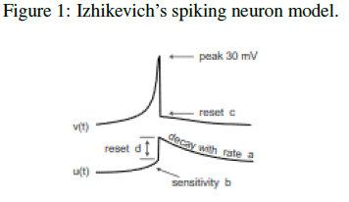
Description of the problem
Main task: Use Brian2 to model the Izhikevich spiking neuron patterns.

Slide 3
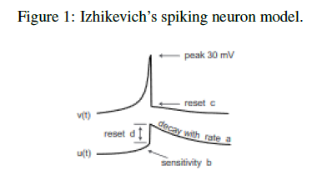


Description of the problem
Izhikevich model:
The Izhikevich model is an specific model for spiking neurons.
Uses a two-dimensional system of ordinary differential equations.
As a reset, a second system defines for when v reaches its threshold value (30).

Slide 4
Description of the problem
Izhikevich model:
The parameters:
  V is membrane potential, U is membrane recovery.
  A is the time scale of U, b relates the sensitivity of U to V.
  C is the reset value of V, D is the effect spiking has on U on reset.

Slide 5

Description of our approach:
The equation in our model:
Problems:
  The “constants” are not constant.
  Brian2 requires a time step.

Slide 6
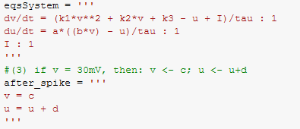
Description of our approach:
In brian2:

Slide 7
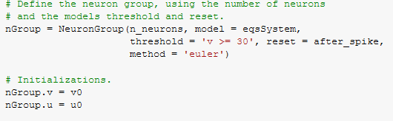
Description of our approach:
In brian2:

Slide 8
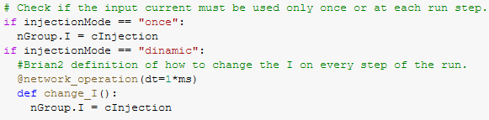
Description of our approach:
In brian2:

Slide 9
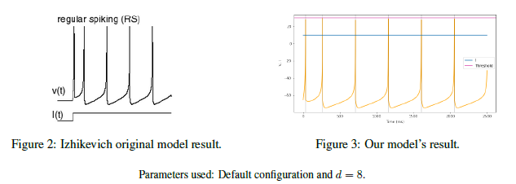
Results:

Slide 10
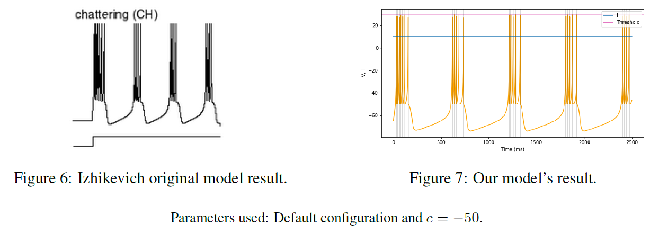
Results:

Slide 11
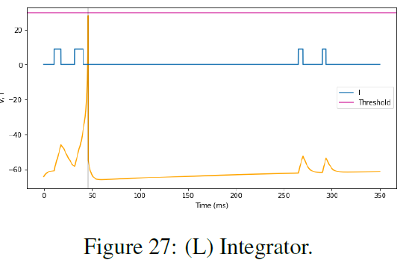
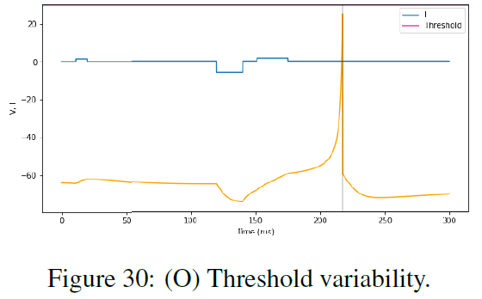
Results:

Slide 12
Conclusions:
From the 26 patterns, we could correctly replicate every single one but 2 of them.
  (R) Accommodation and (RZ) Resonator.
Mixed feelings on the Izhikevich model.
  The good: extremely simple to implement and really fast model that could replicate lots and lots of neuron patterns.
  The bad: The abuse of what we call “magic numbers”.
About brian2:
  Powerful and reliable.
  Really good error back-tracing system.

