Slide 1
Test-Driven Development (TDD) in Software Engineering
Ishwari Patel
CSCI 4350 SE 2
Notes:
Hello everyone! Today I’ll be presenting on Test-Driven Development, or TDD, an advanced practice in software engineering that helps ensure code correctness, maintainability, and efficiency. In this talk, I’ll explain what TDD is, how it works, its benefits, challenges, and best practices, along with a real-life example.

Slide 2

Hook
What if you could write code that’s guaranteed to work from the start?
Many developers spend hours debugging. TDD aims to prevent that.
Notes:
"Imagine writing code and knowing it works perfectly before you even finish. Sounds great, right? That’s the goal of TDD. Many developers spend hours debugging and fixing mistakes, but with TDD, we focus on preventing these errors before they happen."

Slide 3
What is TDD?
Write tests before code
Red-Green-Refactor cycle:
1. Red – Write a failing test
2. Green – Write code to pass test
3. Refactor – Clean up code
Notes:
TDD is a methodology where we write tests before the actual code. The workflow is simple: first, write a test that fails (Red), then write code to pass that test (Green), and finally refactor the code to improve structure and readability. This ensures that your code is always aligned with expected behavior."

Slide 4
Why TDD Matters
Ensures code correctness
Reduces bugs
Encourages clean, maintainable code
Makes refactoring safer
Notes:
TDD guarantees code works as intended, reduces bugs, encourages clean code, and makes refactoring safe because tests immediately show issues.
"TDD is important because it guarantees that the code works as intended. It reduces bugs, encourages writing clean and maintainable code, and makes refactoring much safer because we have tests that immediately show if something breaks."

Slide 5
TDD Workflow
Write test → Run test (fails) → Write code → Run test (passes) → Refactor
Diagram: Red-Green-Refactor loop
Notes:
The TDD workflow follows a cycle: write a test, run it and see it fail, implement code to pass the test, then refactor. Each cycle ensures small, tested improvements.
"The TDD workflow follows a cycle: write a test, run it and see it fail, implement code to pass the test, then refactor. This loop is called Red-Green-Refactor. Each cycle ensures small, tested improvements rather than large untested changes."

Slide 6
Tools for TDD
JUnit (Java)
pytest (Python)
NUnit (.NET)
Example snippet: simple test before code
Notes:
Tools depend on the programming language: JUnit for Java, pytest for Python, NUnit for .NET. They automate tests and integrate them into development.
There are many tools available for TDD depending on the language. For Java, we use JUnit, for Python we use pytest, and for .NET, NUnit. These tools help automate tests and integrate them into the development process. Let’s look at a small example of a test written before code."

Slide 7

Real-Life Example / Demo
Example: Factorial or sum function
Write test first → code → pass test
Include screenshot or snippet
Notes:
For example, to implement factorial, we write a test expecting factorial(5) = 120, then code until the test passes. This ensures correctness from the start.
Let’s see an example. Suppose we need a factorial function. In TDD, we first write a test expecting factorial of 5 to be 120. Then we write the code to make this test pass. Once the test passes, we refactor the code if needed. This way, we are confident the function works correctly from the beginning."

Slide 8
Advantages of TDD
• Better code quality
• Fewer bugs
• Easier maintenance
• Confidence in refactoring
Notes:
TDD improves code quality, reduces bugs, makes maintenance easier, and allows confident refactoring.
The benefits of TDD are numerous. It improves code quality because every part is tested. It reduces bugs, makes the code easier to maintain, and allows developers to refactor with confidence, knowing that tests will catch any unintended changes."

Slide 9
Challenges of TDD
Initial slower development
Writing good tests is hard
Can be overkill for small projects
Notes:
Challenges include initial slower development, difficulty writing good tests, and TDD may feel unnecessary for small projects, but for long-term projects, benefits outweigh the cost.
TDD is not without challenges. At first, development may seem slower because you’re writing tests alongside code. Writing good tests can be difficult, and for very small projects, it may feel like overkill. However, for long-term projects, the benefits outweigh the initial effort.

Slide 10
Best Practices
Start small
Keep tests independent
Refactor continuously
Test normal and edge cases
Notes:
Best practices: start small, keep tests independent, continuously refactor, and test normal plus edge cases to make TDD effective.
Some best practices for TDD include starting small with simple tests, keeping tests independent from each other, continuously refactoring code, and testing both normal and edge cases. Following these practices ensures that TDD is effective and sustainable.

Slide 11
Conclusion
• TDD improves software quality and reliability
• Requires discipline but pays off in long-term projects
• Personal opinion: makes code more reliable
Notes:
In conclusion, TDD improves software quality and reliability, requires discipline, but pays off long-term. Personally, it makes my code more reliable and maintainable.
To wrap up, TDD is an advanced software development practice that improves software quality and reliability. It requires discipline and effort but pays off in the long run. Personally, I have found TDD makes my code more reliable and easier to maintain.

Slide 12
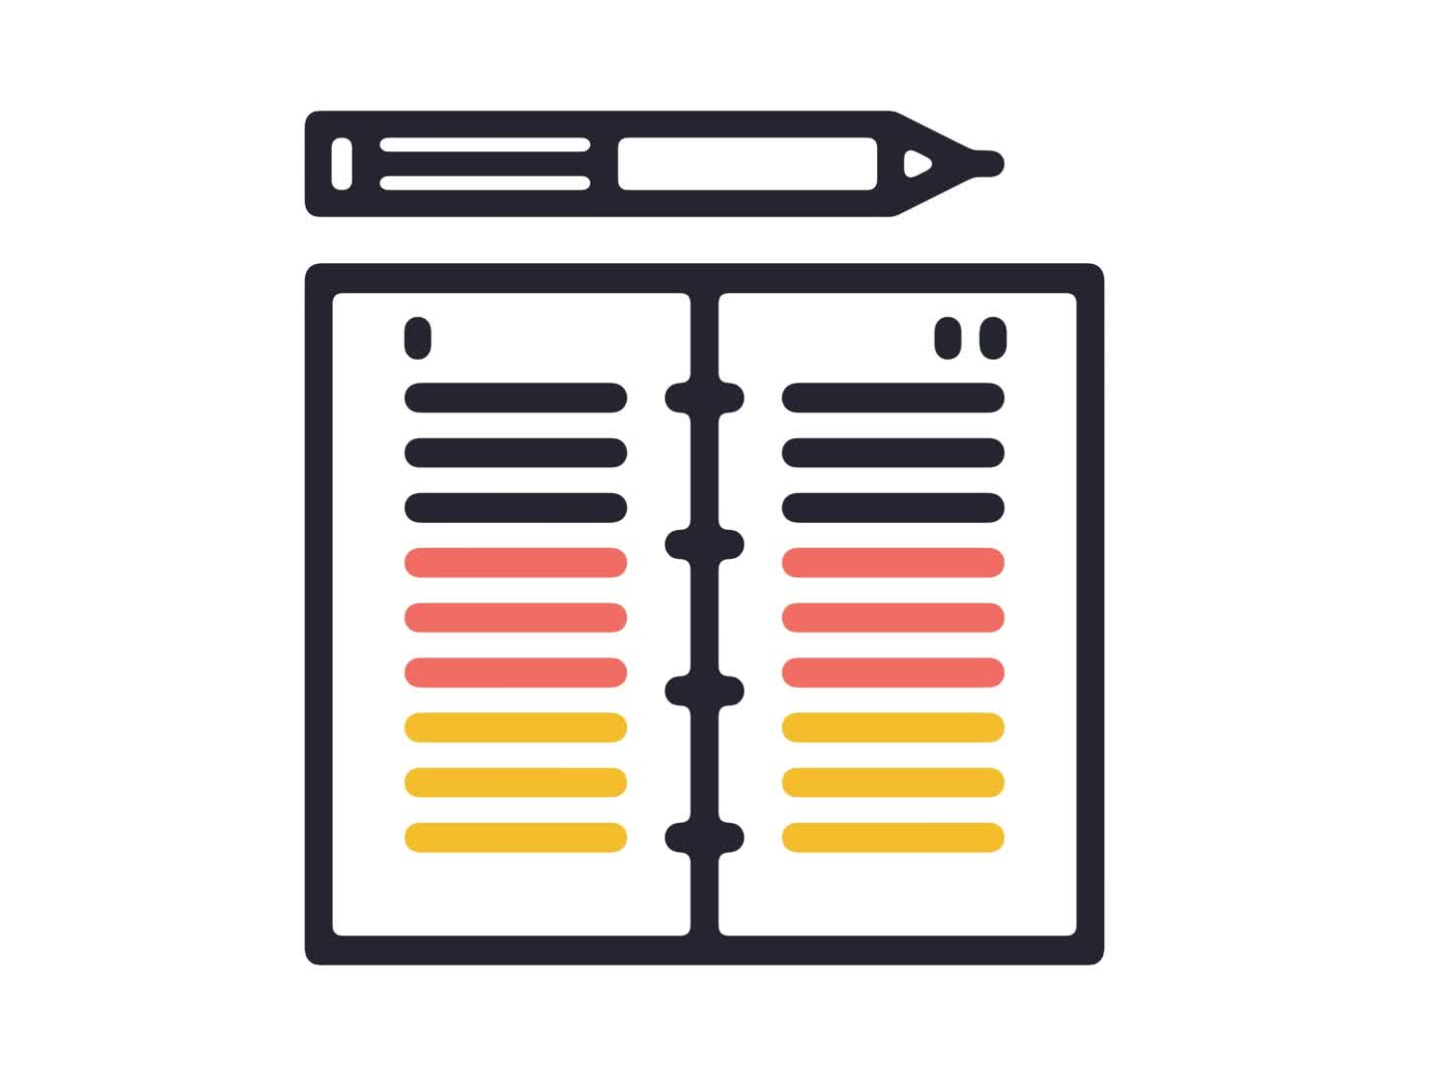
References
• Articles, tutorials, documentation
Notes:
These are the sources I referred to while preparing this presentation. Thank you for listening!

