Slide 1
CHAINGUARD
AI-Powered Software Supply Chain Security
Malicious Package Detection & Vulnerability Reachability Analysis
0.96
92 → 3
15,886
F1 Score
Advisories → Reachable
Packages Evaluated

Slide 2
THE PROBLEM
Modern apps are assembled, not written
A typical project pulls in 200–1,500 transitive dependencies. Two distinct risks follow.
①
Deliberately malicious packages
②
Known-vulnerability alert fatigue
Typosquats of popular names (reqeusts vs requests)
Install-time payloads (npm postinstall, setup.py)
Credential & SSH-key exfiltration
Signature scanning fails — every sample is new
150–300 CVE advisories per real project
Security teams cannot triage that volume
So teams end up triaging nothing
Known-vulnerable dependencies stay unpatched
02

Slide 3
THE CORE INSIGHT
Most reported CVEs are noise — reachability finds the signal
A vulnerability that can never be invoked by your application cannot be exploited through it. ChainGuard proves reachability with an actual call path.
92
3
→
reported advisories
actually reachable — with proof
PROOF PATH
app
→
app.main
→
app.bootstrap
→
config.load_settings
→
yaml.load
03

Slide 4
PRIOR ART
Detecting malicious packages — what's been tried
ChainGuard is not the first attempt at this problem. Its classifier design and training data build directly on this line of work.
1
2
Backstabber's Knife Collection
MalOSS
First systematic dataset and taxonomy of real open-source supply-chain attacks — the attack taxonomy ChainGuard's evidence signals draw on. It's where the "shape" of a malicious package came from
Static + dynamic heuristic analysis across npm, PyPI and RubyGems; found hundreds of live malicious packages.They Run Packages
[1] Ohm, Plate, Sykosch, Meier — “Backstabber's Knife Collection,” DIMVA 2020
[2] Duan et al. — “Towards Measuring Supply Chain Attacks on Package Managers for Interpreted Languages,” NDSS 2021
3
4
Amalfi
GuardDog
ML classifier over static + registry-metadata features for npm — the closest prior work to ChainGuard's classifier design.
Open-source Semgrep-rule scanner for npm/PyPI. Also the origin of ChainGuard's labeled training corpus.
[3] Sejfia & Schäfer — “Practical Automated Detection of Malicious npm Packages,” ICSE 2022
[4] Datadog — github.com/DataDog/guarddog (open source)
5
6
LastPyMile
npm ecosystem threat study
Diffs published package code against its source repo to catch injected code that metadata-only checks miss.
Large-scale empirical study establishing how much of the npm dependency graph is exposed to a single compromised maintainer.
[5] Vu, Massacci, Pashchenko, Plate & Sabetta — “LastPyMile,” ESEC/FSE 2021
[6] Zimmermann, Staicu, Tenny, Pradel — “Small World with High Risks,” USENIX Sec. 2019
04

Slide 5
PRIOR ART
Proving reachability — what's been tried
The insight that most reported CVEs are unreachable predates ChainGuard. It applies a Java-ecosystem idea to Python and JavaScript.
1
2
Eclipse Steady
“Counting Those That Matter”
Pioneered call-graph-based reachability for known vulnerabilities in Java/Maven — the technique ChainGuard applies to Python and JavaScript.
First empirical case that most reported CVEs in a dependency tree are not actually reachable from application code.They measured the phenomenon
[1] Ponta, Plate, Sabetta — “Beyond Metadata: Code-Centric and Usage-Based Analysis of Known Vulnerabilities in OSS,” ICSME 2018
[2] Pashchenko, Plate, Ponta, Sabetta, Massacci — “Counting Those That Matter,” ESEM 2018
3
4
Vuln4Real
OSV.dev / OSV-Scanner
Follow-on methodology for counting genuinely exploitable dependency vulnerabilities at scale. Methodolog
Unified open vulnerability database and an experimental call-graph reachability mode. ChainGuard queries OSV.dev directly as its advisory source.
[3] Pashchenko et al. — IEEE Trans. Software Engineering, 2020
[4] Google — github.com/google/osv-scanner (open source, since 2021)
5
6
Fixes-to-vulnerabilities corpus
Commercial reachability engines
Manually curated dataset mapping CVEs to their fixing commits — the kind of ground truth reachability tooling is validated against.
Endor Labs and Socket.dev ship reachability-based prioritization in production, validating the same signal-over-noise thesis at scale.
[5] Ponta, Plate, Sabetta, Bezzi & Dangremont — MSR 2019
[6] Endor Labs & Socket.dev — Industry, 2023–
05

Slide 6
DETECTION DESIGN
Two independent mechanisms, neither is a black box
 | ML Classifier | LLM Layer (OpenAI / Gemini)
Technique | Gradient-boosted trees over 58 static features | Language model, natural-language reasoning, structured output (verdict, confidence, reasoning)
Role | Decides: is this package malicious? | Reviews flagged/suspicious packages along with classifier's verdict
Status | System of record, always on | Optional, falls back to the classifier's verdict if no key/network
Why | Measurable precision/recall, generalises to unseen malware, offline & free | Cannot be evaluated with a confusion matrix; needs network + API key
The classifier is the system of record. The LLM is a presentation layer, ChainGuard is fully functional without it.
06

Slide 7
VALIDATED RESULTS
Measured against a rules-based baseline
Grouped 5-fold cross-validation
15,886 real packages evaluated
7,444 malicious · 8,442 benign
Every figure is out-of-fold
Split grouped by package and identical feature vectors — no version of a package appears on both sides (no leakage)
EVALUATION METHOD
07

Slide 8
VALIDATED RESULTS
The full picture: confusion matrix and metrics
Same evaluation as the previous slide — grouped 5-fold cross-validation, 15,886 packages, no leakage.
CONFUSION MATRIX · CHAINGUARD MODEL
HEADLINE METRICS
TRUE POSITIVE
FALSE NEGATIVE
ACCURACY
PRECISION
6,991
453
0.963
0.980
Actual malicious, flagged malicious
Actual malicious, flagged benign
Correct across both classes
Of flagged packages, truly malicious
FALSE POSITIVE
TRUE NEGATIVE
RECALL
F1 SCORE
140
8,302
0.939
0.959
Actual benign, flagged malicious
Actual benign, flagged benign
Of malicious packages, actually caught
Precision and recall, balanced
08

Slide 9
SCIENTIFIC CONTRIBUTION
Validated on an independent benchmark
F1 SCORE · SAME 13,436 NPM PACKAGES
WHAT WE VALIDATED
13,436 independent npm packages from a 2026 study (Guo et al.)
Benchmarked against 7 published detectors on identical packages
Leakage check: F1 unchanged (0.884) after removing 33 overlapping names
Finds 272 malicious packages GuardDog misses — complementary coverage
Trained on both corpora: F1 0.959 (grouped 5-fold cross-validation)
Source: Guo et al., “How Effective Are NPM Malicious Package Detectors? A Large-Scale Empirical Study,” arXiv:2603.27549, 2026
Dataset: doi.org/10.6084/m9.figshare.31869370 (CC BY 4.0)
09
Notes:
Independent check on someone else's data: Guo et al. (arXiv:2603.27549) ran 11 npm detectors on 13,708 packages. We scored our deployed-before-benchmark model on 13,436 of them (some tarballs no longer available). Off-the-shelf F1 0.885: behind GuardDog (0.924), level with SAP XGBoost (0.883), ahead of SAP RF, Packj, OSSGadget, GENIE, SocketAI. Other tools' numbers are recomputed from their published per-package verdicts on the same packages. IntelGuard (paper's best, 0.960, proprietary) is not in the chart: its per-package results are not published. Our tool and GuardDog catch different malware (272 vs 537 unique catches). 0.959 is cross-validated with benchmark data in training, so it is not comparable to the 0.924/0.885 head-to-head numbers.

Slide 10
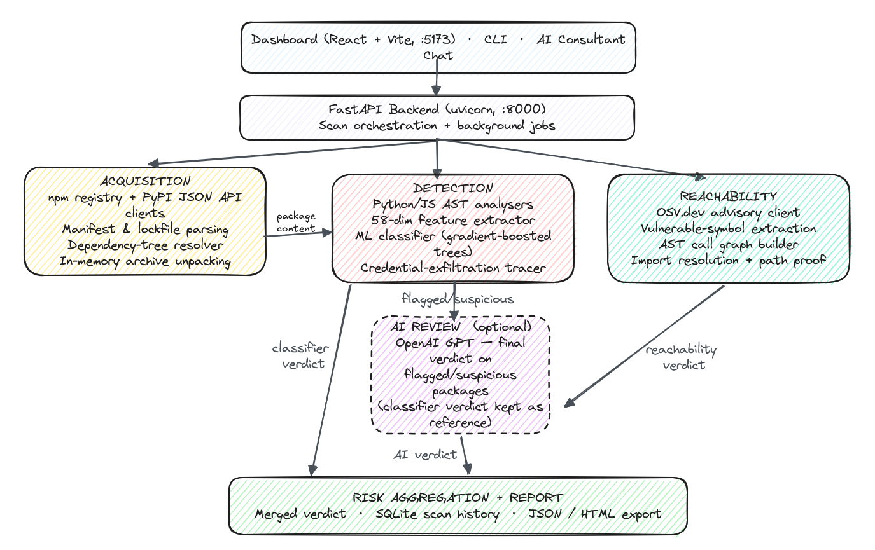
SYSTEM ARCHITECTURE
React + Tailwind Dashboard · Vite · port 5173
FastAPI Backend · uvicorn · port 8000 · scan orchestration + jobs
DETECTION
REACHABILITY
static analyzers
feature extraction (58-dim)
ML classifier
OSV.dev advisories
AST call graph
import resolution + path proof
Risk Aggregation + Report · SQLite persistence · JSON / HTML / PDF export
10

Slide 11
HOW A SCAN WORKS
Two pipelines run independently, then merge
Manifest → resolve dependency tree → download packages (in-memory)
STATIC ANALYSIS
Python / JS AST · install hooks · typosquat detection
58-feature vector
ML classifier
→ Malice score + evidence
MERGED RISK REPORT
Combined risk model + remediation plan.
Detection and reachability are independent — a failure in one does not take out the other.
OSV.DEV ADVISORIES
CVSS · fixed versions · vulnerable symbols
Reachability analysis via call graph
→ Reachable + proof, or
→ Not reachable + reason
11

Slide 12
SECURITY BY DESIGN
The scanner treats itself as an attack surface
ChainGuard analyses hostile input by design, and its training data contains real malicious packages.
✓
Nothing analysed is ever executed
✓
Malicious samples encoded at rest
No pip install, no npm install, no setup.py invocation, no eval of package content. All analysis is static parsing of source text.
Training samples are never written to disk in runnable form — decoded into memory only. No antivirus exclusion required.
✓
Ingestion is bounded at every step
✓
Extraction is hardened
Archive size, compression ratio, member count, per-file size, AST parse size, and per-package analysis time are all capped.
Path traversal, symlinks, and absolute paths are rejected during archive extraction.
12

Slide 13
DEPLOYMENT
Deployable and runnable today
REQUIREMENTS
RUNS WITHOUT EXTRA SETUP
Python 3.10+ · Node 18+ (dashboard only — backend has no Node dependency)
No trained ML model? Falls back to a rules baseline — clearly labeled as such in every result.
No API key? The optional LLM layer (OpenAI or Gemini) is simply disabled; the core system is unaffected and fully functional.
Interactive API docs are served automatically at /docs once the backend is running.
Full test suite runs fully offline in under a second — no network required to validate the build.
QUICK START
python -m venv .venv && pip install -r requirements.txt
python -m pytest backend/tests -q # offline, <1s
python -m chainguard scan-project demo/vulnerable-app
uvicorn chainguard.api.app:app --port 8000
cd frontend && npm install && npm run dev # :5173
scripts/start.ps1 # one-shot: starts both services
13

Slide 14
REPOSITORY LAYOUT
Where everything lives
backend/chainguard/
analysis · registry · vulns · dataset · ml · api · scanner.py · cli.py
frontend/
React + Vite + Tailwind dashboard
demo/
Sample vulnerable project for the reachability demonstration
scripts/
Dataset build, model training, popular-package list generation
docs/
Model card, dataset notes, ten-minute demo walkthrough
14

Slide 15
TWO-PART VALUE, ONE SCAN
Fewer false alarms. Real proof. Ready to run.
0.96 F1
92 → 3
100%
Catches malicious packages the classifier has never seen before — measured, not assumed.
Cuts CVE noise from hundreds of advisories to the handful that are genuinely reachable, with proof.
Offline-capable core, open architecture, security-first by design — deployable today.
ChainGuard — AI-Powered Software Supply Chain Security

