Slide 1
CSC 480 · FINAL PRESENTATION · MAY 6, 2026
Sentiment
Analysis of
Movie Reviews
91.3%
best test accuracy
Linear SVM + TF-IDF
(after ablation tuning)
Classical ML on the IMDb 50k dataset
Ethan Olla
Instructor: Chicheng Zhang
1 / 5

Slide 2
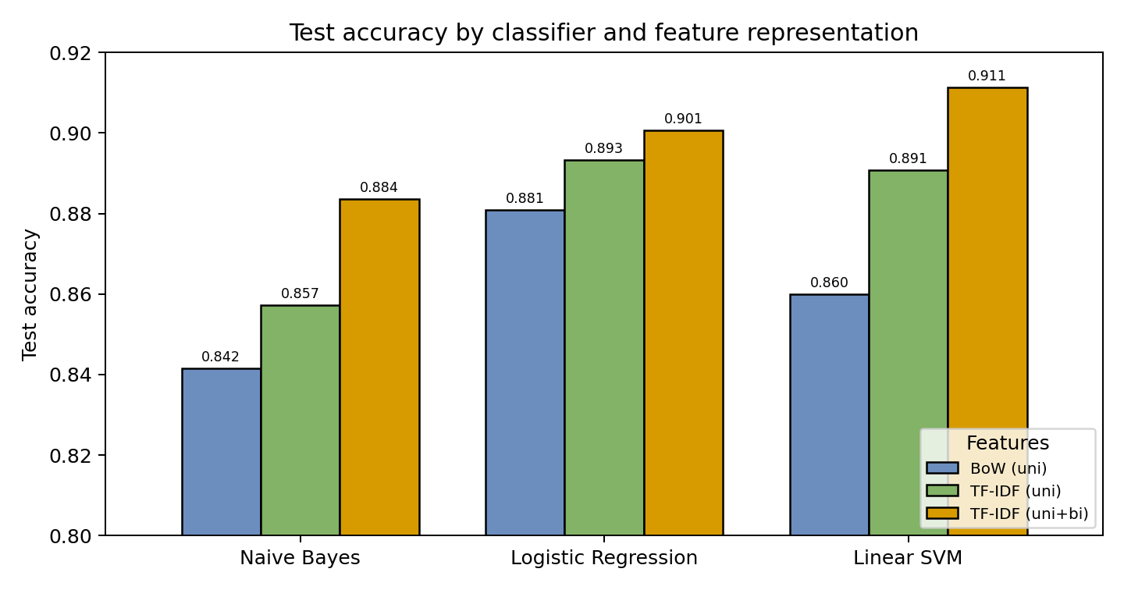
RECAP
Mid-project results at a glance
Problem: binary sentiment classification of 50k IMDb reviews using three classical ML classifiers and three feature representations. Best mid-project result: Linear SVM + TF-IDF (uni+bi) at 91.12%, beating the Maas et al. 2011 baseline of 88.9%. What remained: ablation study, deeper error analysis, and positioning against the state-of-the-art skyline.
Model | BoW | TF-IDF | +Bigrams
Naive Bayes | 84.2% | 85.7% | 88.4%
Logistic Reg. | 88.1% | 89.3% | 90.1%
Linear SVM | 86.0% | 89.1% | 91.1%
CSC 480 · Final Presentation · Ethan Olla
2 / 5

Slide 3
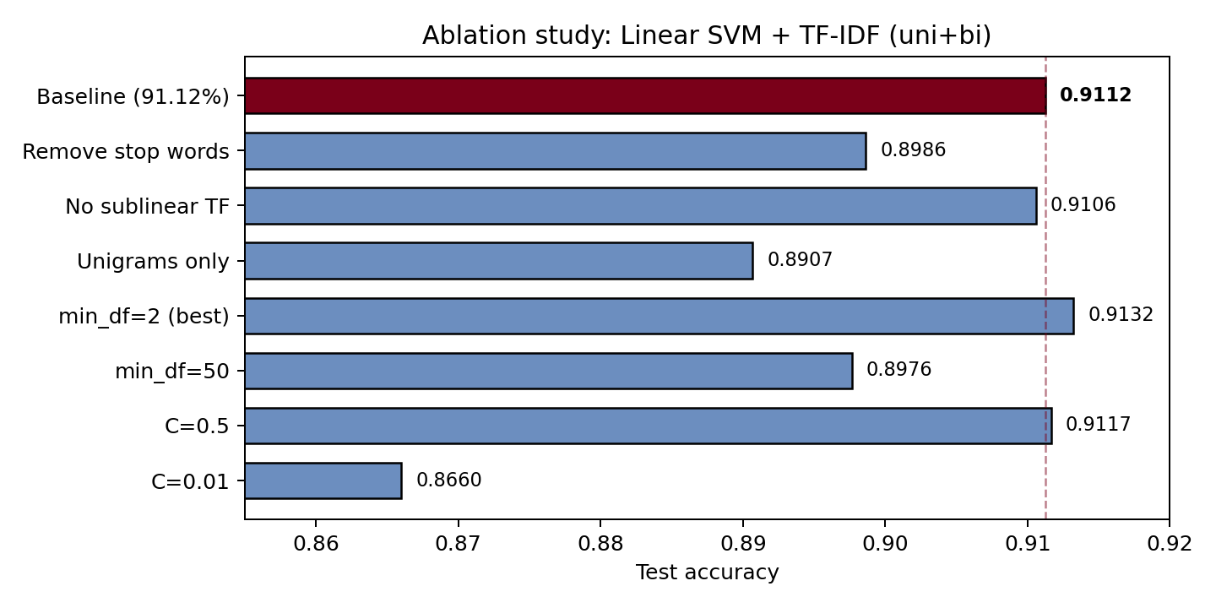
NEW WORK
Ablation study: what actually matters?
TAKEAWAYS
Keeping stop words is critical
Removing them drops accuracy 1.3 points. Words like "not," "no," and "never" carry negation signal the model needs.
Bigrams add +2 points
Unigrams alone: 89.1%. Adding bigrams: 91.1%. Pairs like "not good" and "the worst" drive the gain.
min_df=2 edges out min_df=5
91.32% vs 91.12%. Slightly larger vocab helps but gains are marginal past this point.
SVM is robust to C
C=0.5 and C=1.0 are nearly tied. Only extreme values (0.01) significantly hurt.
Sublinear TF has minimal impact (0.06 pts). The default configuration was already near-optimal.
CSC 480 · Final Presentation · Ethan Olla
3 / 5

Slide 4
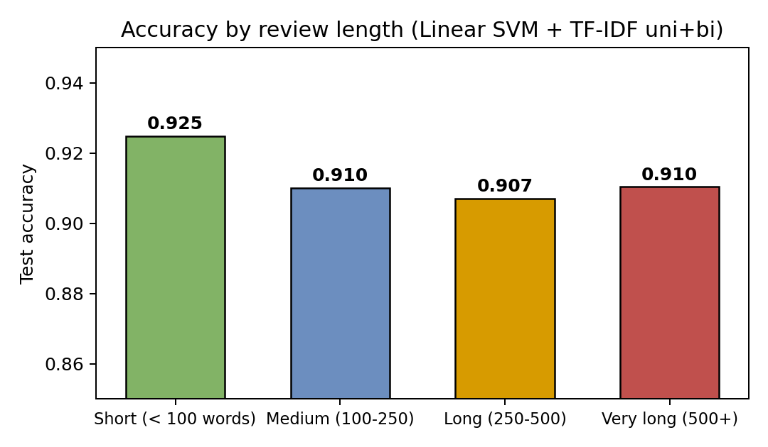
NEW WORK
Where does the model fail?
THE NEGATION PROBLEM
89%
of all errors contain negation words
Reviews with negation: 91.0% accuracy
Reviews without negation: 92.3% accuracy
1,976 of 2,219 errors involve words like "not," "never," "don't." Even with bigrams, long-range negation and sarcasm remain the dominant failure mode.
FINDINGS
Short reviews are easiest (92.5%) because they tend to be blunt and unambiguous. Longer reviews are harder (90.7%) because they mix positive and negative language. The remaining ~9% error budget is dominated by negation, which bigrams only partially capture.
CSC 480 · Final Presentation · Ethan Olla
4 / 5

Slide 5
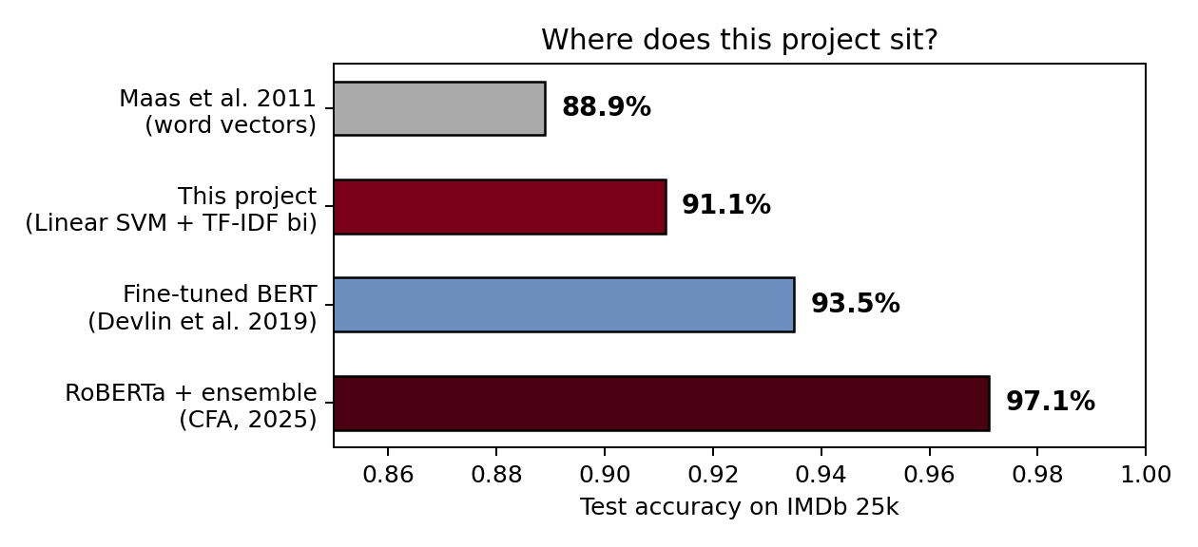
CONCLUSIONS
How far can classical ML go?
KEY LESSONS
Classical ML captures most of the signal
91.3% with a linear SVM, no neural components.
Feature engineering is the bottleneck
Bigrams and stop word retention matter more than classifier choice.
Negation is the ceiling
89% of errors involve negation. Breaking past 91% needs contextual understanding.
Bottom line: A well-tuned TF-IDF + SVM pipeline is a surprisingly strong baseline. The remaining headroom belongs to models that understand context, not just word counts.
Thank you. Questions welcome.
CSC 480 · Final Presentation · Ethan Olla
5 / 5

