Slide 1
CSC 480 · MID-PROJECT UPDATE · APRIL 13, 2026
Sentiment
Analysis of
Movie Reviews
91.1%
best test accuracy
Linear SVM + TF-IDF
(unigrams + bigrams)
Classical ML on the IMDb 50k dataset
Ethan Olla
Instructor: Chicheng Zhang

Slide 2
THE QUESTION
Can classical ML read a movie review's tone?
Reviews are messy, subjective, sometimes sarcastic. Before reaching for neural models, how far can well-tuned classical pipelines get on a binary positive vs. negative task?
Multinomial
Naive Bayes
Logistic
Regression
Linear
SVM
Probabilistic, fast.
Strong text baseline.
Linear, calibrated,
workhorse for NLP.
Margin-based, built
for high-dim text.
FEATURES TRIED
BoW (unigrams) → TF-IDF (unigrams) → TF-IDF (unigrams + bigrams)
CSC 480 · Mid-Project Update · Ethan Olla
2 / 6

Slide 3
DATA & PIPELINE
IMDb 50k, cleaned and vectorized
50,000
25k / 25k
152,680
labeled reviews
(Maas et al., 2011)
stratified
train / test split
bigram vocabulary
(min_df = 5)
PIPELINE
1
2
3
4
5
Clean
Split
Vectorize
Train
Evaluate
strip <br>,
lowercase
25k train /
25k test
BoW / TF-IDF
1-2grams
NB / LR /
Linear SVM
acc, P, R, F1
5-fold CV
Reviews average 229 words (median 171, p95 585). Corpus is perfectly balanced: 25k positive, 25k negative.
CSC 480 · Mid-Project Update · Ethan Olla
3 / 6

Slide 4
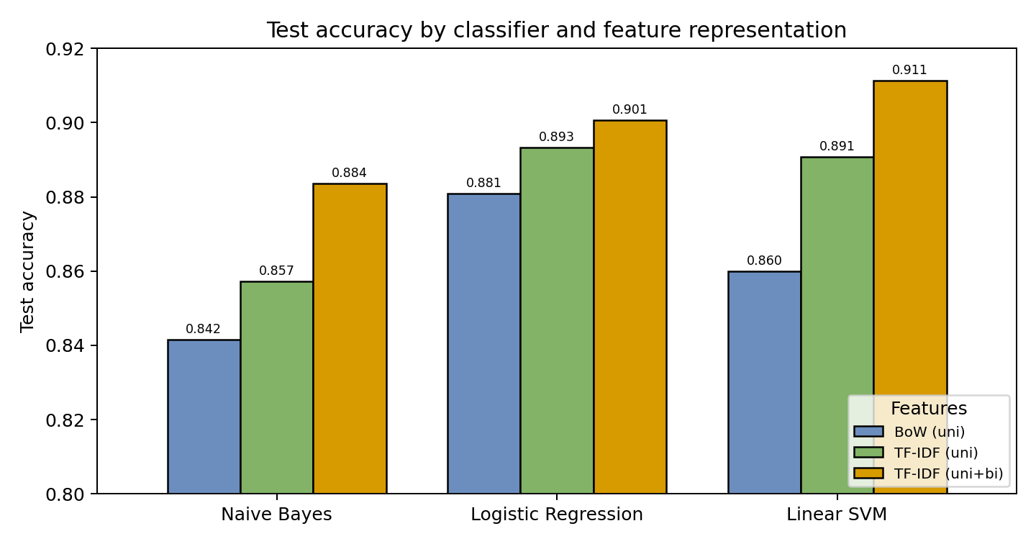
RESULTS
TF-IDF + bigrams + Linear SVM wins
Model | BoW | TF-IDF | +Bigr.
Naive Bayes | 0.842 | 0.857 | 0.884
Log. Reg. | 0.881 | 0.893 | 0.901
Linear SVM | 0.860 | 0.891 | 0.911
KEY FINDINGS
Bigrams help every model. NB jumps +2.6pts, hinting at negation handling. Linear SVM beats Maas 2011 (88.9%). 91.12% on the same 25k test set, no word vectors.
CSC 480 · Mid-Project Update · Ethan Olla
4 / 6

Slide 5
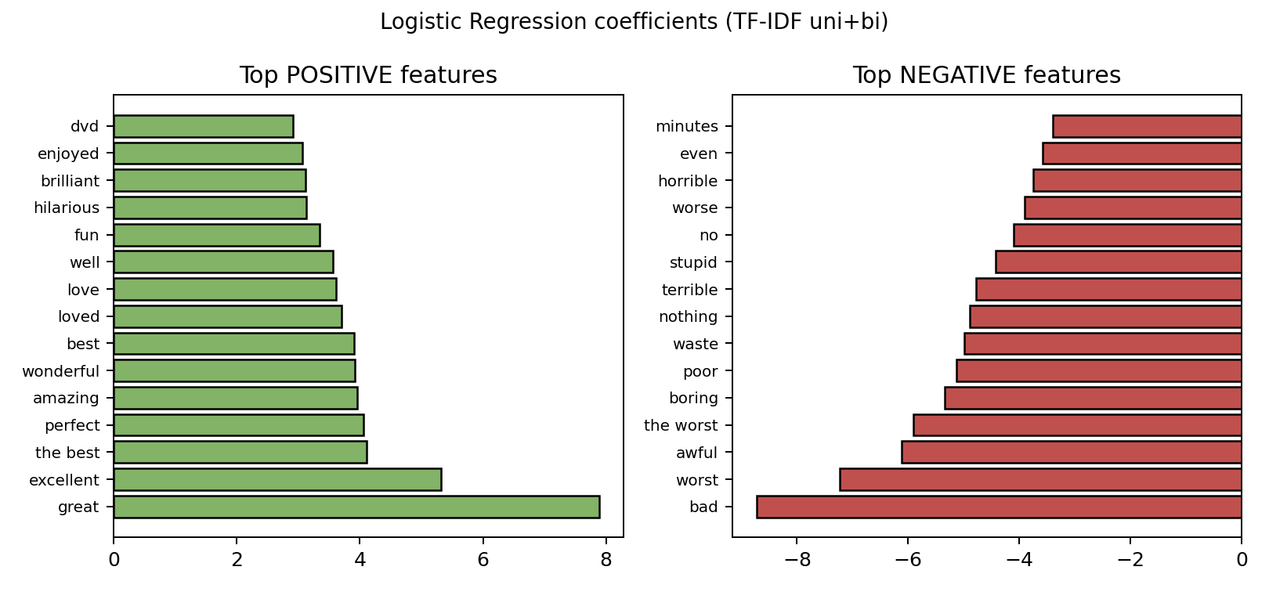
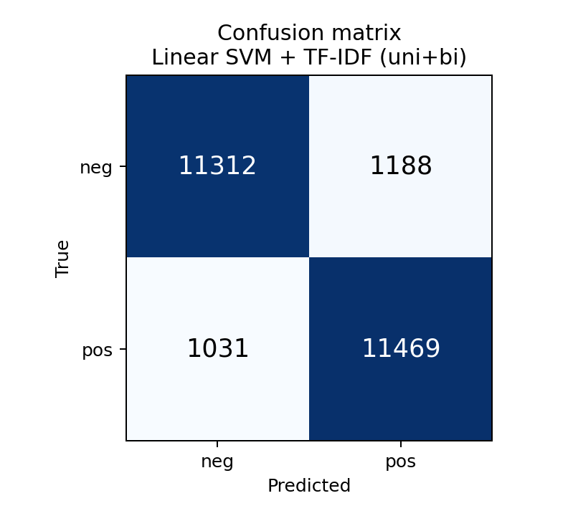
INSIDE THE MODEL
What does TF-IDF + LogReg actually learn?
ERRORS SKEW LONGER
Misclassified reviews average 235 words vs. 229 for correct ones.
CSC 480 · Mid-Project Update · Ethan Olla
5 / 6

Slide 6
WHAT'S NEXT
Remaining work and known risks
TIMELINE TO FINAL REPORT
RISKS & MITIGATIONS
1
Week 4 (Apr 18)
Models are already close
Deeper error analysis: sarcasm, mixed reviews, length buckets
LR and SVM are within 1 point. Plan: ablation study on vocab size and stop words.
2
Week 5 (Apr 25)
Ablations: vocab size cutoffs, stop words, sublinear TF
Sarcasm and negation
3
Week 6 (May 3)
Bigrams helped but cannot catch long-range flips. Will quantify negation errors.
Write results + discussion in NeurIPS LaTeX template
4
Week 7 (May 6)
Final presentation; submit report May 10
Beating our own 91% is hard
If extensions stall, shift focus to interpretability: per-class features, calibration.
Thank you. Questions welcome.
CSC 480 · Mid-Project Update · Ethan Olla
6 / 6

