Slide 1

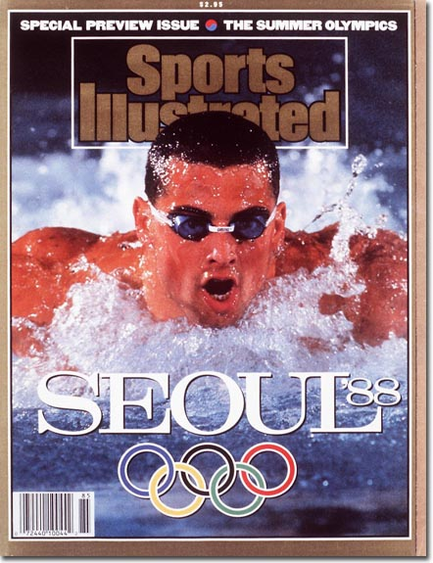
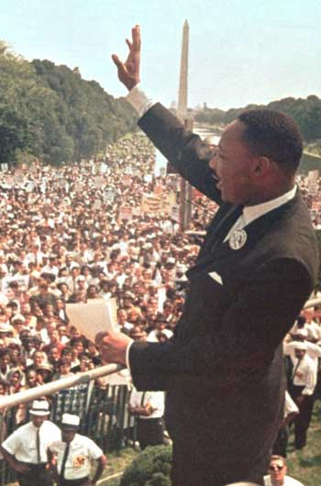
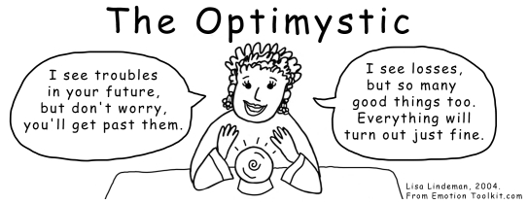
Beliefs as
Self-Fulfilling Prophecies

Slide 2
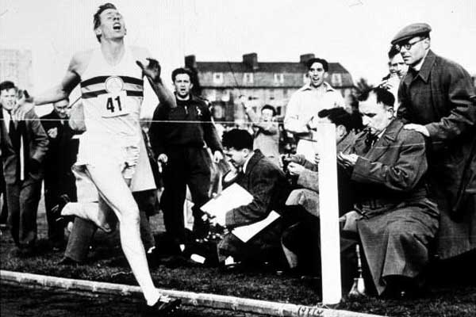
Roger Bannister

Slide 3
Outline
Beliefs shape reality
How it works
Optimizing optimism
Raising our beliefs

Slide 4
We are what we think.
All that we are arises with our thoughts.
With our thoughts, we make our world.
The Buddha

Slide 5
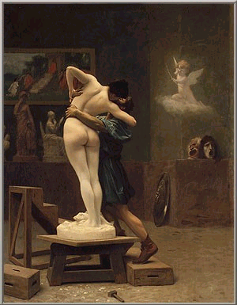
Pygmalion

Slide 6
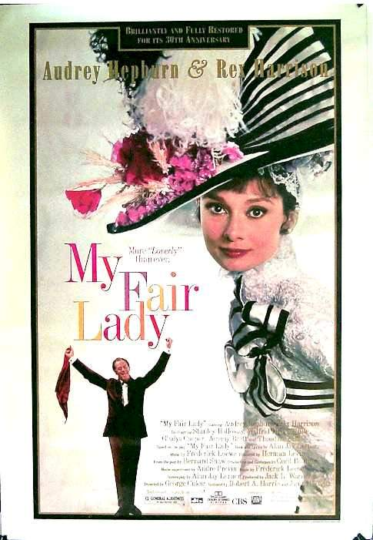
Pygmalion

Slide 7
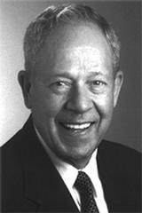
Pygmalion
in the classroom (Robert Rosenthal)
In the
workplace
Jamieson (1987)

Slide 8
“Treat a man as a he is and he will remain as he is. Treat a man as he can and should be and he shall become as he can and should be.”
Johann Wolfgang von Goethe

Slide 9
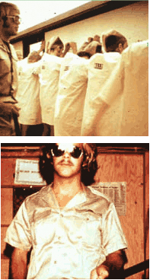
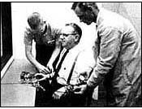
The Power of the Situation
Milgram’s Obedience to Authority
Zimbardo’s Prison
Experiment

Slide 10
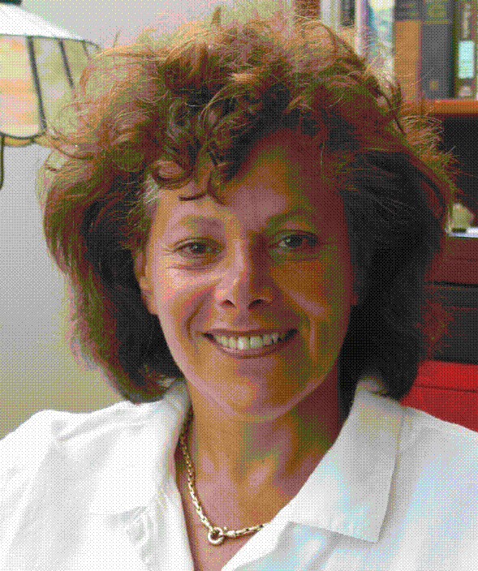
The (Positive) Power of the Situation
  men above 75
  week in “1959” resort
  mental and biological age decreases
Langer (1989)
  testing eyesight
  Improves with role
Langer (1979)

Slide 11
Positive Priming
Bargh (1999)
Dijksterhuis & Van Knippenberg (1998)
Creating a positive environment
  pictures (people, places, etc)
  pleasant objects (memorabilia, flowers, etc)
  quotes
  books, films, music
  positive research

Slide 12

The Self-Help Movement
“Whatever your mind can conceive and believe it can achieve” Napoleon Hill
“Whether you think you can or can’t—you are right” Henry Ford

Slide 13

The Self-Help Movement
“Have great hopes and dare to go all out for them. Have great dreams and dare to live them. Have tremendous expectations and believe in them.” Norman Vincent Peale

Slide 14


Slide 15


Slide 16
Albert Bandura on Self Efficacy
“Beliefs in personal efficacy affect life choices, level of motivation, quality of functioning, resilience to adversity and vulnerability to stress and depression.”
“People who regard themselves as highly efficacious act, think, and feel differently from those who perceive themselves as inefficacious. They produce their own future, rather than simply foretell it.”
Cultivated over time
Curry (1997) on college athletes

Slide 17
Nathaniel Branden on Self-Esteem
“The level of our self-esteem has profound consequences for every aspect of our existence: how we operate in the workplace, how we deal with people, how high we are likely to rise, how much we are likely to achieve—and, in the personal realm, with whom we are likely to fall in love, how we interact with our spouse, children, and friends, what level of personal happiness we attain.”
“Self concept is destiny.”

Slide 18
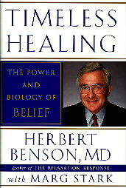
The Placebo Effect

Slide 19
Beliefs as Self-fulfilling Prophecies
Subjective
Beliefs
Expectations
Motivation
Interpretation
Consistency
Objective
Performance

Slide 20
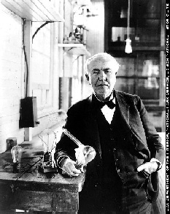
“I failed my way to success”
Thomas Edison

Slide 21
Optimism and Pessimism (Seligman)
Interpretation style
  Permanent/temporary
  Pervasive/specific
Success
Mental/physical health
  immune system
  resilience
  happiness
  longevity
It can be learned!

Slide 22

Optimizing Optimism
What about unrealistic beliefs?

Slide 23
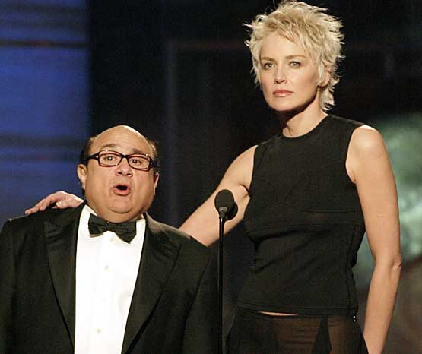

Slide 24
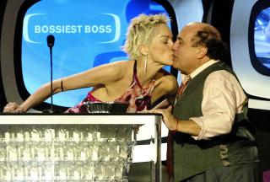

Slide 25
Optimizing Optimism
What about unrealistic beliefs?
  The Stockdale Paradox
  Positive thinking is not enough
“False optimism sooner or later means disillusionment, anger and hopelessness.”
Abraham Maslow

Slide 26
The “Secret” of Success
Optimism, passion, hard work.
“I am a great believer in luck, and I find that the harder I work, the luckier I get.”
Thomas Jefferson
“There is no substitute for hard work.” Thomas Edison

Slide 27
What About Happiness and Self-Esteem?
Do high expectations lead to disappointment?
Self-esteem=success/pretensions
William James
Coping versus Avoidance
  Self perception theory (Bem, 1967)
  realizing the pain of actual failure
  more success

Slide 28
On Becoming An Optimist
Just do it! (action)
Imagine that… (visualization)
Cognitive therapy (rational thinking)

Slide 29
Taking Action (Bandura)
Hard Work Coping
Self-Efficacy
Success

Slide 30
To dare is to lose one’s footing momentarily. Not to dare is to lose oneself.
Soren Kierkegaard

Slide 31
Imagining Success
The mind as simulator (Kosslyn, 1994)
Focus on journey and destination (Taylor, 2005)
Involve different senses
Evoke emotions

Slide 32
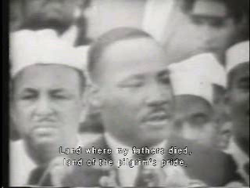

Slide 33
Cognitive Therapy
Thoughts drive emotion
Restoring rationality/realism
Highly effective
An acquired skill

Slide 34
Avoiding the 3 M’s…
Magnifying (exaggerating)
  Permanent and Pervasive (over-generalizing)
  All-or-nothing thinking
Minimizing (underplaying)
  Tunnel vision
  Dismissal of positive or negative
Making up (fabricating)
  Personalization or blame
  Emotional reasoning

Slide 35
Get Real!
Is my conclusion tied to reality?
Is my conclusion rational?
Am I ignoring something important?
What important evidence do I still need to take into consideration?
What am I magnifying?
What am I minimizing?
Am I ignoring anything that is going well?
Am I ignoring anything that is not going well?
What is the big picture?

Slide 36

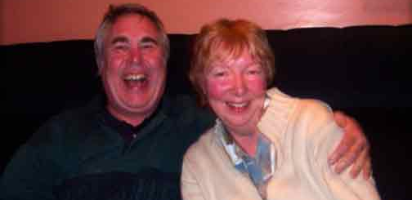
Extremely Happy People
(Diener and Seligman, 2002)
Everyone experiences negative emotions
Different cognitive interpretations (pessimists vs. optimists)
Self-fulfilling prophecies
Spiraling down or up

Slide 37
Bibliography and Recommendations
Ayres, J. & Hopf, T. (1992). Visualization: Reducing Speech Anxiety and Enhancing Performance. Communication Reports, 5, 1-10.
Bandura, A. (1999). Perceived Self-Efficacy in Cognitive Development and Functioning. Educational Psychologist, 28 (2), 117-148.
Benson, H. (1997). Timeless Healing. Scribner.
Burns, D. (1999). Feeling Good : The New Mood Therapy. Avon.
Langer, E. (1989). Mindfulness. Addison-Wesley.
Leahy, R. L. (2003). Cognitive Therapy Techniques: A Practitioner’s Guide. Guilford Publication.
White, S. S. & Locke, E. A. (2000). Problems with the Pygmalion Effect and Some Proposed Solutions. Leadership Quarterly, 11, 389-415.
Rosenthal, R., and Jacobson, L. (1968). Pygmalion in the Classroom. New York: Rinehart and Winston.
Selgiman, M. (1998). Learned Optimism : How to Change Your Mind and Your Life. Free Press.

