Slide 1
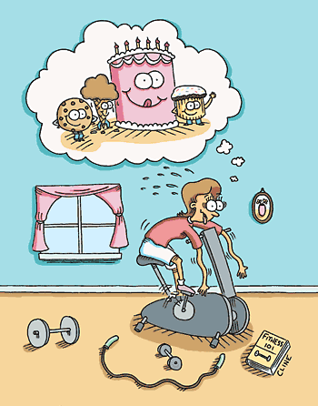
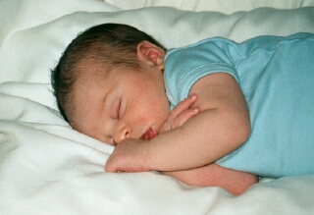
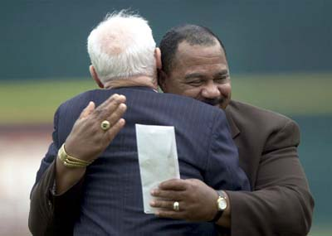
Healthy Body, Healthy Mind

Slide 2
Wonder Drug!
Feel good
Enhances self-esteem
Induces calm
Improves thinking
Makes you more attractive
No negative side effects
It’s legal
It’s free

Slide 3
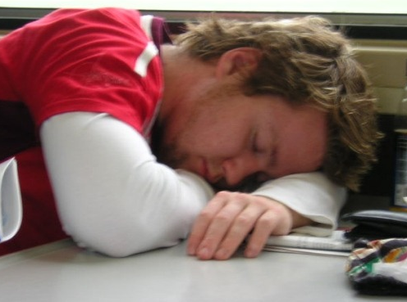
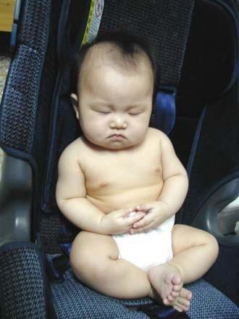
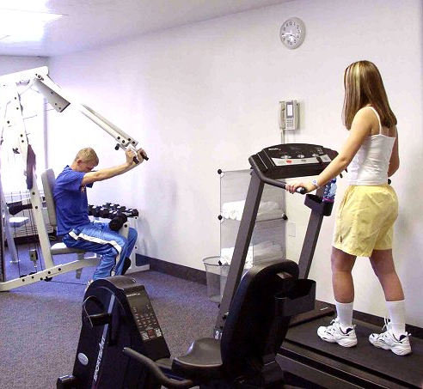

Overview
Exercise
Mindfulness
Sleep
Touch

Slide 4
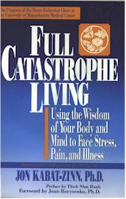
“Perhaps the most fundamental development in behavioral medicine is the recognition that we can no longer think about health as being solely a characteristic of the body or the mind because body and mind are interconnected.”

Slide 5
Exercise and Modernity
Reduction of physical work
Rising levels of mental illness
The need for exercise
“Our forefathers lived every jot as well as we, when they provided and dressed their own meat with their own hands; lodged upon the ground, and were not as yet come to the vanity of gold and gems.”
Seneca

Slide 6
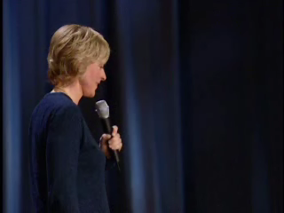

Slide 7
Overcoming Depression (Babyak et al. 2000)
156 patients with Major Depressive Disorder
Three groups (exercise, medicine, exercise*medicine)
Anti-depressant: Sertraline (Zoloft)
Exercise: Thirty minutes three times/week

Slide 8
Overcoming Depression (Babyak et al. 2000)
Results (16 weeks):
  All three groups improved (>60%)
  No significant differences among groups
10 months follow-up
  Relapse medication: 38%
  Relapse medication*exercise: 31%
  Relapse exercise: 9%
For dysthymia (McCann & Holmes, 1984)
Not exercising is like taking depressants

Slide 9
More Benefits
Psychological
  Enhanced self-esteem
  Lower anxiety and stress
  Adjunctive treatment for clinical disorder
  Improved cognitive functioning
Physical
  Weight loss/control
  Reducing chronic diseases
  Stronger immune system
Better Sex
Not a panacea!

Slide 10
Micro and Macro Recovery
“Repeated workouts that are too intense to allow complete recovery may cause endurance athletes to experience ‘staleness,’ a syndrome that is characterized by increased psychological symptoms of anxiety with increased sympathetic nervous system, catecholamine, and cortisol base rates.”
Dienstbier & Zillig (2002)
1-4 days of rest a week
Listen to your body!
Quantity affects quality

Slide 11
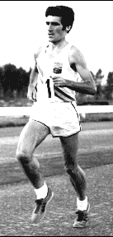
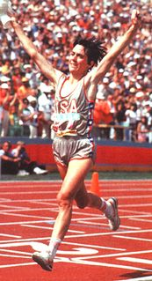
Recovery in Sports
Derek Clayton
Joan Benoit

Slide 12
Overcoming barriers
Pain/discomfort
  Divide and conquer
  Distracters (TV, music, etc)
  Social support

Slide 13
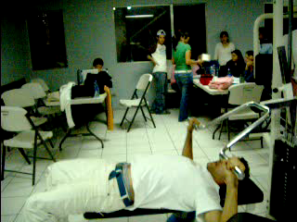

Slide 14
Overcoming barriers
Pain/discomfort
  Divide and conquer
  Distracters (TV, music, etc)
  Social support
Time commitment
  An investment
  Ritualize
Subconscious
  Just do it (the five minute take off)
  Body as important as mind

Slide 15
Exercise: The Unsung Hero
“In a way, exercise can be thought of as a psychiatrist’s dream treatment. It works on anxiety, on panic disorder, and on stress in general, which has a lot to do with depression. And it generates the release of neurotransmitters—norepinephrine, serotonin, and dopamine—that are very similar to our most important psychiatric medicines. Having a bout of exercise is like taking a little bit of Prozac and a little bit of Ritalin, right where it is supposed to go.”
John Ratey

Slide 16
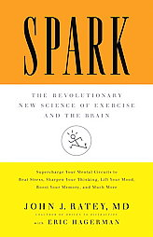
Exercise Revolution
Obesity
School performance
Violence
Ultimate currency

Slide 17
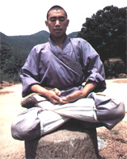
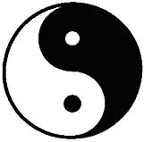
Mindfulness Meditation
One-pointedness
Deep breathing
No good/bad meditation

Slide 18
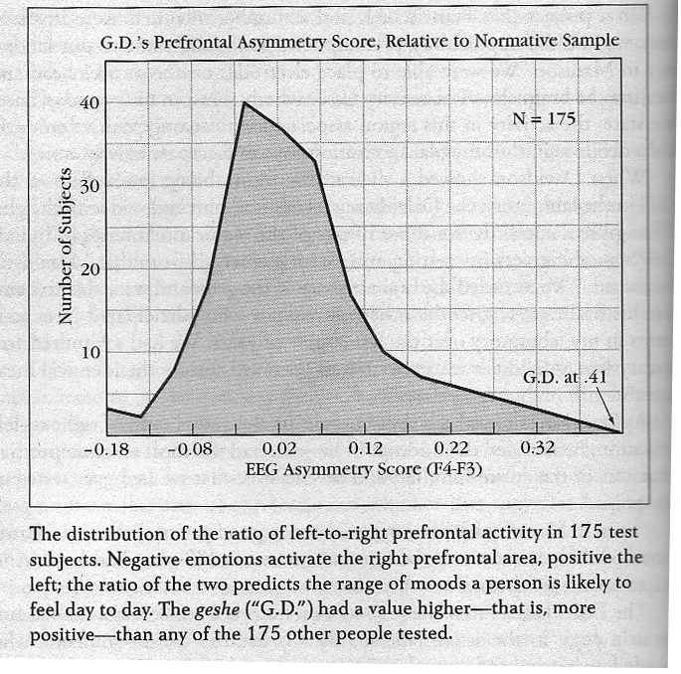
The Mind of a Meditator
Left-to-right ratio in prefrontal cortex

Slide 19
The Mind of a Meditator
Left-to-right ratio in prefrontal cortex
The startle response
“Given that the larger someone’s startle, the more intensely that person tends to experience upsetting emotions, Oser’s performance had tantalizing implications, suggesting a remarkable level of emotional equanimity.” Daniel Goleman

Slide 20
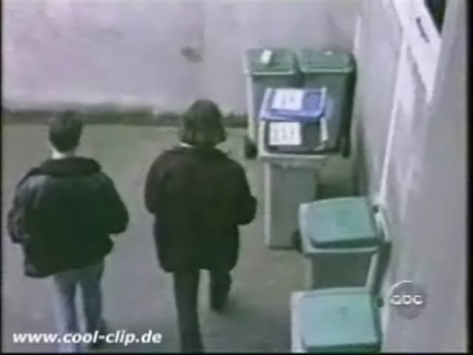

Slide 21
Growing Tip Statistic
“The process itself has some extraordinary qualities, but not necessarily the subject. The important idea is that this process is within the reach of anyone who applies himself or herself with enough determination.”
Lama Oser
“From the perspective of neuroscience, the point of all this research has nothing to do with demonstrating that Oser or any other extraordinary person may be remarkable in him-or herself, but rather to stretch the field’s assumptions about human possibility. Some of these key assumptions have already begun to expand, in part due to a revolution in neuroscience’s supposition about the malleability of the brain itself.”
Daniel Goleman

Slide 22
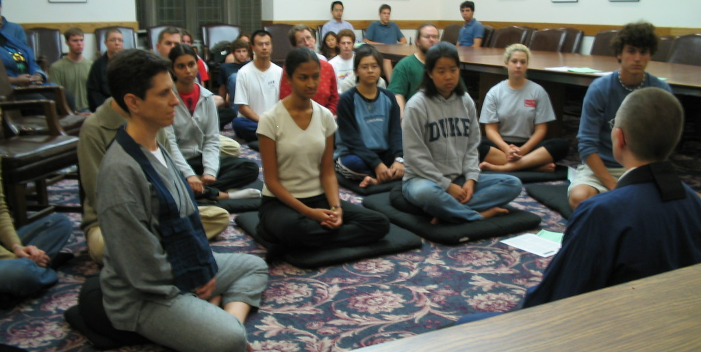
Mindfulness Meditation (Kabat-Zinn)
Decrease in anxiety
Mood change
Pre-frontal cortex activation
Immune response

Slide 23
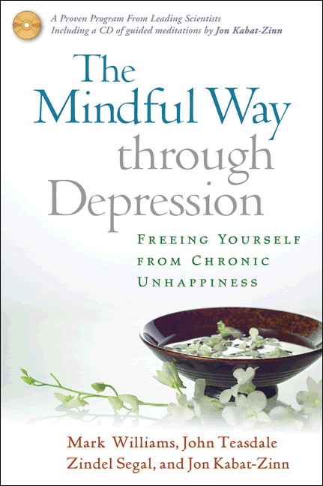
Mindfulness Therapy
Awareness/acceptance of body signals
Creating alternative neural pathways
Practice and practice

Slide 24
From Doing to Being (William et al. 2007)
“Trying to get rid of depression in the usual problem solving way, trying to ‘fix’ what’s ‘wrong’ with us, just digs us in deeper.... rumination is part of the problem, not part of the solution.”
“With the shift from trying to ignore or eliminate physical discomfort to paying attention with friendly curiosity, we can transform our experience.”

Slide 25
Breathing
Stress/Anxiety
Calm/wellbeing
Shallow breathing
Deep breathing

Slide 26
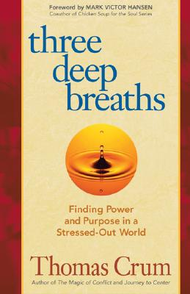
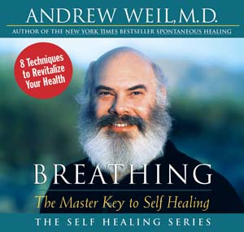
Breathing
“If I had to limit my advice on healthier living to just one tip, it would be simply to learn how to breathe correctly.”
Andrew Weil

Slide 27
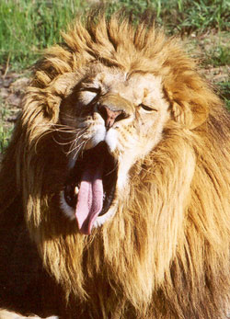
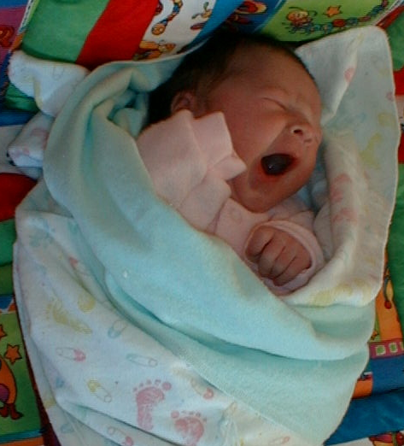
Sleep
Pre-Edison: 10 hours/day
Today: 7 hours/day
25% of 18-29 year olds get 8 hours
Make sleep a priority

Slide 28
Effects of Sleep
Immune system
Energy levels
Weight
Motor skills (accidents)
Cognitive functioning
Stress/anxiety levels
Depression
Get your “Happiness Sleep”

Slide 29
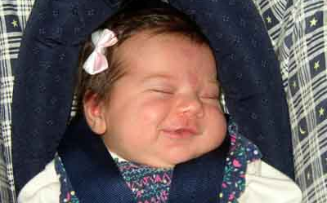
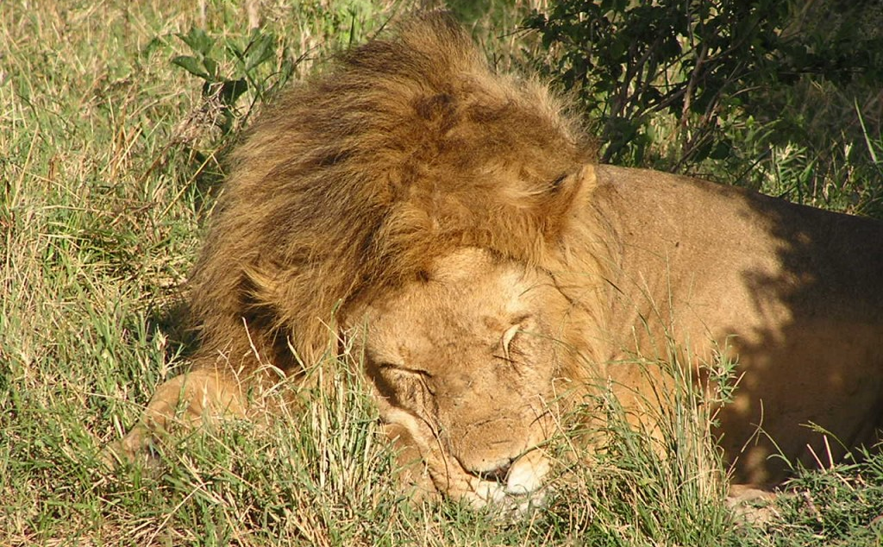
Sleep Tips
8 hours/day
Nap time
Watch your exercise and food
Permission to be human
Pay attention to internal rhythms

Slide 30
Good Night, Good Life
“Effects of sleep deprivation on health and well-being have been documented by research. Cognitive skills and physical performance are impaired by sleep deprivation, but mood is affected even more. People who get less than a full night's sleep are prone to feel less happy, more stressed, more physically frail and more mentally and physically exhausted as a result. Sufficient sleep makes us feel better, happier, more vigorous and vital.”
William Dement

Slide 31
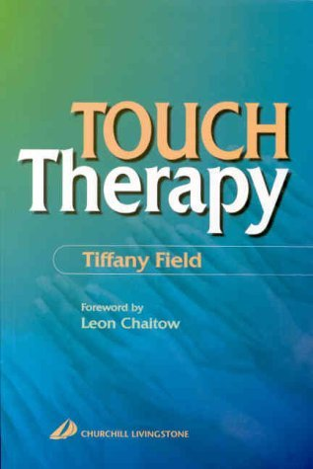
Getting In Touch With Touch
Physical health
Mental health
Better sex life (Masters & Johnson)

Slide 32
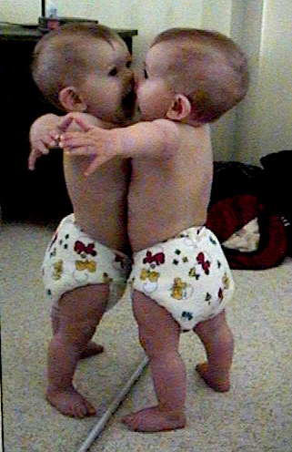
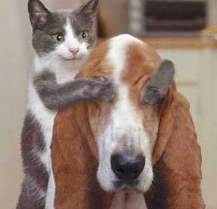
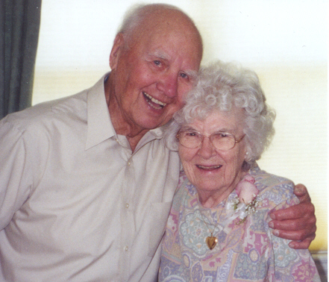
The Need for Touch
“We need 4 hugs a day for survival.
We need 8 hugs a day for maintenance.
We need 12 hugs a day for growth.”
Virginia Satir
Hug research (Clipman, 1999)
Win-win
Respecting self and others

Slide 33


Slide 34
Bibliography and Recommendations
Babyak, M., et al. (2000). Exercise Treatment for Major Depression: Maintenance of Therapeutic Benefit at 10 Months. Psychosomatic Medicine, 62, 633-638.
Benson, H. (1997). Timeless Healing. Scribner.
Field, T. (2003). Touch. Bradford Books.
Murphy, S. (2004). Run for Life: The Real Woman’s Guide to Running. The Lyons Press.
Salmon, P. (2001). Effects of Physical Exercise on Anxiety, Depression, and Sensitivity to Stress: A Unifying Theory. Clinical Psychology Review, 21, 33-61.
Sarno, J. E. (1991). Healing Back Pain: The Mind-Body Connection. Warner Books.
Trockel, M. T. et al. (2003). Health-Related Variables and Academic Performance Among First-Year College Students: Implications for Sleep and Other Behaviors. Journal of American College Health, 49, 3.

Slide 35
Bibliography and Recommendations
Bennett-Goleman, T. (2002). Emotional Alchemy. Three Rivers Press.
Benson, H. The Relaxation Response. HarperTorch.
Carrington, P. et al. (1980). The Use of Meditation: Relaxation Techniques for the Management of Stress in a Working Population. Journal of Occupational Medicine, 22, 221-231.
Derezotes, D. (2000). Evaluation of Yoga and Meditation Trainings With Adolescent Sex Offenders. Human Science Press, 17, 97-113.
Kabat-Zinn, J. (1990). Full Catastrophe Living: Using the Wisdom of Your Body and Mind to Face Stress, Pain, and Illness. Delta.
Hall, S. S. (2003). Is Buddhism Good for Your Health? New York Times Magazine, September 14.
Shapiro, S. L. et al. (2002). Meditation and Positive Psychology. In C. R. Snyder and S. J. Lopez (Eds.), Handbook of Positive Psychology, 632-645. Oxford University Press.

