Slide 1
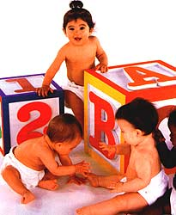
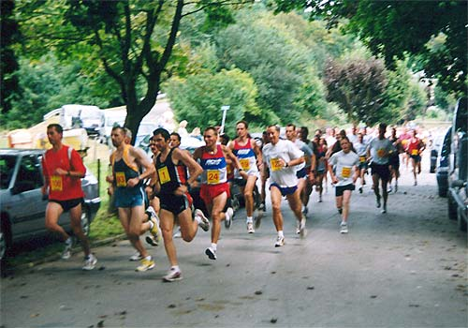
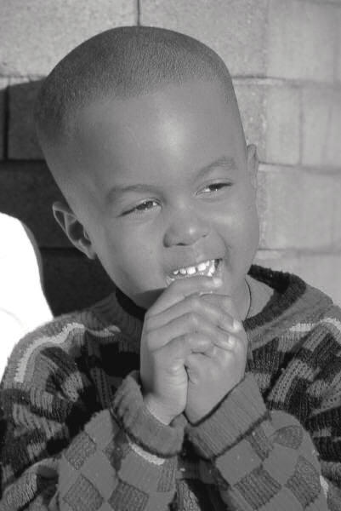


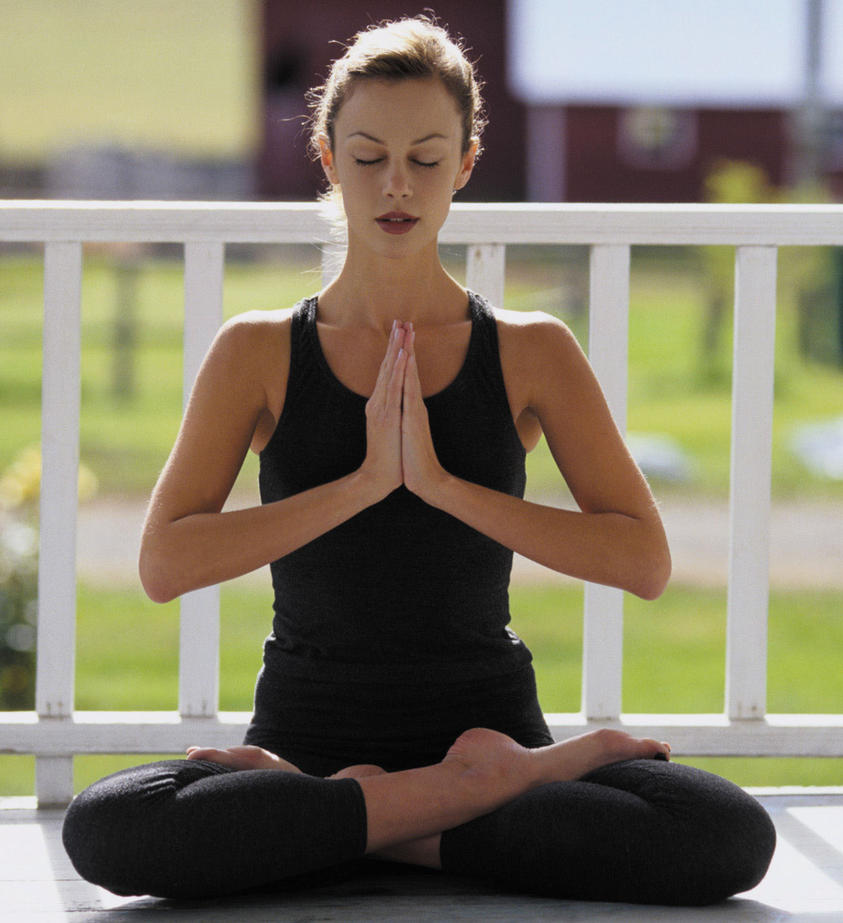

积极心理学

Slide 2
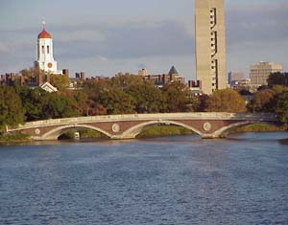

架起象牙塔与大众之间的桥梁
积极心理学的目的是将严格的学术研究与自助运动的可及性相结合。

Slide 3
内务工作
反馈和提问
紧急情况下…
我们会有“练习时间”
PPT和录像会上传到网上
主动做笔记
常规时间

Slide 4

“语言不是教育和学习的唯一交流媒介。我们也保持沉默。沉默使我们有机会思考我们所说所闻。在真正的教育中，静谧被视为可靠环境以便让学生进行内省。它是一种最深层次的学习媒介。”

Slide 5
积极心理学历史
人文心理学 (50’s)
三股势力
对行为主义的反应 (第一势力)
对精神分析的反应 (第二势力)
缺乏严格的方法

Slide 6
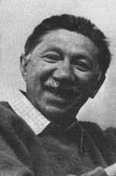
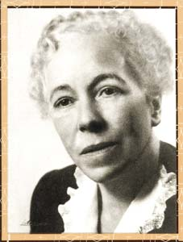
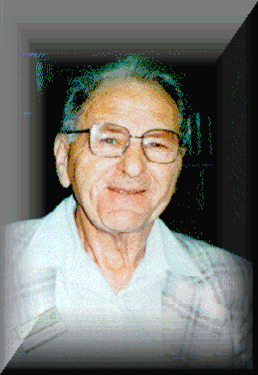
遇见祖父祖母
Abraham Maslow
(1908-1970)
Karen Horney
(1885-1952)
Aaron Antonovsky
(1923-1994)

Slide 7
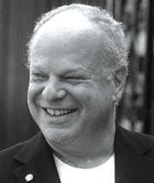

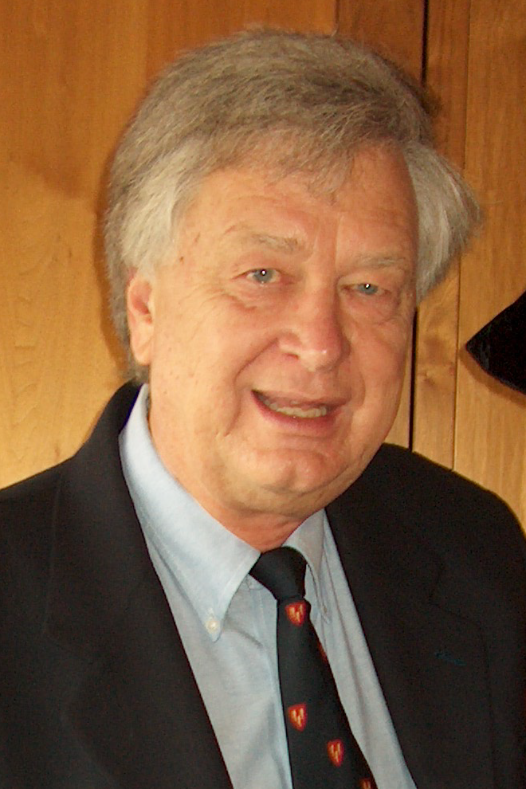
遇见父辈
Martin Seligman
Ellen Langer
Philip Stone

Slide 8

遇见1504课程

Slide 9
不仅仅是信息的接收
也要有转变、变换
去除掩盖，发现潜能

Slide 10
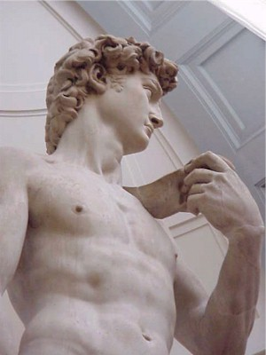
“The soul grows by subtraction, not addition.”
Thoreau
“为学日益，
为道日损”
——老子

Slide 11

轰动之处的研究
没有令人震惊的部分
让常识更为人所知

Slide 12
信息还不够
“错的不是科学中的重大发现。有信息总比无知强，不管是何种信息，也不管是何种无知。而是错在信息背后的信念，认为信息将改变世界的信念。但他不会。” —Archibald MaCleish

Slide 13
信息还不够
“人文哲学衍生出关于学习，教学和教育的新概念。简单地说这个概念认为教育的功能，教育的目标，人类的目标，人性的目标，那些所有被人类关注的目标，最终都是人的自我实现：成为一个完整的人。达到人类或者特定的某个人所能达到的极限。通俗点说就是帮助一个人成为你能成为的最好的自己。” —Abraham Maslow

Slide 14
这不关乎提供关于美好生活的明确答案
这关乎确定正确的问题
教育是对知识和转变的「探寻」，因此必须从一个「问题」开始。
“管理决策中最常见的错误来源是强调找到正确的答案，而不是找到正确的问题。”
—Peter Drucker

Slide 15


Slide 16

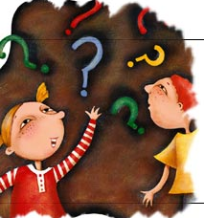
“The one real object of education is to leave a man in the condition of continually asking questions.” Bishop Creighton

Slide 17
The Question of Questions
How can we help ourselves and others—individuals, communities, and society—become happier?

Slide 18
It is not a survey of positive psychology
It is a selective exploration of the ‘question of questions.’
Eclectic
Cross cultural psychology
“[We were] a little surprised by the Dalai Lama’s seeming resistance to the notion of cultural differences.”
Daniel Goleman

Slide 19
Studying Ourselves (as well)
“What is most personal is most general.” Carl Rogers
“We must remember that knowledge of one’s own deep nature is also simultaneously knowledge of human nature in general.” Abraham Maslow

Slide 20
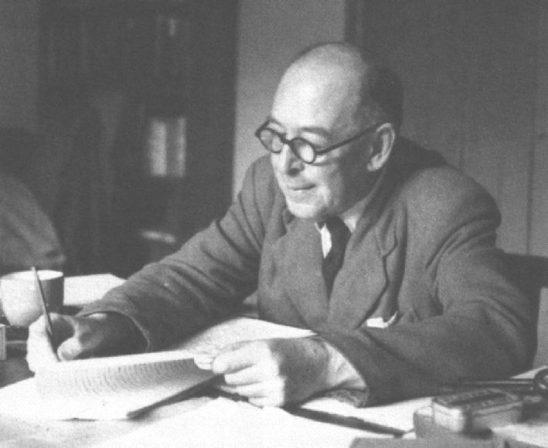
“There is one thing, and only one in the whole universe which we know more about than we could learn from external observation. That one thing is [ourselves]. We have, so to speak, inside information; we are in the know.”
CS Lewis

Slide 21
It is not English 10a or Math 55
It is about rigorous fun
“I would not give a fig for the simplicity on this side of complexity, but I would give my life for the simplicity on the other side of complexity.” Oliver Wendell Holmes
A different kind of effort
“On Monday, don’t tell me how great it was; tell me what you’re doing differently.” Peter Drucker

Slide 22
Final Project
20-30 minute Presentation
Any topic within positive psychology
Written text (10-15 pages double spaced)
Slides (word or powerpoints)
Include:
Reference to research
Optional: stories, film clips, exercises, etc
Why a presentation?
Teaching as learning
Spread goodness…

Slide 24

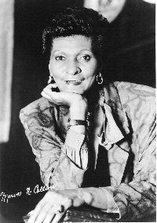

Why Positive Psychology?

Slide 25
Psychological Abstracts (1967-2000)
Anger: 5,584
Anxiety: 41,416
Depression: 54,040
Joy: 415
Happiness: 1,710
Life satisfaction: 2,582
Ratio: 21/1

Slide 26
Focusing on What Doesn’t Work
“The science of psychology has been far more successful on the negative than on the positive side; it has revealed to us much about man’s shortcomings, his illnesses, his sins, but little about his potentialities, his virtues, his achievable aspirations, or his psychological height. It is as if psychology had voluntarily restricted itself to only half its rightful jurisdiction, and that the darker, meaner half.” Abraham Maslow

Slide 27
Psychology Needs Help
21/1 ratio is unhealthy…
… but it reflects reality
depression 10 times higher today than 1960
mean age for depression today is 14.5 (compared to 29.5 in 1960)

Slide 28
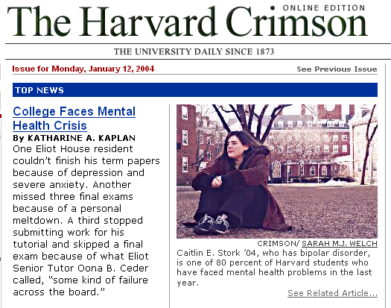

Slide 29
Does Psychology Need Help?
21/1 ratio of studies is unhealthy…
… but it reflects reality
depression 10 times higher today than 1960
mean age for depression today is 14.5 (compared to 29.5 in 1960)
mental health crisis on campuses nationwide (Kadison, 2005)
worldwide mental health epidemic

Slide 30
Why Positive Psychology?
The importance of focusing on what works
Happiness is not the negation of unhappiness
Prevention through cultivating capacity

Slide 31
1. The Importance of Focusing on What Works
“The aim of Positive Psychology is to catalyze a change in psychology from a preoccupation only with repairing the worst things in life to also building the best qualities in life.” Martin Seligman

Slide 32
Reframing Questions: The Case of At-Risk Population
Traditional psychology (Post-WWII)
“Why do these individuals fail?”
Positive psychological approach (1980s-)
“What makes some individuals succeed despite unfavorable circumstances?”

Slide 33
Resilience
“A class of phenomena characterized by patterns of positive adaptation in the context of significant adversity or risk.”
Masten & Reed
Superkids?
Ordinary characteristics, extraordinary results
Optimism
Faith and a sense of meaning
Prosocial behavior
Focusing on strengths
Set goals
A role model
Social support

Slide 34
From Pathogenic Questions to Salutogenic Questions
“All those familiar with the history of science are aware that important advances come with the formulation of new questions. The question is the breakthrough; the answer comes with difficulty, but it is the new question that is important. The salutogenic question, I submit to you, is a radically new question, which provides the impetus for formulating a new paradigm to help us understand health and illness. It has serious implications for researcher and clinician, biological and social scientist alike.”
Aaron Antonovsky

Slide 35
“We see what we look for and we miss much of what we are not looking for even though it is there... Our experience of the world is heavily influenced by where we place our attention.”
Stavros and Torres

Slide 36

Role models
High Expectations
From blame to responsibility
Tough and respectful
Optimism and faith in future
From focusing on deficiencies to focusing on strengths

Slide 37
Passive Victim Vs. Active Agent
___________________________________________
self pity
blame
frustration
anger
take action
responsibility
confidence
hope and optimism

Slide 38
Reframing Questions: The Case of a Chicago School
Traditional Way
“How can we keep students in school?”
Marva Collins’ Way
“How can we cultivate the seed of greatness in our students?”
“How can we cultivate the seed of greatness in our selves and families, in our communities and organization, in our nation and our world?”

Slide 39
2. Happiness isn’t the Negation of Unhappiness
neurosis, anger, anxiety, wellbeing, satisfaction, joy
depression, psychosis excitement, happiness
_______________________ 0 ____________________ +
Disease Model Health Model
Focus on weaknesses Focus on strengths
Overcoming deficiencies Building competencies
Avoiding pain Seeking pleasure
Running from unhappiness Pursuing happiness
Neutral state (0) as ceiling No ceiling
Tensionless as ideal Creative tension as ideal

Slide 40
3. Prevention through Cultivating Positive
Illness as the absence of health (vs. health as the absence of illness)
“It [neurosis] is a falling short of what one could have been, and even, one could say, of what one should have been, biologically speaking, that is, if one had grown and developed in an unimpeded way. Human and personal possibilities have been lost. The world has been narrowed, and so has consciousness. Capacities have been inhibited.” Abraham Maslow

Slide 41
“We have discovered that there are human strengths that act as buffers against mental illness: courage, future-mindedness, optimism, interpersonal skill, faith, work ethic, hope, honesty, perseverance, the capacity for flow and insight, to name several... We have shown that learning optimism prevents depression and anxiety in children and adults, roughly halving their incidence over the next two years... Similarly, I believe, that if we wish to prevent drug abuse in teenagers who grow up in a neighborhood that puts them at risk, that the effective prevention is not remedial. Rather it consists of identifying and amplifying the strengths that these teens already have.” Martin Seligman

Slide 42
Cultivating Capacity
Stronger “psychological immune system”
Larger and stronger “psychological engine”
Mental health at Harvard

Slide 43
“The message of the Positive Psychology movement is to remind our field that it has been deformed. Psychology is not just the study of disease, weakness, and damage; it also is the study of strength and virtue. Treatment is not just fixing what is wrong; it also is building what is right. Psychology is not just about illness or health; it is about work, education, insight, love, growth, and play. And in this quest for what is best, Positive Psychology does not rely on wishful thinking, self-deception or hand-waving; instead it tries to adapt what is best in the scientific method to the unique problems that human behavior presents in all its complexity.” Martin Seligman

Slide 44
Bibliography and Recommendations
www.psychologymatters.org
http://www.ppc.sas.upenn.edu/
Antonovsky (1979). Health, Stress, and Coping. San Fransisco: Jossey-Bass.
Masten, A. S. & Reed, M. J. (2002). Resilience in development. In C. R. Snyder and S. J. Lopez (Eds.), Handbook of Positive Psychology, 528-540. Oxford University Press.
Seligman, M. E. P., & Csikszentmihalyi, M. (2000). Positive Psychology. American Psychologist, 55, 5-14.
Sheldon, K. M. & King, L (2001). Why Positive Psychology Is Necessary. American Psychologist, 56, 216-217.
Snyder, C. R. & Lopez, S. J. (Eds.) (2002). Handbook of Positive Psychology, 528-540. Oxford University Press.
Collins, M. & Tamarkin, C. (1990). Marva Collins’ Way. Putnam: New York.
Werner, E. & Smith, R. (2001). Journeys from Childhood to Midlife: Risk, Resilience and Recovery. Cornell University Press.

