Slide 1
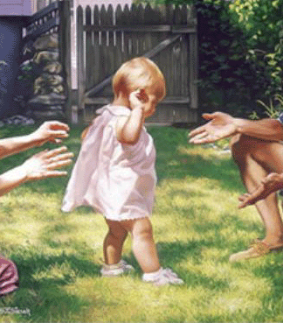

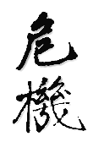
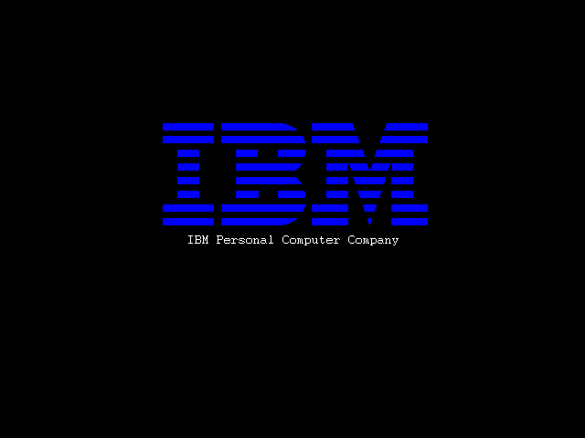
ti
Perfec onizm

Slide 2
Outline
What is Perfectionism?
Characteristics
Consequences
Success and Happiness
Sources of Perfectionism
Overcoming Perfectionism

Slide 3


Slide 4
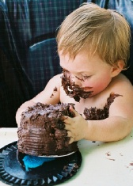
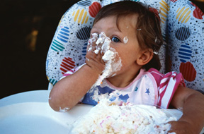
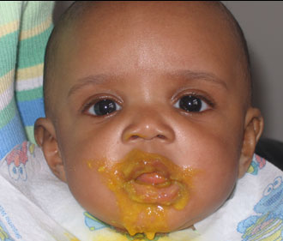
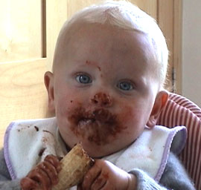
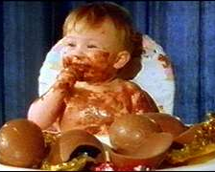

Slide 5
Learn to fail or fail to learn

Slide 6
Crisis (Wei Ji)
Danger
and
Opportunity

Slide 7
“The greatest mistake a man can make is to be afraid of making one.”
Elbert Hubbard

Slide 8
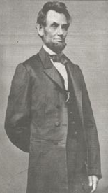
The Path of Failure
Age 22: Lost job
Age 23: Defeated for state legislature
Age 24: Failed in business
Age 27: Nervous breakdown
Age 34: Ran for congress and defeated
Age 39: Defeated again
Age 46: Ran for senate and defeated
Age 47: Defeated for nomination for vice president
Age 50: Defeated again for senate
Age 51: 16th US President

Slide 9
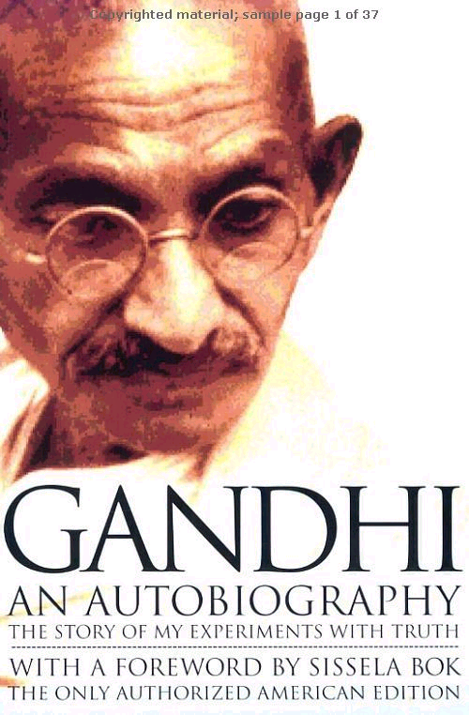
“Freedom is not worth having if it does not connote freedom to err.”
Mohandas Gandhi

Slide 10
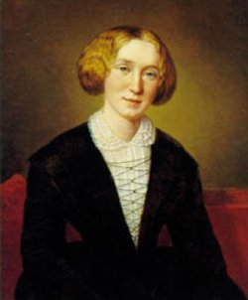
“The important work of moving the world forward does not wait to be done by perfect men.”
George Eliot

Slide 11
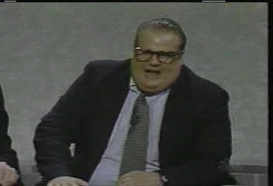

Slide 12
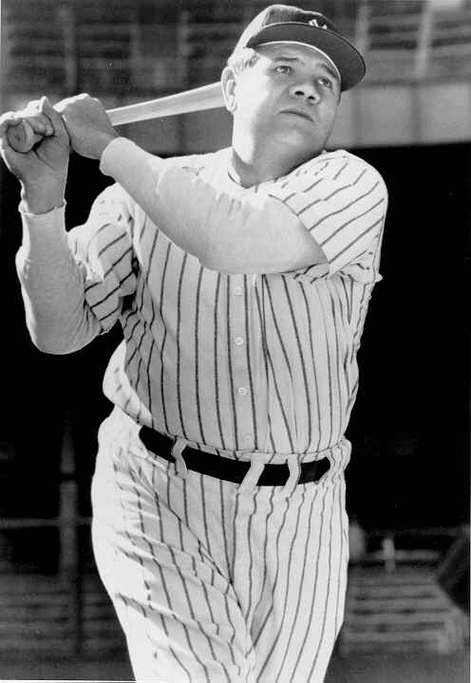
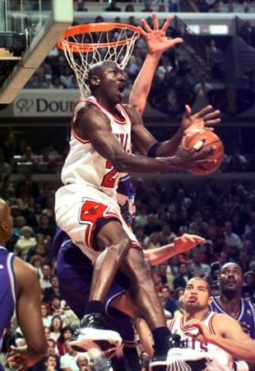

Slide 13


Slide 14
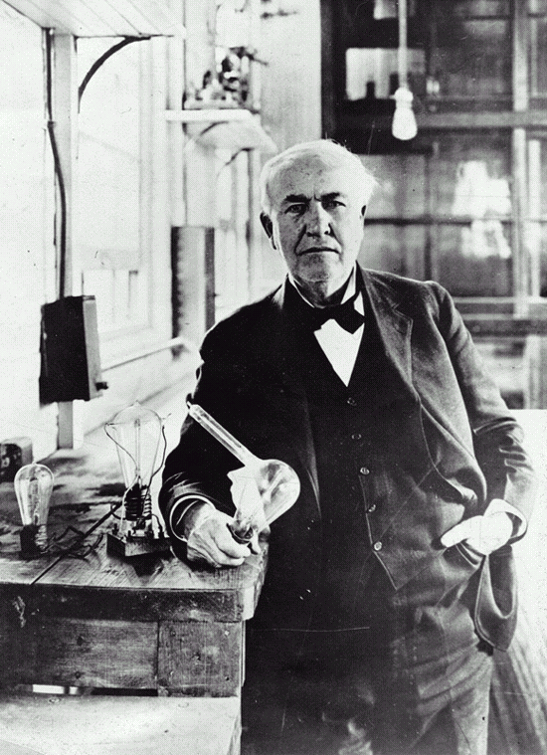


Slide 15
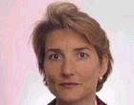
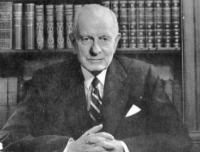
Amy Edmondson (1999)
“Psychological Safety”
Thomas Watson Sr.
IBM
“If you want to increase your success rate, double your failure rate.”
Thomas Watson Sr.
“Origins of Genius” (Simonton, 1999)
Fail your way to success (Klem, 1997)

Slide 16
Perfectionism is an incapacitating fear of failure that permeates our lives, especially those areas that we care about most.
It is an approach, a cognitive and emotional schema, that we hold toward the journey of our lives, toward the process of getting from point A to point B.

Slide 17
Perfection Vs. Excellence
Characteristics
Perfection
Excellence
Defensive
Open to Suggestions
Half Empty
Half Full
Over Generalize
Realistic
No Self-Acceptance
Unconditional Acceptance
Static
Dynamic
Fear of failure
Failure as feedback
Focus on Destination
Journey and Destination

Slide 18
Perfection Vs. Excellence
Consequences
Perfection
Excellence
Temporary Relief
Lasting Satisfaction
Inevitable Failure
Possibility of Success
Wastes time
Appropriate Time Allocation
Prone to disorders
Healthy Approach
Hurts Self-Esteem
Continuous Improvement
Harms Relationships
Allows for Growth
Anxiety/Stress
Creative Tension
Performance?
Less Pain More Gain

Slide 19
Less Pain More Gain ??*@#!!#??
Sustainable approach to growth
Procrastination
Higher levels of self-confidence
Learn to fail or fail to learn
‘The Luck Factor’ (Wiseman, 2003)
Creativity (Simonton, 1999)
80/20 Rule (Pareto’s Principle)
Increase in flow experiences (Csikszentmihalyi, 1991)

Slide 20
Source of Perfectionism
Conditioning
Destination = Reward = Acceptance
Journey = Unrewarded = Means Only
Social environment
Permission to be human?

Slide 21


Slide 22

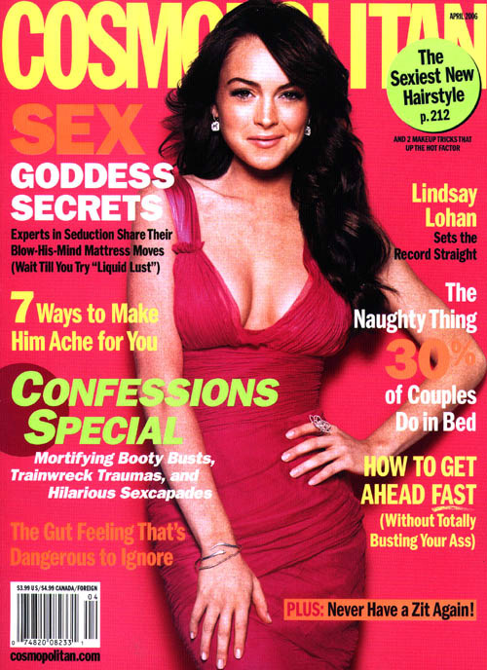

Slide 23


Slide 24



Slide 25



Slide 26



Slide 27
Harmful Praise? (Dweck, 2005)
Intelligence versus Effort
“Emphasizing effort gives a child a variable that they can control. They come to see themselves as in control of their success. Emphasizing natural intelligence takes it out of the child’s control, and it provides no good recipe for responding to a failure.”
“When you praise kids' intelligence and then they fail, they think they're not smart anymore, and they lose interest in their work. In contrast, kids praised for effort show no impairment and often are energized in the face of difficulty.”
Fixed versus Malleable

Slide 28
Overcoming Perfectionism
Awareness

Slide 29


Slide 30
Overcoming Perfectionism
Awareness
Focus on, and reward, effort
Active Acceptance
Behavior changes attitude
Meditation and visualization
Setting a liberating goal or vision
The Platinum Rule
Helping others?

Slide 31
Applying the 3 P’s…
1. Permission
  Acceptance
  Respect for reality
2. Positive
  Benefit finding
  Failure as opportunity
  Distracting
3. Perspective
  Don’t sweat the small stuff…
  Psychological maturity

Slide 32
Nature to be commanded must be obeyed.
Francis Bacon

