Slide 1

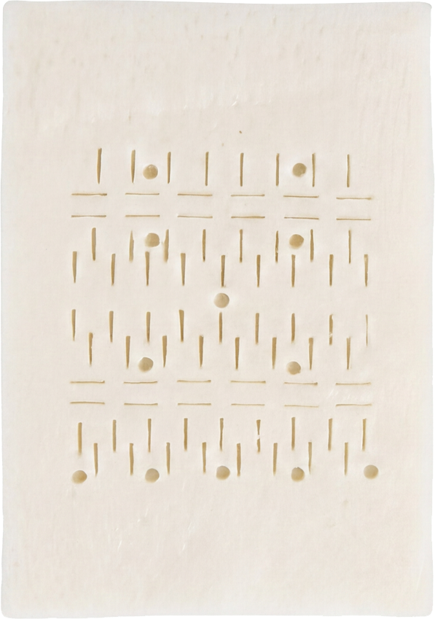
VIETNAM UROLOGY WEBINAR
MegaDerm
Penile
Augmentation
Clinical Cases and Perioperative Care
Jinmo Koo
21 October 2026
Jinmo Koo · HIGHST Urology
01
Notes:
Jinmo Koo, HIGHST Urology. Vietnam MegaDerm Webinar, 21 October 2026.

Slide 2
SPEAKER
Jinmo Koo
HIGHST Urology
Jinmo Koo · HIGHST Urology
02
Notes:
Jinmo Koo, HIGHST Urology.

Slide 3
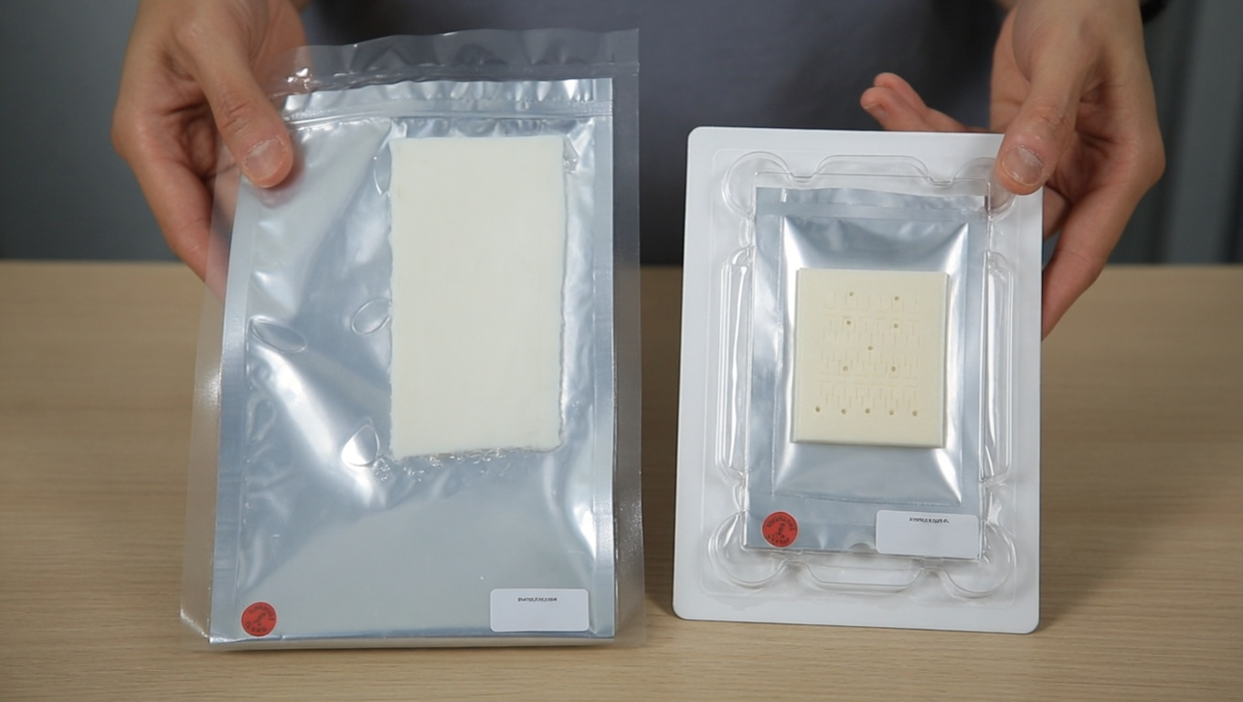
MATERIALS
MegaDerm & MegaFill
MegaDerm
Acellular dermal matrix
Hydrated / Freeze-dried
MegaFill
Micronized acellular dermal matrix
MegaDerm stock at HIGHST: 3–5 mm / 5 × 6, 5 × 8, 5 × 10, 6 × 12 cm
Jinmo Koo · HIGHST Urology
03
Notes:
MegaDerm is a sheet acellular dermal matrix. HIGHST stocks hydrated and freeze-dried types. The stated thickness and sizes describe HIGHST's inventory. MegaFill is a micronized form of acellular dermal matrix. The photograph is supplied by HIGHST. Individual packages are not assigned type labels.
Sources
https://lncbio.co.kr/theme/basic/images/L%26CBIO_catalog.pdf

Slide 4
EVALUATION
Preoperative Evaluation
Blood and urine testing
Penile biothesiometry
Liver function
Blood glucose
Inflammatory markers
STI screening
Vibration perception threshold
Penile sensitivity assessment
Jinmo Koo · HIGHST Urology
04
Notes:
Blood and urine testing: liver function, blood glucose, inflammatory markers and STI screening are the categories provided by HIGHST. Penile biothesiometry assesses vibration perception thresholds and penile sensitivity. It contributes to the clinical assessment rather than establishing a diagnosis of premature ejaculation by itself.
Sources
https://pubmed.ncbi.nlm.nih.gov/28874780/

Slide 5
PREPARATION
Surgical Preparation
Shaving and Draping
Jinmo Koo · HIGHST Urology
05
Notes:
Shaving and draping.

Slide 6
CLINICAL CASES / CASE 1
Pubic Incision
Jinmo Koo · HIGHST Urology
06
Notes:
Case 1: Pubic Incision.

Slide 7
CLINICAL CASES / CASE 2
Circumcision-line Incision
Jinmo Koo · HIGHST Urology
07
Notes:
Case 2: Circumcision-line Incision.

Slide 8
CLINICAL CASES / CASE 3
Secondary Dermal Grafting
Jinmo Koo · HIGHST Urology
08
Notes:
Case 3: Secondary Dermal Grafting.

Slide 9
CLINICAL CASES / CASE 4
Revision Surgery
Jinmo Koo · HIGHST Urology
09
Notes:
Case 4: Revision Surgery.

Slide 10
CLINICAL CASES / CASE 5
Contour Step-off Correction
Jinmo Koo · HIGHST Urology
10
Notes:
Case 5: Contour Step-off Correction.

Slide 11
COMPLICATIONS
Potential Complications
01
Bleeding and swelling
Hematoma, foreskin edema
02
Wound complications
Delayed healing, infection, skin necrosis
03
Contour and discomfort
Graft contour irregularity, discomfort during erection
Reported in ADM augmentation literature
Jinmo Koo · HIGHST Urology
11
Notes:
These categories are reported in published ADM augmentation literature. They do not represent HIGHST or MegaDerm-specific outcome data. No incidence rates are extrapolated to HIGHST.
Sources
https://pubmed.ncbi.nlm.nih.gov/31420614/

Slide 12
AFTERCARE
Postoperative Care & Dressing
Postoperative care
Dressing technique
Jinmo Koo · HIGHST Urology
12
Notes:
Postoperative care and dressing technique.

Slide 13
DISCUSSION
Questions & Answers
Thank you
Jinmo Koo · HIGHST Urology
13
Notes:
Thank you.

