Slide 1
DivX
STOCKLANA PROTOTYPE · SEPTEMBER 2026
Keep the stock exposure.
Sell the dividend rights.
A dividend market for tokenized stocks on Solana.
WORKING PROGRAM · PUBLIC DEVNET · GUIDED SANDBOX
Notes:
Narration: DivX lets you keep the stock exposure and sell the right to a year of dividends. A dividend is a payment a company makes to its shareholders. We built this for Stocklana on Solana. The program and demo work today with test assets.
Presenter notes: Working annual-claims prototype with synthetic test assets. No mainnet launch, qualified live issuer settlement or partnership claim.
Sources and evidence: planning/mainnet-readiness-2026-09-20.md | https://hackathons.solana.com/hackathons/stocklana

Slide 2
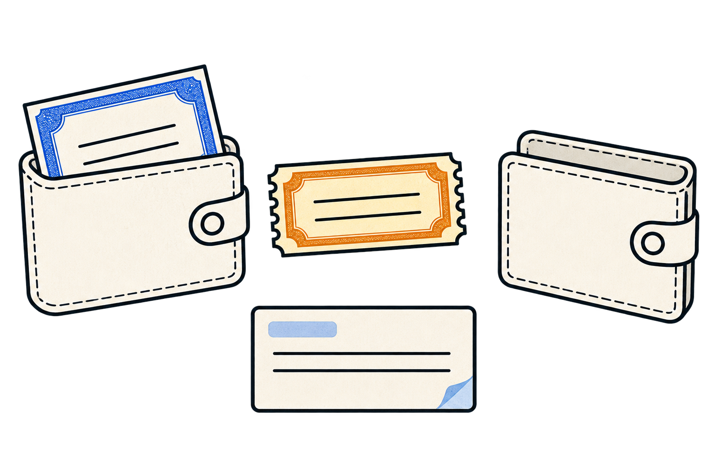
DivX
02
Two sides of one trade
TRADITIONAL DIVIDEND MARKET
SELLERS
BUYERS
Bank trading desks
Asset managers and hedge funds
Manage dividend risk from structured products.
Trade expected payouts. Survista is one documented buyer.
DIVX FLOW
Stockholder
Buyer
Retains PT stock exposure.
Sells the annual DR.
Pays the holder for DR.
Receives that year's
dividend rights.
Notes:
Narration: People already trade dividends separately in traditional finance. Banks use dividend contracts to manage risk from structured products. Investment funds buy exposure to future dividends. With DivX, a stockholder retains PT for stock exposure and sells the annual DR to a buyer for payment.
Presenter notes: The institutions above are participants in traditional dividend markets, not DivX users. Bank direction varies by book and tenor; hedge funds can buy or sell. Traditional dividend futures and swaps are generally cash-settled. DivX allocates collateral in the deposited stock token, and proceeds require a willing buyer at an agreed price.
Sources and evidence: Eurex 2025 whitepaper, pp. 31–32: https://www.eurex.com/resource/blob/4418754/f90fd622a278beb08757729864e93925/data/whitepaper-derivatives-forum-frankfurt-2025.pdf | CME, Trading Dividend Uncertainty, 2024: https://www.cmegroup.com/articles/2024/trading-dividend-uncertainty.html | CME dividend-futures primer, 2024: https://www.cmegroup.com/articles/2024/equity-index-dividend-futures-a-primer.html | design/illustrations/assets/dividend-trade-v2.png

Slide 3

DivX
03
One deposit, two tokens
Deposit 100 stock tokens
100 PT
Stock exposure
100 DR
The year’s dividend rights
Keep, transfer or trade
either side.
The stock tokens stay in the vault.
Notes:
Narration: In this example, deposit 100 stock tokens into a vault. Receive 100 PT for the stock exposure and 100 DR for the year’s dividend rights. The stock tokens stay in the vault. You can keep, transfer or trade each side. The counts describe claims, not a promised dividend amount.
Presenter notes: Illustrative 100-unit display, not a 50/50 value allocation or guaranteed payout. PT and DR redeem in the deposited token; their dollar values can change. Raw issuance is one raw PT and one raw DR per deposited raw unit; displayed counts depend on series denomination and scaling.
Sources and evidence: spec/annual-series-accounting.md | design/illustrations/assets/deposit-vault-claims-v1.png | design/illustrations/social/deposit-split-counts-v2.jpg

Slide 4
DivX
04
Established markets, familiar behavior
LISTED DIVIDEND DERIVATIVES
ONCHAIN YIELD SEPARATION
21M+
Pendle
dividend contracts traded on Eurex in 2024
Separate principal from future yield
Investors already trade dividends separately.
Crypto users already separate yield.
Notes:
Narration: More than 21 million dividend contracts traded on Eurex in 2024. In crypto, Pendle separates principal from future yield. These markets show that people want to trade income separately from an asset. DivX brings that idea to stock tokens.
Presenter notes: Historical precedents validate the use case, not demand for DivX or the safety of this implementation. The Eurex figure measures contracts traded, not dollars of liquidity.
Sources and evidence: https://www.eurex.com/ex-en/find/news-center/news/Eurex-dividend-options-received-CFTC-approval-for-trading-in-the-U.S.--4248358 | https://docs.pendle.finance/pendle-v2/ProtocolMechanics/YieldTokenization/PT

Slide 5
DivX
05
One year of dividend rights
COCA-COLA EXAMPLE · KOX 2027
PT-KOx-2027
DR-KOx-2027
Before the year
Deposit and split. New issuance closes when 2027 begins.
During the year
Trade existing PT or DR. DR accrues qualified dividends.
After finalization
Redeem each side separately. Accrued rights do not expire.
Matching PT and DR can be recombined while the series is active.
Notes:
Narration: Each stock token and year has its own series. Deposit and split before the year starts; issuance closes at the cutoff. During the year, people can trade existing PT or DR, and DR accumulates qualified dividends. A midyear buyer gets DR from another holder, not from new issuance. Matching PT and DR can recombine while the series is active. After finalization, each side can redeem separately, and accrued rights do not expire.
Presenter notes: The stock token and year have one series. A buyer who acquires DR midyear buys an existing token on the secondary market; the vault cannot issue a new one after the preyear cutoff. Qualified official ex-dates determine the annual event set. Maturity stops new accrual eligibility; finalization requires complete, resolved records and may occur later. Cancellations, corrections, unsupported actions and cumulative rounding are tested. Unsupported actions block unsafe finalization. DR transfers include accrued allocation. Reinvested dividends settle in stock tokens, not guaranteed cash. A matching pair cannot erase previously transferred claims.
Sources and evidence: spec/annual-series-accounting.md | planning/program-review.md

Slide 6

DivX
06
Why Solana
>95%
of tokenized-equity trading
Solana reached this share during Q2 2026.
Put existing capital to work.
Bring more capital to Solana.
Fast settlement · Fractional positions · Auditable
Galaxy Research · Q2 2026 report · A level reached, not a quarterly average.
Notes:
Narration: Stock-token trading is already happening on Solana. Galaxy reports that its share reached over 95 percent during the second quarter of 2026. We want to give existing capital more uses and attract additional capital to Solana through DivX. Fast settlement, fractional positions and auditable records can make both tokens useful to other builders.
Presenter notes: The metric is tokenized-equity trading share reached during Q2 2026. It is not total RWA liquidity, a quarter average, or current market share. DivX aims to give existing capital more uses and offer a reason for additional capital to join Solana; inflows are not assured. Auditability means visible program records, not audit certification or proof of issuer reserves.
Sources and evidence: https://www.galaxy.com/insights/research/solana-q2-2026-report-tokenized-economy-dex-rwa-stablecoins | design/illustrations/assets/solana-capital-access-v1.png

Slide 7
DivX
07
Both sides are composable
PT for stock exposure. DR for dividend rights.
Liquidity markets
Raydium · Meteora
Routing and orders
Jupiter: aggregation, recurring buys and limit orders.
Sales and vesting
Streamflow escrow and vesting; Jupiter Lock.
Treasuries and strategies
Squads multisig; dividend baskets and rolling strategies.
Lending later: reliable prices, liquidity and maturity rules first.
Integrations depend on venue support and available liquidity.
Notes:
Narration: Raydium and Meteora offer liquidity markets for compatible tokens. We have demonstrated a dividend-right market using Raydium with test assets. Compatible markets could use Jupiter for routing and orders. Streamflow could support agreed-price sales. Jupiter Lock and Streamflow could schedule delivery, while Squads could manage a shared treasury. Lending comes later, with reliable prices and enough liquidity.
Presenter notes: No partnerships, mainnet markets or automatic listings are implied. Raydium was transaction-tested with test assets on public devnet and captured-program private chains. Meteora has not been integration-tested. Other named integrations are proposed uses, not implemented. Jupiter routing/orders need eligible venues and liquidity. Rolling products must change annual vintages; a DCA cannot reopen closed issuance. Locking schedules token delivery, not DivX dividend accrual. Treasury support requires client and mint compatibility.
Sources and evidence: planning/amm-review.md | presentation/divx-article-draft.md | planning/research/defi-demo-sequence.md | https://docs.meteora.ag/ | https://support.jup.ag/ | https://lock.jup.ag/ | https://docs.streamflow.finance/en/articles/11514590-create-an-order | https://docs.squads.so/main/getting-started/treasury-management-overview

Slide 8
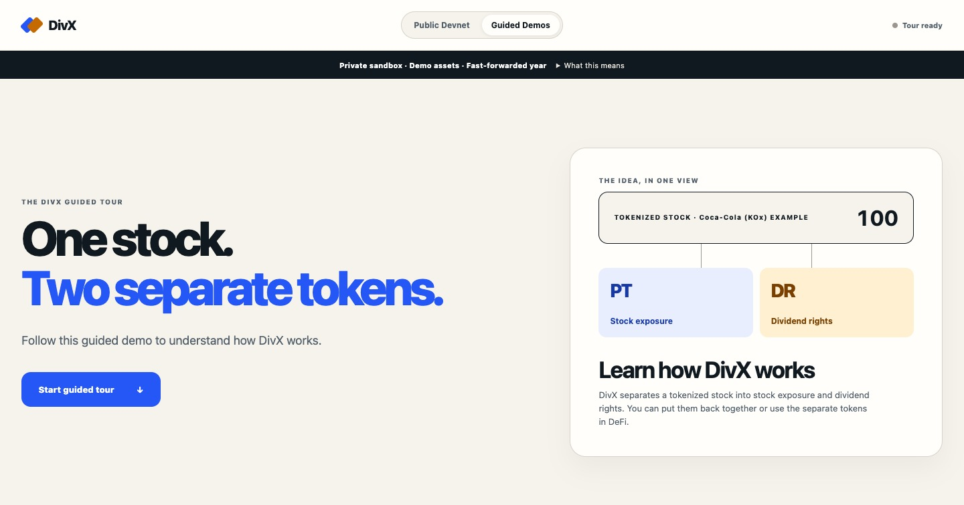
DivX
08
A working guided demo
01
Split and recombine
02
See dividends build up
03
Trade DR and redeem
Selected stock profiles from
Ondo · Backpack · xStocks
https://divx.payai.network/demos/
Public devnet: real calendar. Guided sandbox: accelerated year. Both use test assets.
Notes:
Narration: The guided tour at https://divx.payai.network/demos/ lets anyone split a stock token, put it back together, see the dividend effect and trade dividend rights with a second wallet. It runs real program transactions in a private sandbox with synthetic assets and accelerated time. The public devnet app uses the real calendar. Our test catalog represents selected stocks from Ondo, Backpack and xStocks.
Presenter notes: The public devnet series remains on real 2027 calendar time; independent redemption is not available until maturity and finalization. The guided tour executes actual program instructions on an isolated private chain with synthetic balances/events and captured Raydium bytecode. Fifteen synthetic issuer-specific profiles span six companies; these are not real mainnet issuer mints. No selected issuer is qualified for live custody/settlement. Preview screenshot is existing approved product imagery, not fresh transaction proof.
Sources and evidence: https://divx.payai.network/demos/ | https://divx.payai.network/app/ | https://solscan.io/account/2EpQ2iKz921Ce2rremdnFrqG15DQq3Y2rSXbgixceDQE?cluster=devnet | planning/mainnet-readiness-2026-09-20.md | planning/guided-lazy-entry-review-2026-09-21.md

Slide 9
DivX
09
From prototype to mainnet
WORKING TODAY
BEFORE REAL ASSETS
Annual program and SDK
Public devnet app
Guided split, trade and redemption
Qualified issuer records
Verified custody and payouts
Security and legal review
Then: more liquidity, rolling dividend strategies and other networks.
Try DivX
divx.payai.network
Stocklana hackathon · No wallet or real funds needed for the guided demo.
Notes:
Narration: The annual program, transaction SDK and guided demo are working. Before mainnet, we need complete issuer records, reviewed settlement operations, independent security review and legal and issuer checks. More liquidity, rolling dividend strategies and other networks come later. Try the guided demo at divx.payai.network. No wallet or real funds are needed.
Presenter notes: Mainnet requires explicit custody admission, complete qualified event feeds, attestor governance, corrections and incident policy, independent security review, monitoring, issuer-term/legal review, and liquidity. Current software is a tested prototype, not a live issuer settlement service. Named issuer families are selected research/test scope, not endorsements.
Sources and evidence: planning/mainnet-readiness-2026-09-20.md | https://divx.payai.network/ | https://github.com/notorious-d-e-v/divx | https://hackathons.solana.com/hackathons/stocklana

