Slide 1
Analyzing FitBit dataset to help influence BellaBeat's marketing strategy
Clarence Amoranto
Feb 10, 2023
Notes:
ID=d924773e-9a16-4d6d-9803-8cb819e99682 Recipe=text_billboard Type=TextOnly Variant=0 FamilyID=AccentBoxWalbaum_Zero

Slide 2

Agenda
Introduction
Problem and Solution
Key Insights
Summary
Recommendations
Timeline

Slide 3

Introduction
The objective is to gain insights from Fitbit secondary data to drive business decisions for another health tracker company called BellaBeat - a high-tech manufacturer of health-focused products for women. This data analysis can help guide BellaBeat’s marketing strategies, particularly for two of their products Leaf (tracker bracelet) and Time (wellness watch).

Slide 4
Problem and Solution

Slide 5
Problem
Provide BellaBeat with recommendations for their digital marketing strategy.

Slide 6
Solution
Gain insights from Fitbit secondary data to drive business decisions for BellaBeat.

Slide 7
Key Insights
Steps vs Calories
Sleep vs Distance
Distance vs Calories
Sleep vs Calories

Slide 8
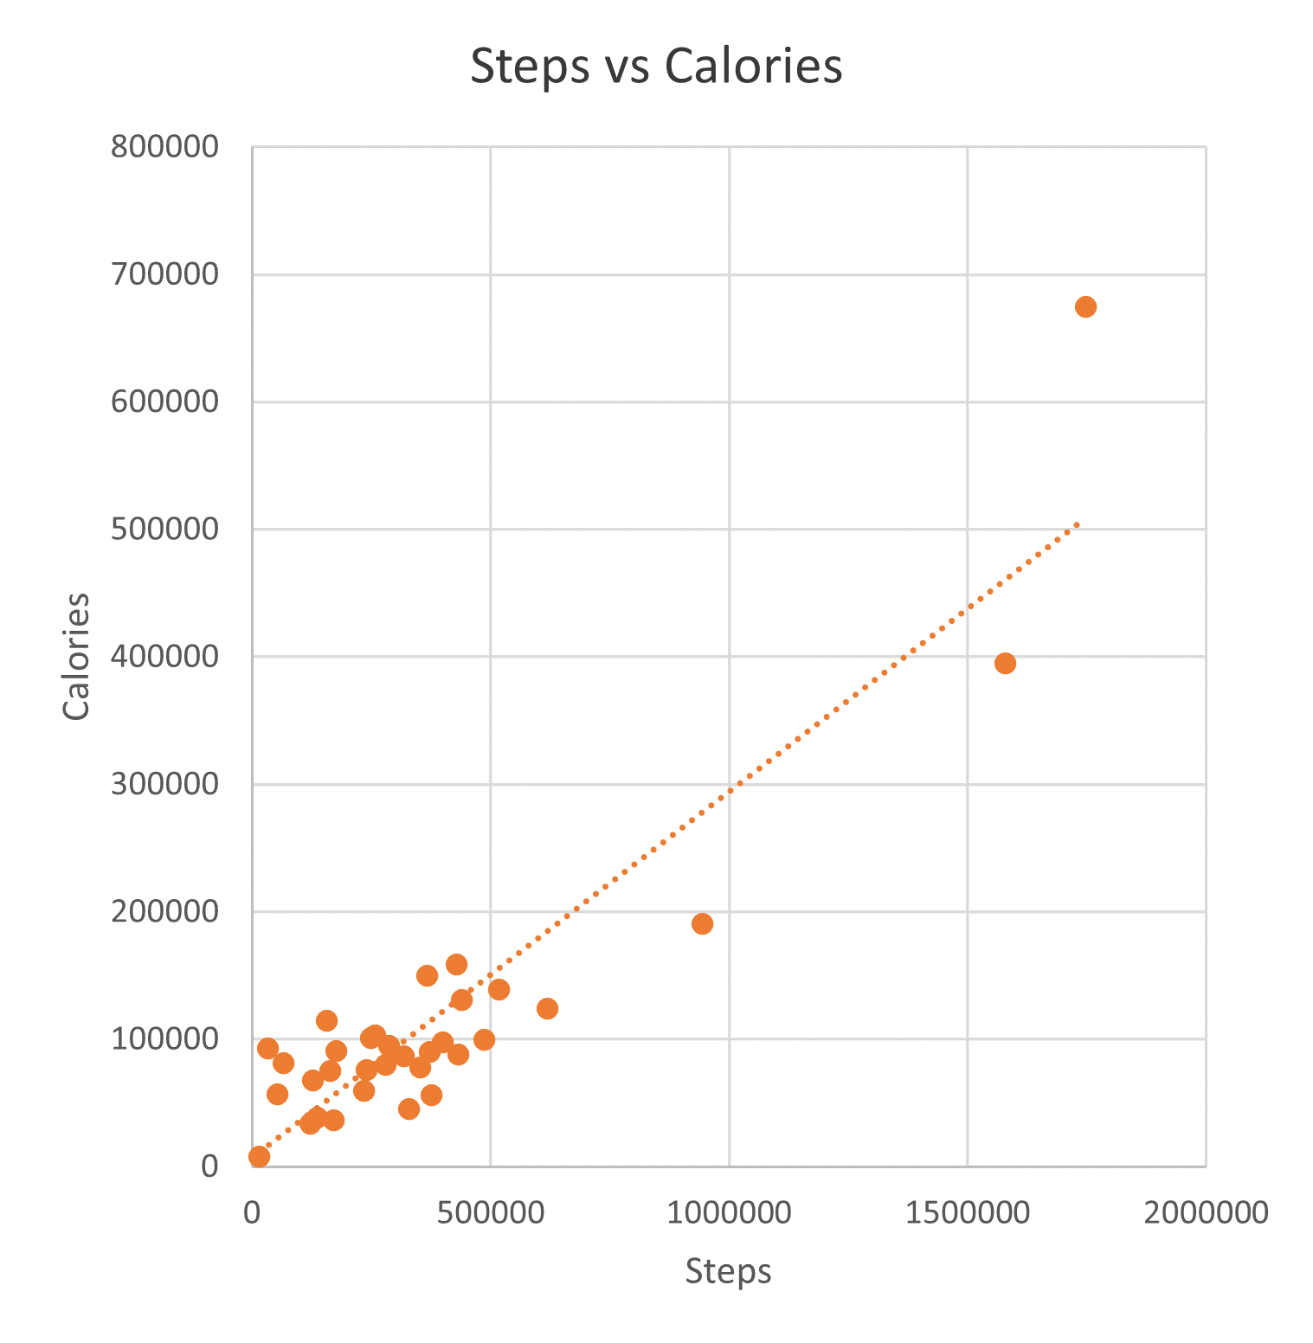
Steps vs Calories
Conclusion: Correlation - 0.91
Correlation of 0.91 between Total number of steps and Total Calories burned
This means that there’s a strong correlation between these 2 variables.
The insight makes sense because, in theory, Any physical activities require energy and calorie is the unit of energy. Therefore, more movement (steps) means more burned calories.

Slide 9
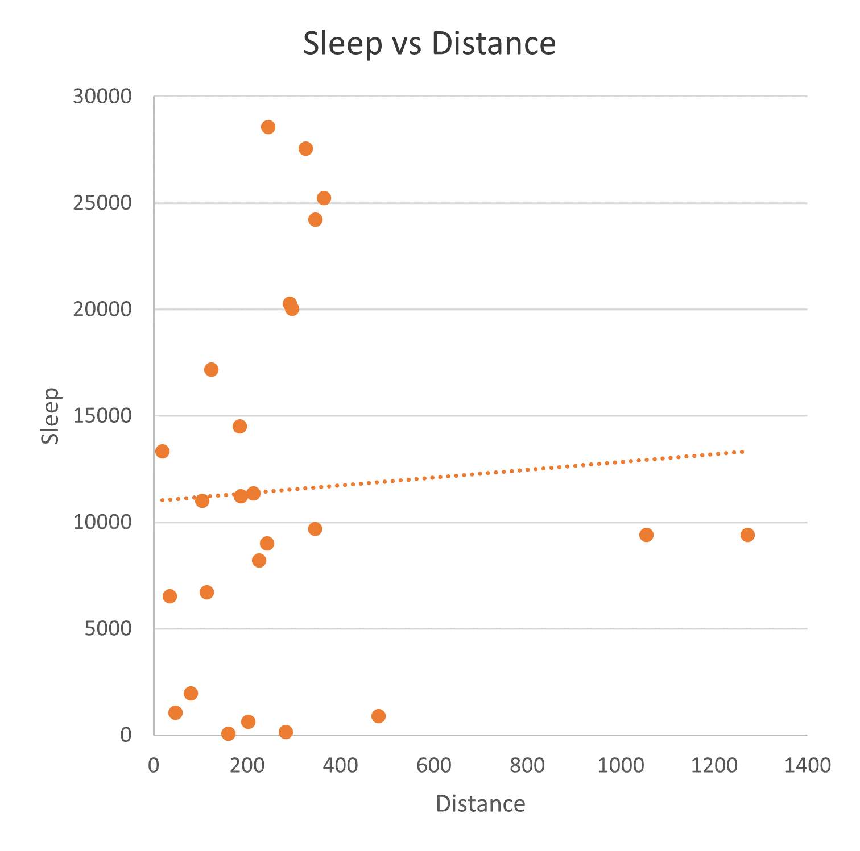
Sleep vs Distance
Note: Due to lack of Sleep data. Following IDs have been removed: 2022484408 2873212765 3372868164 4057192912 6290855005 8253242879 8583815059 8877689391
Conclusion: Correlation - 0.06
Correlation of 0.06 between Total number of Distance and Total Sleep Minutes
This means that there’s a weak relationship between the 2 variables
The insight suggests that:
The Total traveled distance is not related to the quality of sleep
Participants who sleep more minutes have fewer distance travel/steps

Slide 10
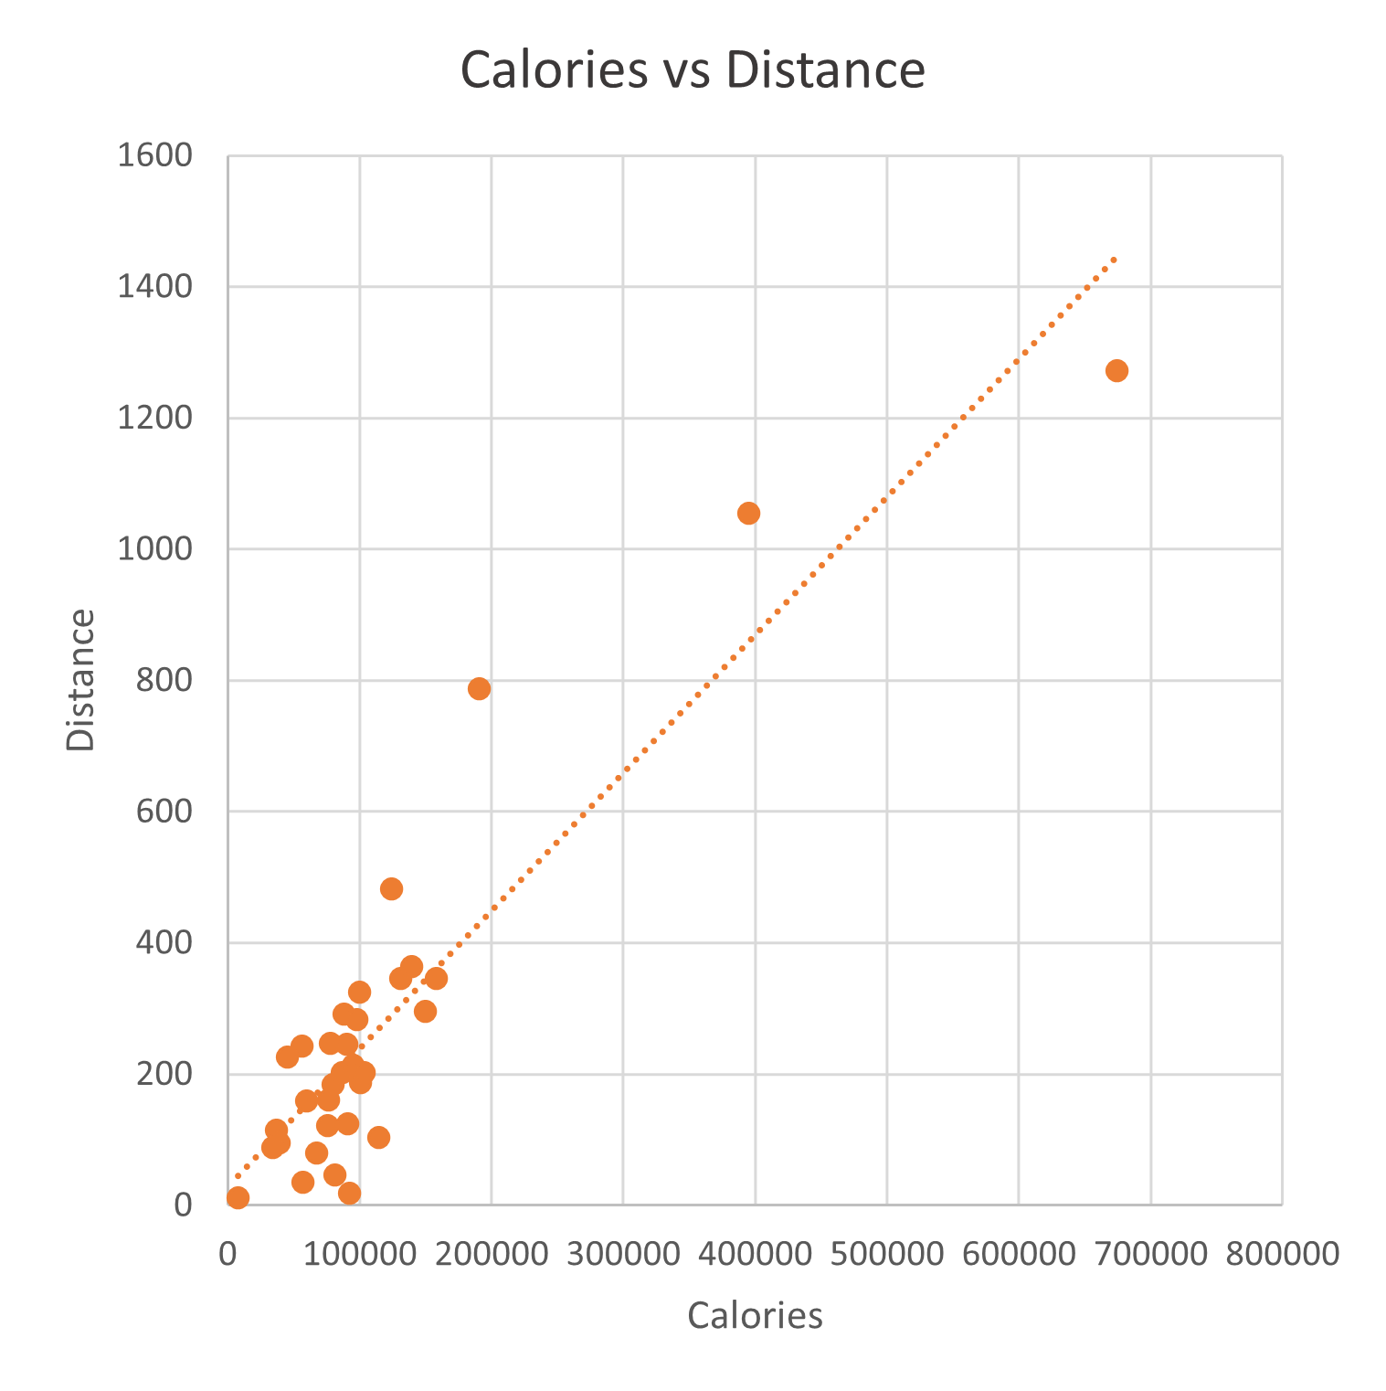
Distance vs Calories
Conclusion: Correlation - 0.91
Correlation of 0.91 between Total number of Distance traveled and Total Calories burned
This means that there’s a strong correlation between these 2 variables.
The insight makes sense because, in theory, Any physical activities require energy and calorie is the unit of energy. Therefore, more traveled distance means more burned calories.

Slide 11
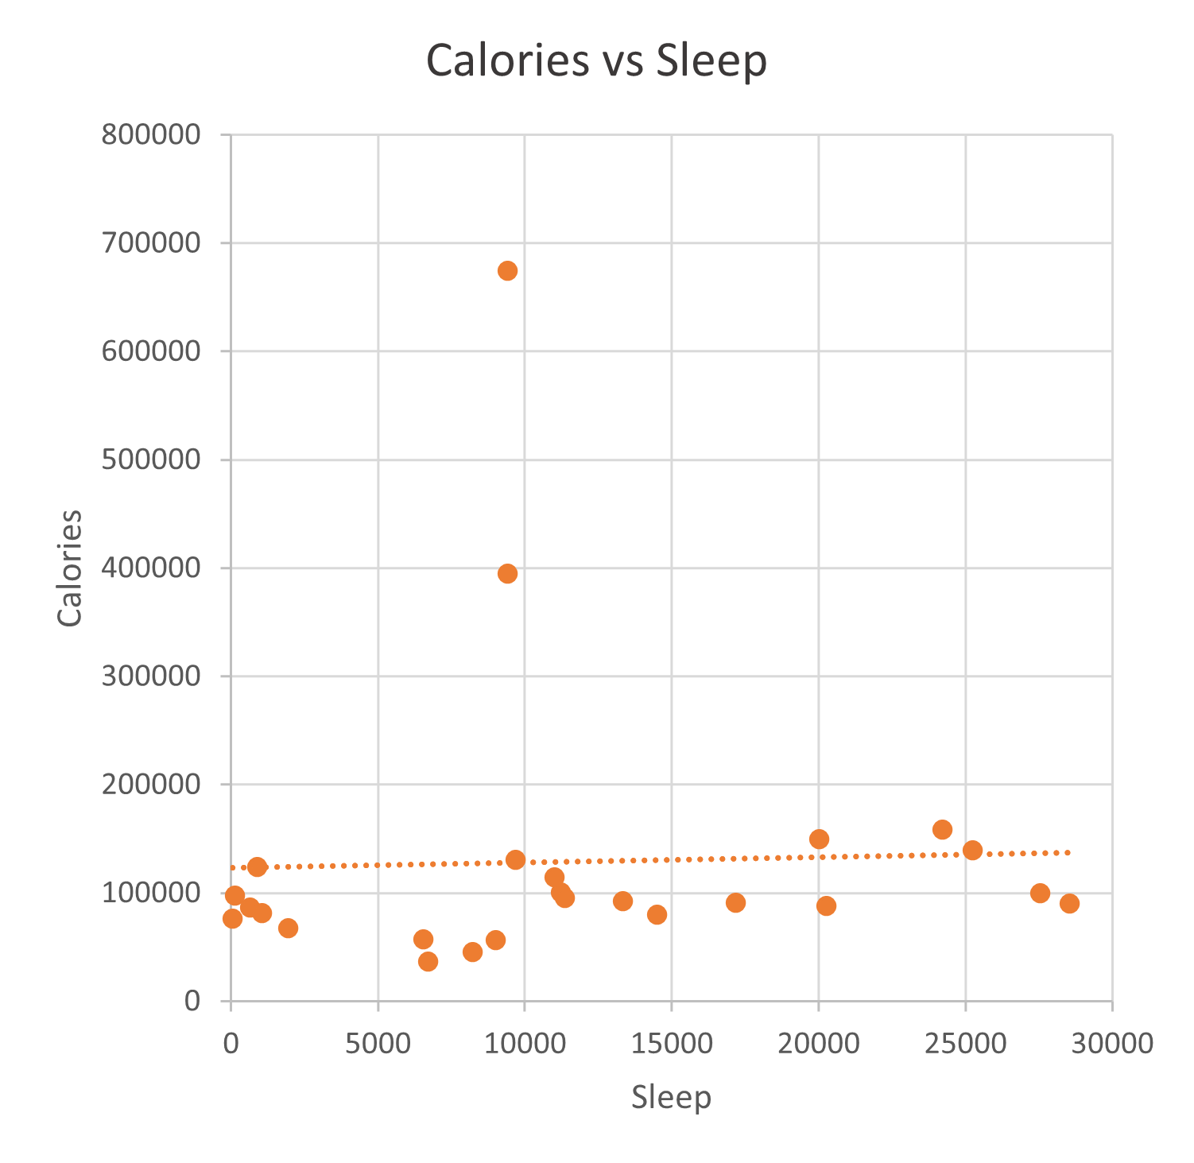
Sleep vs Calories
Note: Due to lack of Sleep data. Following IDs have been removed: 2022484408 2873212765 3372868164 4057192912 6290855005 8253242879 8583815059 8877689391
Conclusion: Correlation - 0.03
Correlation of 0.03 between Total number of Calories burned and Total Sleep Minutes
This means that there’s a weak relationship between the 2 variables.
The insight suggests that:
Since the 2 variables have weak correlation, High sleep minutes mean low number of burned calories and vice versa.
Sleeping doesn’t involve a lot of physical movement which supports our insight.

Slide 12
Summary
Steps vs Calories
Sleep vs Distance
Distance vs Calories
Sleep vs Calories
The insight makes sense because, in theory, Any physical activities require energy and calorie is the unit of energy. Therefore, more movement (steps) means more burned calories.
The insight suggests that the Total traveled distance is not related to the quality of sleep of participants who sleep more minutes have fewer distance travel/steps.
The insight makes sense because, in theory, Any physical activities require energy and calorie is the unit of energy. Therefore, more traveled distance means more burned calories.
The insight suggests that since the 2 variables have weak correlation, High sleep minutes mean low number of burned calories and vice versa and sleeping doesn’t involve a lot of physical movement which supports our insight.

Slide 13
Recommendations
Improve application to increase customer sales.
Create a weekly summary of user data:
Distance traveled
Calories burned
Steps taken
Sleeping hours
Add a personal goal section in the application, and with this data, we can create notifications based of their output.
Motivate users who fail to commit to their goals
Appraise users who achieved their goals
Recommend users to avail BellaBeat membership

Slide 14
Timeline
Analysis
Week 01-02
Present Analysis
Week 03-04
Build App Features
Week 05-08
Testing & Iterations
Week 09-12
Launch
Week 13

Slide 15
“Setting goals is the first step into turning the invisible into the visible.”
Tony Robbins

Slide 16



Thank you!
Clarence Amoranto
amorantoclarence@gmail.com
www.linkedin.com/in/amorantoclarence/

