Slide 1
PROGRAMMING SKILL TRENDS
Clarence Amoranto
2023-09-15

Slide 2

OUTLINE
Executive Summary
Introduction
Methodology
Results
Data Viz – Charts
Dashboard
Discussion
Conclusion
Appendix

Slide 3

EXECUTIVE SUMMARY
Collecting job openings from various technologies and locations.
Analyzing the data to identify insights and trends
The top programming languages
The top databases skills
The popular IDEs
Bring the information together with a dashboard that shows current skills, future trend skills, and demographics.

Slide 4
INTRODUCTION
In order to effectively keep up with the ever-evolving technology landscape, it is crucial to have a strong foundation in programming. Programming serves as the backbone for IT solutions and plays a vital role in the work of consultants. By proficiently analyzing data, professionals can uncover valuable insights and trends that can drive informed decision-making and enhance business strategies. The ability to harness the power of programming empowers individuals to navigate the complex world of technology with ease and precision, ensuring successful outcomes and staying ahead of the competition.
The focus problems are:
What are the programing/database skills in the present?
What are the programing/database skills in the future?

Slide 5
METHODOLOGY
Data Collection
Data Source: Job posting, Training portals and Surveys
Data Wrangling
Data Analysis
Data Visualization
Dashboard Creation
Data Storytelling

Slide 6

RESULTS
The collected data is transferred to a data cleaning process, and then statistical techniques are applied to analyze it. Once all the information is concluded, dashboards are created to show current and next year trends.

Slide 7
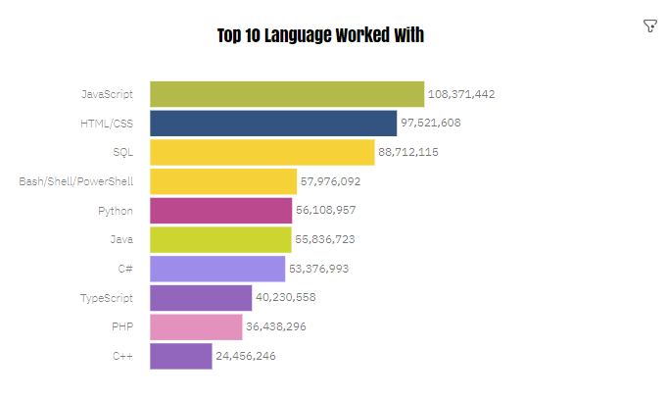
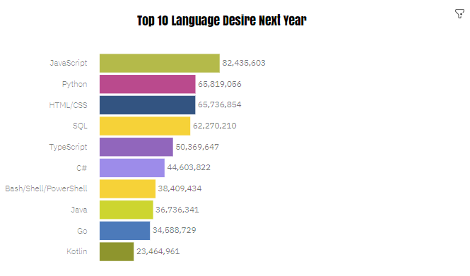
PROGRAMMING LANGUAGE TRENDS
CURRENT YEAR
NEXT YEAR

Slide 8
PROGRAMMING LANGUAGE TRENDS - FINDINGS & IMPLICATIONS
FINDINGS
JavaScript has the most highest number of people working with
IMPLICATIONS
JavaScript will be still in the top of the food chain for the coming year

Slide 9
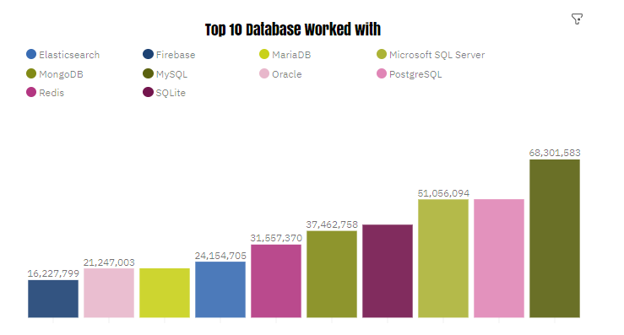
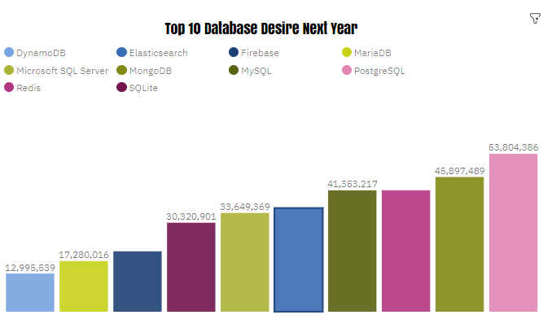
DATABASE TRENDS
CURRENT YEAR
NEXT YEAR

Slide 10
DATABASE TRENDS - FINDINGS & IMPLICATIONS
FINDINGS
MySQL has the most highest number of people working with
IMPLICATIONS
MySQL will be replaced by PostgreSQL but will still be relevant in the future

Slide 11
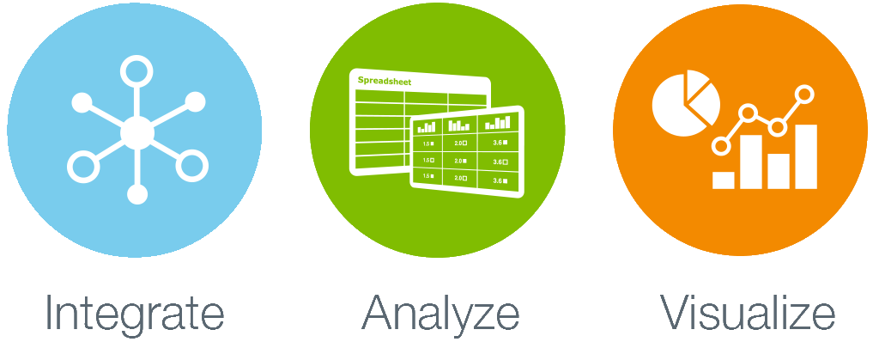
DASHBOARD
The shareable preview of the dashboard created in Watson Studio can be seen HERE!

Slide 12
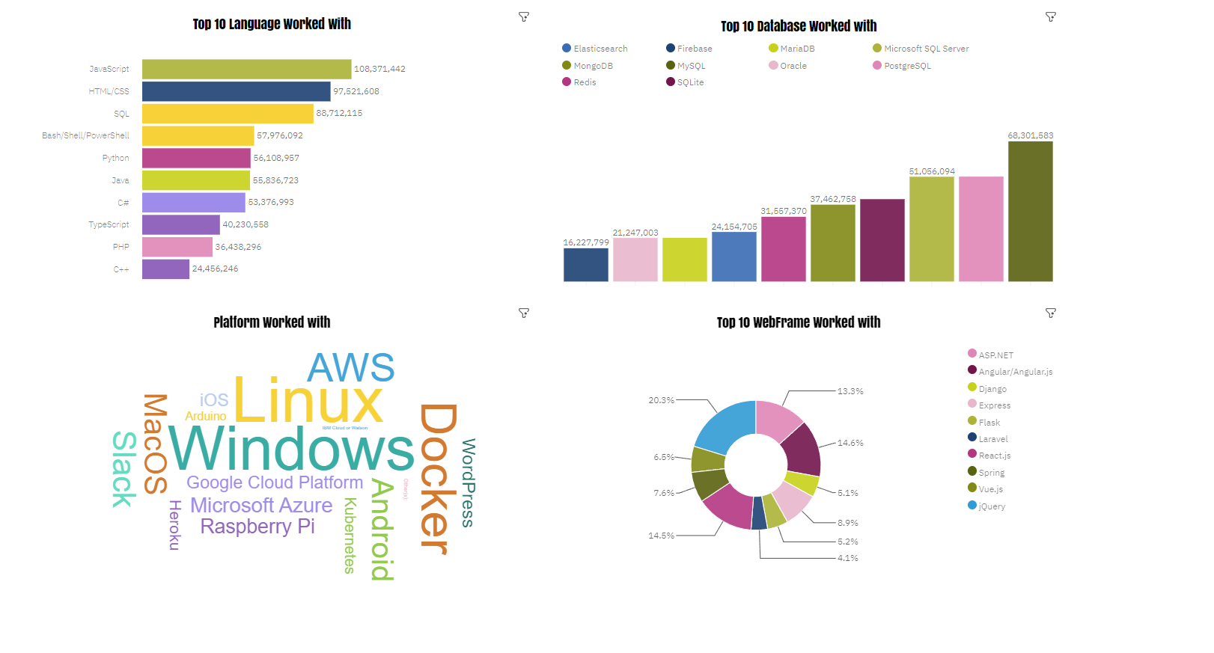
CURRENT TECHNOLOGY USAGE

Slide 13
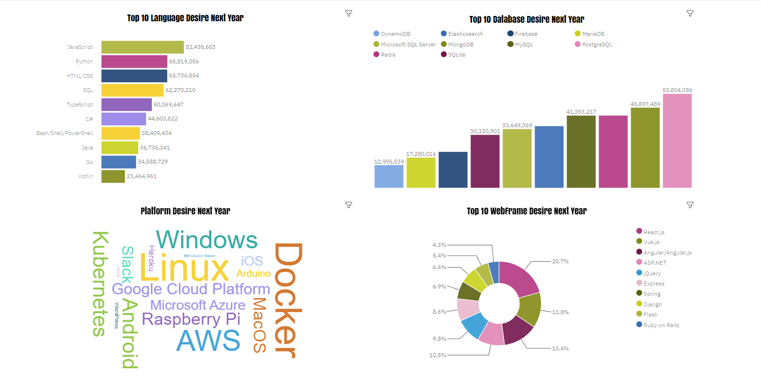
FUTURE TECHNOLOGY TREND

Slide 14
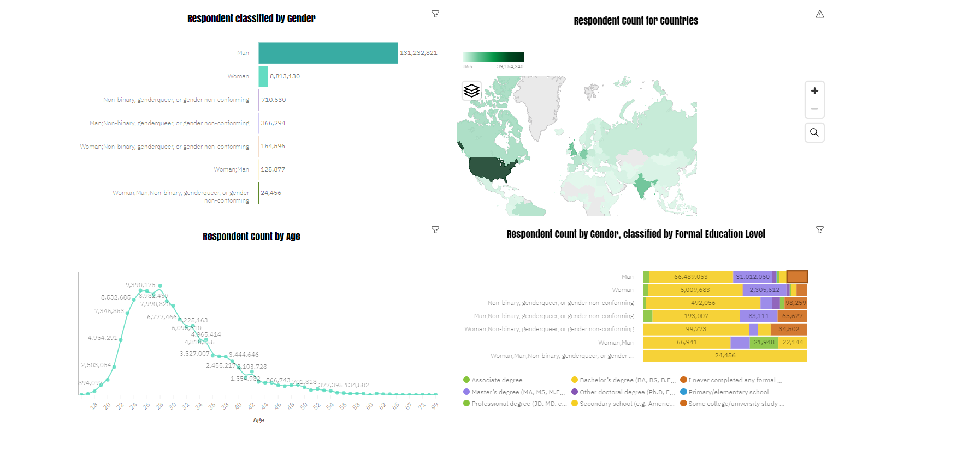
DEMOGRAPHICS

Slide 15

DISCUSSION
Women's roles in global IT fields
Why do SQL servers remain the most interesting in the future?
What is the key value of HTML/CSS that continues to be in demand?

Slide 16
OVERALL FINDINGS & IMPLICATIONS
JavaScript and HTML/CSS will remain in the top 1st and 2nd positions by next year.
While SQL will be surpassed by Python, Bash/Shell/PowerShell are not expected to be prominent in the coming year.
PostgreSQL is projected to be in the 1st place, replacing MySQL, while Microsoft SQL Server and SQLite are expected to disappear.
Linux is the most widely used platform, with Docker predicted to replace Windows.
In terms of web frameworks, React.js is predicted to be the most preferred option in the next year, replacing jQuery.
In terms of gender, men are shown to respond more than women. The highest number of respondents are from the Russian Federation, and the average age is around 28 with a Bachelor’s degree.
JavaScript and HTML/CSS will continue to be popular.
Python is expected to gain more interest.
SQL servers will still be required, with PostgreSQL expected to be the most popular database.
Docker is highly preferred, especially in Linux environments.
The demand for jQuery is decreasing.
It is assumed that a large number of young Russian men with Bachelor's degrees will respond to the analysis.

Slide 17
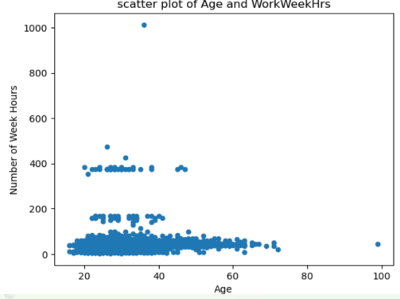
APPENDIX
SCATTERPLOT

Slide 18
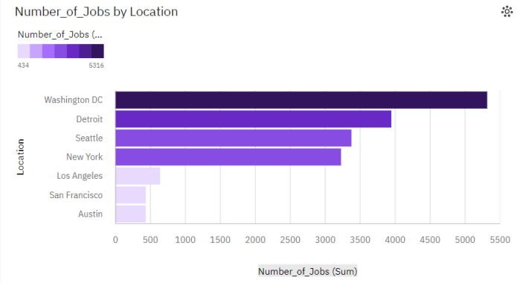
APPENDIX
JOB POSTINGS

Slide 19
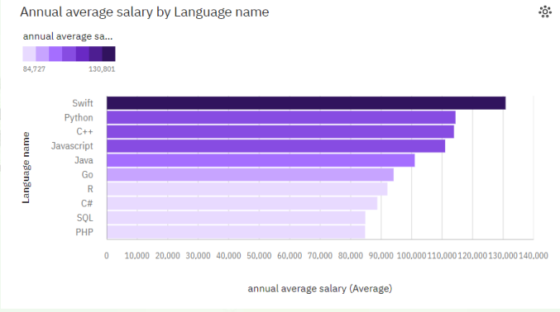
APPENDIX
POPULAR LANGUAGES

