Slide 1
West Bengal
2021 vs 2026
294 constituencies · 5,052 candidacies
two elections, compared seat by seat
Kapil · github.com/notoriouskapil/bengal-election-analysis
Notes:
Two West Bengal assembly elections, built from the Election Commission's own statistical reports. I built the dataset, wrote the queries, made the charts.

Slide 2
Four numbers
BJP: 46.2% of votes
70.6% of seats
129 seats TMC → BJP
Zero returned
Turnout 82.2% → 93.6%
5m names left the roll
TMC fell in all 8 regions
worst: 50% → 36%
Notes:
Findings one and two are first-past-the-post doing what it does. Finding three is the one that changes how you read the headline turnout figure.

Slide 3
Where this came from
15 ECI statistical workbooks covering both elections, reshaped into seven tables and checked back against the totals ECI publishes in its own Highlight report.
ok
electors, 293 polled seats
68,125,496
ok
valid votes
63,258,138
ok
NOTA votes
494,932
ok
contestants
2,920
Every figure reconciles to the published report. Nine defects in the source data found and corrected — including constituency names that match 0 of 294 across the two years.
Notes:
The assertions matter more than the cleaning. If the ECI reissues a workbook the pipeline fails loudly instead of quietly producing different numbers.

Slide 4
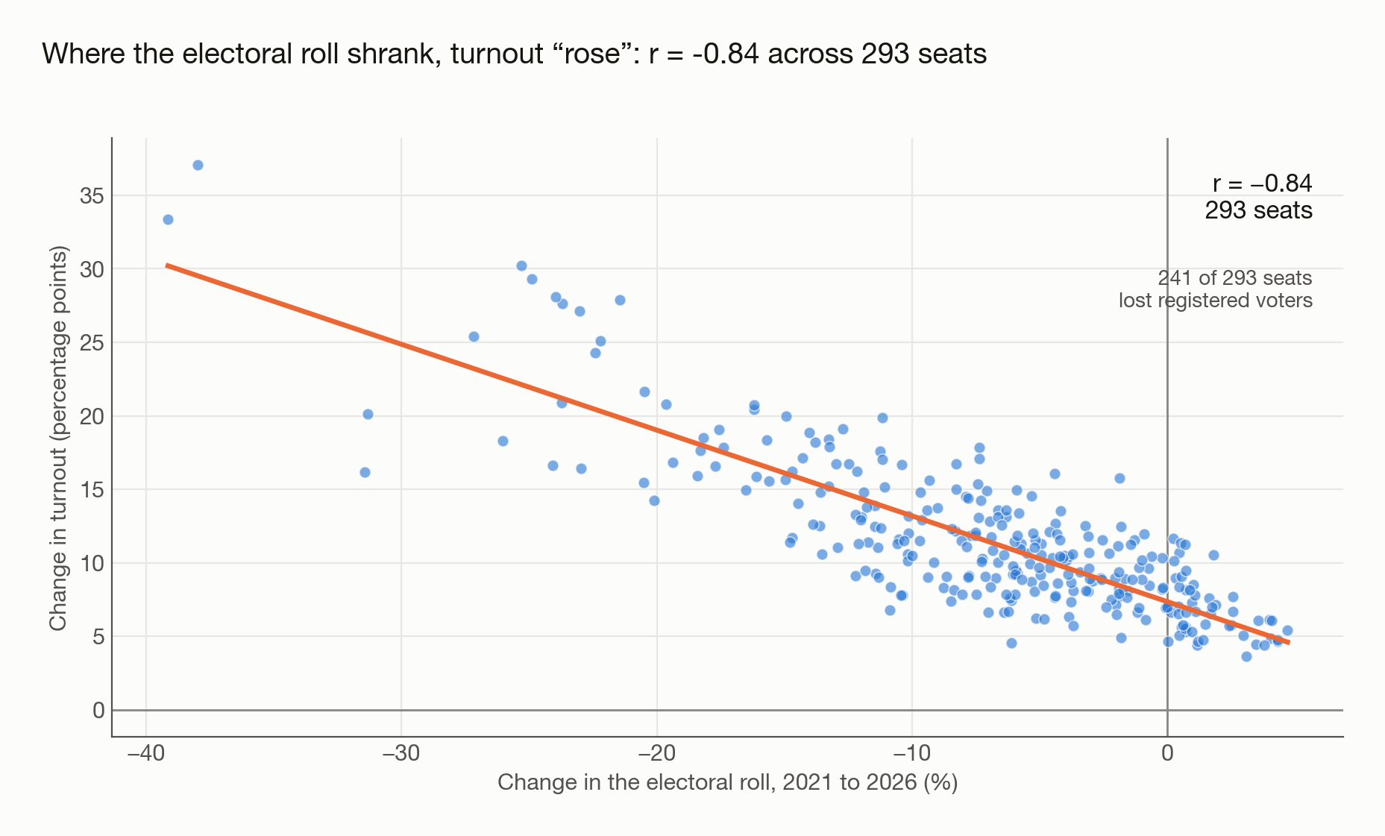
FINDING 1
Most of the turnout rise is a smaller denominator, not more voters
Run 2026's votes against the 2021 roll and turnout reads 87.1%, not 93.6%. More than half the rise is 5 million names leaving the roll. Cause unestablished.
Notes:
82.15% in 2021. 93.58% reported in 2026. 87.12% if you hold the roll fixed. The roll fell by 5.05 million across 293 seats and 241 of them lost voters. What drove the revision is not something this data can answer.

Slide 5
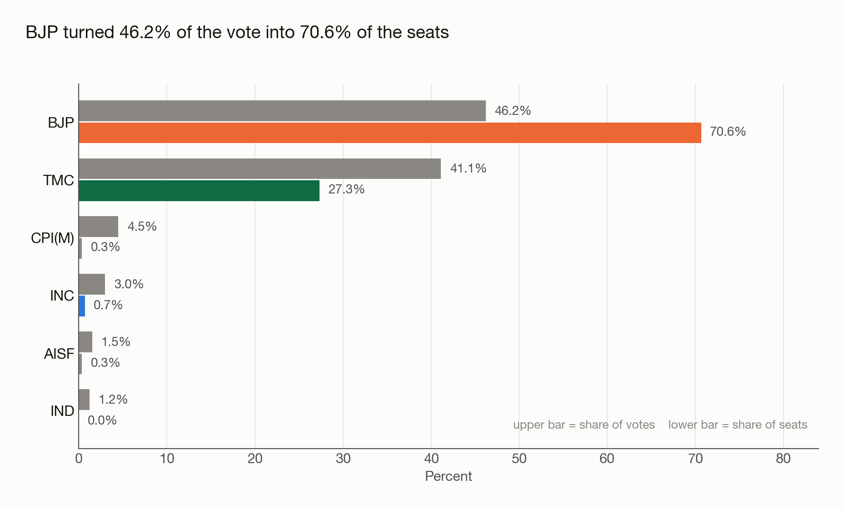
FINDING 2
46.2% of the vote. 70.6% of the seats.
Under first-past-the-post a plurality nearly everywhere becomes a supermajority. BJP went from 38.4% of the vote to 46.2%, and gained 130 seats.
Notes:
Seat share is over 293, not 294: Falta held no poll in 2026. TMC sits on the other side of the same mechanism — 41.1% of votes, 27.3% of seats.

Slide 6
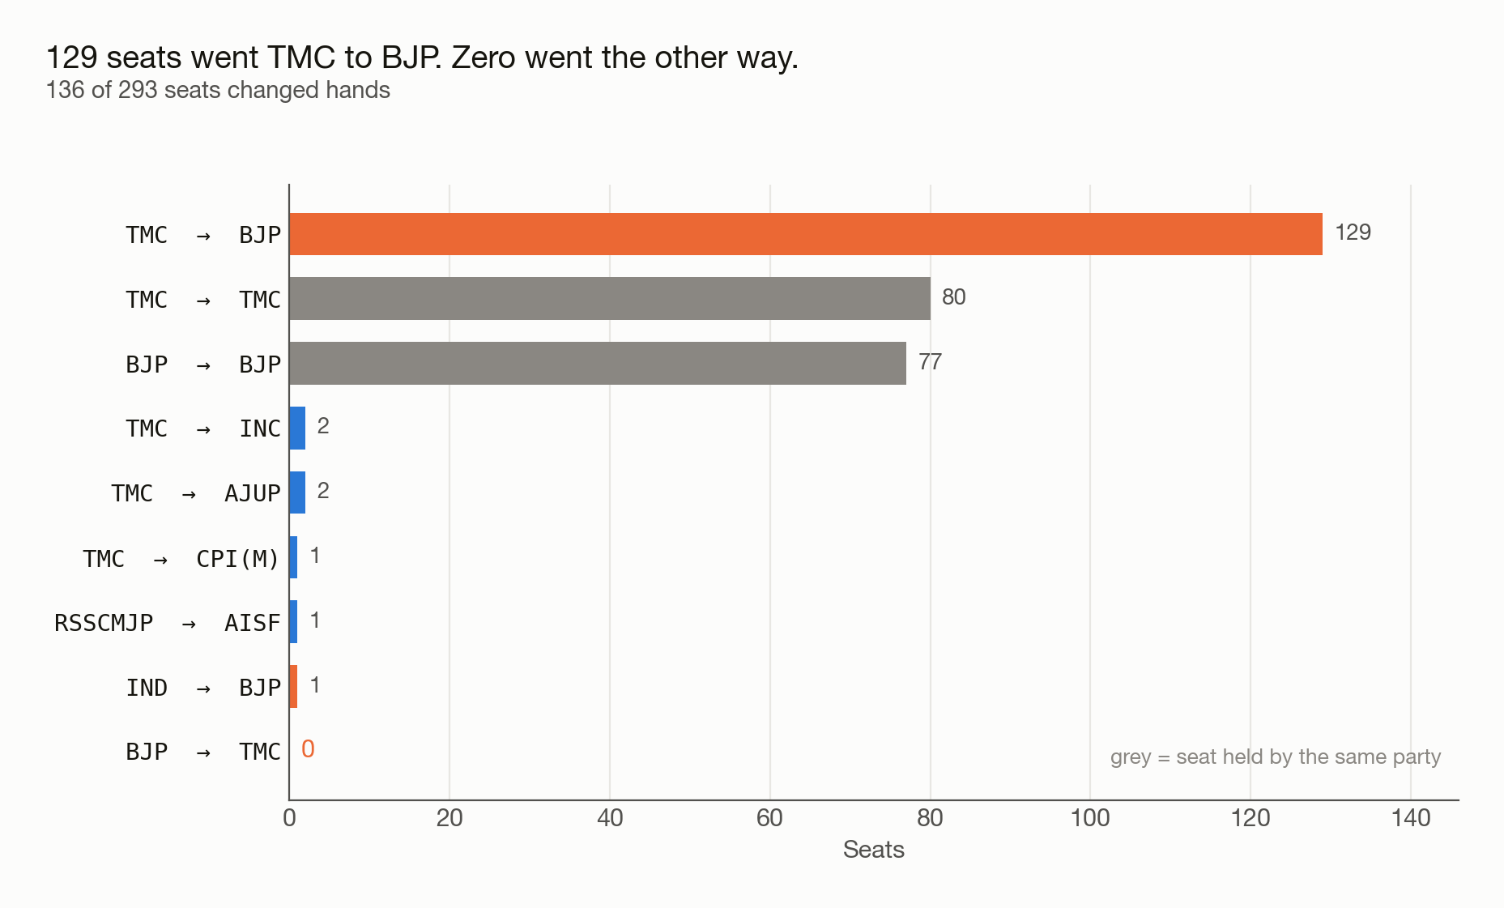
FINDING 3
129 seats went one way. None came back.
136 of 293 seats changed hands and not one moved to TMC. BJP took 129 from TMC and one from an independent; the other six went to smaller parties.
Notes:
Not a single seat flipped against the tide. The two-way flip matrix is the only join that answers this — a name join silently fans out.

Slide 7
What this can't tell you
LIMITATIONS
NEXT
· District mapping derived, not sourced
· Find what drove the roll revision
· No cross-year candidate tracking — 543 of 2,079 names match
· Add 2016 for a three-election trend
· Nothing here is causal
Notes:
The roll revision is the open question. I can measure the effect. I cannot say what caused it, and I am not going to guess on a slide.

Slide 8
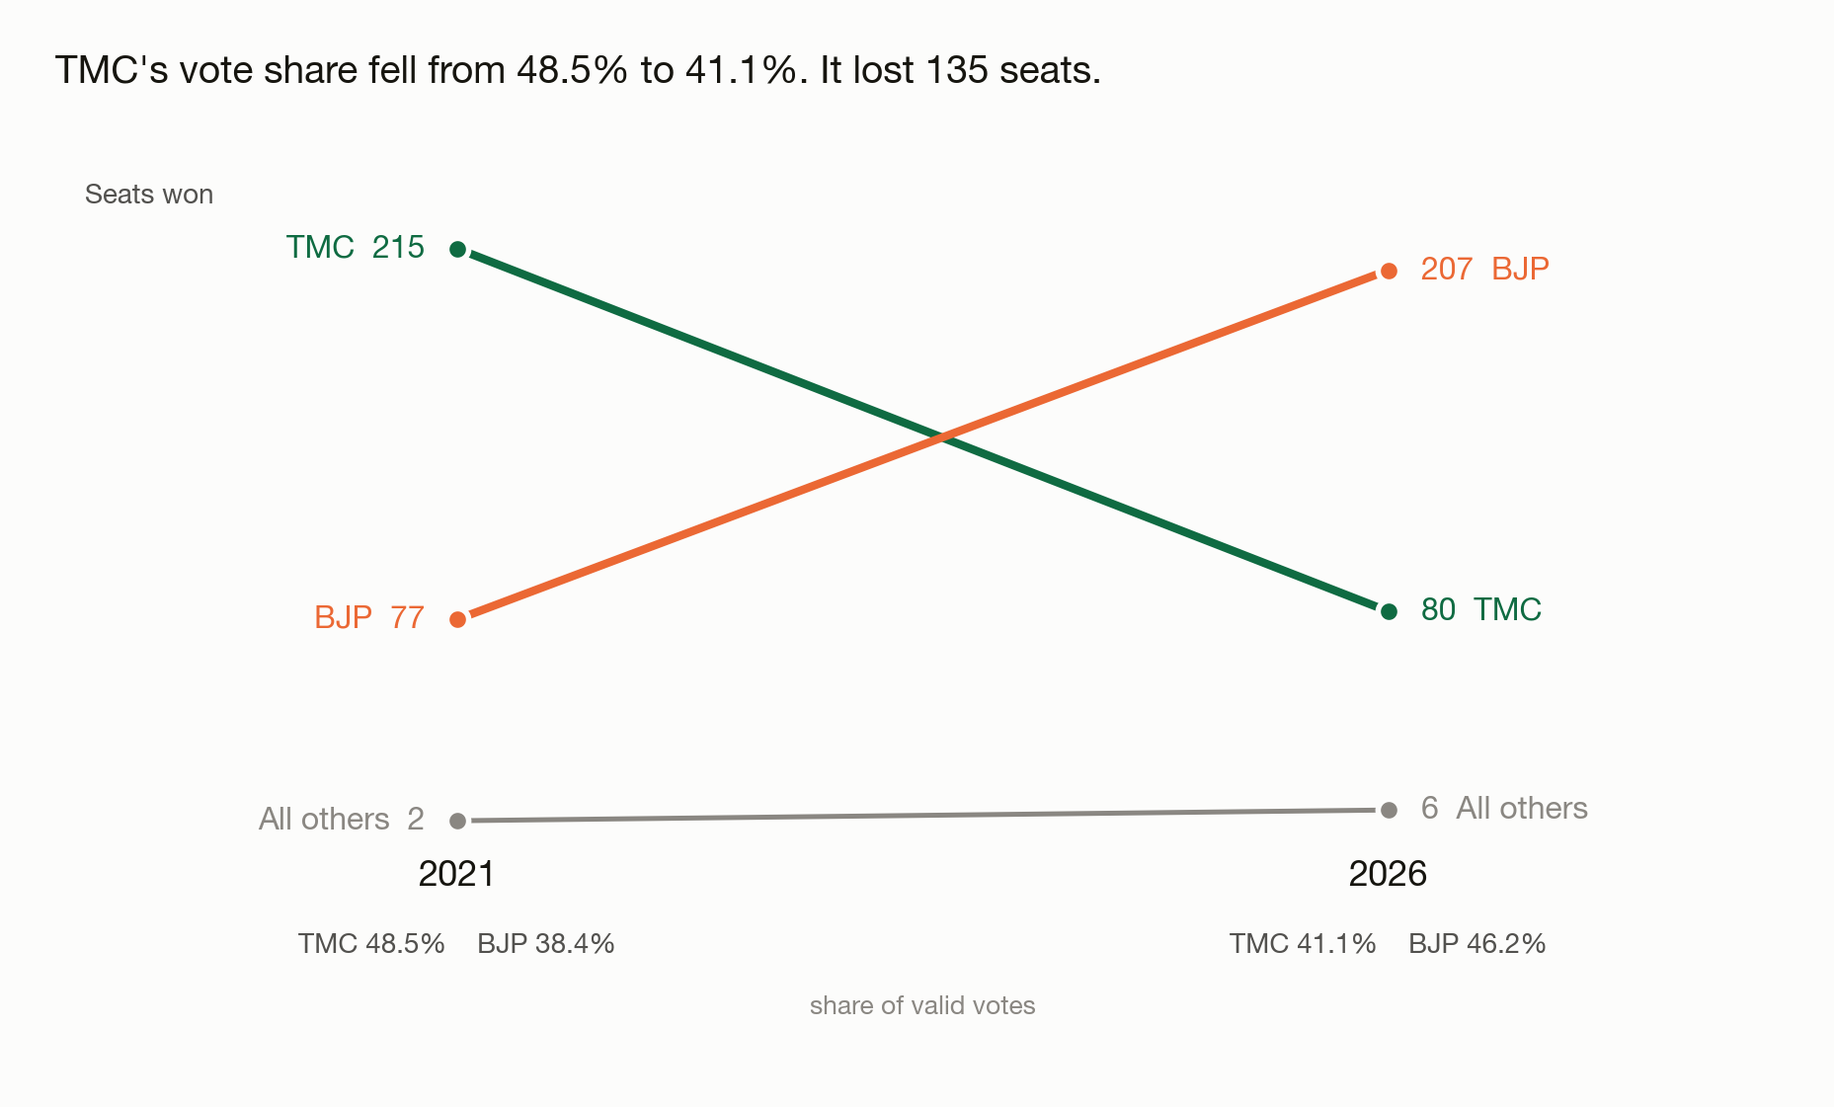
TMC 215 → 80. BJP 77 → 207.
TMC's vote share fell from 48.5% to 41.1% and it lost 135 seats. Seats won, with each year's vote share beneath.
Notes:
The slope chart is the setup for the vote-to-seat slide, not a separate finding.

Slide 9
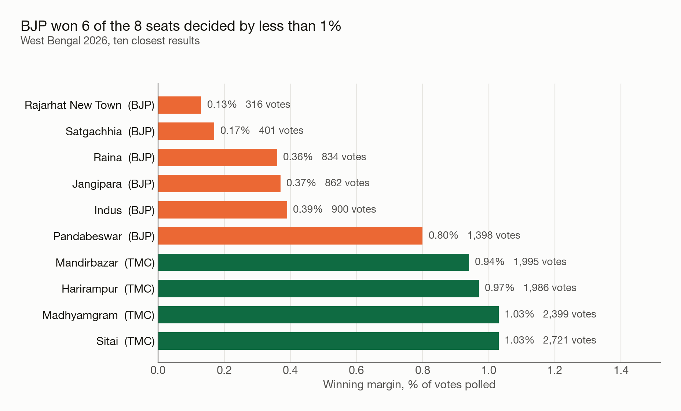
BJP won 6 of the 8 seats decided by less than 1%
Ranked on margin as a percentage of votes polled — the measure that stays comparable across seats of different size.
Notes:
Rajarhat New Town came down to 316 votes.

Slide 10
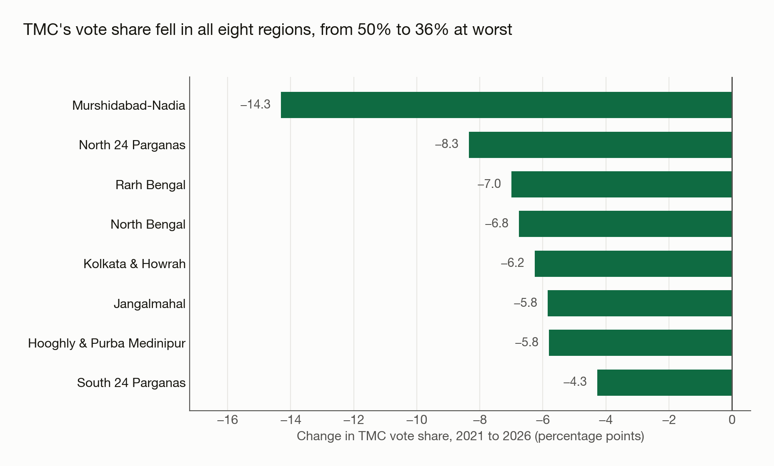
TMC's vote share fell in every region
From 52% down to 48% in South 24 Parganas, and 50% down to 36% in Murshidabad-Nadia. Regions are derived from district, not sourced.
Notes:
Eight regions built from the district mapping, which is inferred. A boundary error would move a region's number but not its sign.

