Slide 1
Classifying Phishing Websites
By: Rod Ta

Slide 2
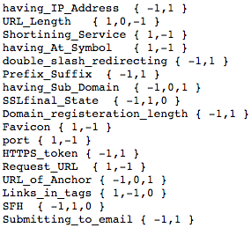
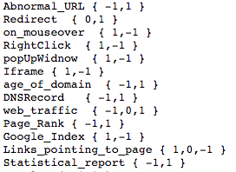
List of Features Used (Total:30)

Slide 3
Machine Learning Methods Used
Naive Bayes
Logistic Regression
Decision Tree
SVM (Support Vector Machine)

Slide 4
Naive Bayes
Bernoulli – good for making predictions from binary features
Gaussian – good for making predictions from normally distributed features
Multinomial – good for features that describe discrete frequency counts
(e.g. word counts)
Results
BernoulliNB 0.903
GaussianNB 0.603
MultinomialNB: 0.775

Slide 5
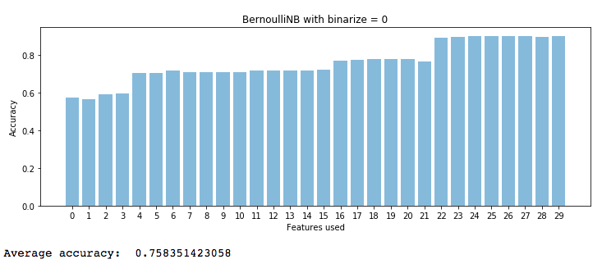
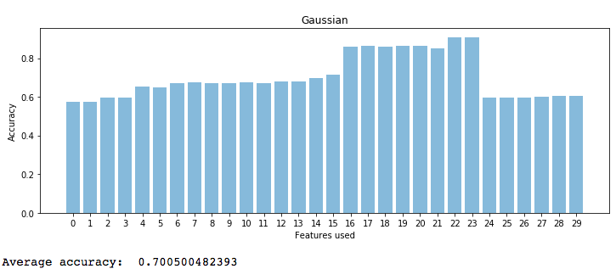
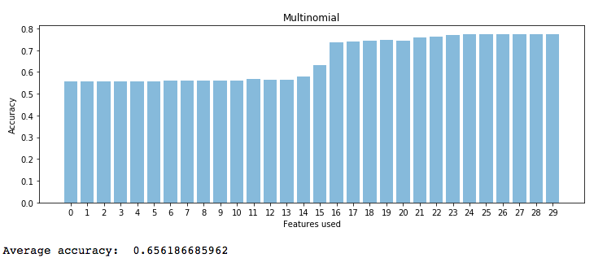
Naive Bayes

Slide 6
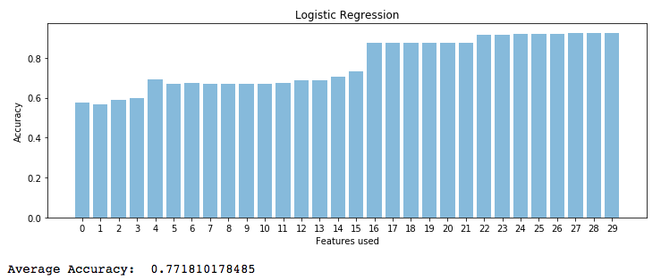
Logistic Regression
Best Accuracy: 0.926

Slide 7
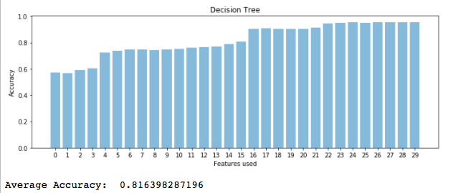
Decision Tree
Best Accuracy 0.953

Slide 8
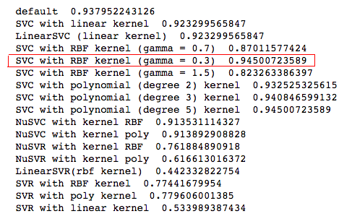
SVM (Support Vector Machine)

Slide 9
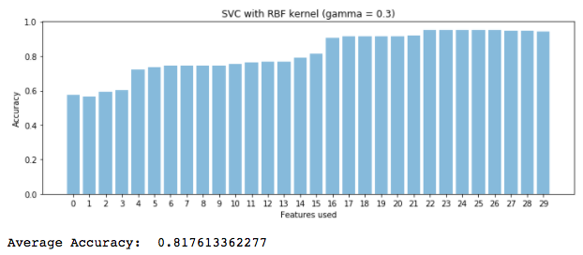
SVM (Support Vector Machine)

Slide 10
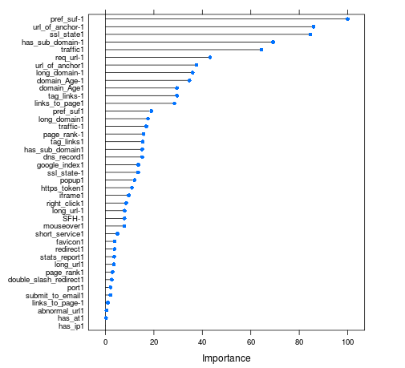
Order of importance
Prefix_suffix
URL of Anchor
SSL_State
Has_Sub_Domain
Traffic
Req_URL
Long_domain
Domain_Age
Tag_links
Accuracy using only these features: 94%

Slide 11
Conclusion
Having more features does not mean always better accuracy
The best methods were Decision Tree and SVM
Best accuracy: 95%
Average accuracy: 82%
Most important features when classifying phishing websites are: Prefix_suffix, Url of Anchor, SSL_State, Has_sub_Domain, Traffic, Req_URL, Long_domain, Domain_Age and Tag_Links.

Slide 12
Dataset
https://archive.ics.uci.edu/ml/datasets/phishing+websites

