Slide 1



Browser DevTools
Hack…using HTML
(just kidding)
Notes:
Thank you for those words! I am Monish, and I will be covering browser DevTools.
Firstly, how many of you know about the developer tools? (check show of hands) Alright, so for the benefit of the rest of the audience, lets hold our horses, shall we?

Slide 2


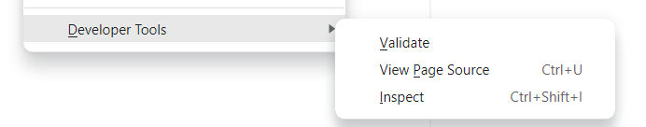
Notes:
On nearly every browser, we can open Developer tools by right clicking anywhere on the page, and towards the bottom of the menu one can find “Inspect Element”, “Inspect”, “Developer Tools”, or something along those lines.

Slide 3
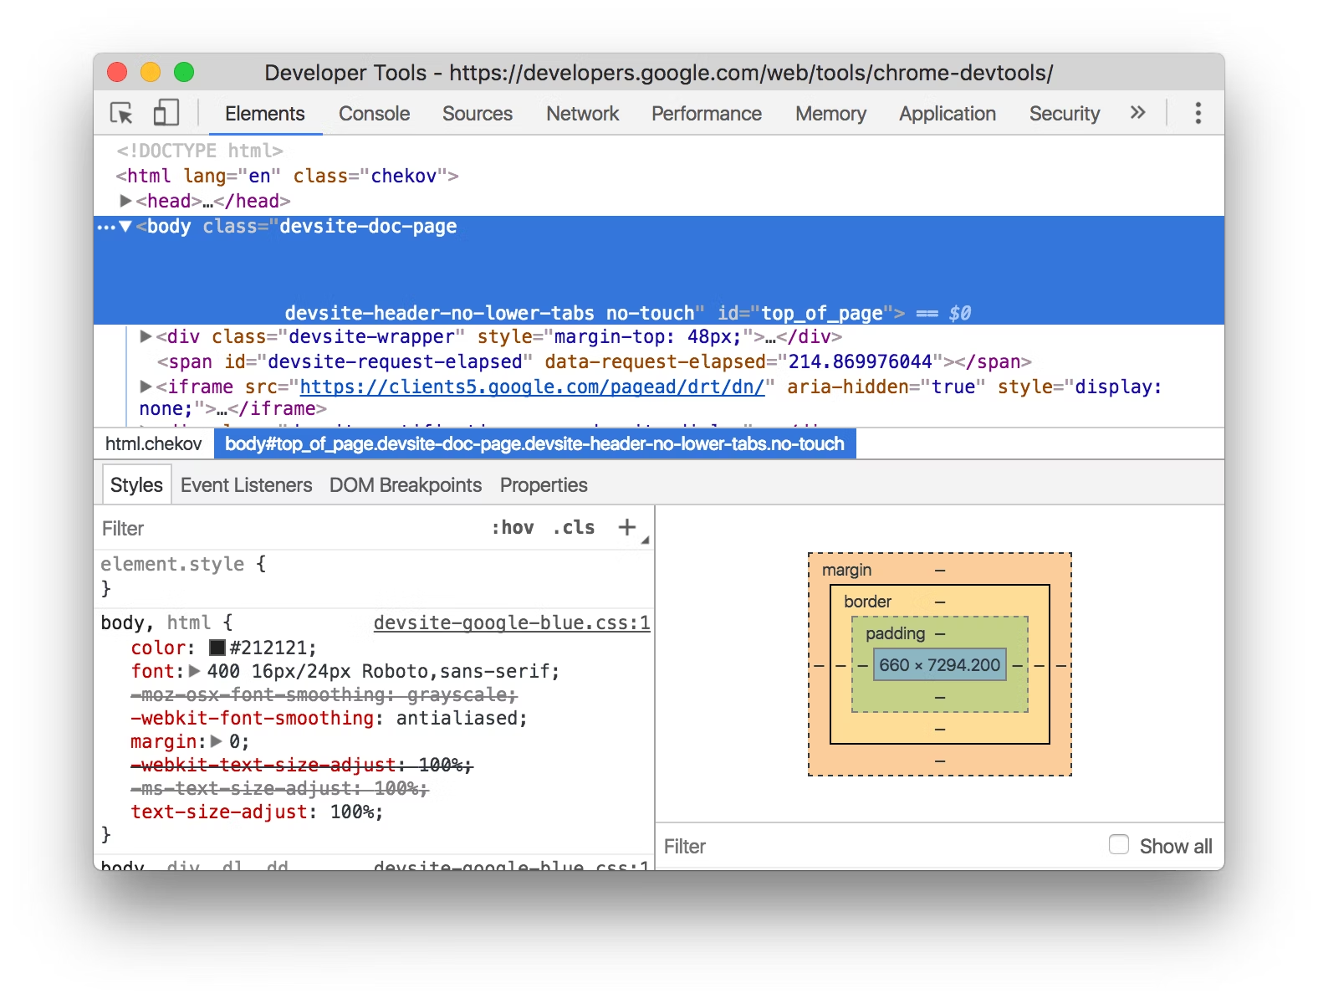
Notes:
What you might be seeing is something like this.

Slide 4
Task: Visit Wikipedia and open DevTools
Notes:
So lets do this. Open Wikipedia, pick out a page at random, and open DevTools on it. If you are done, raise your hands.

Slide 5
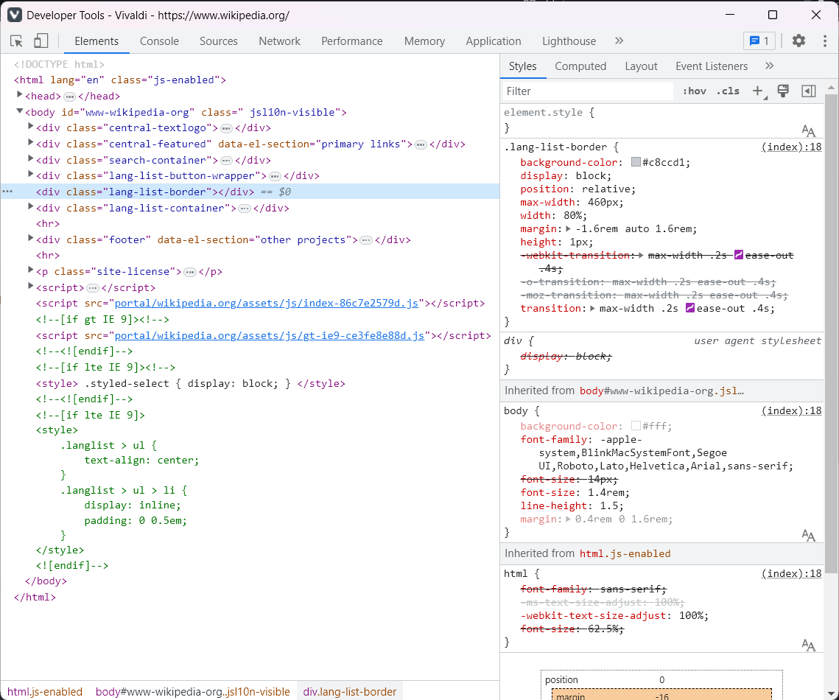
Notes:
So this is the Elements panel. It consists of all of the HTML panel, as parsed by the browser. Observe that this also includes all of the comments in the HTML. What actually happens is this displays all of the HTML that was received from the server and parsed by the browser. Now, and this is the important bit, is that it does not modify the HTML in any way. You can even see the comments in this case. Why does this matter?

Slide 6
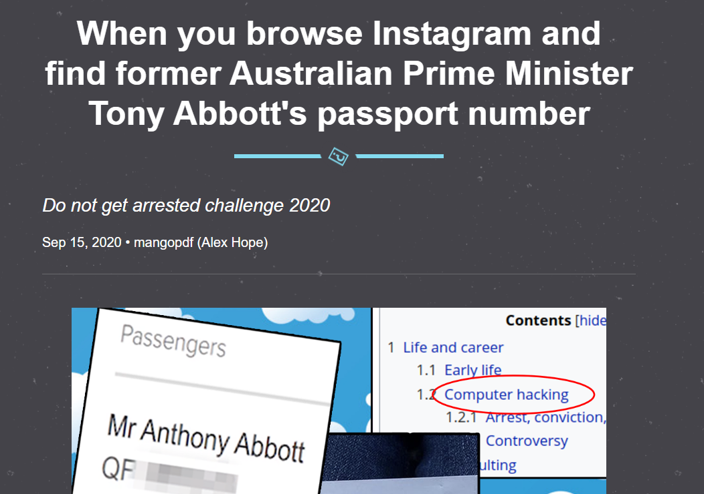
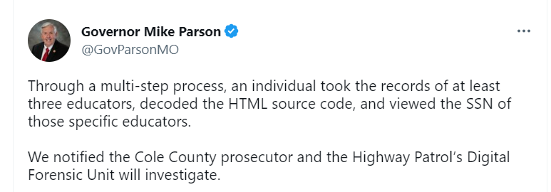

Surprise! You know enough to actually hack!
Notes:
Because, it isn’t unheard of for HTML source code to have information people shouldn’t have had. The first (detailed in a fun blog), goes through how the author found Australian PM Tony Abbott’s passport number and phone number in the HTML of Quantas’ website, after logging in using his boarding pass credentials. I highly recommend you to read it after this session, its incredibly well written. The other was quite an incident in the Missouri, since Social Security Numbers are somewhat equivalent to Aadhar numbers, and about 1 lakh SSN numbers were visible in plain ol’ HTML. Observe how the Governor of Missouri claimed it was a “multi-step process” of “decoding HTML”. lol
The important takeaway is that you don’t need to know the entire library to discover secret stuff. Just be curious, things will come to you.

Slide 7
Notes:
There are a ton of useful tools that are hidden in this screen itself, but for the benefit of time, I will cover my favourite one: Inspector View. It is the purple rectangle in the top left corner. If you click it, and then click on element in the webpage, you can navigate to that particular element in the Element pane. Also, if you right click on any element, you get a pretty cool list of options, that you can explore at your own pace.

Slide 8
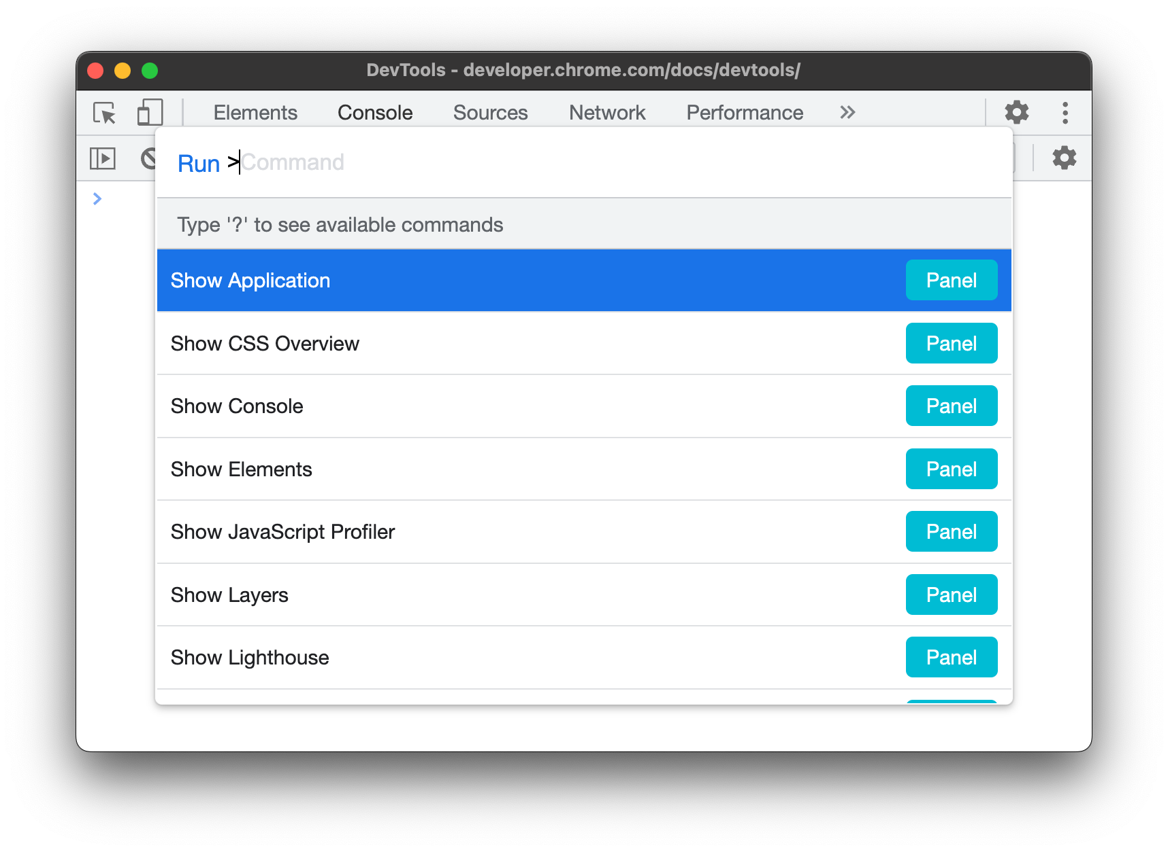
DevTools Command Palette: Ctrl-Shift-P
Notes:
Another pretty useful tool is the command palette. It is only in Chrome and Chromium derivatives, so sorry about that, Firefox users. However, it is an incredibly useful tool, and it can do a ton of things. Pretty much anything that has a button in the UI can be accessed using the command palette. Again, there are a ton of manuals that you can find on this.

Slide 9
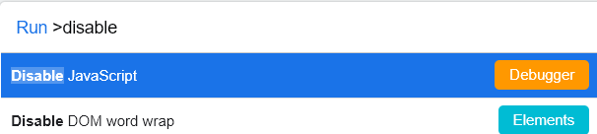
Psst…. News publishers hate this one trick!! Get rid of paywalls small and big*!
*Not guaranteed to work
Notes:
Disabling news paywalls is by far my favourite usecase of this. What often happens is that when the browser requests the news article, the server sends the entire article, and then on the client side, it puts up an ugly paywall by hiding the article using JS. Now, obviously, there is a very obvious way to escape it. Before I give it away, can anyone in the audience figure it out?
Yeah, disable the execution of JavaScript. Easy Peasy. :) Now, there are high changes that it would degrade your reading experience, but maybe after this talk, you might just be able to find a better solution :D

Slide 10
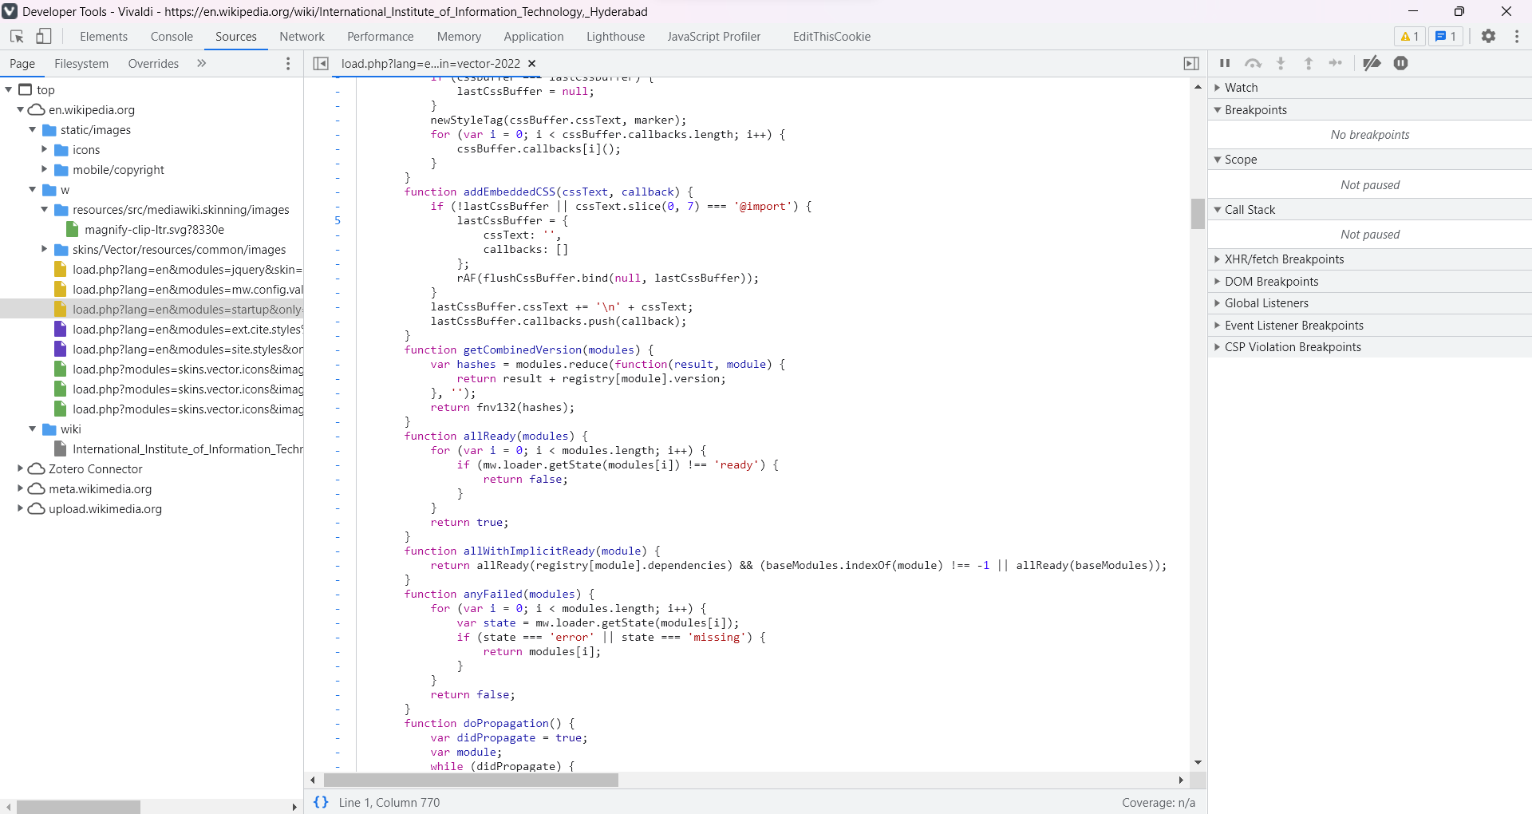
Notes:
Another pane that I would like to walk you through is the sources pane. This is where you can see all of the HTML, CSS and JS source code, images and icons. So, if anyone has tried to copy images off Instagram, now you know how to do it better than ever before.
For JS in particular, there are some cool tools that this has to offer. If I set up a breakpoint that actually executes, you can see that it gives a very comprehensive view of the execution up until that point.

Slide 11

Let’s play…

Slide 12
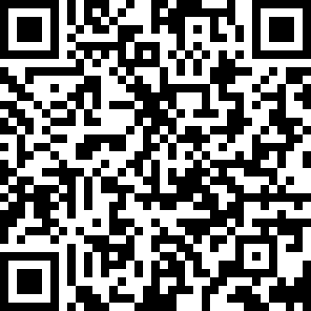
Let’s play…
(don’t play the NYT version)
Notes:
Let us all take a break. Time for Wordle! Do you want to solve it on the big screen, or on your own?
For reasons that will become much more clear once I complete, we are starting with an older version of Wordle, dated 01/01/2022
If own: Everyone, scan the QR code to open Wordle.
If big screen: Alt-Tab and wait for guesses

Slide 13
Exercise:
Find the Wordle word for 31/12/2021
Psst: Use what we have already learnt :)
(Bonus: Get tomorrow’s Wordle word)
Notes:
Why play Wordle? Because it is a pretty neat example of simplicity. So much so, that the answers are hidden somewhere in the source code. Try finding the wordle word for 31st December, using what we just solved.
For those of you who are done, try doing the same thing for the NYT version.

Slide 14
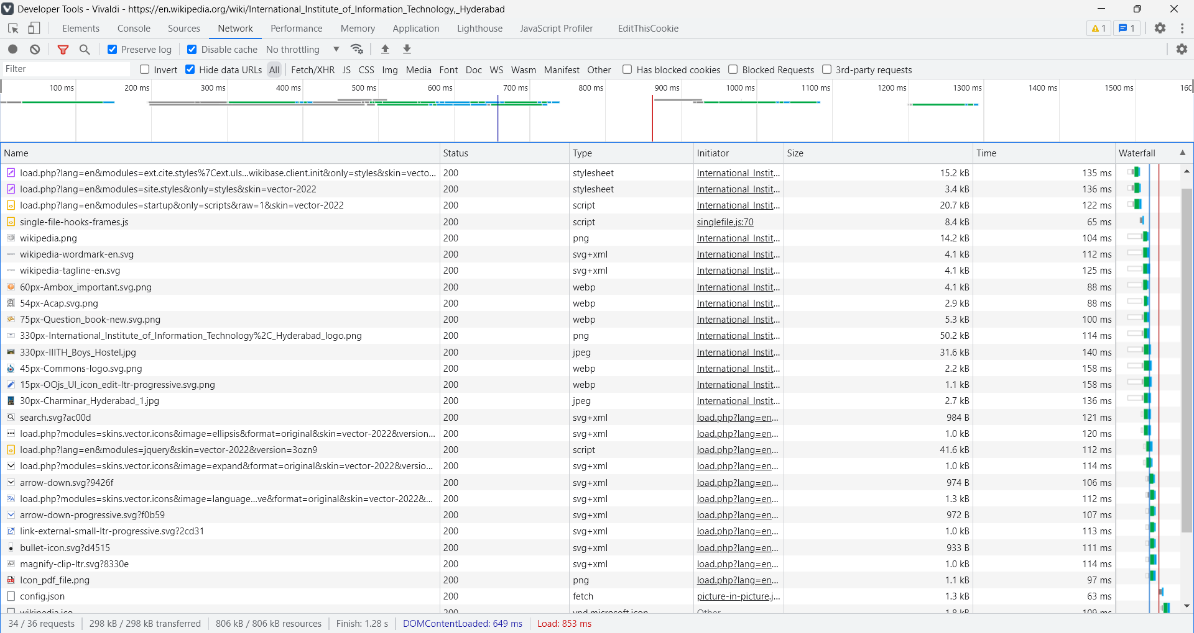
Notes:
Another tab that I want to cover is the Network panel.
To understand this, understanding how websites work becomes very important. Essentially, there are a bunch of places where you can generate network requests from:
Loading the website itself
CSS/JS calls arising from the webpage’s HTML code
Images and Videos
Fancy fonts that websites load to make things pretty
Calls from JavaScript
Websockets: which are a fast way of two-way communication between the server and the user
If you observe the little words in the green box, you can see all what I mentioned. They are filters that you can select to narrow down the source of the network call.
The actual network calls are in the blue box below. In this case, you can see a whole load of image files being downloaded. If you click on any one of these, you will see a host of more details that pop up.

Slide 15
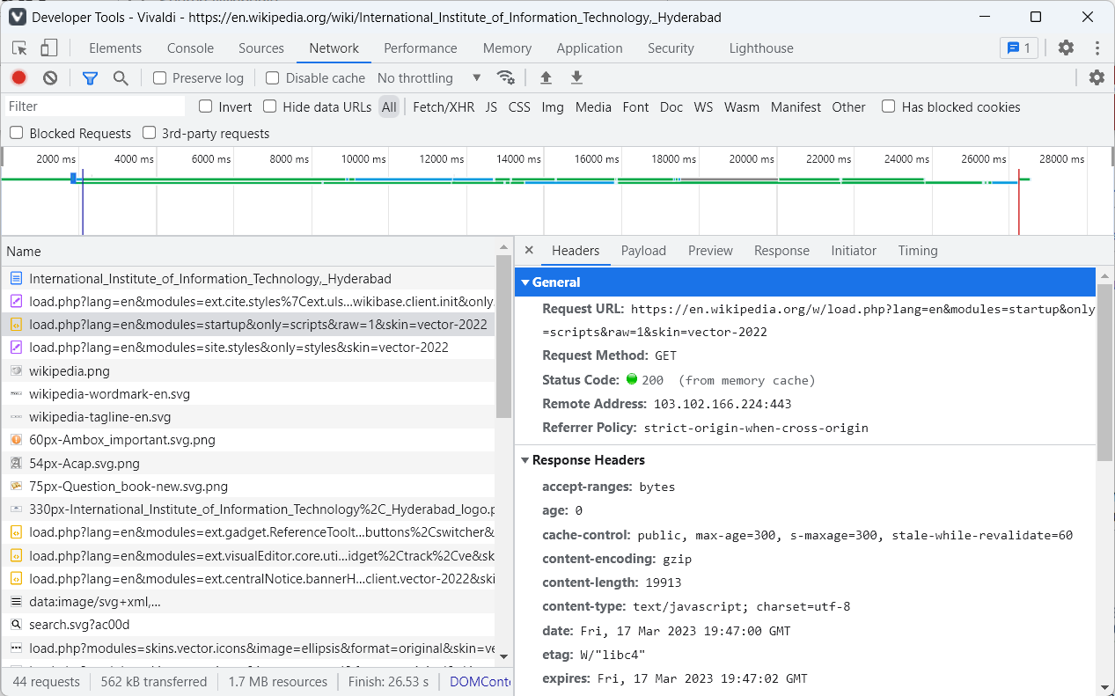

Slide 16
Command line shenanigans: curl
Notes:
curl is an incredibly useful tool. It can do a lot of things, but here, I want to focus on the key idea that it was built for: transferring data across data protocols.
So you can download websites using a very simple curl <url-name>
Demo about curl: curl curl.se
We can also do all sorts of cool tricks with curl, including getting weather data:
Curl https://api.open-meteo.com/v1/forecast?latitude=17.38&longitude=78.46&hourly=precipitation_probability,precipitation&forecast_days=1

Slide 17
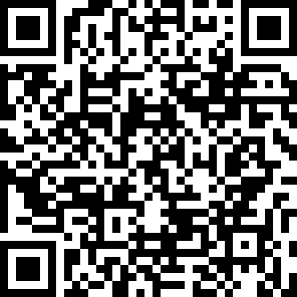
Exercise:
(QR code to the NYT version)
Find the Wordle word for 09/05/2022, but for the NYT version this time.
(Bonus: Find, how far into the future, can you find the answers for)
Notes:
Try using the Network panel this time to find out where is the answer hidden, and try getting the answer for 9th May. Good luck!

Slide 18
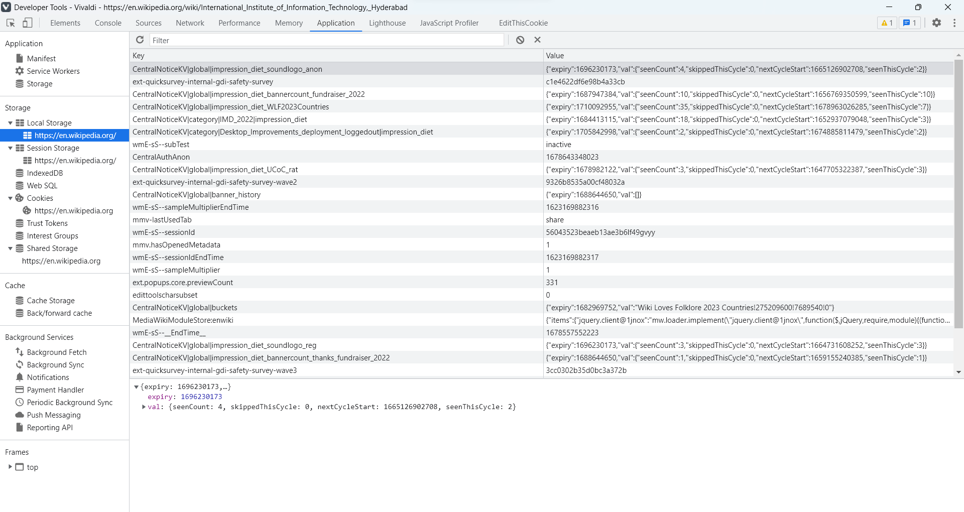

Slide 19
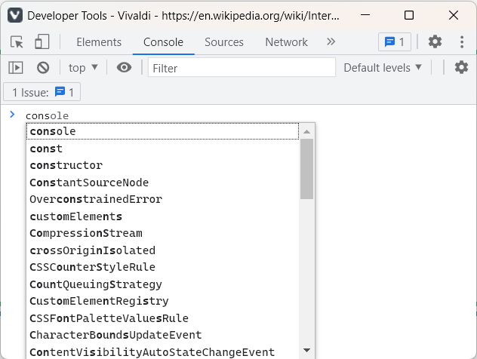

Slide 20
Over to the next speaker…

