Slide 1


Intro to SQL Injections
Ankith Pai
UG1

Slide 2

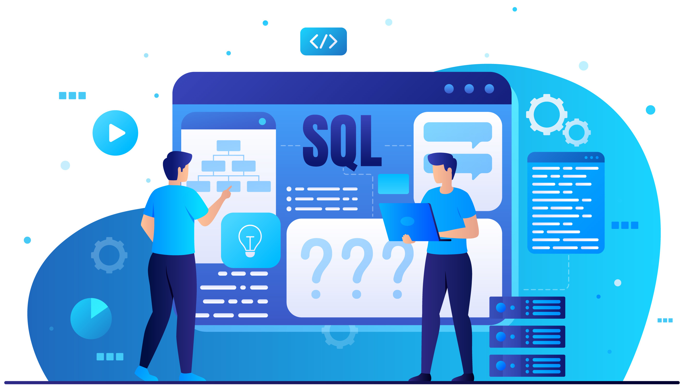
SQL – A brief overview
What’s SQL? A query language used to interface with databases.
A “table”, is a collection that can hold multiple records of data with named attributes. A “database” is a collection of tables that could be related to one another.
With SQL one can do multiple operations on tables in databases - add, remove, modify data.
What typically happens behind the scenes when you fill a form on a website?

Slide 3
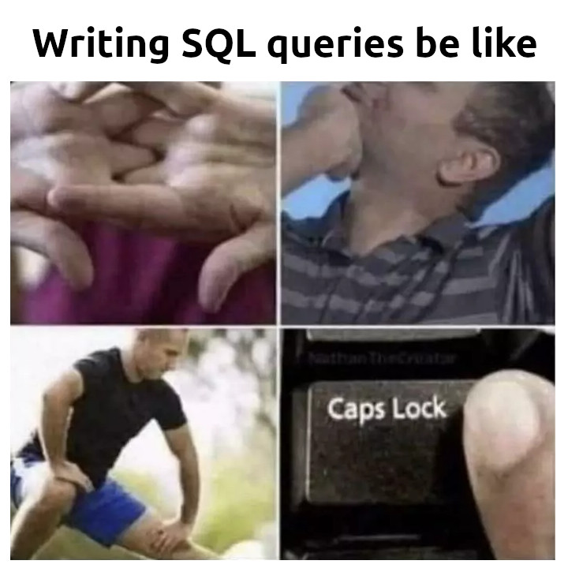

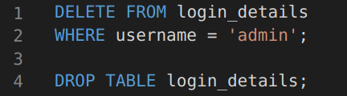
SQL – A few examples
Get all records from “login_details” table where username is “admin” and password is “1234”
Deleting stuff in the database

Slide 4
SQL – A few examples
Register a new user: insert name, password and email of a new user into the table.
Update password of a given user

Slide 5
SQL Injection
Exploit vulnerabilities in backends - by inserting SQL code as part of the form inputs.
Vulnerable server-side code can evaluate this malicious SQL code while handling the inputs, and let the attacker run arbitrary SQL commands.
We have already seen a few examples of SQL queries. Now imagine if anyone is able to execute any command on a database server that holds sensitive data of multiple users!

Slide 6
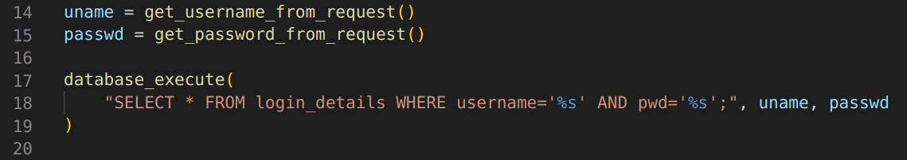
SQL Injection – Example
Consider this snippet of a hypothetical backend (in pseudo-code). It handles a login request sent by the user – gets username and password the user entered and constructs an SQL query to find all records in the table matching that. This query is then executed on the database in the SQL server.
What’s wrong here?

Slide 7
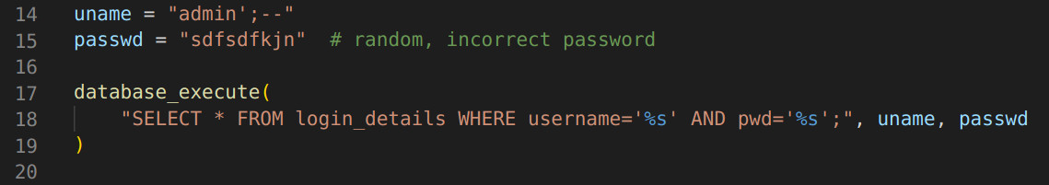
SQL Injection – Example
Consider this snippet of a hypothetical backend (in pseudo-code). It handles a login request sent by the user – gets username and password the user entered and constructs an SQL query to find all records in the table matching that. This query is then executed on the database in the SQL server.
What’s wrong here?

Slide 8
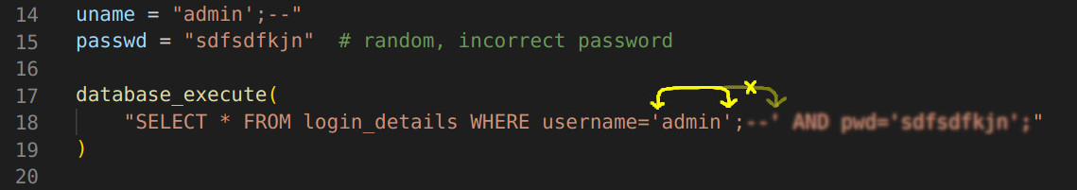
SQL Injection – Example
Consider this snippet of a hypothetical backend (in pseudo-code). It handles a login request sent by the user – gets username and password the user entered and constructs an SQL query to find all records in the table matching that. This query is then executed on the database in the SQL server.
What’s wrong here?

Slide 9

SQL Injection
Source: https://xkcd.com/327/

Slide 10
SQL Injection Types of attacks
Classic exploits
Gain access to privileged data
Modify or delete records
Identity spoofing
Can also be compounded with other kinds of attacks
DDOS (Distributed Denial-Of-Service)
XSS (Cross-site scripting)
RCE (Remote code execution)

Slide 11
Protection against SQLI attacks
Sanitising input with string escaping
Escape characters that have a special meaning to SQL with backslash, so they are interpreted as being part of the string.
Pattern/type check
Validate input before constructing the query, ensure it matches a pattern or a datatype.

Slide 12
Protection against SQLI attacks
Permissions of database
Set permissions to the bare minimum, as per principle of least privilege. Disallow dangerous commands like DELETE.
Object Relational Mappers (ORM)
ORM frameworks can be used instead of bare SQL to run queries in a safe and developer-friendly way. Since they are no longer constructed as strings, there is no danger of an injection vulnerability.

Slide 13

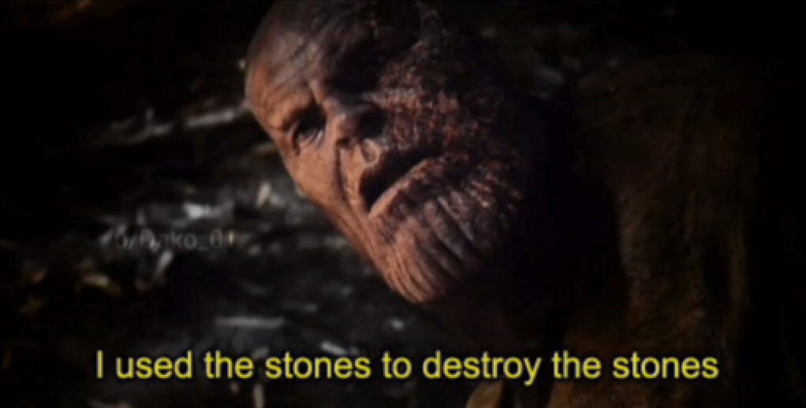
Trivia: Instances of real-world SQLI
In August 2020, an SQL injection attack was used to access information on the romantic interests of many Stanford students, as a result of insecure data sanitization standards on the part of “Link”, a start-up founded on campus.
On March 27, 2011, www.mysql.com, the official homepage for MySQL, was compromised by a hacker using SQL blind injection.

Slide 14

Trivia: Instances of real-world SQLI
On June 27, 2013, the Turkish government website was attacked, and people’s debt to government agencies was erased.
On August 17, 2009, there was a theft of 130 million credit card numbers. The attacker targetted a number of corporate victims after researching their payment processing systems. Among the companies hit were credit card processor Heartland Payment Systems, convenience store chain 7-Eleven, and supermarket chain Hannaford Brothers.

Slide 15
SQLI: Problems
Come up with your own SQL injection (for educational purposes ofc) that deletes all user records stored on a vulnerable server.
PS: There is a lot of implementation-specific behaviour in SQL, what attack works in one place may not work on another even if the underlying vulnerability is the same. The underlying tech-stack on the server side may also lead to such differences.

Slide 16
SQLI: Problems
If you have experience with backend development, try implementing fix(es) for vulnerable code in the framework of your choice.
Keep this in mind! Will come in handy if you are developing webapps now or will do the same in the future.

Slide 17
Onto our next speaker ...

