Slide 1
Variant 2: rural Sindh, where schooling costs vary widely and women lag far behind men in literacy
Registration no. FA24-BEDS-066
66 = 8 x 8 + 2, so variant 2 = Sindh (prov_code 3), rural (urban_rural 1)
Data: PSLM 2019-20 person file, weighted by hhweight
1,440
Rs 4,500
7,171
students with education spending (Q2)
weighted median spent per student per year
persons aged 10-64 in the literacy sample (Q3)

Slide 2
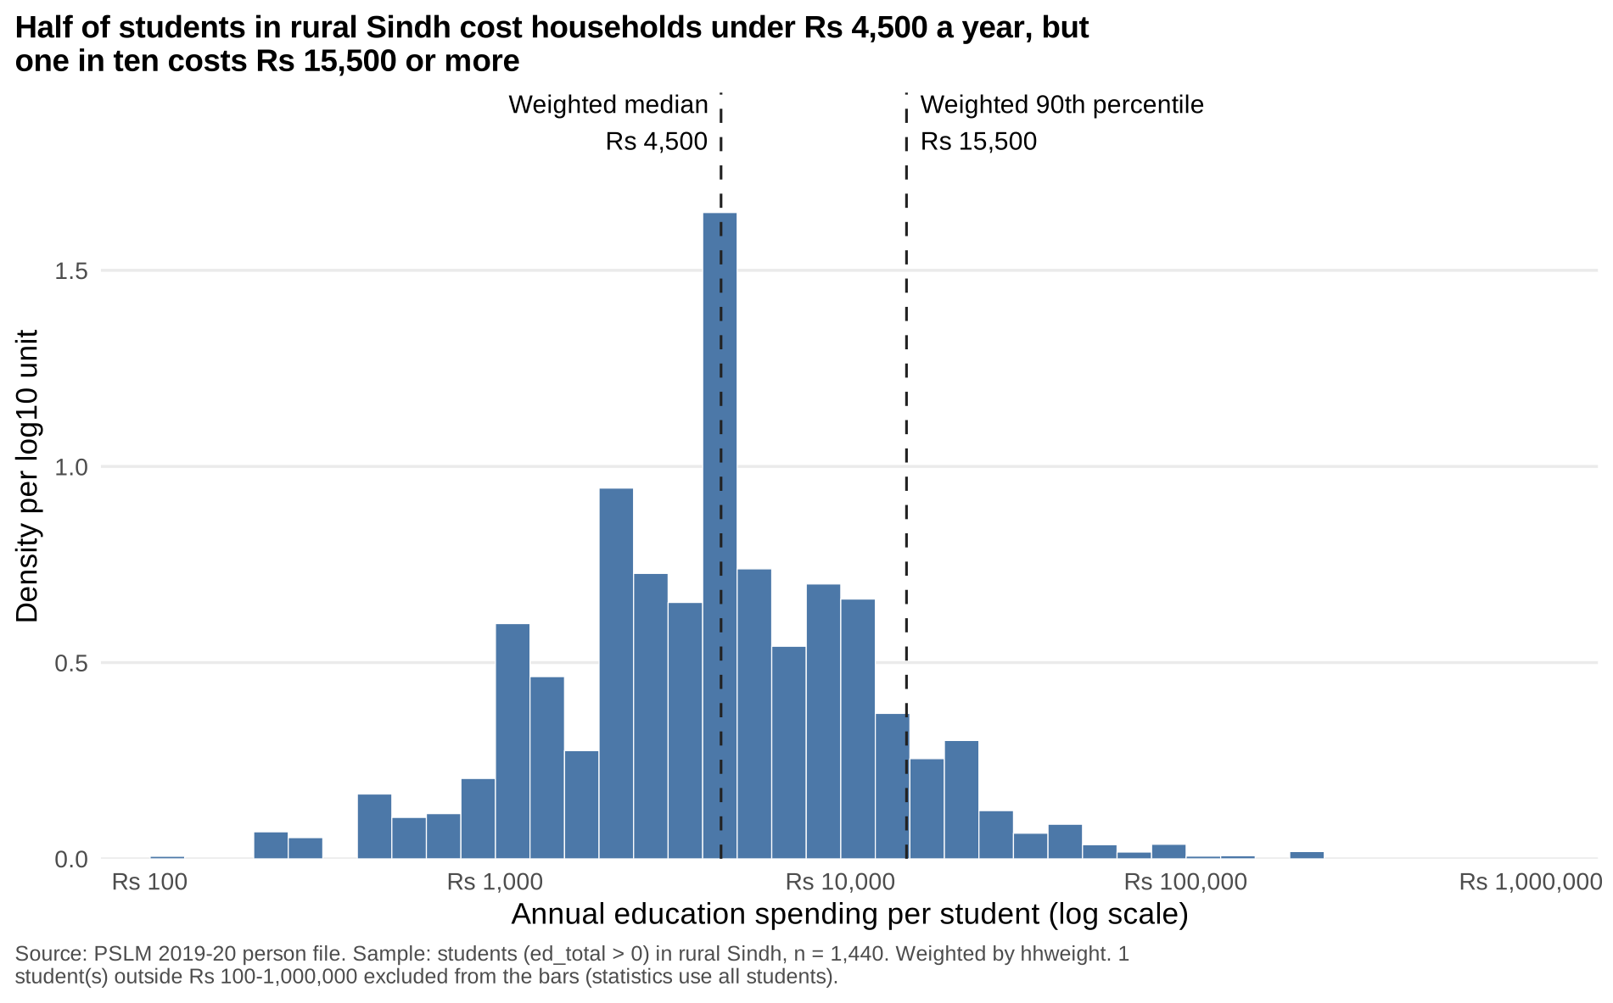
Half of students cost under Rs 4,500 a year, but one in ten costs Rs 15,500 or more
Spread: the 90th percentile is 15.5 times the 10th (Rs 15,500 vs Rs 1,000).
Weights: weighted median Rs 4,500 vs unweighted Rs 4,295; they differ only slightly.
Excluded: 1 student outside Rs 100 to Rs 1,000,000.

Slide 3
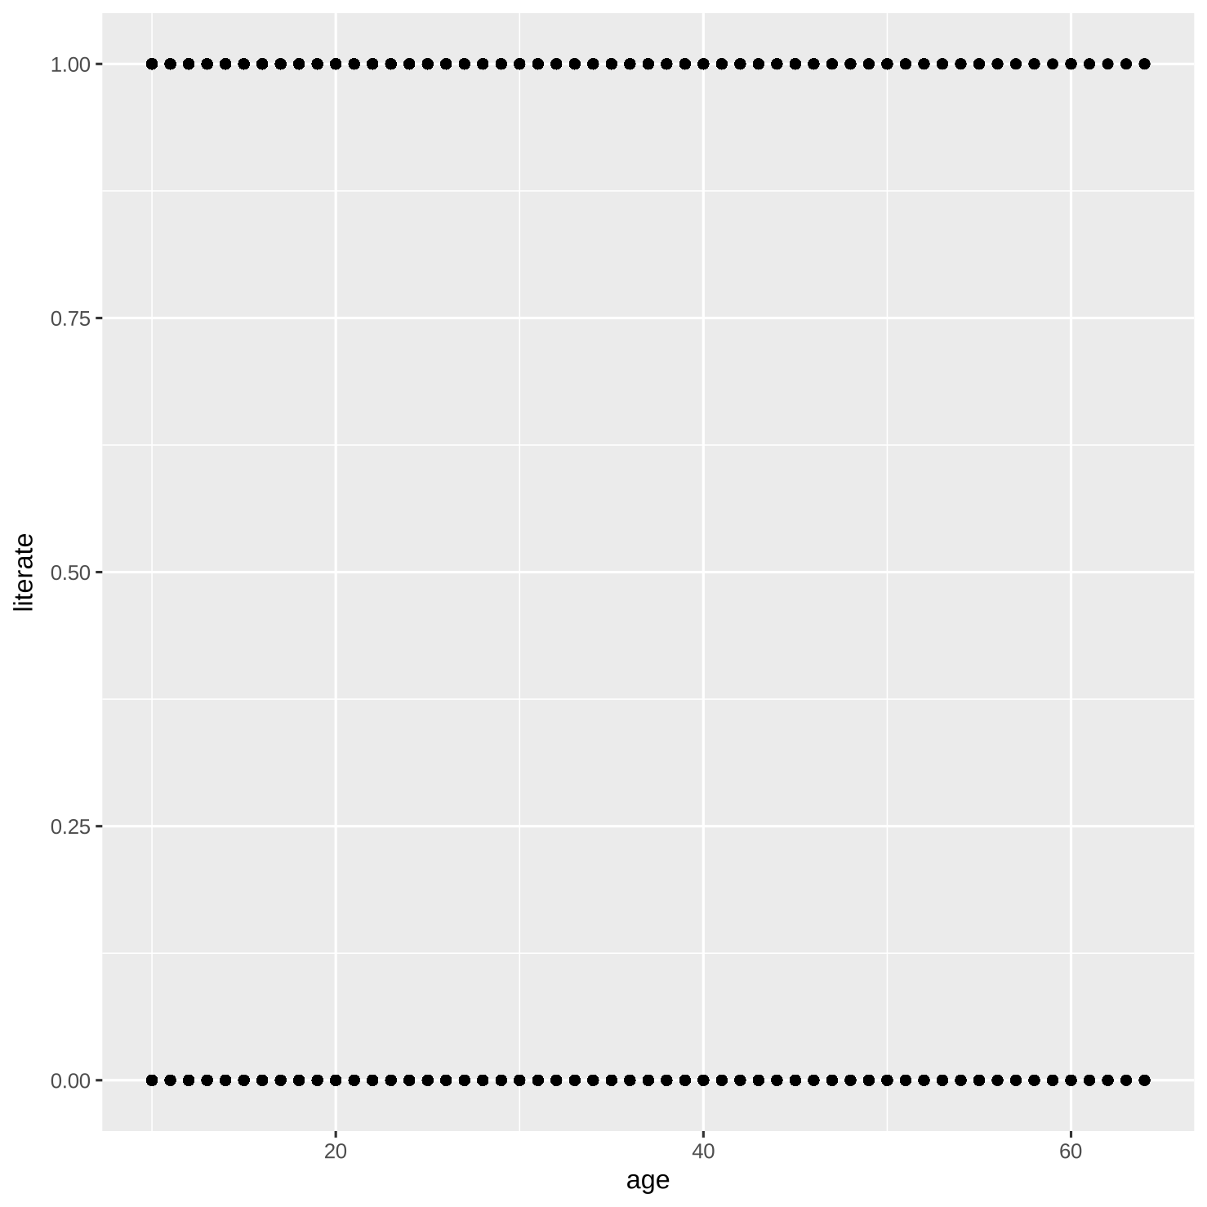
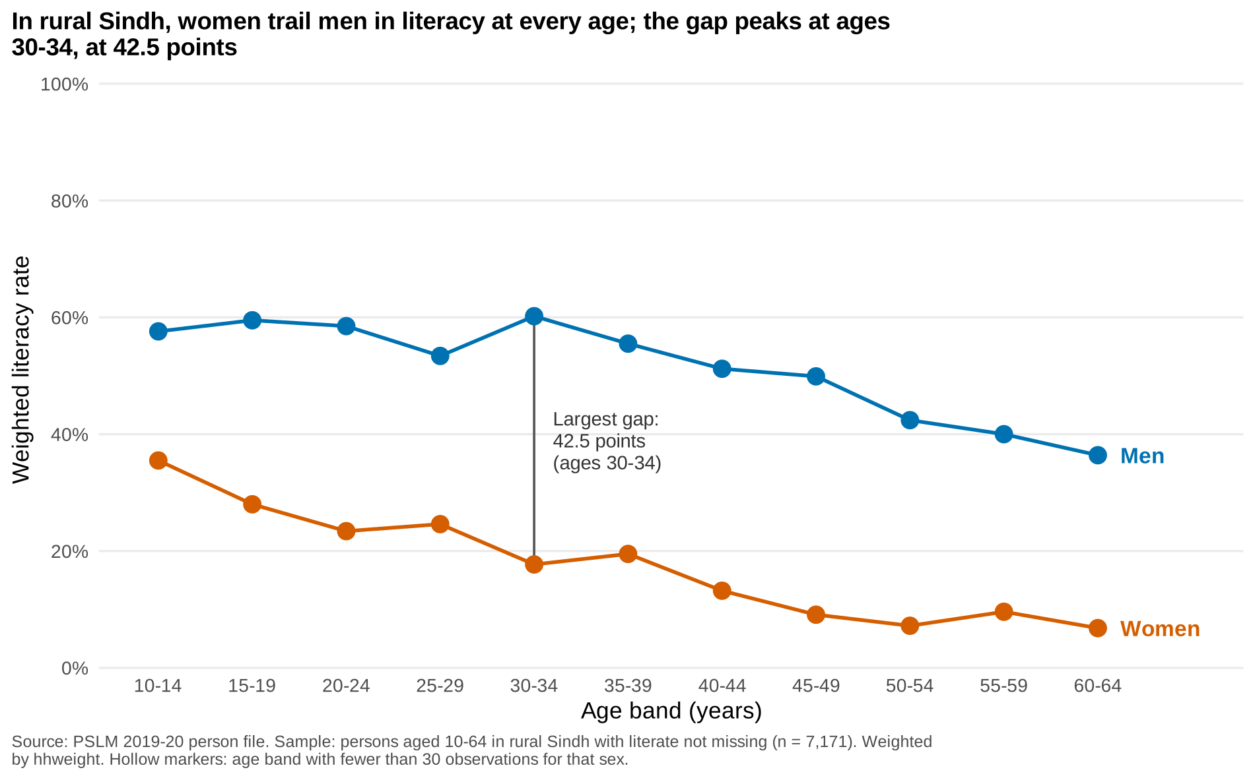
The makeover: from 7,171 overplotted dots to two weighted conditional-mean lines
R default: geom_point() only
Redesign: literacy rate by age band and sex
Position on a common scale, direct labels, no legend, a weighted mean per band, and a title that states the finding.

Slide 4
Most important finding: women trail men at every age, by 42.5 points at ages 30-34
28.0%
women aged 15-19
59.5%
men aged 15-19
9.6% vs 40.0%
women vs men aged 55-59
Notes:
A cross-section cannot separate age from cohort: older women were schooled when access was scarcer.

