Slide 1
Presentation on A Comparative Analysis of Data Balancing Techniques in Machine
Learning for Enhancing Bank Loan Eligibility Predictions
Presented By:
Manoj Rai
Faculty of Science and Technology, Kantipur City Campus
January 27, 2024

Slide 2
Presentation Outline
Introduction
Problem Statement
Research Objective
Methodology
Expected Results
Gantt chart

Slide 3
Introduction
ML in Banking Revolution
  Advanced data analysis for accurate loan predictions; enhancing financial decision-making.
Precision in Loan Assessments
  Addressing the limitations of traditional methods; importance in risk management and profitability.

Slide 4
Problem of Statement
Bias in Predictions from Imbalanced Data:
  Predominance of non-default data skews ML models, leading to inaccurate risk assessments.
Compromised Decision Accuracy:
  Imbalanced datasets impair model performance, resulting in unreliable loan eligibility determinations and potential financial risks.[1]

Slide 5
Research Objective
To compare SMOTE and ADASYN balancing technique with the help of machine learning algorithms.
To build a robust model for predicting eligibility of loan.

Slide 6
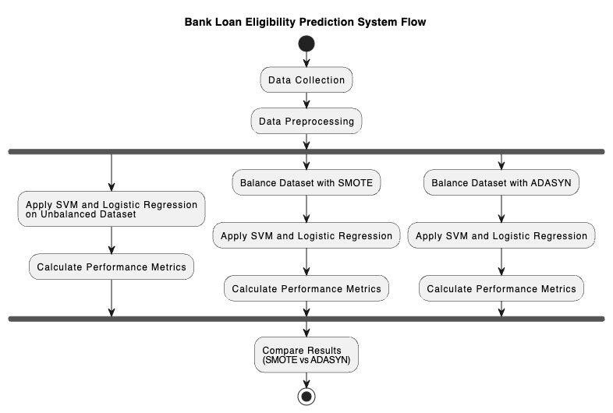
Methodology
Fig: System Flow Diagram

Slide 7
Dataset
4270 sample collected from Kaggle[
Total of 11 features under consideration
Output label:
  two categories (Approved and Rejected)

Slide 8
Dataset
Input Features:
No. of dependents
Education​
Employment Status
Annual Income
Loan amount
Loan term
Civil score
Residential assets
Commercial assets
Luxury assets
Bank assets

Slide 9
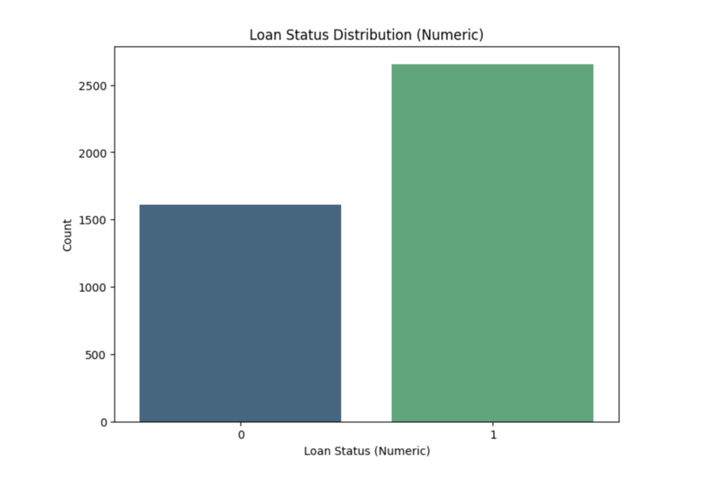
Dataset
Fig: Imbalanced Dataset

Slide 10
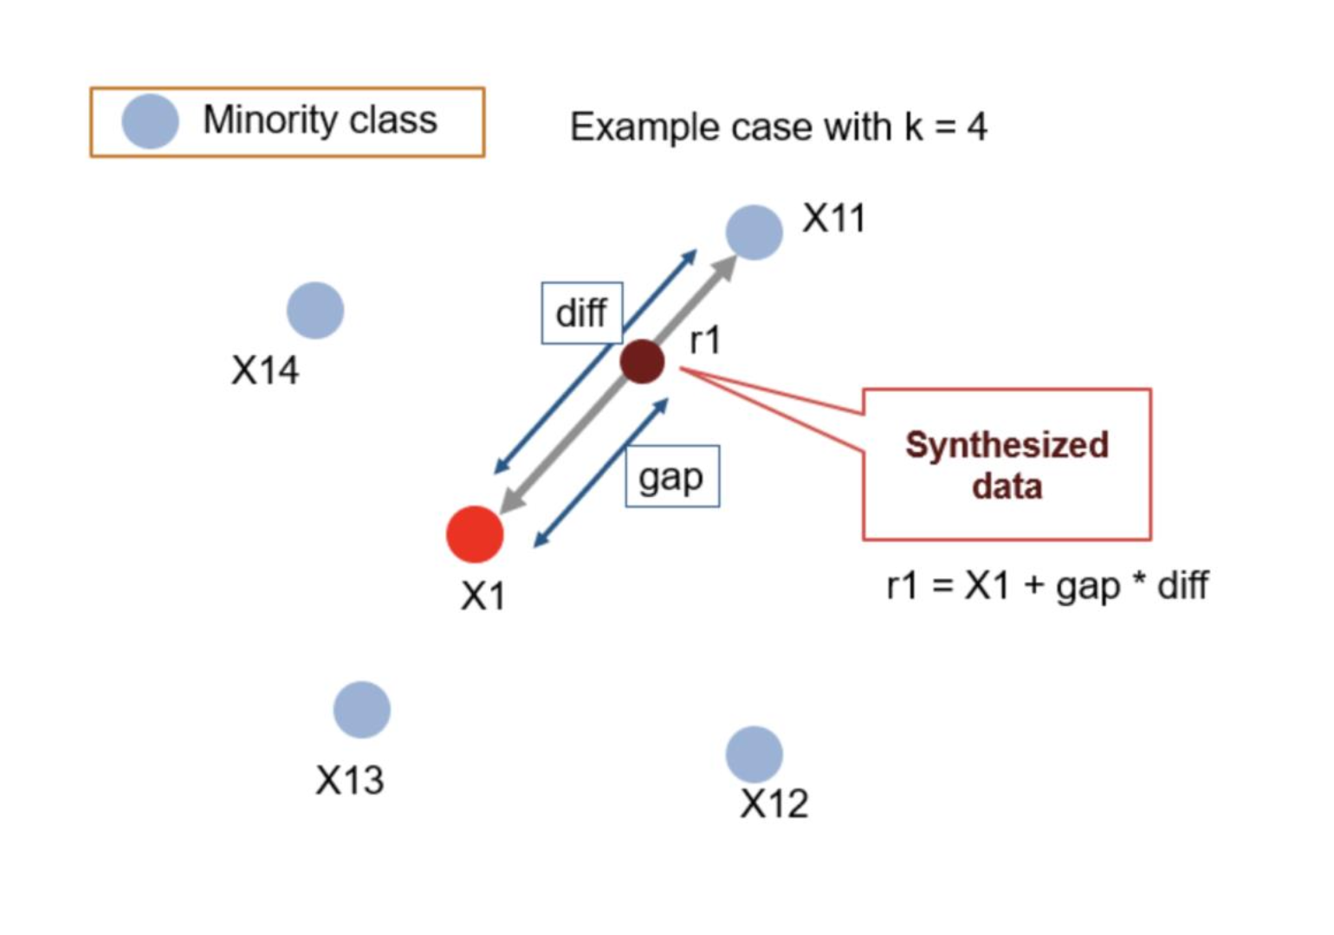
Balancing Algorithm- SMOTE
Synthetic Minority Over-sampling Technique
  generates synthetic samples to balance dataset;
  creating similar, but not identical, new instances.

Slide 11
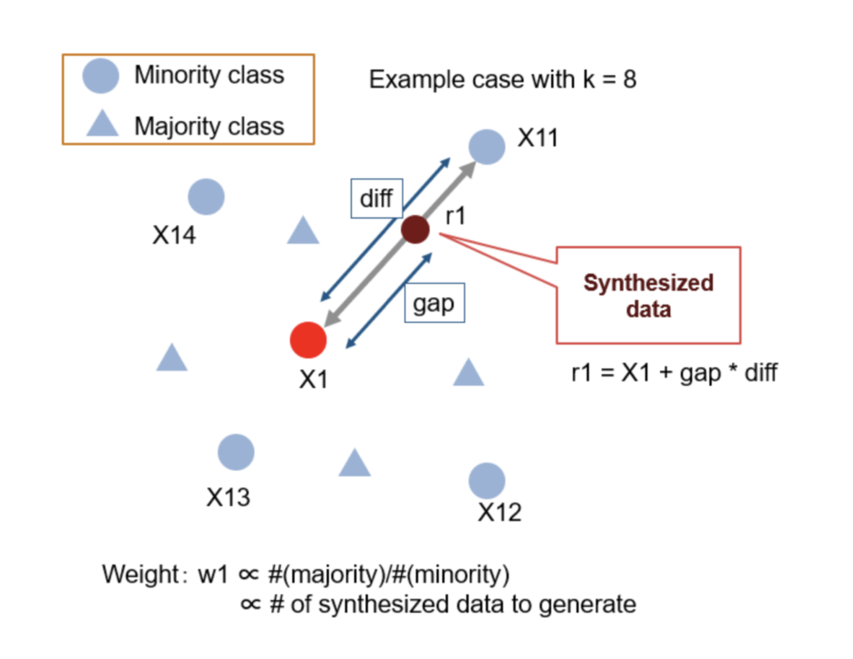
Balancing Algorithm- ADASYN
Adaptive Synthetic Sampling
  generating samples near the borderline;
  where the class imbalance is more pronounced.

Slide 12
SMOTE vs ADASYN
SMOTE (Synthetic Minority Over-sampling Technique):
  Creates synthetic samples from the minority class.
  Equal emphasis on all minority samples.
ADASYN (Adaptive Synthetic Sampling Approach):
  Extends SMOTE by focusing more on harder-to-learn instances.
  Adapts to the learning difficulties: more samples near the decision boundary.[2]

Slide 13
Model Development
Two ML algorithms to test on new balanced dataset
  Logistic Regression
  SVM

Slide 14
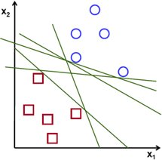
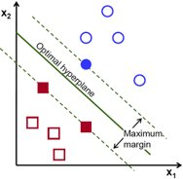
Support Vector Machine (SVM)
  Classification algorithm using hyperplane.​
  Finds the hyperplane that maximally separates two classes.

Slide 15
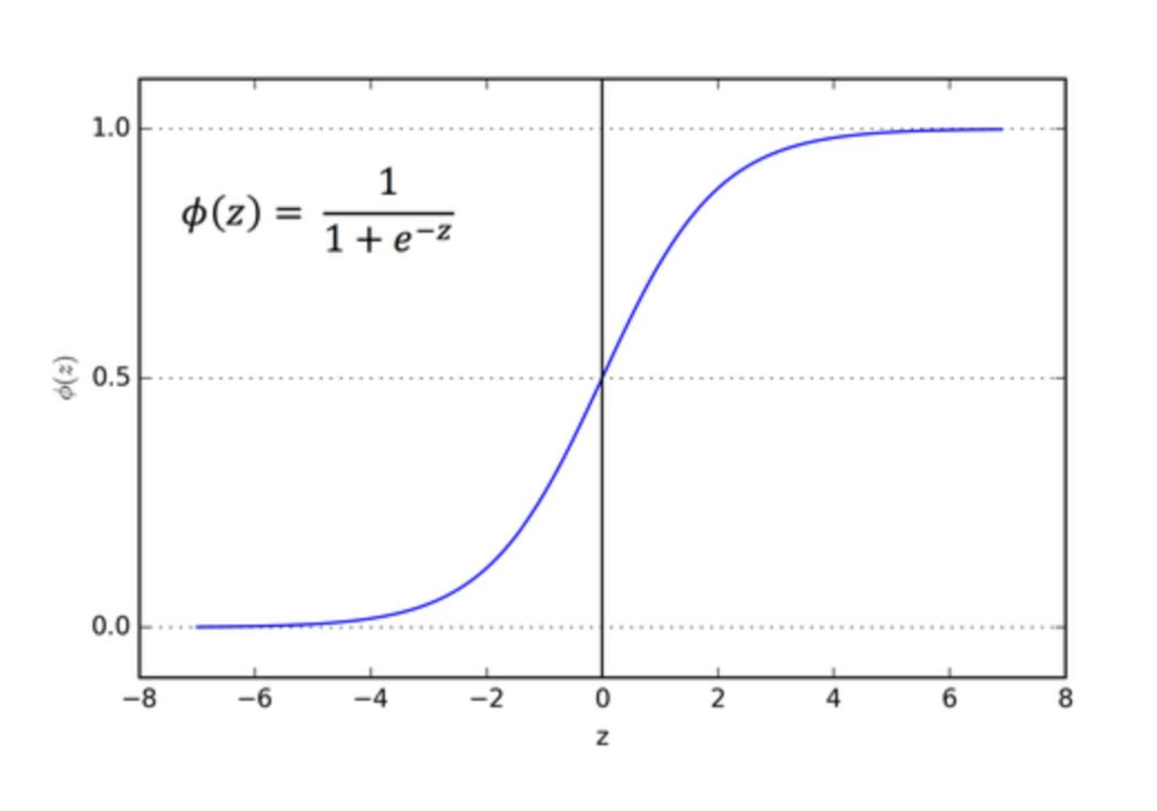
Logistic Regression
  Binary Classification problems.​
  Estimates the probability of an event occuring

Slide 16
Expected Output
Effectiveness of Balancing Techniques:
  Comparing of SMOTE, ADASYN on model accuracy;
  Identifying the most effective method for loan default prediction.

Slide 17
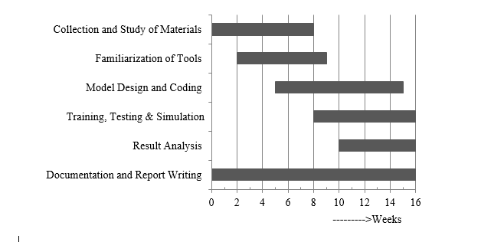
Gantt Chart

Slide 18
References
[1]Robert C. Moore, Daniel P. W. Ellis, Eduardo Fonseca, Shawn Hershey, Aren Jansen, and Manoj Plakal, “Dataset Balancing Can Hurt Model Performance,”IEEE International Conference on Acoustics, Speech, and Signal Processing, Jun. 2023, doi: 10.1109/icassp49357.2023.10095255.
[2] Ishani Dey and Vibha Pratap, “A Comparative Study of SMOTE, Borderline-SMOTE, and ADASYN Oversampling Techniques using Different Classifiers,” 2023 3rd International Conference on Smart Data Intelligence (ICSMDI), Mar. 2023, doi: 10.1109/icsmdi57622.2023.00060.

