Slide 1
Entity Relationship (E-R) Model
DBMS

Slide 2
The Entity Relationship (E-R) Model
E-R Model Components
  Entities
    In E-R models an entity refers to the entity set.
    An entity is represented by a rectangle containing the entity’s name.
  Attributes
    Attributes are represented by ovals and are connected to the entity with a line.
    Each oval contains the name of the attribute it represents.
    Attributes have a domain -- the attribute’s set of possible values.
    Attributes may share a domain.
    Primary keys are underlined.
  Relationships

Slide 3
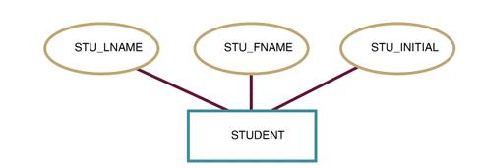
The Attributes of the STUDENT Entity

Slide 4

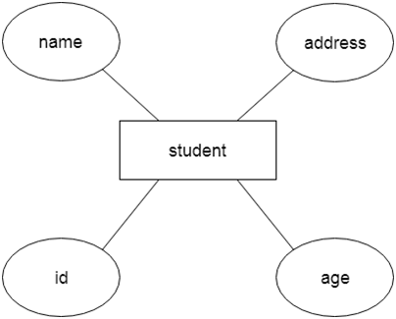

Slide 5
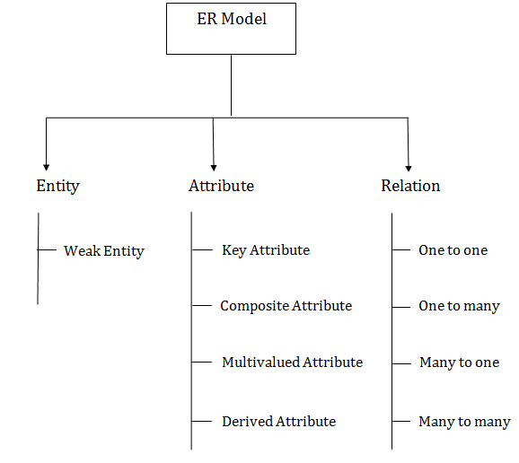

Slide 6


Entity
Weak Entity
An entity that depends on another entity called a weak entity. The weak entity doesn't contain any key attribute of its own. The weak entity is represented by a double rectangle.

Slide 7
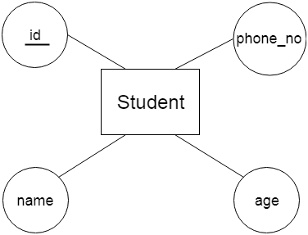
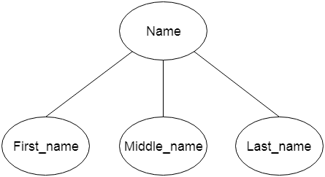
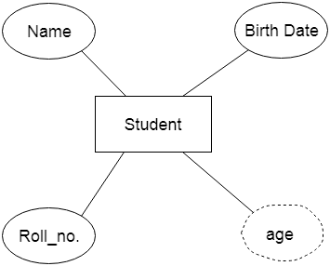
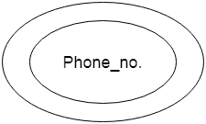
Key Attribute, Key attribute, multi value attribute, Derive attribute

Slide 8





Relationship

Slide 9
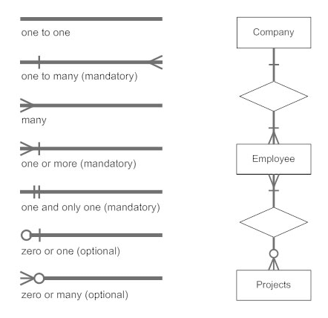

Slide 10
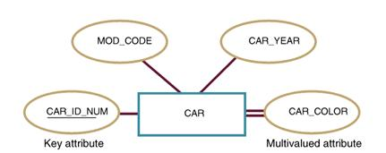
Basic E-R Model Entity Presentation

Slide 11
The Entity Relationship (E-R) Model
Classes of Attributes
  A simple attribute cannot be subdivided.
    Examples: Age, Sex, and Marital status
  A composite attribute can be further subdivided to yield additional attributes.
    Examples:
      ADDRESS  Street, City, State, Zip
      PHONE NUMBER  Area code, Exchange number

Slide 12
The Entity Relationship (E-R) Model
Classes of Attributes
  A single-valued attribute can have only a single value.
    Examples:
      A person can have only one social security number.
      A manufactured part can have only one serial number.
  Multivalued attributes can have many values.
    Examples:
      A person may have several college degrees.
      A household may have several phones with different numbers
    Multivalued attributes are shown by a double line connecting to the entity.

Slide 13
The Entity Relationship (E-R) Model
Multivalued Attribute in Relational DBMS
  The relational DBMS cannot implement multivalued attributes.
  Possible courses of action for the designer
    Within the original entity, create several new attributes, one for each of the original multivalued attribute’s components.
    Create a new entity composed of the original multivalued attribute’s components

Slide 14
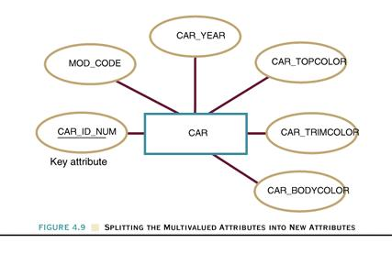
Splitting the Multivalued Attributes into New Attributes

Slide 15
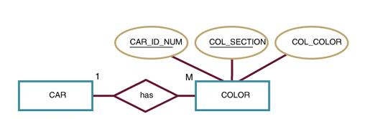
A New Entity Set Composed of Multivalued
Attribute’s Components

Slide 16
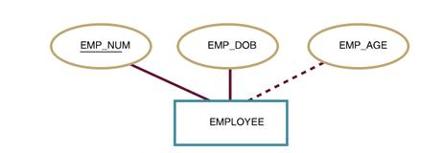
The Entity Relationship (E-R) Model
  A derived attribute is not physically stored within the database; instead, it is derived by using an algorithm.
    Example: AGE can be derived from the data of birth and the current date.
Figure: A Derived Attribute

Slide 17
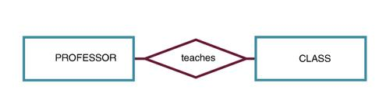
The Entity Relationship (E-R) Model
Relationships
  A relationship is an association between entities.
  Relationships are represented by diamond-shaped symbols.
Figure :An Entity Relationship

Slide 18
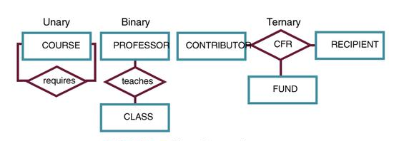
The Entity Relationship (E-R) Model
A relationship’s degree indicates the number of associated entities or participants.
  A unary relationship exists when an association is maintained within a single entity.
  A binary relationship exists when two entities are associated.
  A ternary relationship exists when three entities are associated.

Slide 19
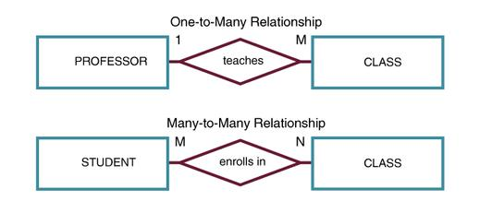
The Entity Relationship (E-R) Model
Connectivity
  The term connectivity is used to describe the relationship classification (e.g., one-to-one, one-to-many, and many-to-many).
Figure :Connectivity in an ERD

Slide 20
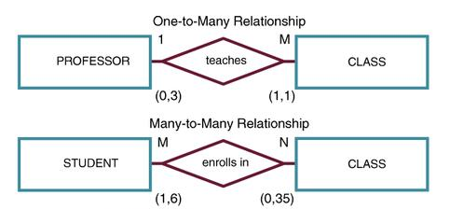
The Entity Relationship (E-R) Model
Cardinality
  Cardinality expresses the specific number of entity occurrences associated with one occurrence of the related entity.
Figure :Cardinality in an ERD

Slide 21
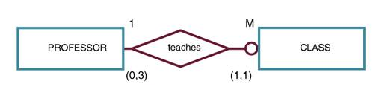
The Entity Relationship (E-R) Model
Relationship Participation
  The participation is optional if one entity occurrence does not require a corresponding entity occurrence in a particular relationship.
  An optional entity is shown by a small circle on the side of the optional entity.
Figure : An ERD With An Optional Entity

Slide 22
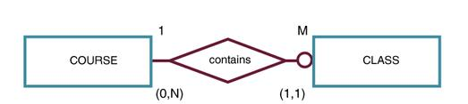
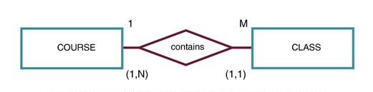
Figure : CLASS is Optional to COURSE
Figure : COURSE and CLASS in a Mandatory Relationship

Slide 23
The Entity Relationship (E-R) Model
Weak Entities
  A weak entity is an entity that
    Is existence-dependent and
    Has a primary key that is partially or totally derived from the parent entity in the relationship.
  The existence of a weak entity is indicated by a double rectangle.
  The weak entity inherits all or part of its primary key from its strong counterpart.

Slide 24
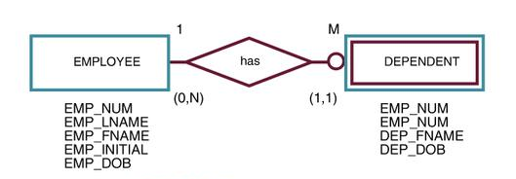
A Weak Entity in an ERD

Slide 25
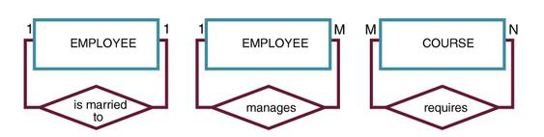
The Entity Relationship (E-R) Model
Recursive Entities
  A recursive entity is one in which a relationship can exist between occurrences of the same entity set.
  A recursive entity is found within a unary relationship.
Figure : An E-R Representation of Recursive Relationships

Slide 26
The Entity Relationship (E-R) Model
Composite Entities
  A composite entity is composed of the primary keys of each of the entities to be connected.
  The composite entity serves as a bridge between the related entities.
  The composite entity may contain additional attributes.

Slide 27
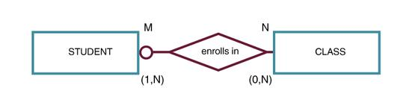
The M:N Relationship Between STUDENT and CLASS

Slide 28
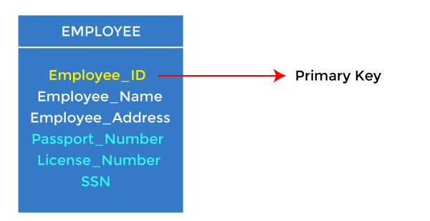
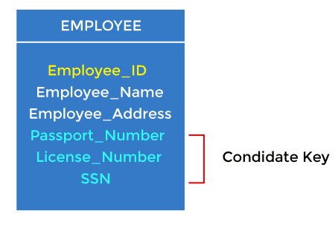
Keys

Slide 29
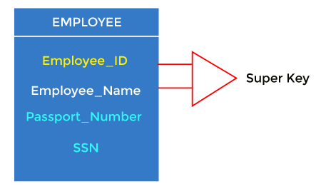
Keys…
Super key is an attribute set that can uniquely identify a tuple. A super key is a superset of a candidate key.

Slide 30
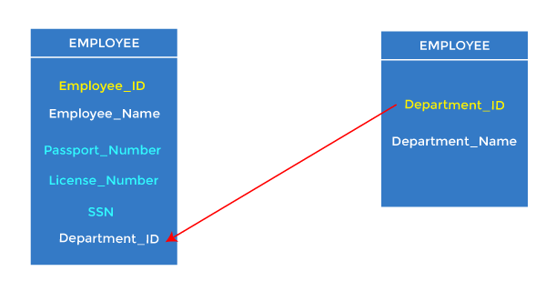
Foreign key

Slide 31
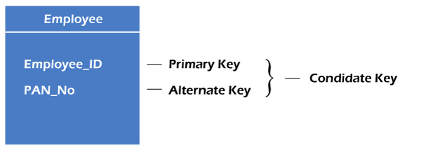
Alternate key
There may be one or more attributes or a combination of attributes that uniquely identify each tuple in a relation. These attributes or combinations of the attributes are called the candidate keys. One key is chosen as the primary key from these candidate keys, and the remaining candidate key, if it exists, is termed the alternate key. In other words, the total number of the alternate keys is the total number of candidate keys minus the primary key. The alternate key may or may not exist. If there is only one candidate key in a relation, it does not have an alternate key

Slide 32
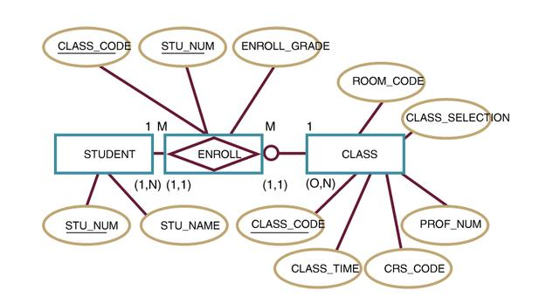
A Composite Entity in the ERD

Slide 33
Developing an E-R Diagram
The process of database design is an iterative rather than a linear or sequential process.
It usually begins with a general narrative of the organization’s operations and procedures.
The basic E-R model is graphically depicted and presented for review.
The process is repeated until the end users and designers agree that the E-R diagram is a fair representation of the organization’s activities and functions.

Slide 34
Developing an E-R Diagram
B.D. College Database (1)
  College is divided into several schools. Each school is administered by a dean. A 1:1 relationship exists between DEAN and SCHOOL.
  Each dean is a member of a group of administrators (ADMINISTRATOR). Deans also hold professorial rank and may teach a class (PROFESSOR). Administrators and professors are also Employees.

Slide 35
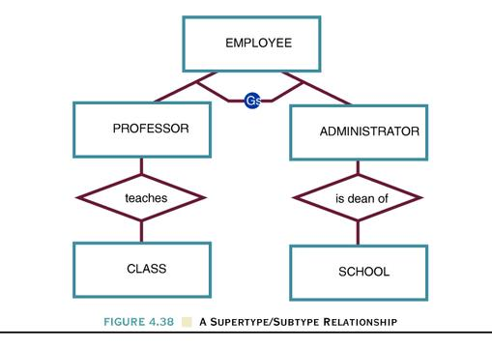
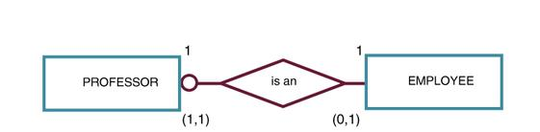

Slide 36
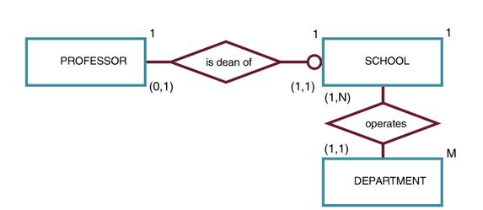
Developing an E-R Diagram
B.D. College Database (2)
  Each school is composed of several departments.
  The smallest number of departments operated by a school is one, and the largest number of departments is indeterminate (N).
  Each department belongs to only a single school.
Figure : The First B.D. College ERD Segment

Slide 37
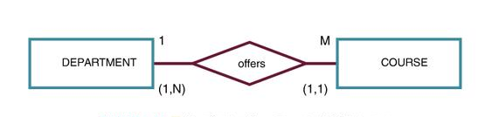
Developing an E-R Diagram
B.D. College Database (3)
  Each department offers several courses.
Figure : The Second B.D. College ERD Segment

Slide 38
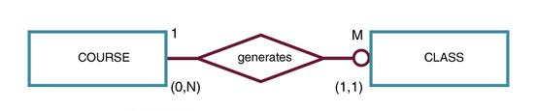
Developing an E-R Diagram
B.D. College Database (4)
  A department may offer several sections (classes) of the same course.
  A 1:M relationship exists between COURSE and CLASS.
  CLASS is optional to COURSE
Figure : The Third B.D. College ERD Segment

Slide 39
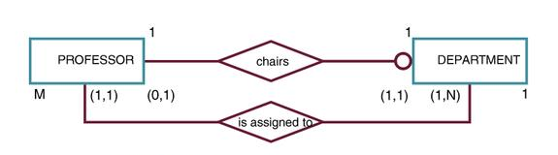
Developing an E-R Diagram
B.D. College Database (5)
  Each department has many professors assigned to it.
  One of those professors chairs the department. Only one of the professors can chair the department.
  DEPARTMENT is optional to PROFESSOR in the “chairs” relationship.
Figure : The Fourth B.D. College ERD Segment

Slide 40
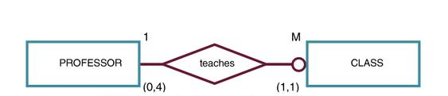
Developing an E-R Diagram
B.D. College Database (6)
  Each professor may teach up to four classes, each one a section of a course.
  A professor may also be on a research contract and teach no classes.
Figure : The Fifth B.D. College ERD Segment

Slide 41
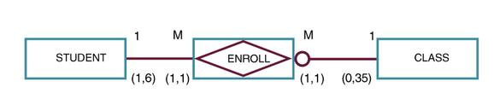
Developing an E-R Diagram
B.D. College Database (7)
  A student may enroll in several classes, but (s)he takes each class only once during any given enrollment period.
  Each student may enroll in up to six classes and each class may have up to 35 students in it.
  STUDENT is optional to CLASS.
Figure : The Sixth B.D. College ERD Segment

Slide 42
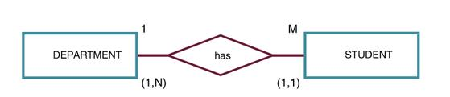
Developing an E-R Diagram
B.D. College Database (8)
  Each department has several students whose major is offered by that department.
  Each student has only a single major and associated with a single department.
Figure : The Seventh B.D. College ERD Segment

Slide 43
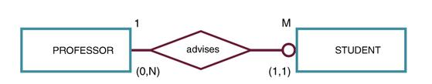
Developing an E-R Diagram
B.D. College Database (9)
  Each student has an advisor in his or her department; each advisor counsels several students.
  An advisor is also a professor, but not all professors advise students.
Figure : The Eighth B.D. College ERD Segment

Slide 44
Developing an E-R Diagram
Entities for the B.D. College Database
SCHOOL
DEPARMENT
EMPLOYEE
PROFESSOR
COURSE
CLASS
ENROLL (Bridge between STUDENT and CLASS)
STUDENT

Slide 45
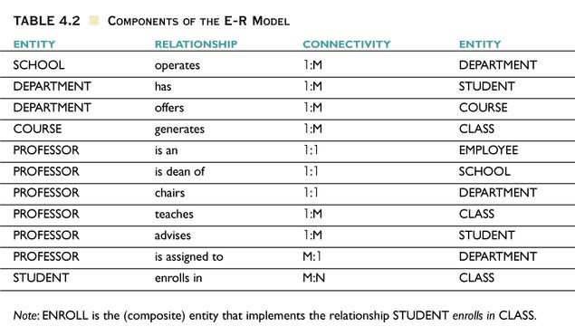
Components of the E-R Model

Slide 46
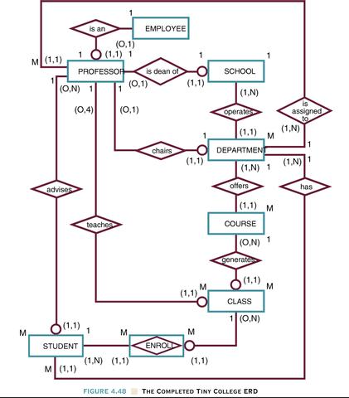

Slide 47
Extended E-R Features: Specialization
Top-down design process; we designate subgroupings within an entity set that are distinctive from other entities in the set.
These subgroupings become lower-level entity sets that have attributes or participate in relationships that do not apply to the higher-level entity set.
Depicted by a triangle component labeled ISA (E.g. customer “is a” person).
Attribute inheritance – a lower-level entity set inherits all the attributes and relationship participation of the higher-level entity set to which it is linked.

Slide 48
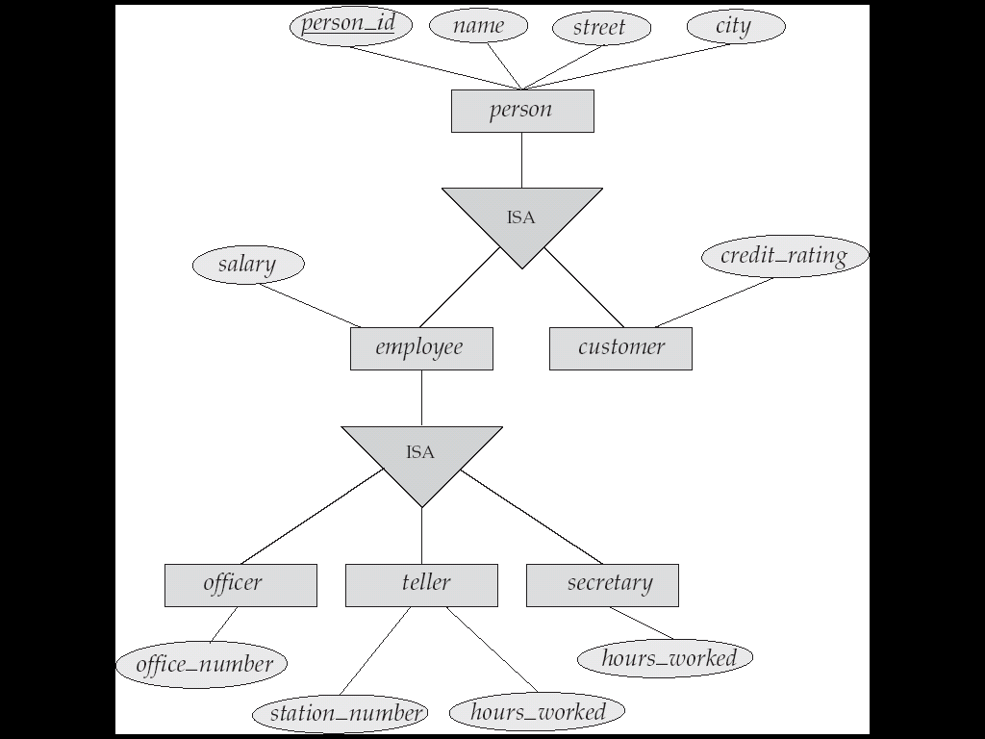
Specialization Example

Slide 49
Extended ER Features: Generalization
A bottom-up design process – combine a number of entity sets that share the same features into a higher-level entity set.
Specialization and generalization are simple inversions of each other; they are represented in an E-R diagram in the same way.
The terms specialization and generalization are used interchangeably.

Slide 50
Specialization and Generalization (Cont.)
Can have multiple specializations of an entity set based on different features.
E.g. permanent_employee vs. temporary_employee, in addition to officer vs. secretary vs. teller
Each particular employee would be
  a member of one of permanent_employee or temporary_employee,
  and also a member of one of officer, secretary, or teller
The ISA relationship also referred to as superclass - subclass relationship

Slide 51
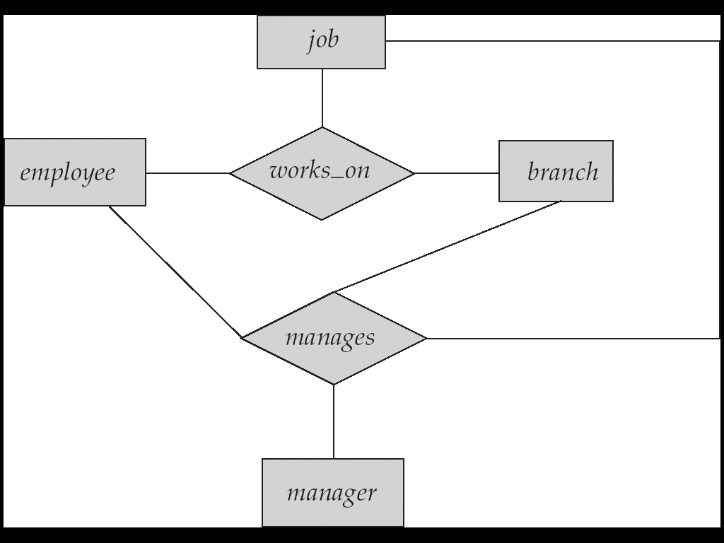
Aggregation
Consider the ternary relationship works_on
Suppose we want to record managers for tasks performed by an
employee at a branch

Slide 52
Aggregation (Cont.)
Relationship sets works_on and manages represent overlapping information
  Every manages relationship corresponds to a works_on relationship
  However, some works_on relationships may not correspond to any manages relationships
    So we can’t discard the works_on relationship
Eliminate this redundancy via aggregation
  Treat relationship as an abstract entity
  Allows relationships between relationships
  Abstraction of relationship into new entity
Without introducing redundancy, the following diagram represents:
  An employee works on a particular job at a particular branch
  An employee, branch, job combination may have an associated manager

Slide 53
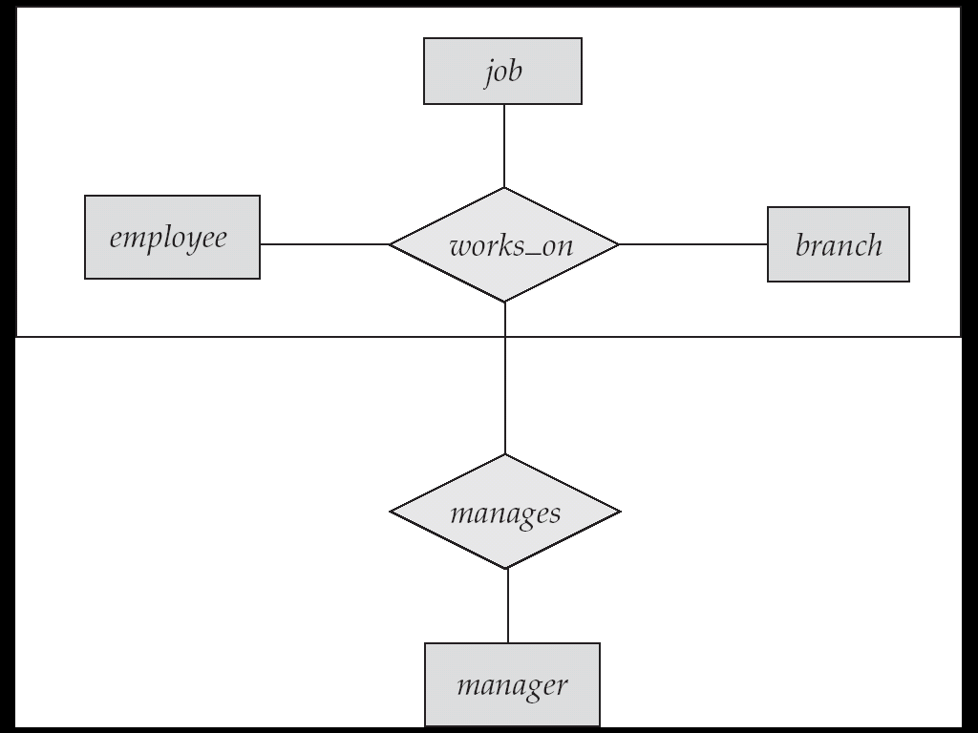
E-R Diagram With Aggregation

Slide 54
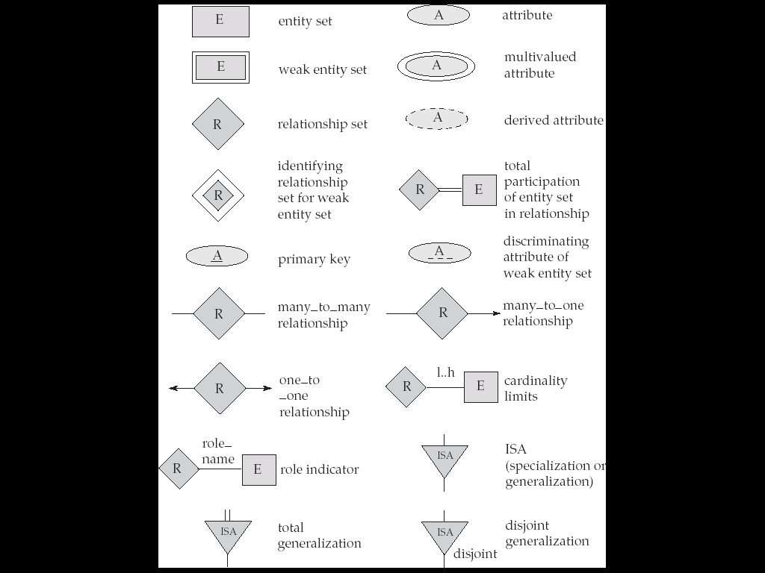
Summary of Symbols Used in E-R Notation

Slide 55
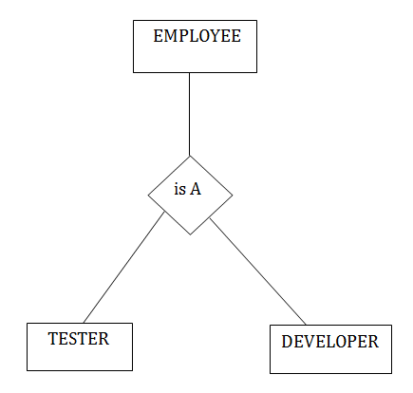
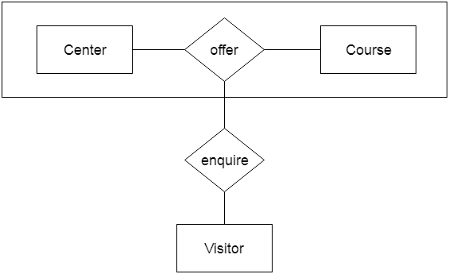
Specialization
Aggragation

Slide 56
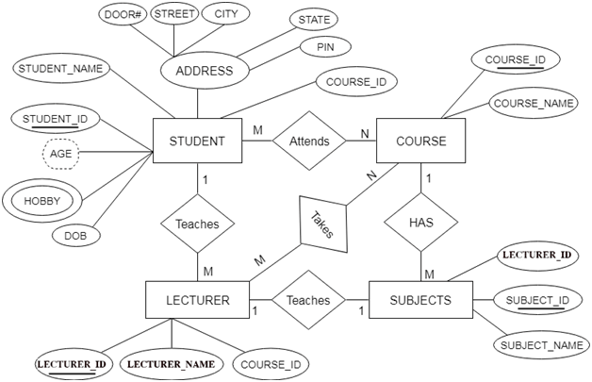

Slide 57



One to One
One to many
Many to many

