Slide 1
PPT 4
(user defined datastructures

Slide 2
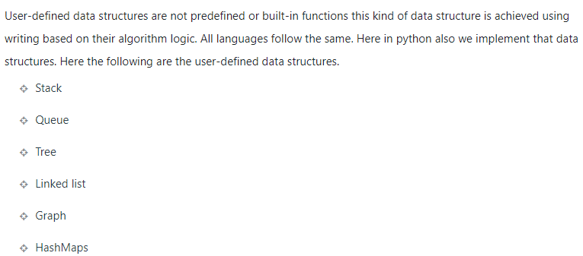

Slide 3
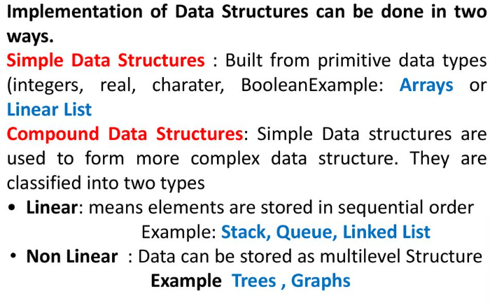

Slide 4
Python does not have built-in support for Arrays, but Python Lists can be used instead.
An array is a collection of items stored at contiguous memory locations.
The idea is to store multiple items of the same type together.
This makes it easier to calculate the position of each element by simply adding an offset to a base value, i.e., the memory location of the first element of the array (generally denoted by the name of the array).

Slide 5
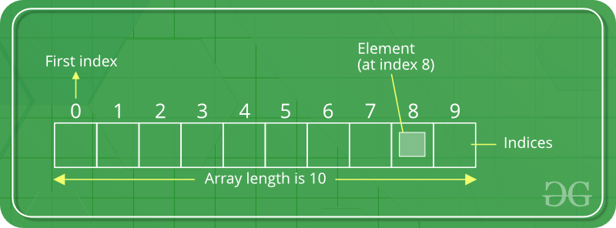

Slide 6
Creating an Array
Array in Python can be created by importing an array module.
array(data_type, value_list) is used to create an array with data type and value list specified in its arguments.

Slide 7
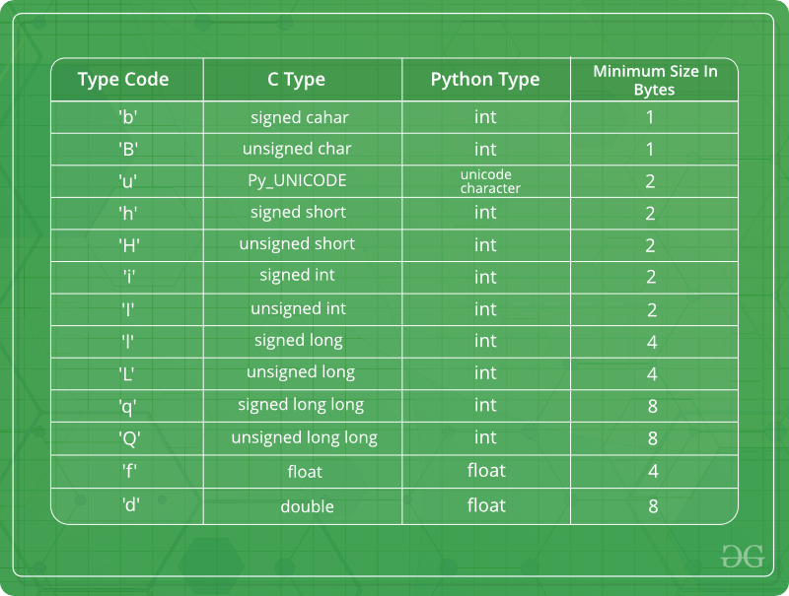
Some of the data types are mentioned below which will help in creating an array of different data types.

Slide 8
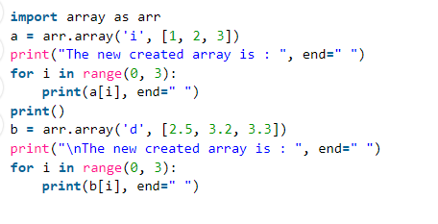

Slide 9
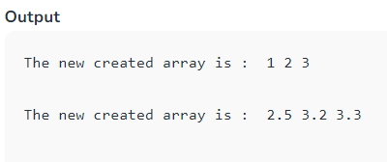

Slide 10
Adding Elements to a Array
Elements can be added to the Array by using built-in insert() function.
Insert is used to insert one or more data elements into an array.
Based on the requirement, a new element can be added at the beginning, end, or any given index of array.
append() is also used to add the value mentioned in its arguments at the end of the array.

Slide 11
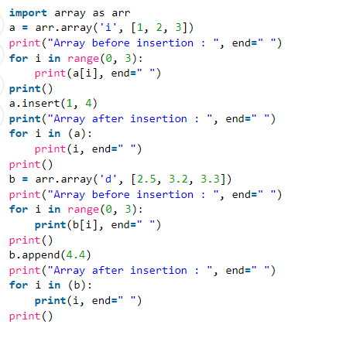

Slide 12
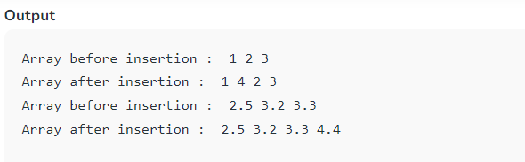

Slide 13
When arrays are used over a list in Python:
Arrays and Lists are two prominent data structures in Python that are similar in many aspects.
They both can be used to store data and enable us to iterate over them, slice them, and even access their elements utilizing the indexing method.
Then what is the difference between list and array in Python?
The contiguous nature of the array allows the data to be stored in adjacent memory locations. This makes it easier to perform operations on array elements.

Slide 14
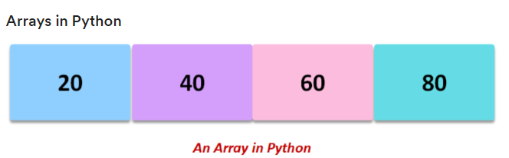
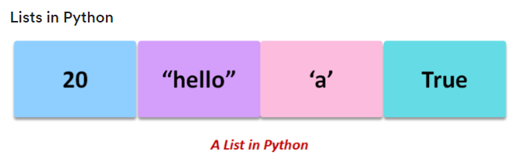

Slide 15
PARAMETER | LIST | ARRAY
Declaration | Lists need not be declared since they are inbuilt in Python. list = [10, 20, 30] | You need to import an array module or NumPy library in order to declare an array. my_arr_1 = array.array(‘i’, [10, 20, 30])
Data Type | A single list can contain values that belong to different data types. myList = [40, ‘hi there’, ‘m’] | All the elements of an array should be of the same data type.myArr = arr.array(i, [1, 0, 9])
Size | Python list is resizeable as, during list initialization, Python initializes some extra elements. | Arrays have a constant size that can not be altered.
Space/ Memory | Consumes larger space and memory for the addition or removal of elements. | Stores data in a more compact manner.
Data Storage | Preferred for storing a small amount of data. | Preferred for storing a large amount of data

Slide 16
Linked Lists
A linked list, like its name suggests, is linked.
Every node in the linked list consists of two segments-
the data field with the data/ value and
the next field holding the reference to the next node, thus linking together.
It is a linear data structure, but the elements are not stored in contiguous memory locations.

Slide 17
Important points about Linked lists:
A linked list is an ordered collection of elements.
A linked list is also used to implement other user-defined data structures like stack and queue.
Using the collections module in Python, we can use the deque object to implement operations like insert and delete on linked lists.
The first node in a linked list is the head, and we must start all the operations on the linked list from it.
The last node of the linked list refers to None showing that the linked list is complete.

Slide 18
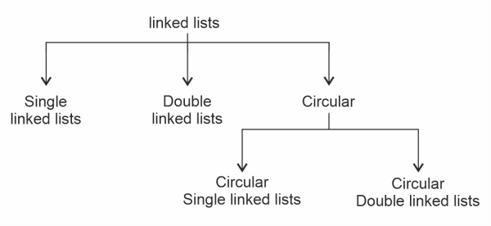

Slide 19

A simple linked list looks like this:
As shown in the above figure, the head is the first node, and the next (reference) part of the last node holds None.

Slide 20
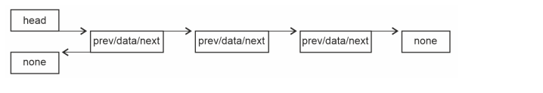
A double-linked list looks like this:
In a double-linked list, every node will have three sections. Head holds the reference of the first node, the "previous" section of the first node holds None, and the next field of the last node refers to None. Each node will hold two references along with the data, one to its previous node and the next to the succeeding node.

Slide 21
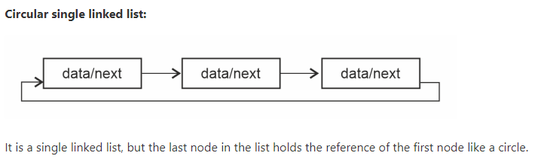
Circular linked list:
A circular linked list can be single or double:

Slide 22
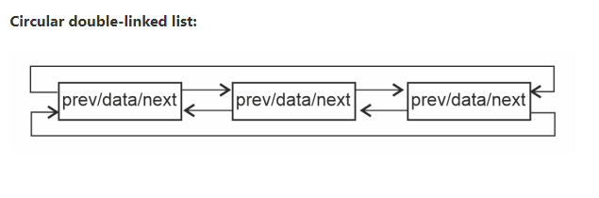
It is a double-linked list, but the last node in the list holds the reference of the first node, and the 'previous' section of the first node holds the reference of the last node like a circle.

Slide 23
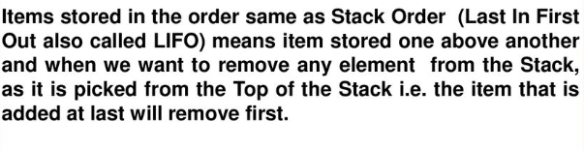
Stack
A stack is a linear data structure that stores items in a Last-In/First-Out (LIFO)
In stack, a new element is added at one end and an element is removed from that end only.
The insert and delete operations are often called push and pop.

Slide 24
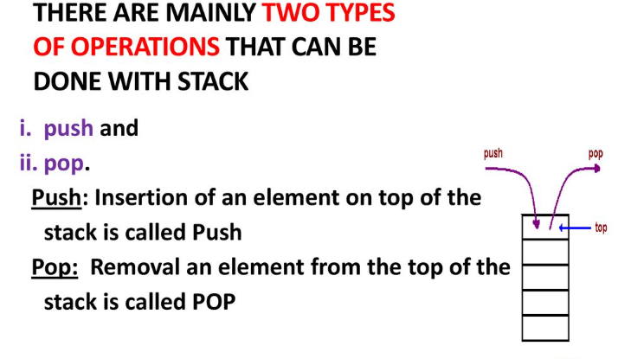

Slide 25
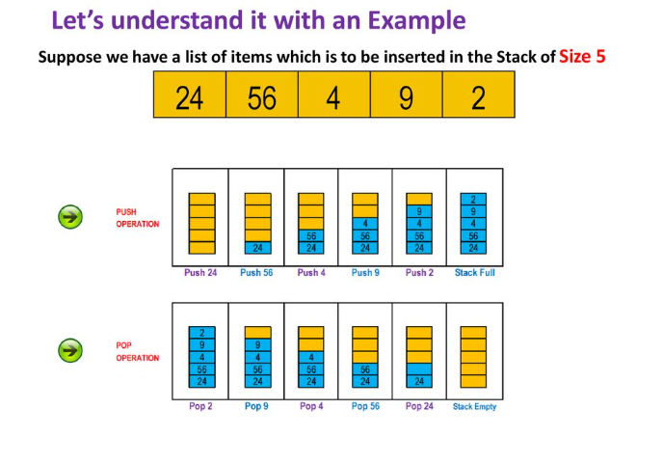

Slide 26
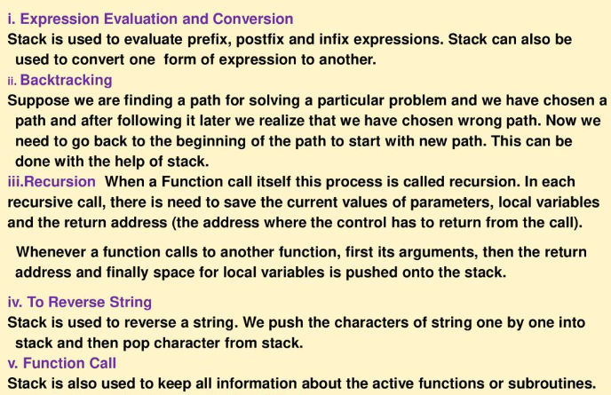
Application of Stack

Slide 27
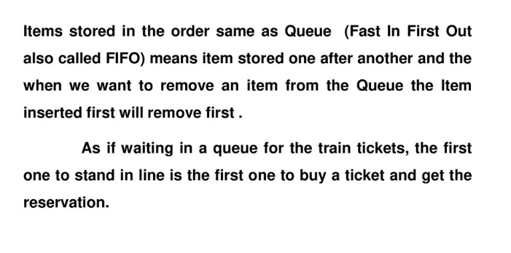
QUEUE

Slide 28
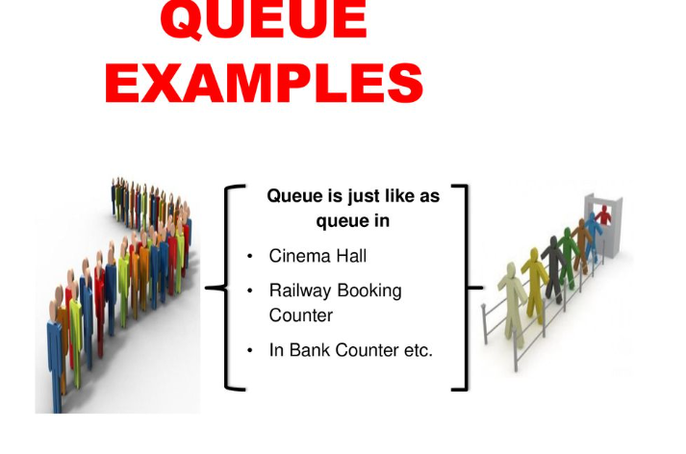

Slide 29
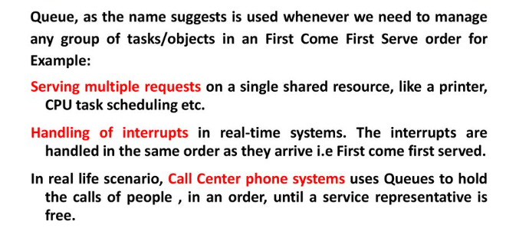
APPLICATION OF QUEUE

Slide 30
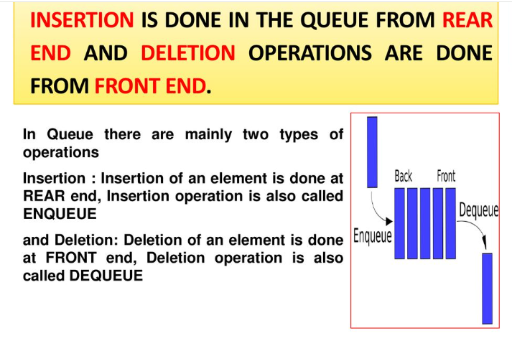

Slide 31
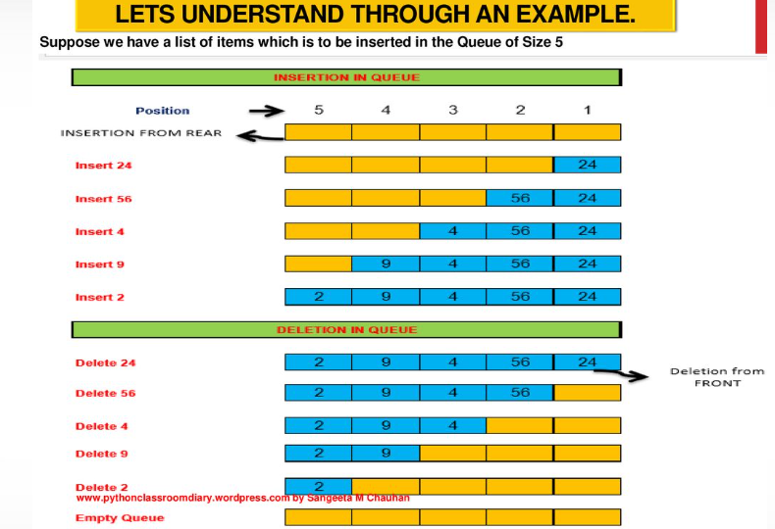

Slide 32
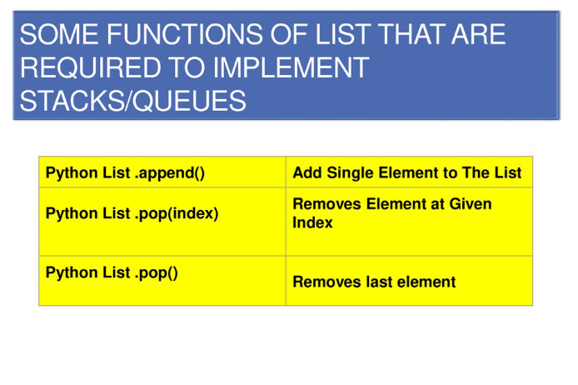

Slide 33
https://www.javatpoint.com/user-defined-data-structures-in-python

Slide 34
Binary Tree
A tree is a hierarchical representation of nodes. Family trees are real-time examples of a tree.
Every node is allowed to have only two children. The node at the highest hierarchy or the top-most node is called the "Root node".

Slide 35
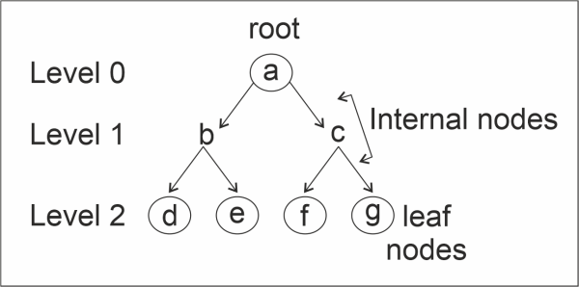
Important points about Binary tree:
Every node can have a left sub-tree and a right sub-tree.
Hence, a node in a binary tree has 3 segments: data, a reference to the left child, and a reference to the right child.
The nodes with the lowest hierarchy without any children are called leaf nodes.

Slide 36
A tree can be traversed using 2 methods:
DFS: By depth
BFS: By breadth (or) level
DFS traversal further has three types of traversals:
Pre-order Traversal: The root is first visited, then the left sub-tree, followed by the right sub-tree.
Post-order Traversal: The left sub-tree is visited first, then the right sub-tree, followed by the root node.
In-order traversal: The left sub-tree is visited first, then the root node, followed by the right sub-tree.

Slide 37
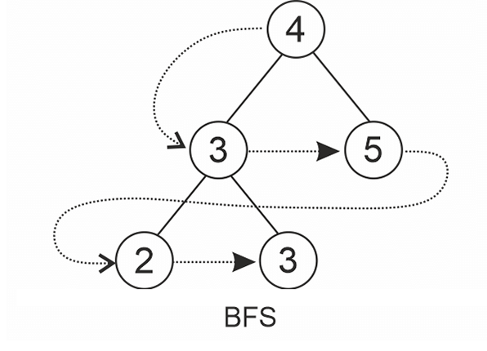
BFS traversal is when we visit the tree level-wise.

Slide 38
Graphs
In short form, G = (V, E). Here V represents vertices, and E represents edges.
A graph is a non-linear Data structure. It consists of nodes/ vertices joined/ connected by edges.
Both vertices and edges have to be a finite set.
An edge can be represented as (u, v) given u and v are the two vertices the edge connects.
A graph can be directed or undirected. In an undirected graph, E = (u, v) and E = (v, u) are the same, while in a directed graph, they are not the same as the directed matters. Hence, edges are represented as ordered pairs of vertices the edge joins.

Slide 39
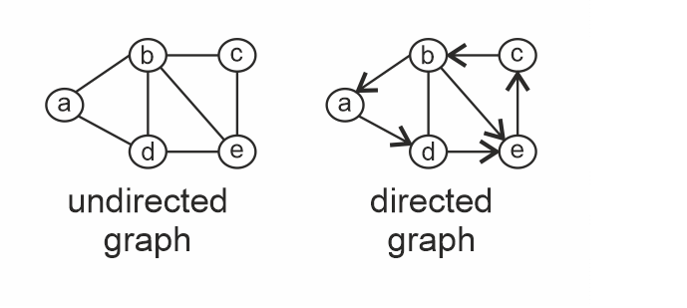

Slide 40
Important points about graphs:
The edges of a graph can have costs or weights.
Networks in real-time are represented using Graphs.
A graph can be implemented using:
Incidence matrix
Incidence List
Adjacency Matrix
Adjacency List
It is the programmer's choice of how to implement the graph based on the need in the scenario.
A graph can consist of cycles.
For graph traversal, BFS and DFS techniques are used like in trees, but to avoid visiting the same vertex again and again in the case of cycles, we need to maintain an array of visited vertices not to visit them again.

Slide 41
Adjacency matrix: An adjacency matrix is a (V X V) 2D array where V represents the vertices in the graph. In the matrix, adj[u][v], if in the graph, there exists an edge between u and v, adj[u][v] = 1, else 0 is assigned.
In an undirected graph, if there exists an edge from u to v, adj[u][v] = 1 and adj[v][u] = 1 as there are no directions. Hence, the adjacency matrix of an undirected graph is always symmetrical.
In a directed graph, adj[u][v] is not equivalent to adj[v][u].
If the edges have weights are costs given, in the place of 1, we give the assigned weight/ cost in the matrix.
The disadvantage of this representation is that it takes more space-O(V2)

Slide 42
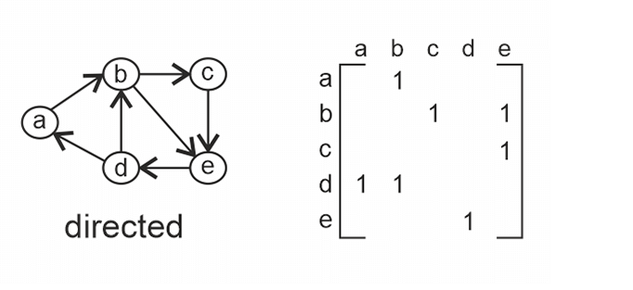

Slide 43
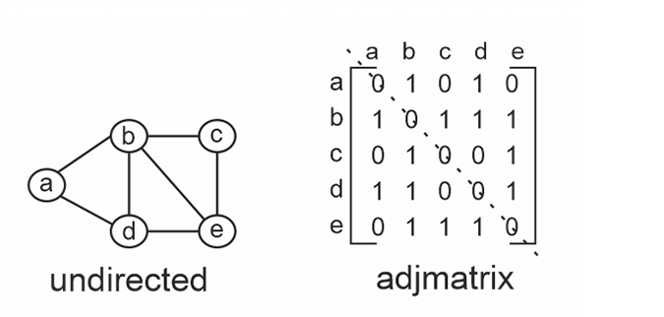

Slide 44
