Slide 1
Functions in python

Slide 2
Python Functions is a block of statements that return the specific task. The idea is to put some commonly or repeatedly done tasks together and make a function so that instead of writing the same code again and again for different inputs, we can do the function calls to reuse code contained in it over and over again.
Some Benefits of Using Functions
Increase Code Readability
Increase Code Reusability

Slide 3
There are three types of functions
Built-in function Functions like help(), max(), min(), print() are built-in functions
User Defined Functions Created by the user to perform a specific task
Anonymous functions Which are also called lambda functions because they are not declared with the standard def keyword.
Recursive Functions in Python
Higher-order Functions in Python

Slide 4
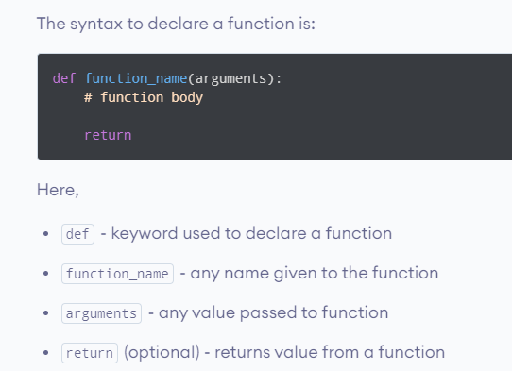
Python Function Declaration

Slide 5
We need to use the def keyword, give your function a name, followed by a pair of parentheses, and end the line with a colon (:).
If your function takes arguments, the names of the arguments (parameters) are mentioned inside the opening and closing parentheses.
Please note that in function definition, the arguments that your function consumes are referred to as parameters.
When you call the function with specific values for these parameters, they're called arguments or actual parameters. This is because the arguments in the function call are the values used for the function's parameters.
Then, you begin an indented block. This is the body of the function that describes what your function does.
There's a return statement that returns the result of the operation on the arguments. The return statement returns control to the point where the function was originally called.
Note that the arguments and the return statement are optional. This means that you could have a function that takes in no arguments, and returns nothing.

Slide 6
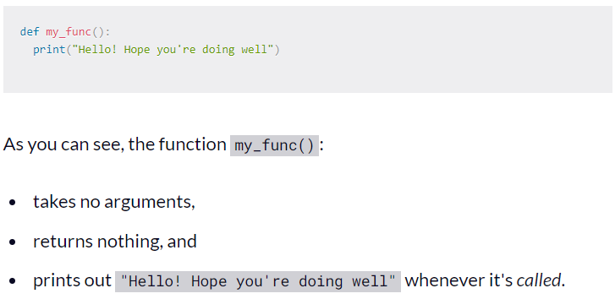
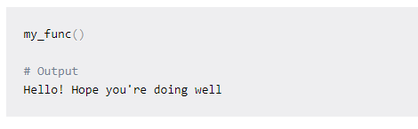
Create a Simple Function

Slide 7
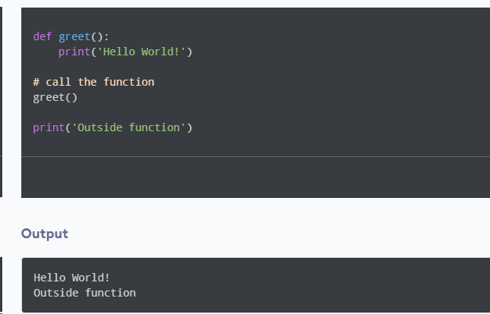
Here,
When the function is called, the control of the program goes to the function definition.
All codes inside the function are executed.
The control of the program jumps to the next statement after the function call.

Slide 8
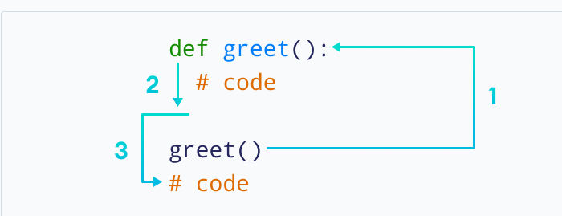

Slide 9
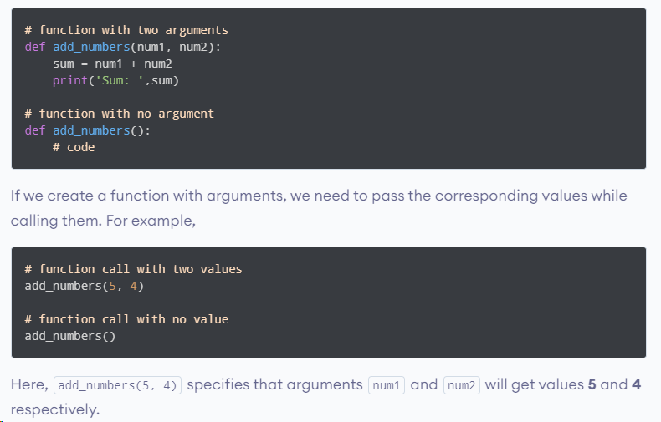
Python Function Arguments
As mentioned earlier, a function can also have arguments. An argument is a value that is accepted by a function. For example,

Slide 10
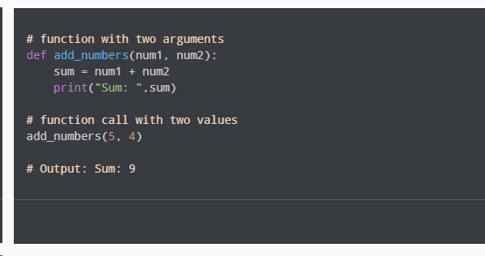
Example

Slide 11
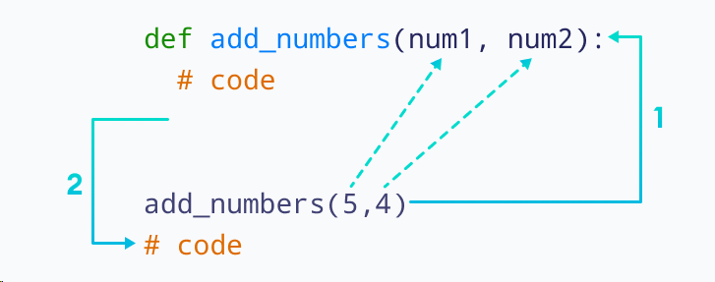
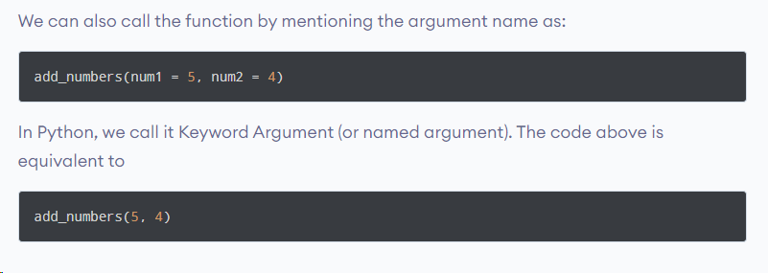

Slide 12
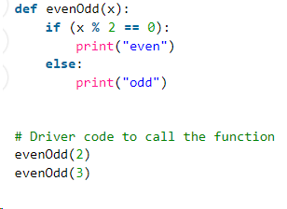
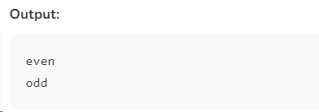
A simple Python function to check whether x is even or odd

Slide 13
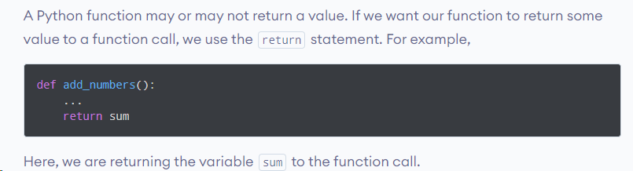
The return Statement in Python
The return statement also denotes that the function has ended. Any code after return is not executed.

Slide 14
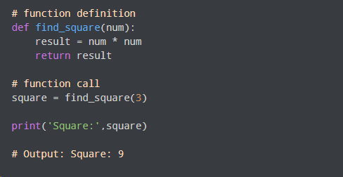
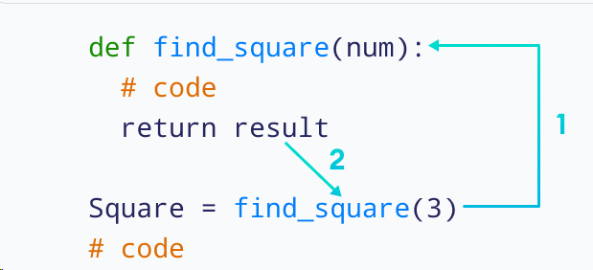

Slide 15
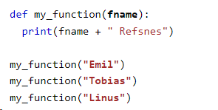

Arguments
Information can be passed into functions as arguments.
Arguments are specified after the function name, inside the parentheses. You can add as many arguments as you want, just separate them with a comma.
The following example has a function with one argument (fname). When the function is called, we pass along a first name, which is used inside the function to print the full name:

Slide 16
Function Arguments
The following are the types of arguments that we can use to call a function:
Default arguments
Keyword arguments
Positional arguments
Arbitrary arguments (variable-length arguments *args and **kwargs)

Slide 17
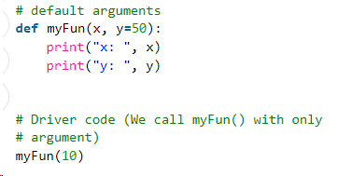
Default Arguments
A default argument is a parameter that assumes a default value if a value is not provided in the function call for that argument. The following example illustrates Default arguments.

Slide 18
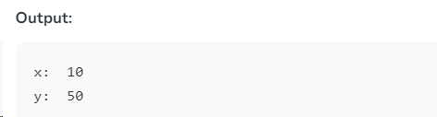

Slide 19
When to Create a Function with Default Arguments
if certain parameters take a specific value most of the time during the function calls?
we can do better than calling the function with the same value for a particular parameter by using default arguments .
Let's create a function total_calc() that helps us calculate and print out the total amount to be paid at a restaurant. Given a bill_amount and the percentage of the bill_amount you choose to pay as tip (tip_perc ), this function calculates the total amount that you should pay.

Slide 20
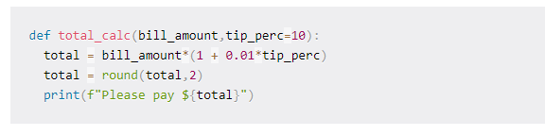
the function definition includes the default value of the parameter tip_perc to be used when the user doesn't specify a tip percentage.

Slide 21
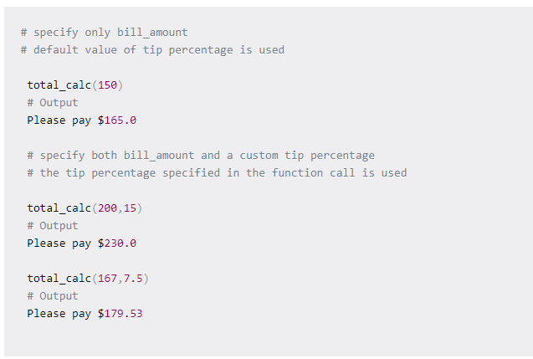
When you call the function total_calc with only the bill_amount, by default the tip percentage of 10 is used.
When you explicitly specify the percentage tip, the tip percentage mentioned in the function call is used.

Slide 22
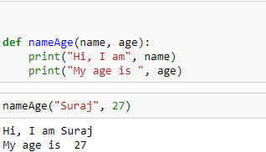
Positional Arguments
We used the Position argument during the function call so that the first argument (or value) is assigned to name and the second argument (or value) is assigned to age.
By changing the position, or if you forget the order of the positions, the values can be used in the wrong places

Slide 23
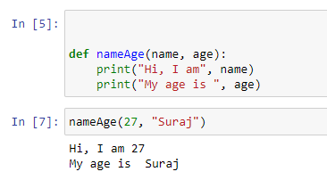

Slide 24
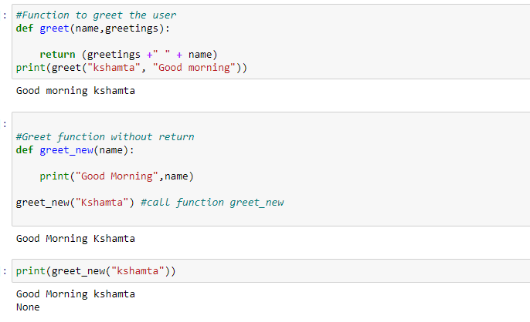

Slide 25
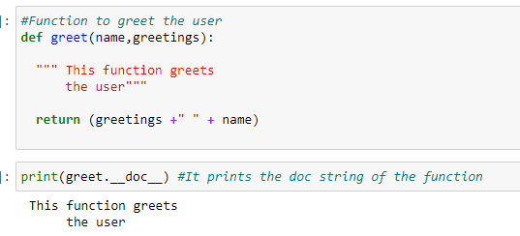
To print docstring of a function

Slide 26
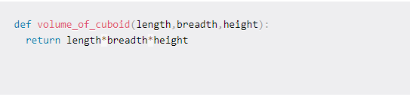
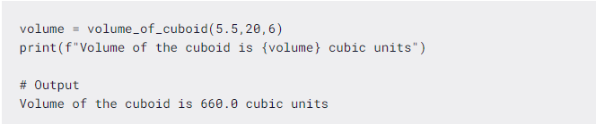
How to Create a Function that Returns Multiple Values in Python
Let's call the function volume_of_cuboid() with the necessary dimension arguments, as shown in the code snippet.
Now we use the variable volume to capture the value returned from the function.

Slide 27
The function volume_of_cuboid() returned only one value, namely, the volume of a cuboid given its dimensions. Let's see how we can return multiple values from a function.
To return multiple values from a function, just specify the values to be returned, separated by a comma.
By default, the function returns the values as a tuple. If there are N return values, we get an N-tuple.

Slide 28
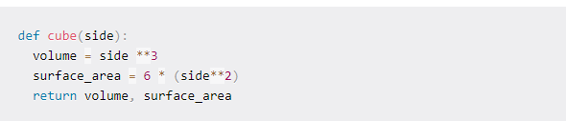
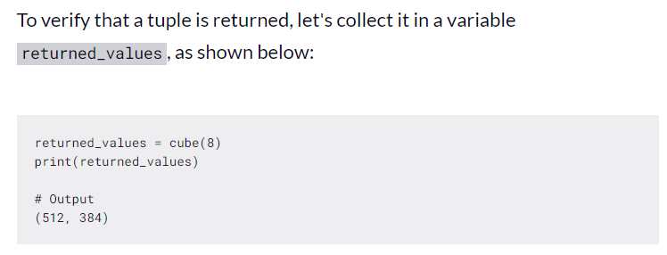
Let's create a simple function cube() that returns the volume and total surface area of a cube, given the length of its side.

Slide 29
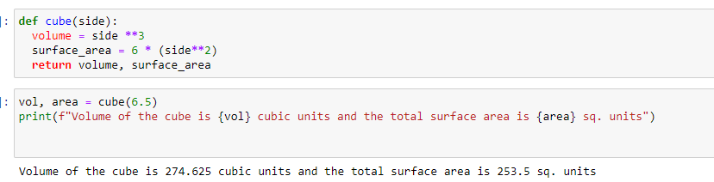

Slide 30
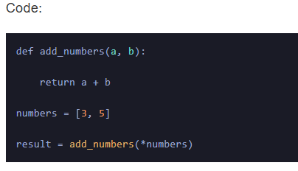
Unpacking Positional Arguments
Python provides a way to unpack a list or tuple and pass its elements as positional arguments to a function. This is useful when we have a collection of values we want to pass as separate arguments.
In this example, we have a list of `numbers` containing the values `[3, 5]`. Using the `*` operator before the list, we unpack its elements and pass them as positional arguments to the `add_numbers` function. The result is `8`, the sum of `3` and `5`

Slide 31
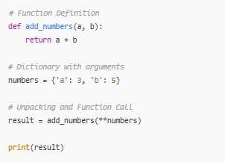


Unpacking Positional Arguments

Slide 32

Double Asterisk (**) for Dictionaries:
The ** operator is used to unpack a dictionary into keyword arguments, where keys match parameter names.

Slide 33
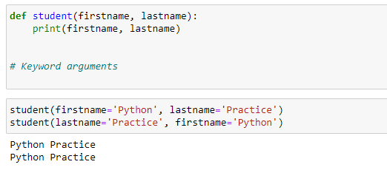
Keyword Arguments
The idea is to allow the caller to specify the argument name with values so that the caller does not need to remember the order of parameters.

Slide 34
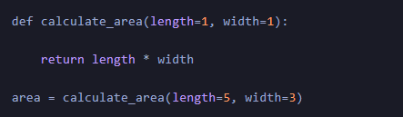
Multiple keyword argument

Slide 35
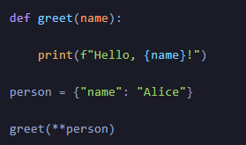
Unpacking Keyword Arguments
Python provides a way to unpack a dictionary and pass its key-value pairs as keyword arguments to a function. This is useful when we have a collection of values we want to pass as separate keyword arguments.
In this example, we have a dictionary `person` containing the key-value pair `{“name”: “Alice”}.` Using the `**` operator before the dictionary, we unpack its key-value pairs and pass them as keyword arguments to the `greet` function.
The output is “Hello, Alice!”.

Slide 36
Arbitrary Arguments
What if we do not know the exact number of arguments beforehand?
Can we create functions that work with a variable number of arguments?
The answer is yes!
Python allows us to define functions that can accept a variable number of arguments. These are known as arbitrary arguments and are helpful when we need to know how many arguments will be passed to the function.
There are two types of arbitrary arguments: `*args` for variable-length positional arguments and `**kwargs` for variable-length keyword arguments.
Let's create a simple function my_var_sum() that returns the sum of all numbers passed in as the argument. However, the number of arguments could be potentially different each time we call the function.

Slide 37
Arbitrary Keyword Arguments
In Python Arbitrary Keyword Arguments, *args, and **kwargs can pass a variable number of arguments to a function using special symbols. There are two special symbols:
*args in Python (Non-Keyword Arguments)
**kwargs in Python (Keyword Arguments)

Slide 38
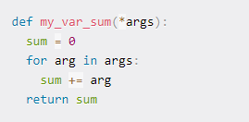
Notice how the function definition now has *args instead of just the name of the parameter.
In the body of the function, we loop through args until we've used all the arguments.
The function my_var_sum returns the sum of all numbers passed in as arguments
Let's now call the function my_var_sum() with a different number of arguments each time and quickly check if the returned answers are correct!

Slide 39
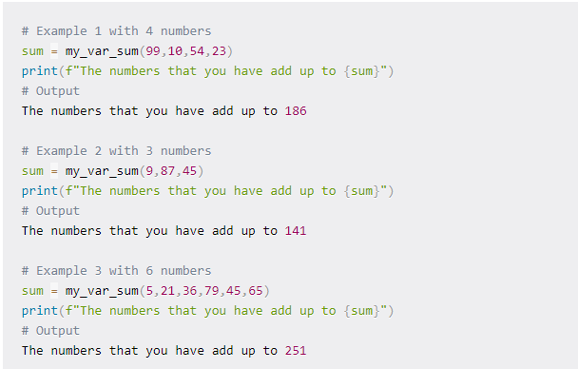

Slide 40
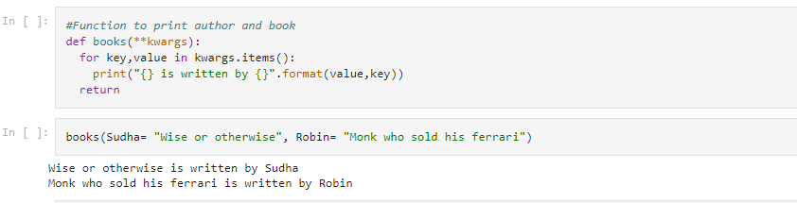
Arbitrary keyword arguments (**kwargs)
Argument which is a key-value pair is packed in a dictionary

Slide 41
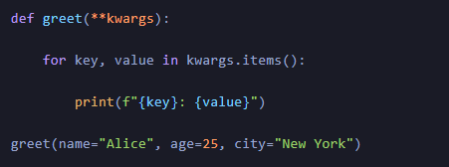
In this example, the `greet` function accepts any number of keyword arguments using the `**kwargs` syntax.
The arguments `”name”: “Alice”,` `”age”: 25`, and `”city”: “New York”` are collected into a dictionary `kwargs.`
We then iterate over the dictionary and print each key-value pair.

Slide 42
Built-in functions
Python has many built-in functions that are already defined and ready to use. These functions perform common operations that are frequently used in programming. Here are some of the most commonly used built-in functions in Python:

Slide 43
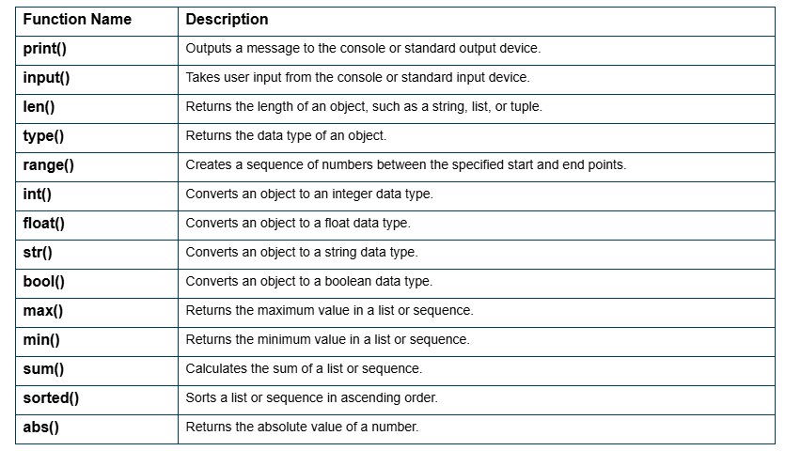

Slide 44
User-defined Functions in Python
User-defined functions are functions that the programmer creates to perform a specific task or set of tasks. Defining a function allows you to reuse code and makes your code more modular and easier to read.

Slide 45
Recursive Functions in Python
Recursive functions in Python call themselves to perform a task repeatedly until a certain condition is met. Recursive functions can be used to solve problems that can be broken down into smaller sub-problems that can be solved using the same approach.
In Python, it’s also possible for a function to call itself! A function that calls itself is said to be recursive, and the technique of employing a recursive function is called recursion.
It may seem peculiar for a function to call itself, but many types of programming problems are best expressed recursively

Slide 46
Why Use Recursion?
some situations particularly lend themselves to a self-referential definition—for example
If you were devising an algorithm to handle such a case programmatically, a recursive solution would likely be cleaner and more concise.
Traversal of tree-like data structures is another good example. Because these are nested structures, they readily fit a recursive definition.

Slide 47
On the other hand, recursion isn’t for every situation. Here are some other factors to consider:
For some problems, a recursive solution, though possible, will be awkward rather than elegant.
Recursive implementations often consume more memory than non-recursive ones.
In some cases, using recursion may result in slower execution time.

Slide 48
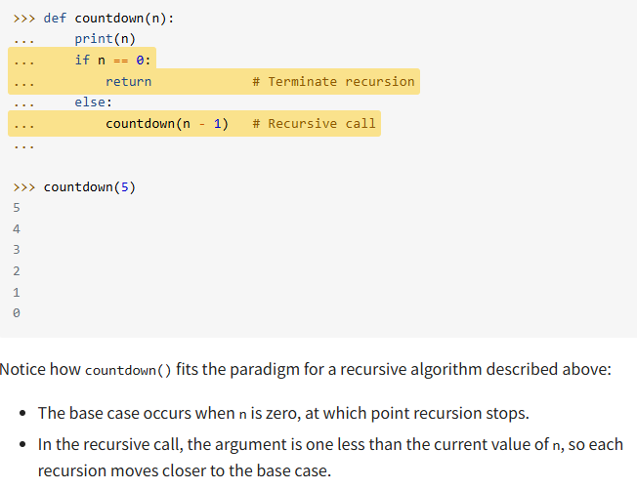
Count Down to Zero

Slide 49
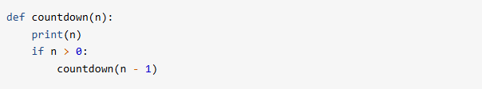
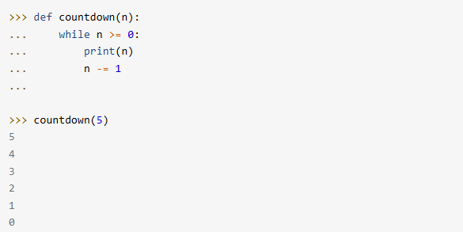
The version of countdown() shown above clearly highlights the base case and the recursive call, but there’s a more concise way to express it:
Here’s one possible non-recursive implementation for comparison:

Slide 50
Recursion or Iteration
Loops are used to perform repetitive tasks, and so are the functions? What is the difference, and how to know when to use what?
It is simple. When we use loops, we need to know how many times we need to iterate the loop as in a for loop. When we know the number of iterations, we use a for loop. If not, we will be left with either while and do-while loops or Recursion. We need to choose based on the need, and in some cases, we use Recursion for the return values.

Slide 51
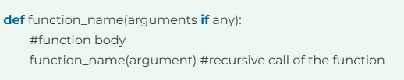
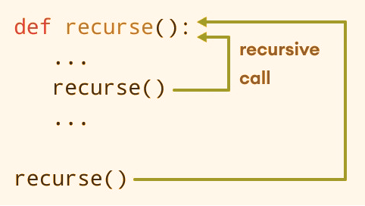

Slide 52
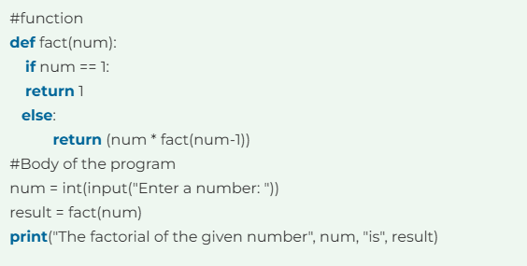
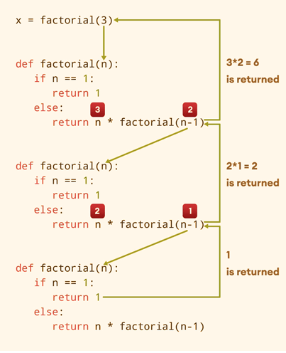


Slide 53
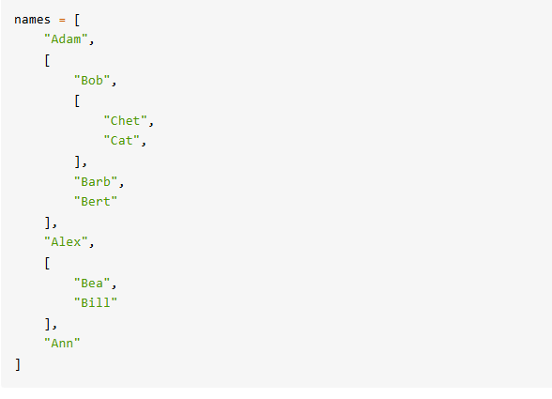
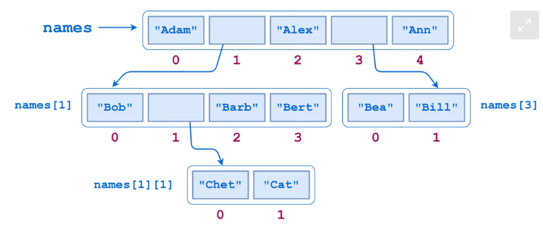
Traverse a Nested List
The following example involves visiting each item in a nested list structure
As the following diagram shows, names contains two sublists. The first of these sublists itself contains another sublist:

