Slide 1
Recursive functions,Lambda function

Slide 2
Python Recursion
Recursion is the process of defining something in terms of itself.
A physical world example would be to place two parallel mirrors facing each other. Any object in between them would be reflected recursively.

Slide 3
Python Recursive Function
In Python, we know that a function can call other functions. It is even possible for the function to call itself. These types of construct are termed as recursive functions.
The following image shows the working of a recursive function called recurse.

Slide 4
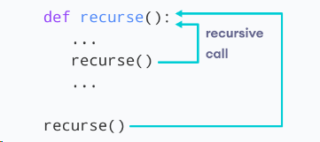

Slide 5
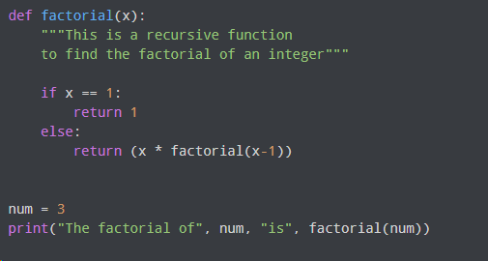
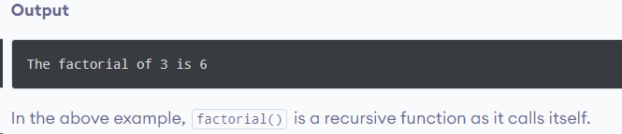
Example of a recursive function

Slide 6
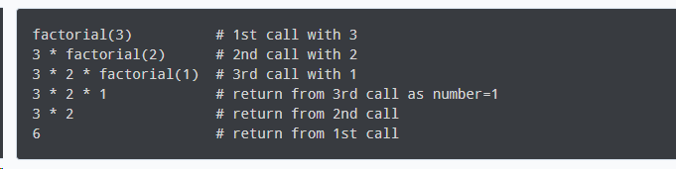
When we call this function with a positive integer, it will recursively call itself by decreasing the number.
Each function multiplies the number with the factorial of the number below it until it is equal to one. This recursive call can be explained in the following steps.

Slide 7
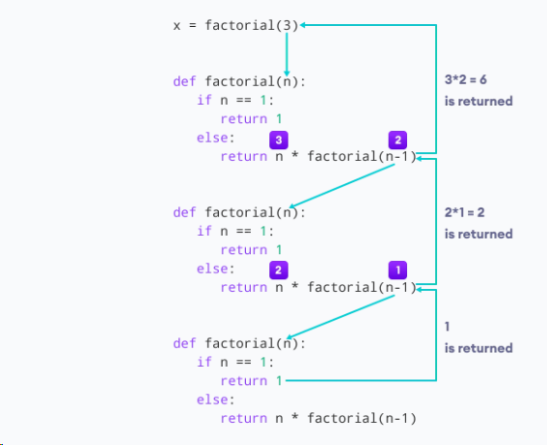

Slide 8
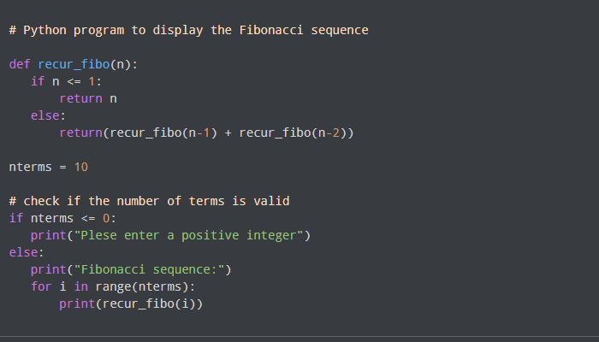
Fibonacci Sequence Using Recursion

Slide 9

Python Lambda/Anonymous Function
A lambda function is a small anonymous function.
A lambda function can take any number of arguments, but can only have one expression.
In Python, a lambda function is a special type of function without the function name. For example,
Here, we have created a lambda function that prints 'Hello World'

Slide 10
Python Lambda Function Syntax
Syntax: lambda arguments : expression
This function can have any number of arguments but only one expression, which is evaluated and returned.
One is free to use lambda functions wherever function objects are required.
You need to keep in your knowledge that lambda functions are syntactically restricted to a single expression.

Slide 11
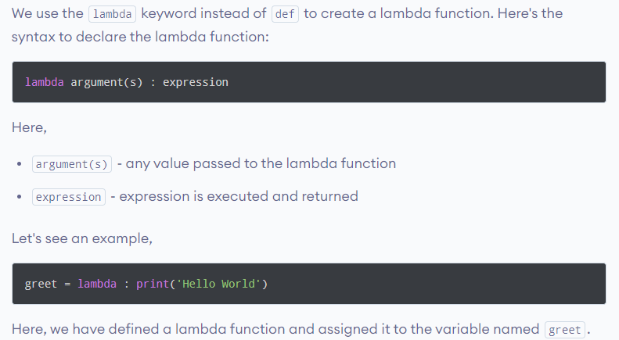

Python lambda Function Declaration

Slide 12
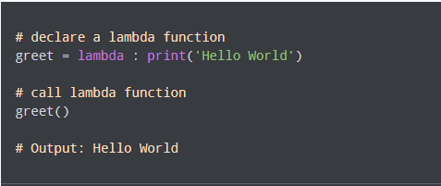
This lambda function doesn't have any arguments.
When we call the lambda function, the print() statement inside the lambda function is executed.

Slide 13



Add 10 to argument a, and return the result:
Output:15
Multiply argument a with argument b and return the result:
Output:30
Summarize argument a, b, and c and return the result:

Slide 14
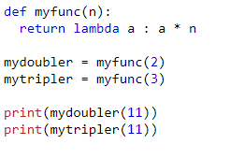
Why Use Lambda Functions?
The power of lambda is better shown when you use them as an anonymous function inside another function.

Slide 15
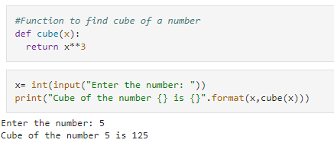
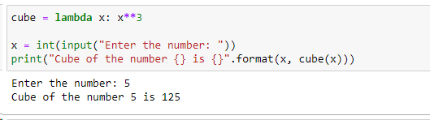

Slide 16
Difference Between Lambda functions and def defined function
With lambda function | Without lambda function
Supports single-line sometimes statements that return some value. | Supports any number of lines inside a function block
Good for performing short operations/data manipulations. | Good for any cases that require multiple lines of code.
Using the lambda function can sometime reduce the readability of code. | We can use comments and function descriptions for easy readability.

Slide 17
Practical Uses of Python lambda function
Python Lambda Function with List Comprehension
On each iteration inside the list comprehension, we are creating a new lambda function with a default argument of x (where x is the current item in the iteration). Later, inside the for loop, we are calling the same function object having the default argument using item() and get the desired value. Thus, is_even_list stores the list of lambda function objects.

Slide 18
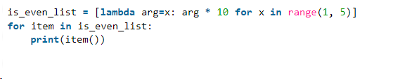
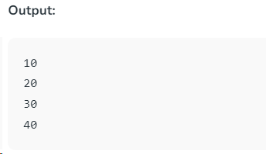
Here's how the results are obtained:
For x=1, lambda function returns 1 * 10 = 10.
For x=2, lambda function returns 2 * 10 = 20.
For x=3, lambda function returns 3 * 10 = 30.
For x=4, lambda function returns 4 * 10 = 40.

Slide 19
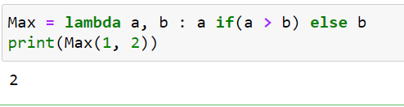
Python Lambda Function with if-else
Here we are using the Max lambda function to find the maximum of two integers.

Slide 20
Python Lambda with Multiple Statements
Lambda functions do not allow multiple statements, however, we can create two lambda functions and then call the other lambda function as a parameter to the first function.
Let’s try to find the second maximum element using lambda.

Slide 21
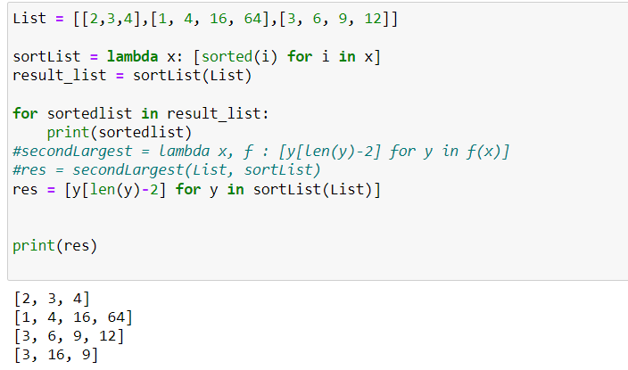

Slide 22
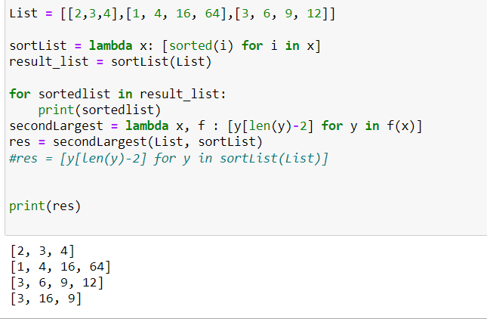

Slide 23
y = [4, 8, 12, 16]:
len(y) is 4.
len(y) - 2 is 2.
Therefore, y[len(y)-2] is equivalent to y[2], which gives the second-to-last element, in this case, 12.

Slide 24
Map () function
It is Python's built-in function to used to apply the given function to all the iterables.
The returned value from map()can then be passed to functions like list() (to create a list), set() (to create a set) and so on.
eg

Slide 25
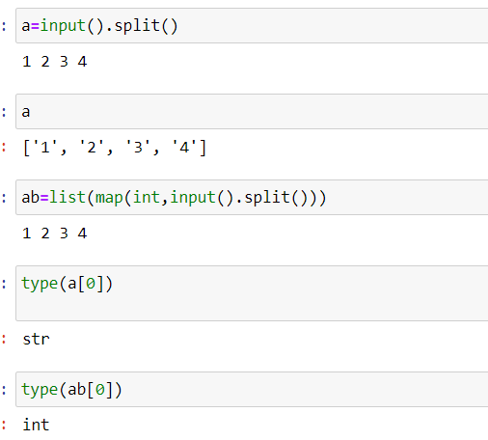

Slide 26
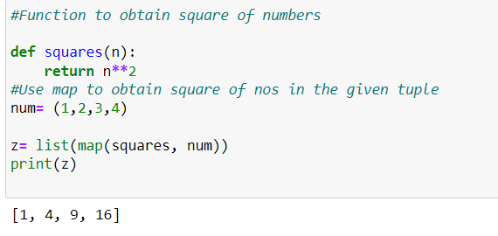

Slide 27
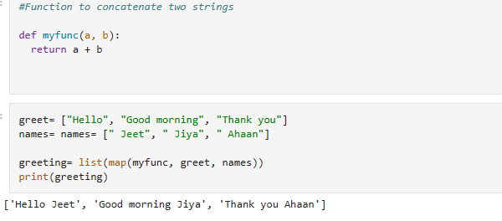

Slide 28
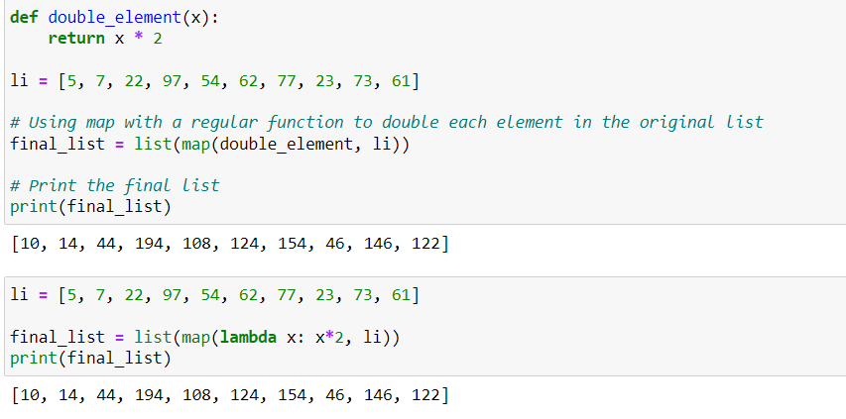
Using lambda() Function with map()
Multiply all elements of a list by 2 using lambda and map() function

Slide 29
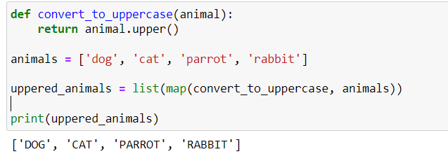
Transform all elements of a list to upper case using lambda and map() function

Slide 30
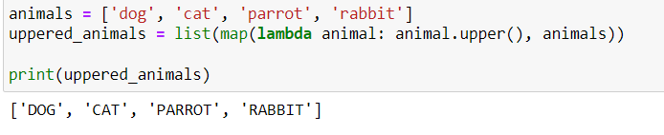

Slide 31
Reduce()
In Python, reduce() is a built-in function that applies a given function to the elements of an iterable, reducing them to a single value.
This function implements a mathematical technique called folding or reduction. It is useful when you need to apply a function to an iterable and reduce it to a single cumulative value
Note reduce is a function in functools package. So import it from functool

Slide 32
reduce in Python from the functools module is a powerful tool for performing functional computations.
This function takes a predefined function and an iterable (like a list, tuple, or dictionary) and methodically applies the function across the iterable to produce a single output value.

Slide 33
How Python reduce() Function works
Initially, the specified function is utilized on the initial pair of elements in the iterable.
Subsequently, the same function is employed on the outcome of the first operation and the subsequent element in the iterable.
This procedure is repeated sequentially through the entire iterable.
Finally, a solitary value, derived from executing the reduce function on the entire iterable, is produced as the output.

Slide 34
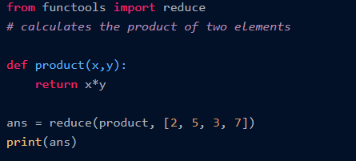

Using a pre-defined function
calculate the result of the following equation(((2x5)x3)x7). First, the multiplication of 2 and 5 is done, and the result of this multiplication is further done with all the other elements of the list one by one.

Slide 35
